Slide 1
Whitey the Polar Bear
A Journey for Food

Slide 2
Whitey the Polar Bear
Polar Bears are arctic, marine mammals that live on land, in the cold ocean waters, and on sea ice.
Polar bears are carnivores and they especially love to hunt seals.
Polar bears hunt seals through breathing holes in the sea ice called leads.
My polar bear was Whitey and he lives in northern Alaska.

Slide 3
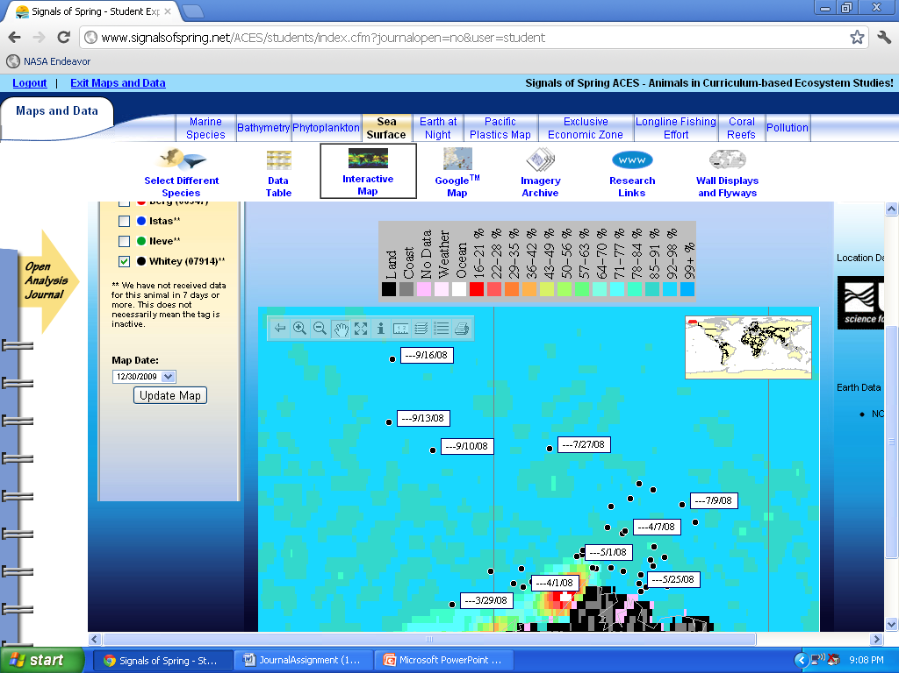
Sea Ice Observations
This map shows Whitey’s movements during August and September of 2008.
Prior to these movements, Whitey had stayed primarily on the edge of the land/sea ice border or pretty nearby.

Slide 4
Whitey on the Move
In August – September of 2008, Whitey the Polar Bear made some major moves.
Prior to August 2nd, Whitey’s movements traveled on or near the sea ice/land border.
From August 2nd to September 10th, Whitey started moving northwest for 234km.
This was Whitey’s first major movement away from the land that he made all year.
Whitey continued to move north/northwest over the next week and ended up traveling a total of 378 km over 6 weeks.

Slide 5
Why the Big Move?
During the warm summer months the sea ice begins to retreat from the land.
During this retreat, seals and other polar bear prey move further from the land as well.
Polar bears have to make a decision during these months to either fast while remaining on land, or swim out toward the sea ice in search of food.

Slide 6
Evaluating Whitey’s Move
Whitey moved during the end of summer to the north, when the sea ice had likely retreated the most.
This move was presumably in search of food since the polar bear’s prey probably moved away from land as the sea ice receded.
As the months continued, he continued north and circled around to the east, eventually moving back toward land in the colder, winter months.

