Slide 1
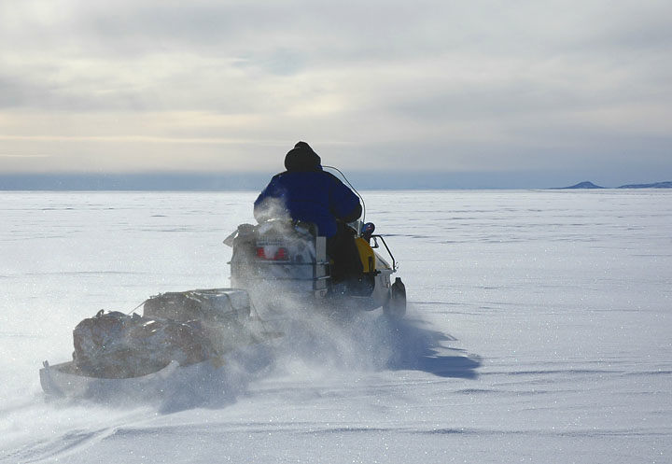
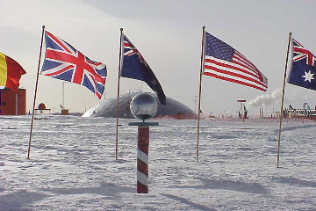
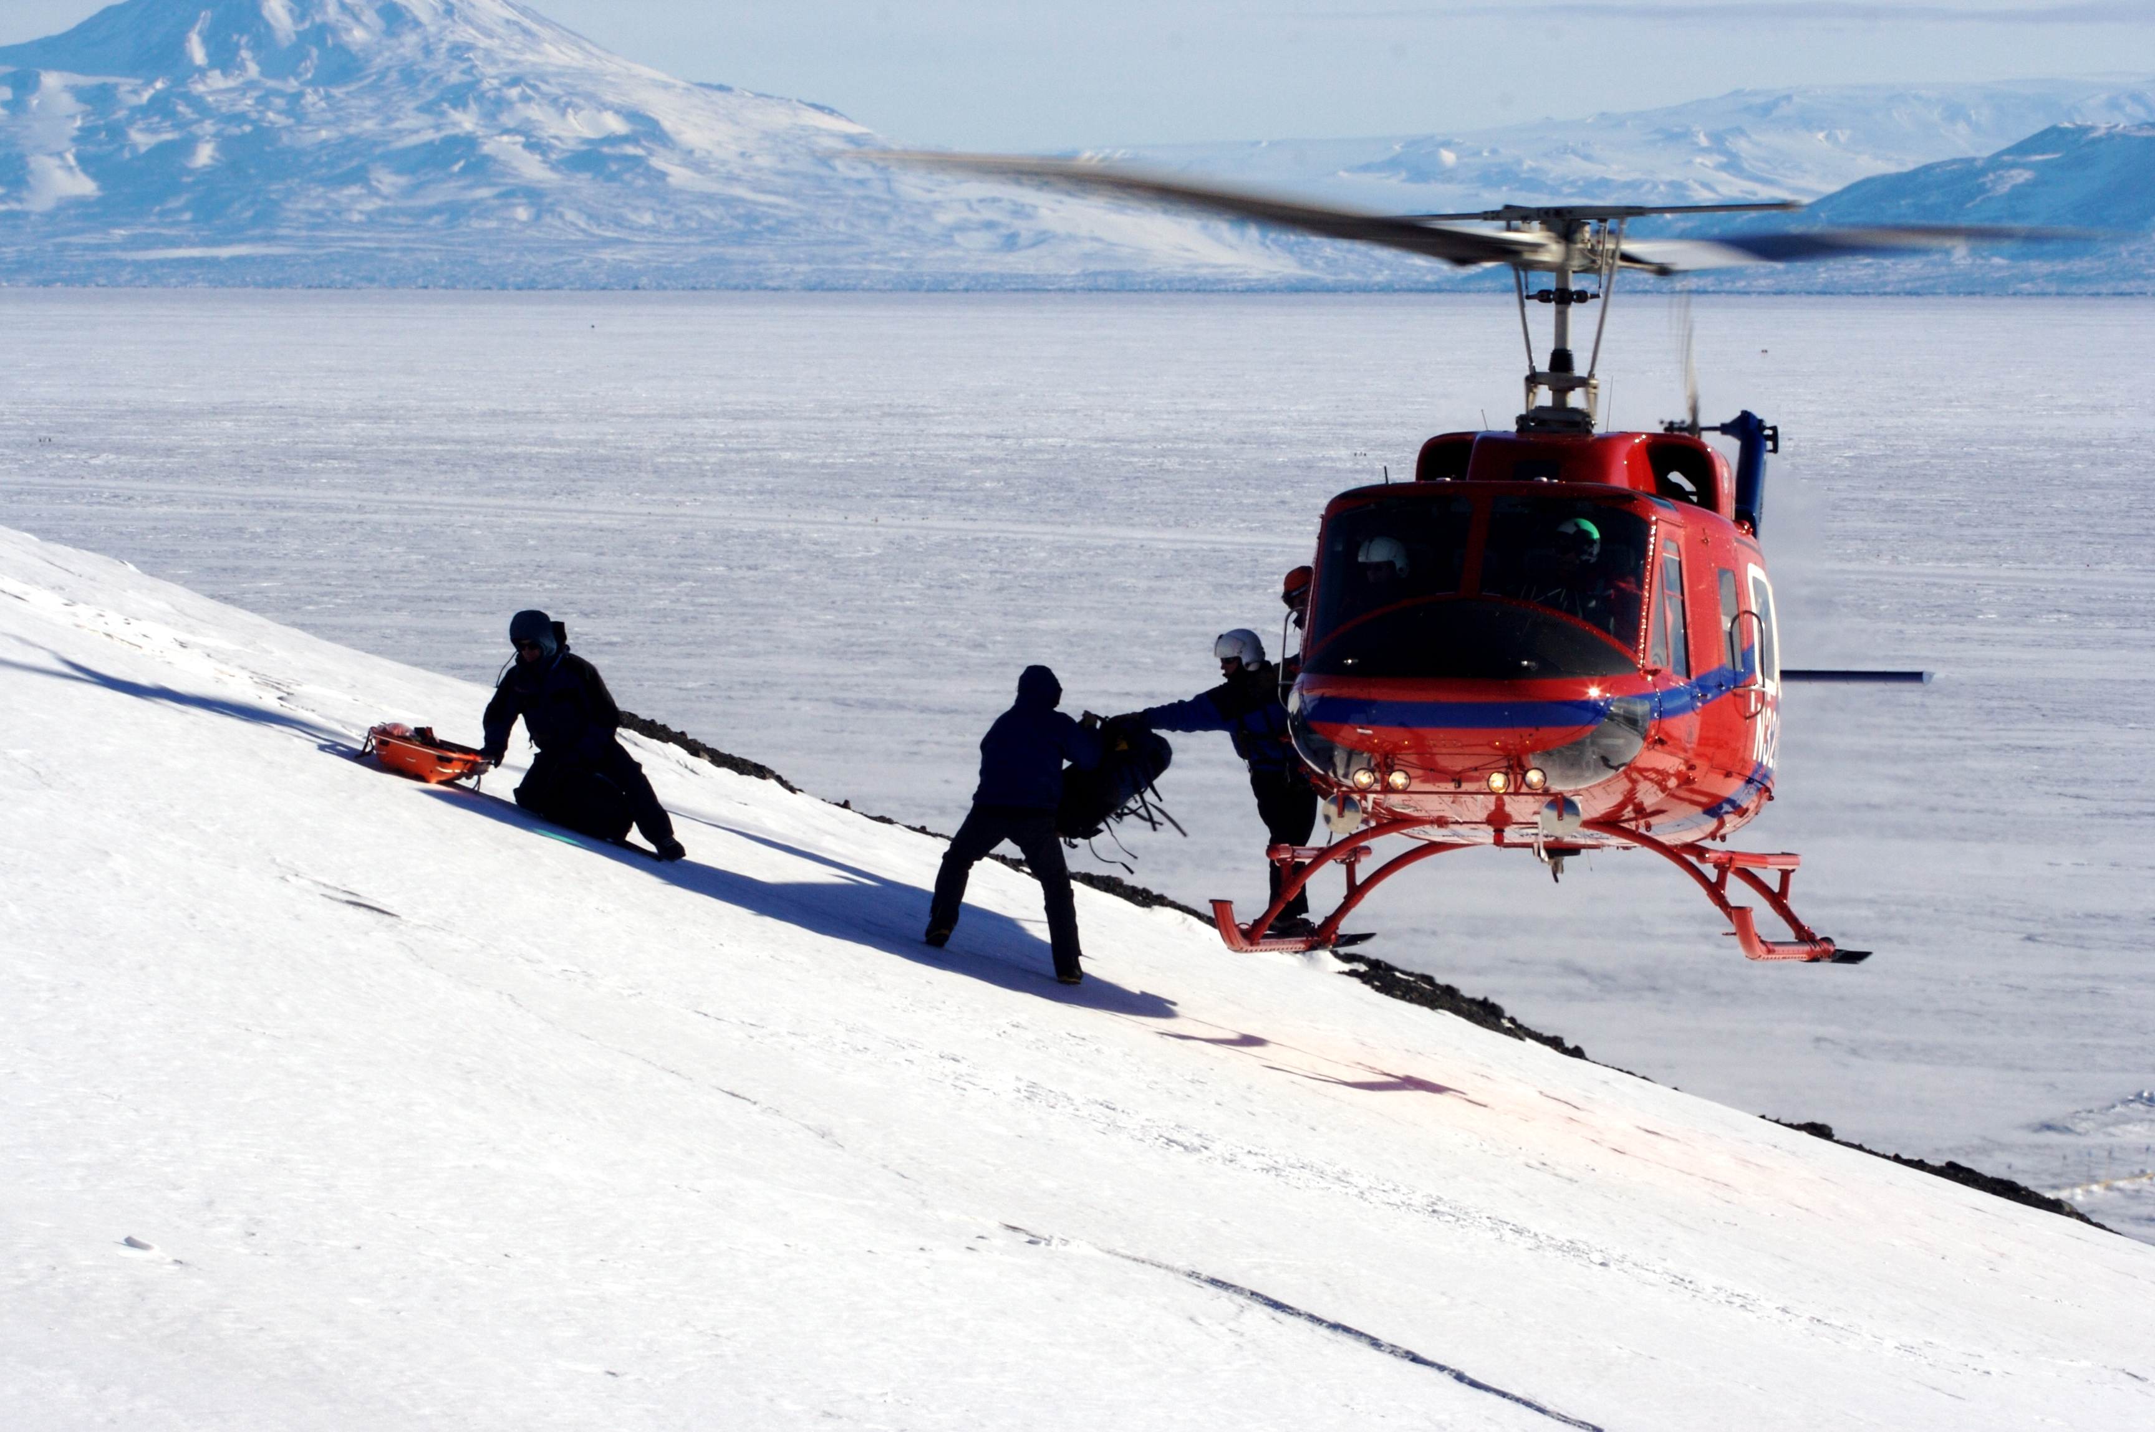
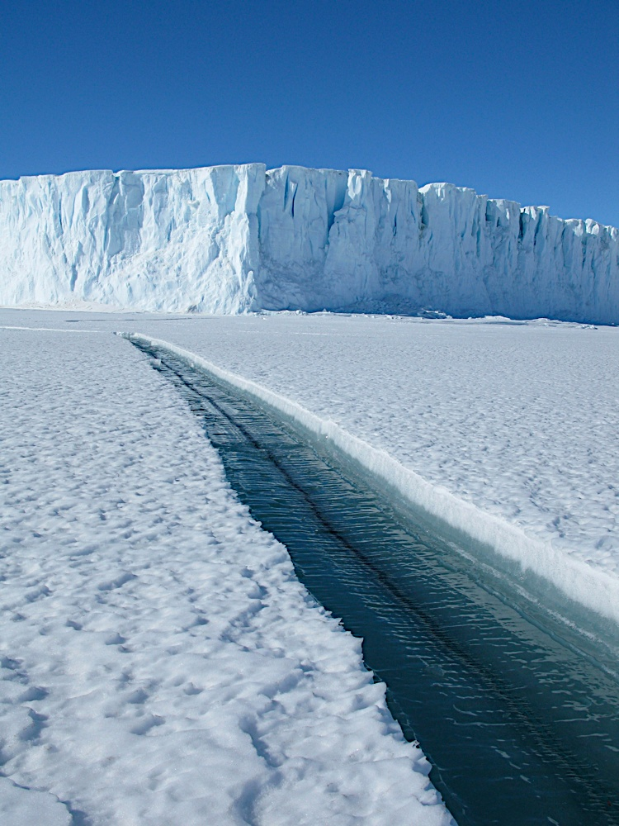
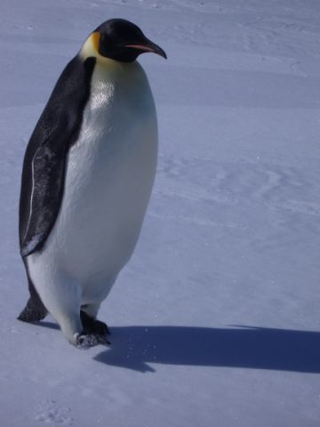
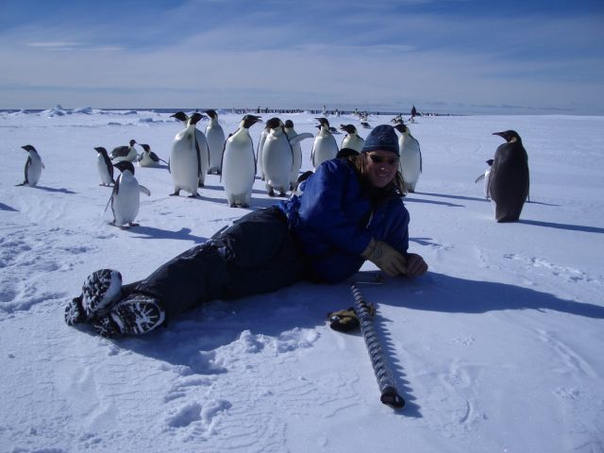

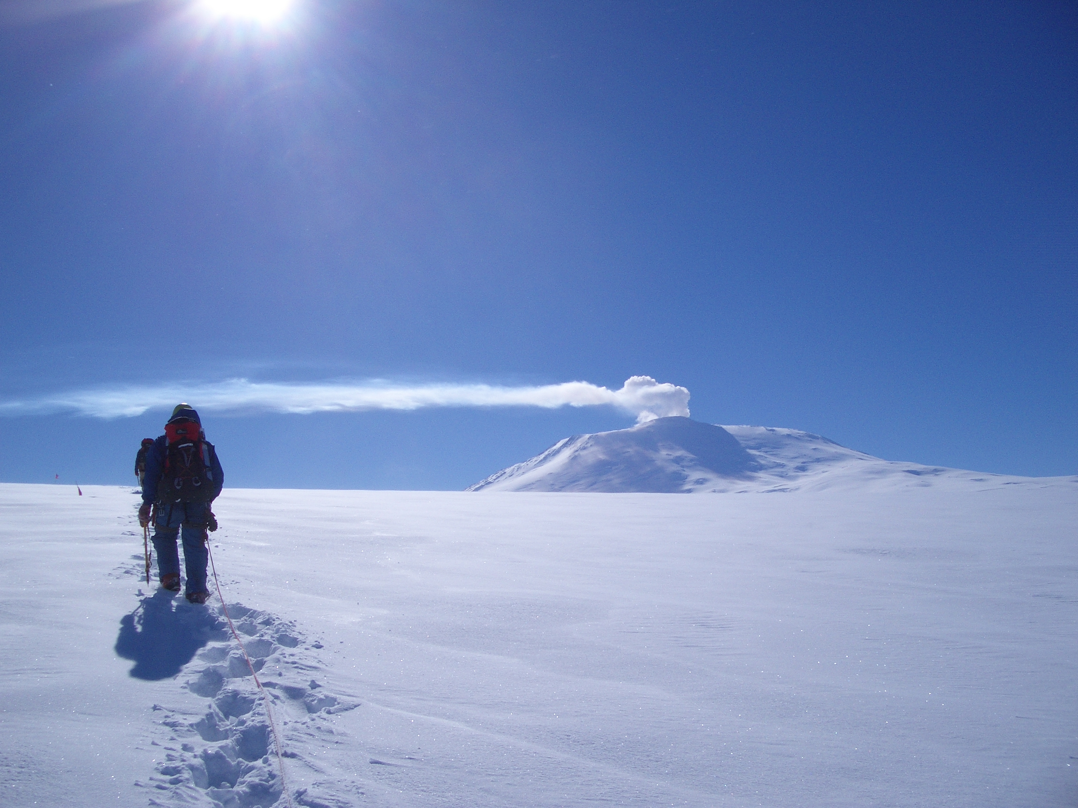
Antarctica
Adventures in Science

Slide 2
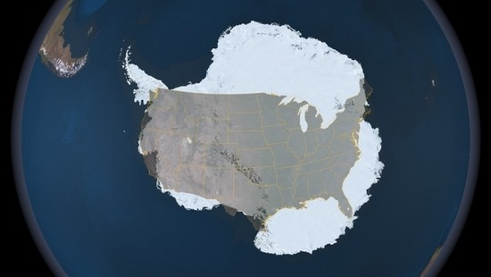
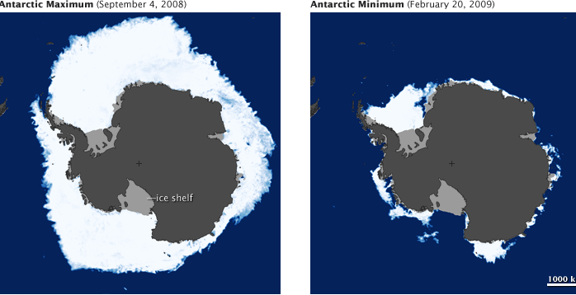
The Continent of Antarctica is the
Coldest
Highest
Driest
Windiest
Least populated

Slide 3
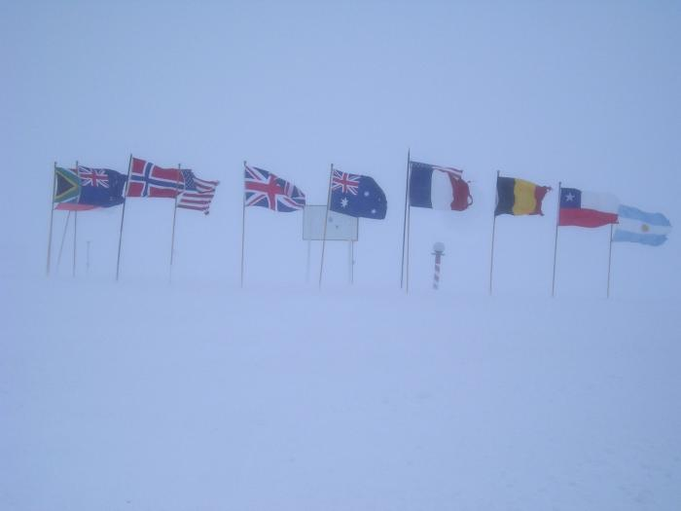
Antarctica Treaty
Signed by 47 Countries and says that:
Antarctica is for Peaceful Purposes
No territorial land claims
Freedom for Scientific Research
No mineral exploration until 2041

Slide 4
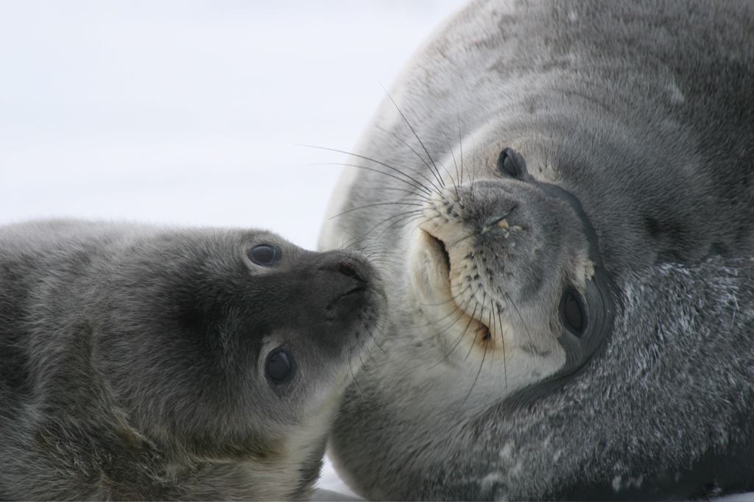
Weddell Seals
Leptonychotes weddellii
Notes:
-We are going to learn about Weddell Seals and the Science Project B-009 who studies them at Big Razor Back Island in Antarctica.
-We will then look at data the scientists collected from 2002 – 2007. In these years there was an unusual sharp decline and subsequent rebound.
-You will formulate a hypothesis on what happened to the Weddell Seals. Your hypothesis must be supported using data.

Slide 5
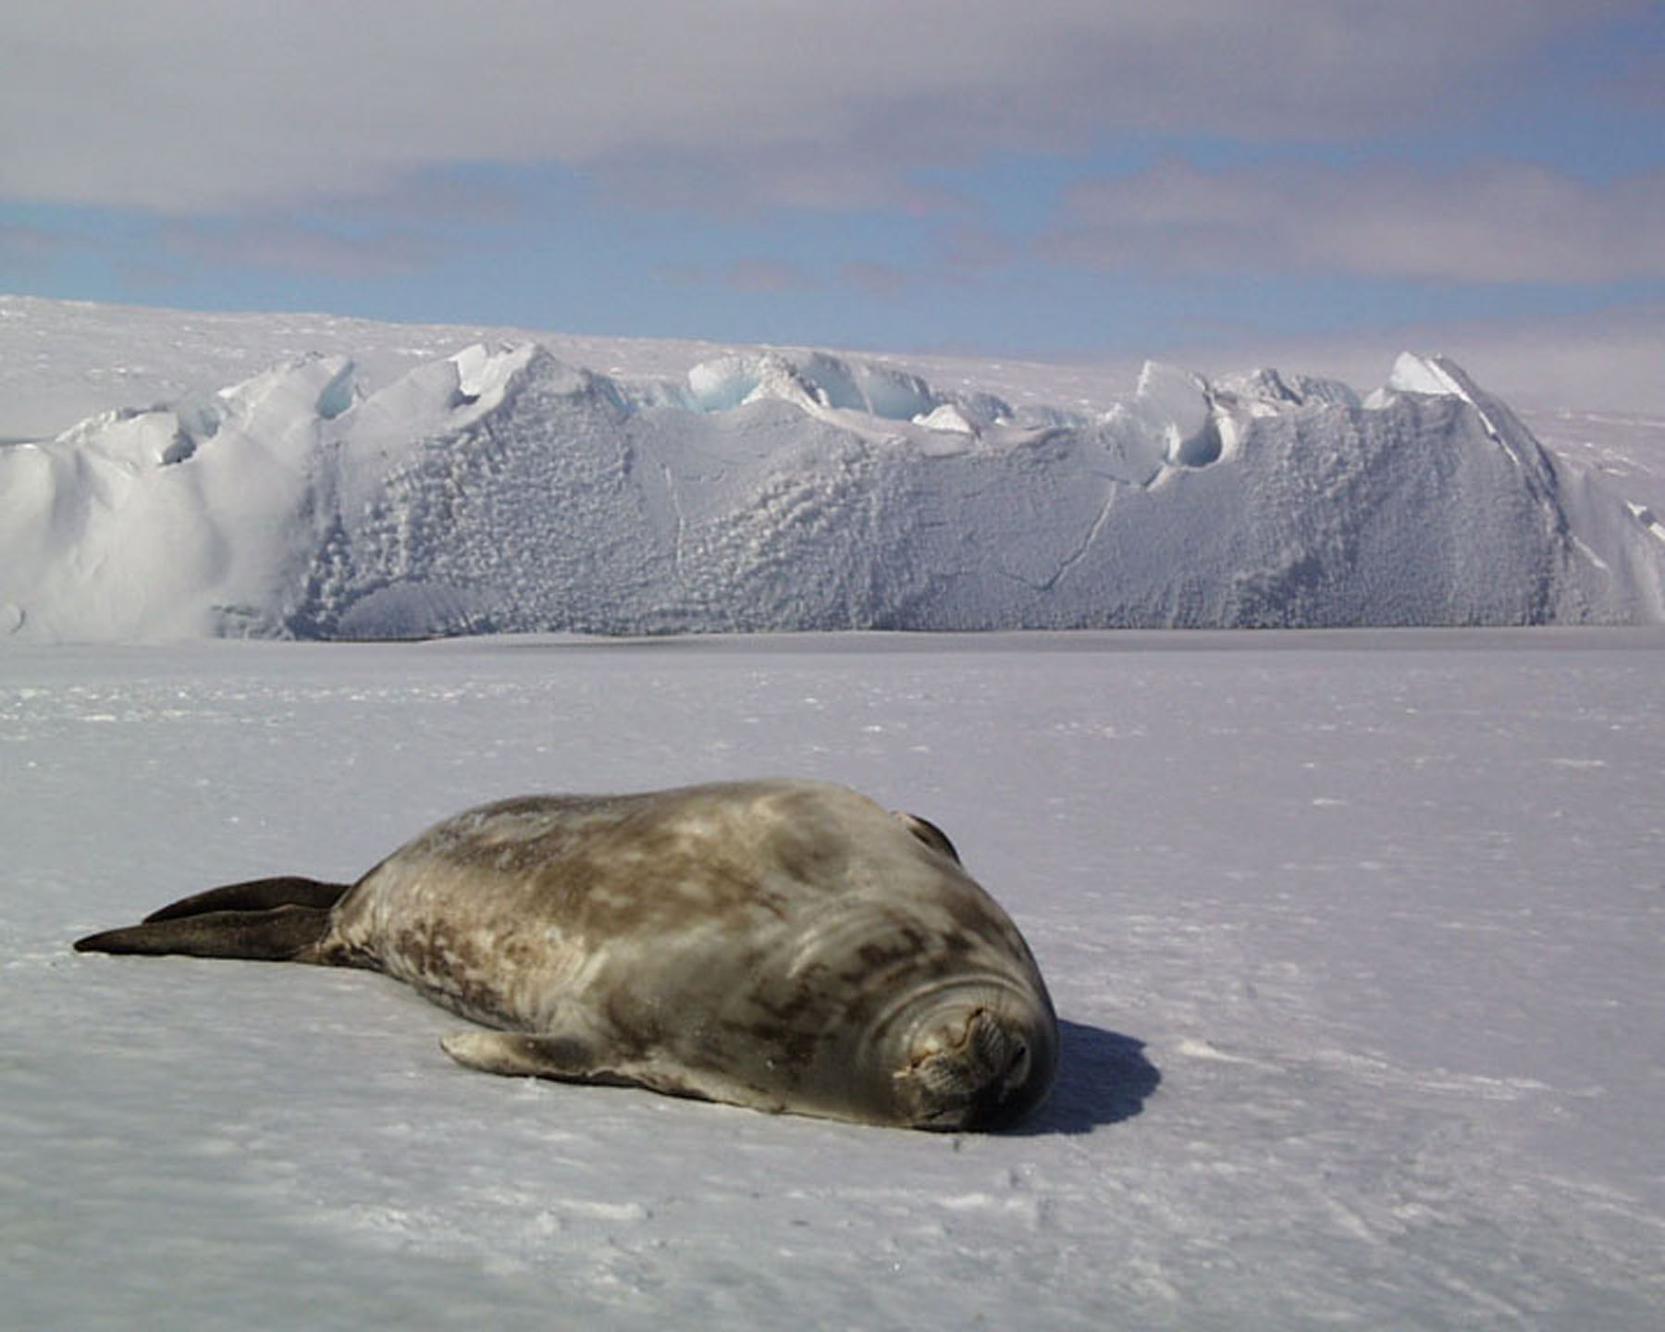
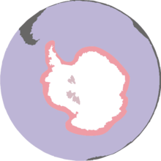
Weddell Seals:
World population approx. 800,000
Live only in Antarctica
Live farther South than any other animal
2 to 3 meters long & 600-800 Kilograms
Live to about 20 years old
Can dive to 700m (2300 feet) and
stay under water for an hour!
“No common Predators”
Notes:
Compare Size to another animal – a big horse?
20 years is about half the life span of most other seals due to their teeth being worn down by maintaining their winter ice holes.
No “common” predators: They are preyed upon by Killer whales and Leopard Seals only when at the ice edge (generally pups and sub adults out exploring) but their adaptations allow them to live far from the ice edge (teeth to chew holes through the ice. They were also historically preyed up by humans.

Slide 6
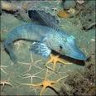
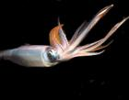
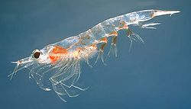
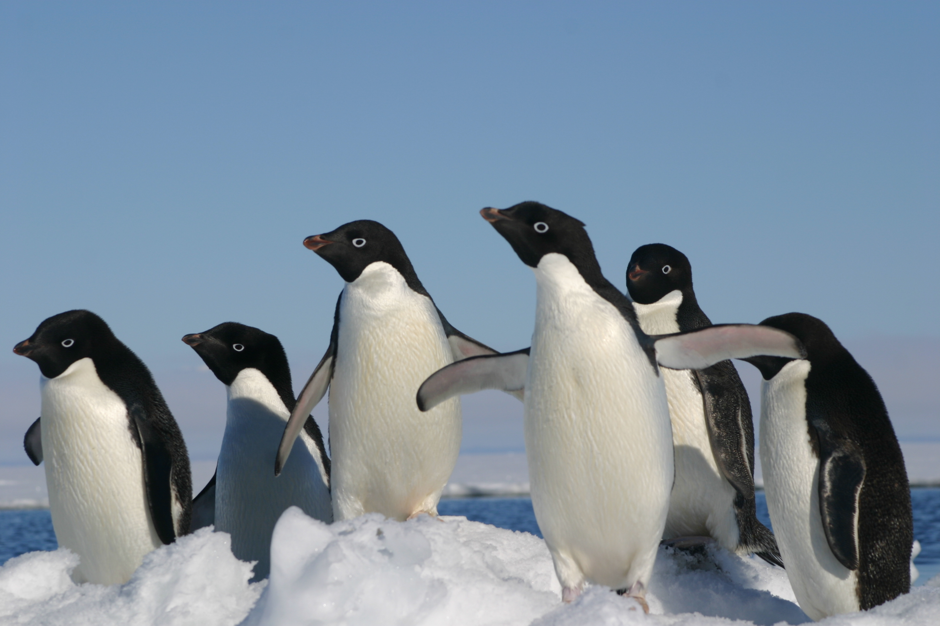
What do Weddell Seals eat?
Fish
Krill
Squid
Penguins (occasionally)
Where do Weddell Seals fit on the Trophic Pyramid?

Slide 7
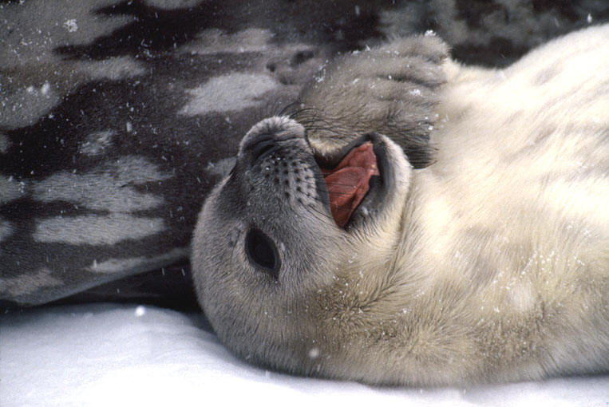
Seal Pups
Born in Spring (Sept. – Nov.)
Weigh 25 – 35 kg at birth
Feed on mother’s milk which is 60% fat
Gain 2 kg (4lbs) per day!
Swim after 1-2 weeks
Notes:
6-7 weeks they weigh 100kg and are weened
Cow’s milk 4 -5%

Slide 8

Notes:
B-009 has been studying the Big Razorback Seals for 40 years. The Seals always return to big Razorback and are easily approached and studied by humans. They have one of the best animal population data sets in the world. Video link: http://www.teachersdomain.org/resource/ipy09.sci.life.eco.seals/

Slide 9
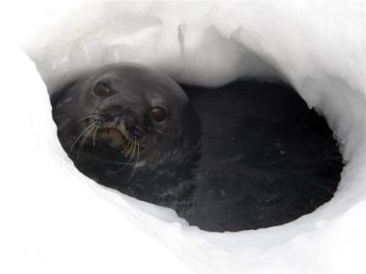
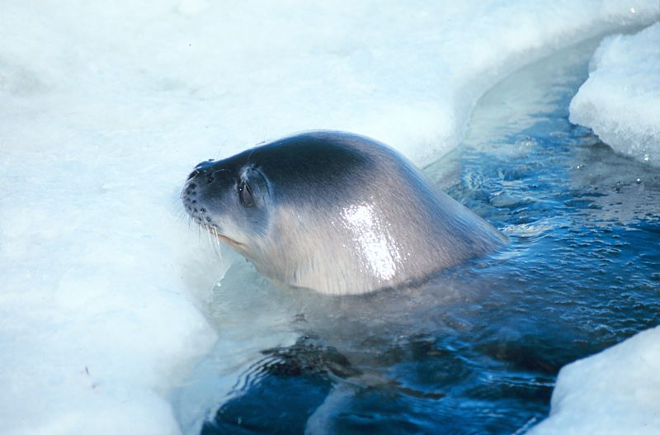
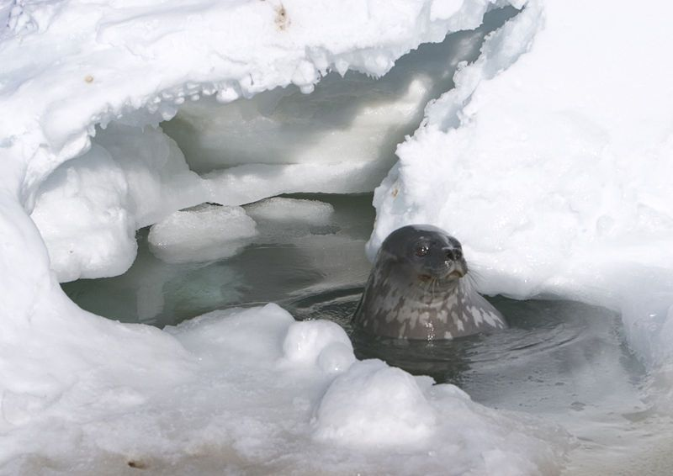
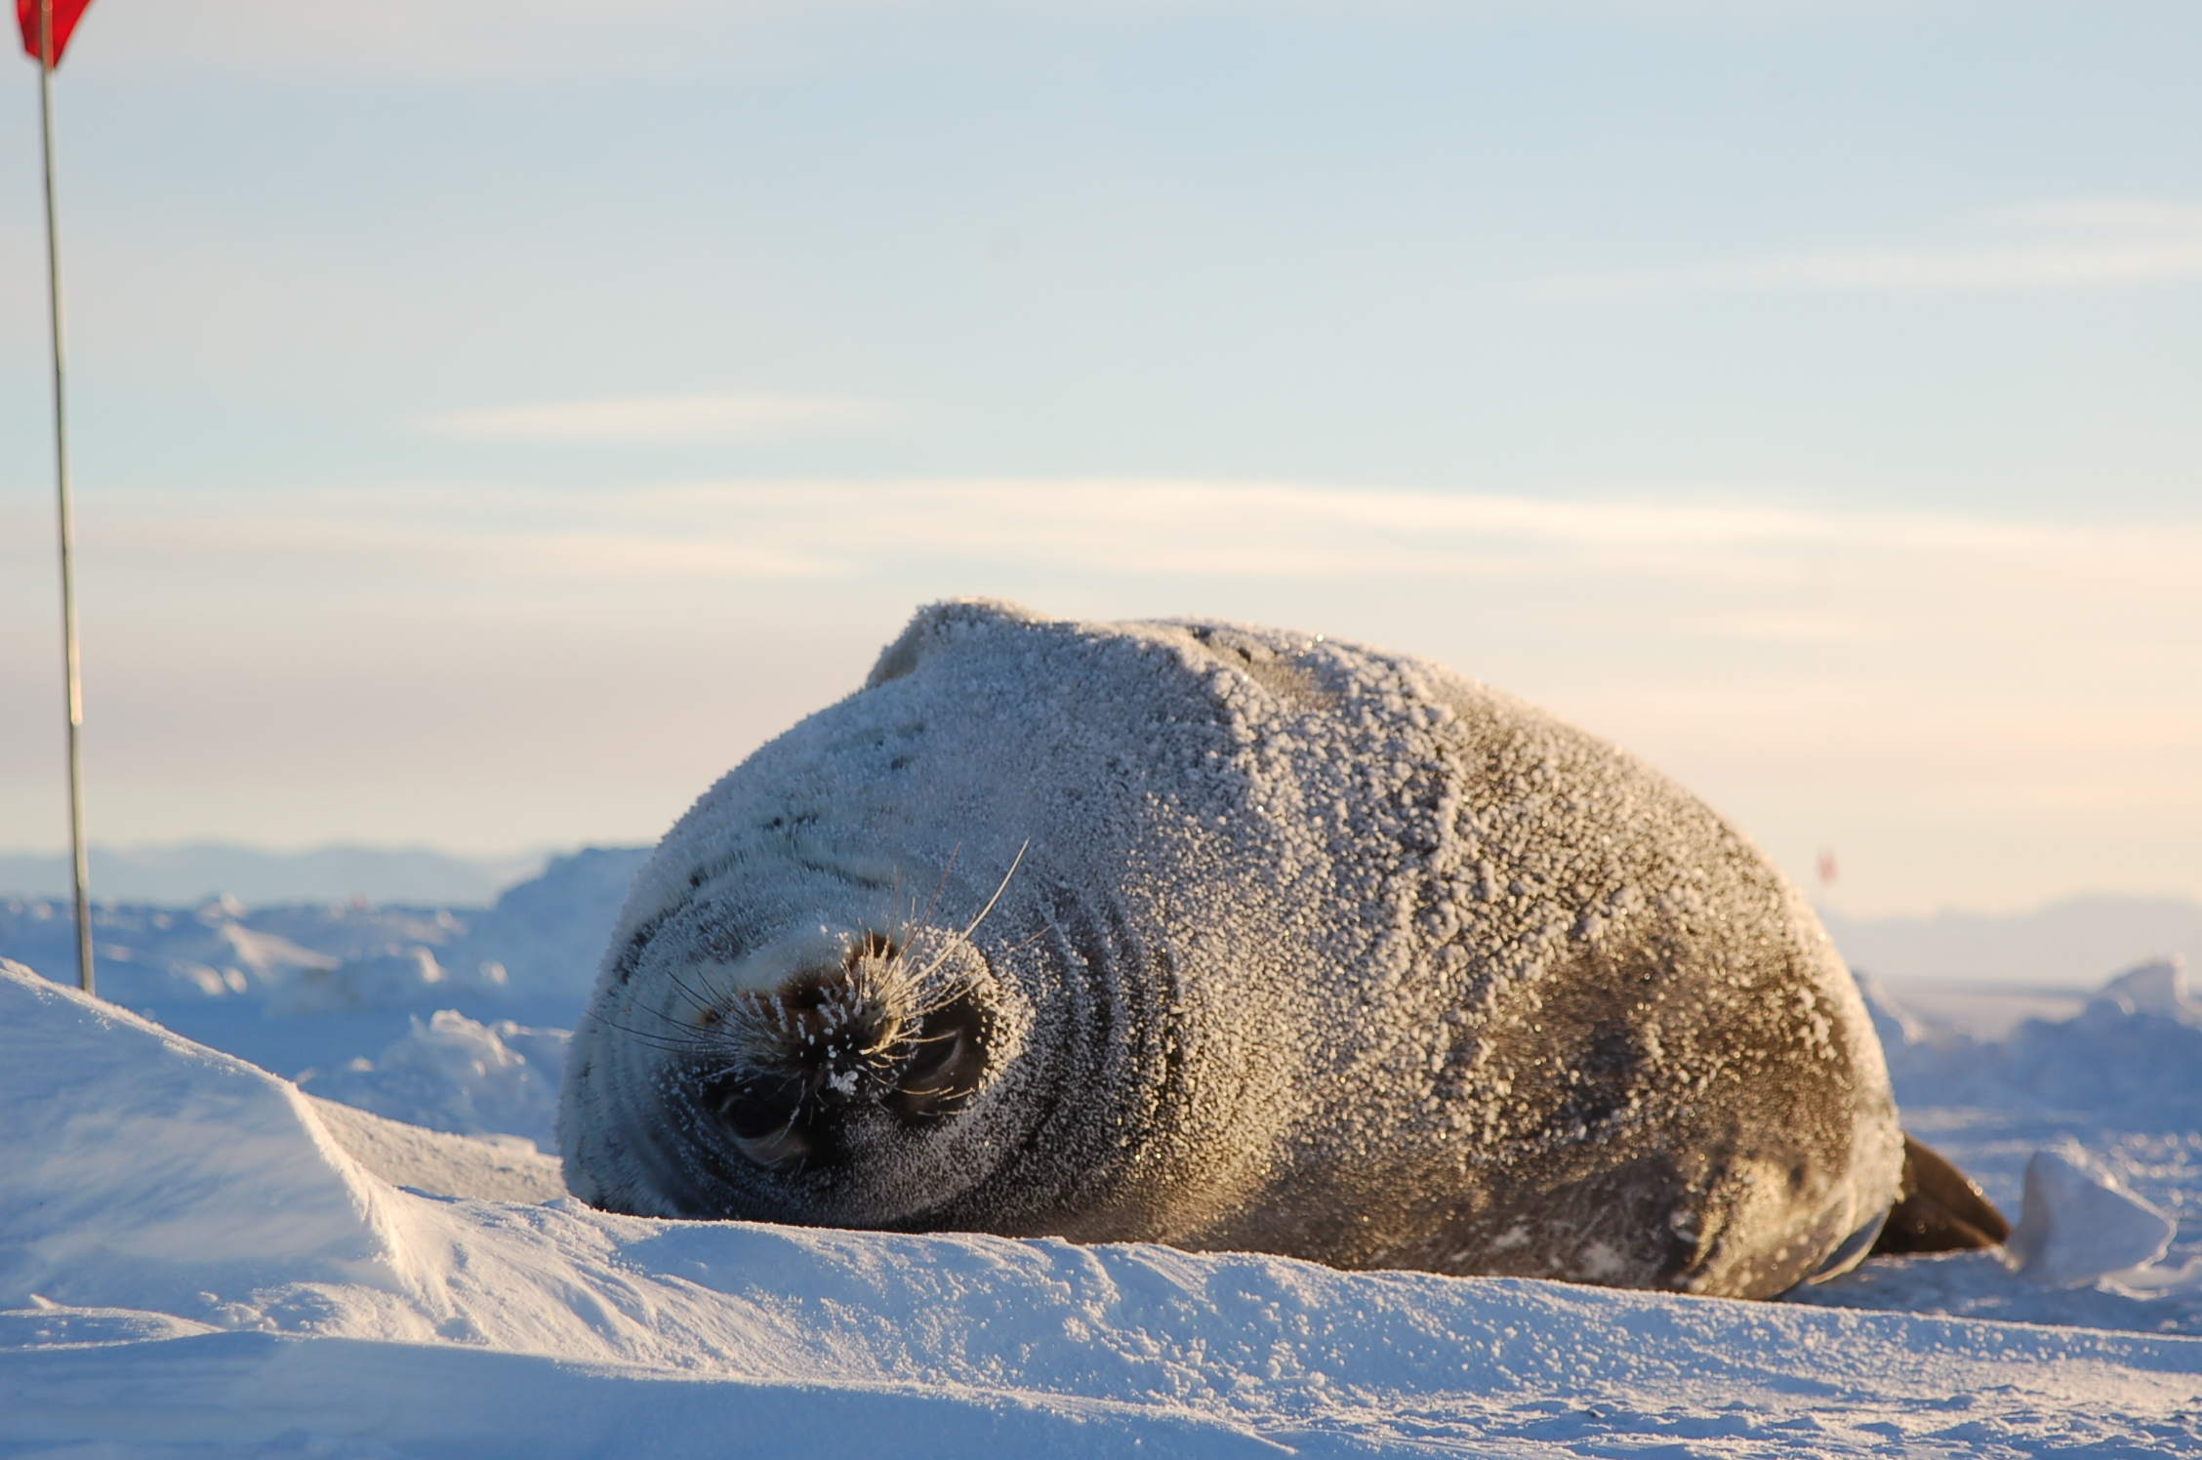
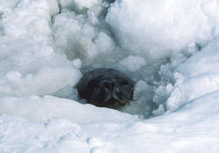
What Adaptations have enabled the Weddell Seal to survive???
Notes:
Weddell Seals are very specialized.
Chew breathing holes in the ice
Live far from the ice edge to avoid predators
Fat as insulation
Eat a variety of food sources
Deep divers and can hold breath for along time.

Slide 10
Adaptations of Weddell Seals
Fat to insulate them from the cold
Eat a variety of food
Can hold their breath for a long time and dive very deep.
Can chew holes in the ice to keep breathing holes open.
They live far from the ice edge where the predators like Killer Whales and Leopard Seals live.
Notes:
Weddell Seals are very specialized.
Chew breathing holes in the ice
Live far from the ice edge to avoid predators
Fat as insulation
Eat a variety of food sources
Deep divers and can hold breath for along time.

Slide 11
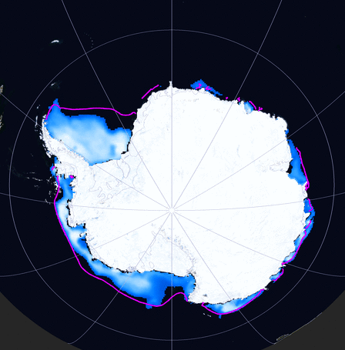
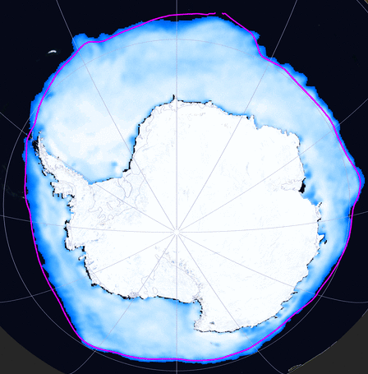
Seasonal Variations in Sea Ice Cover
February 2006
September 2006
Notes:
Before we look at the data we have to understand Antarctic sea ice. Antarctica roughly doubles in size every winter due to sea ice. The Ice cover affects many aspects of ocean life including Weddell seals.

Slide 12
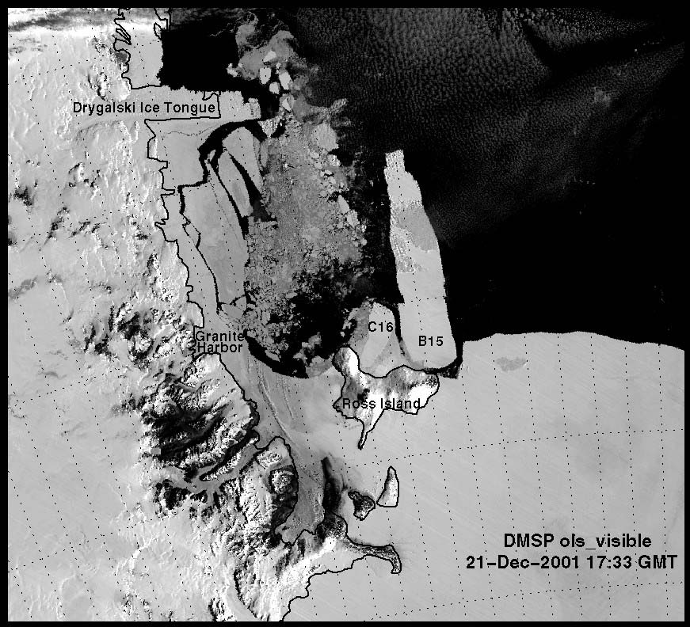
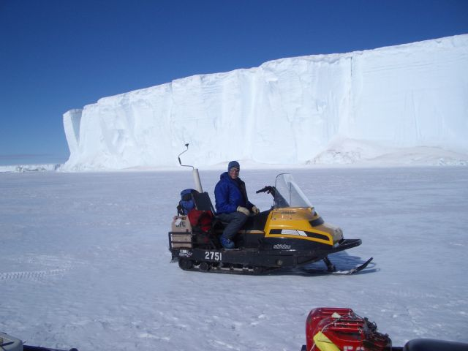
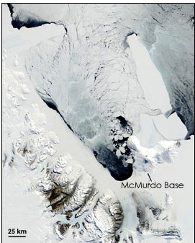
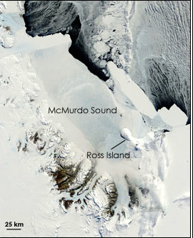
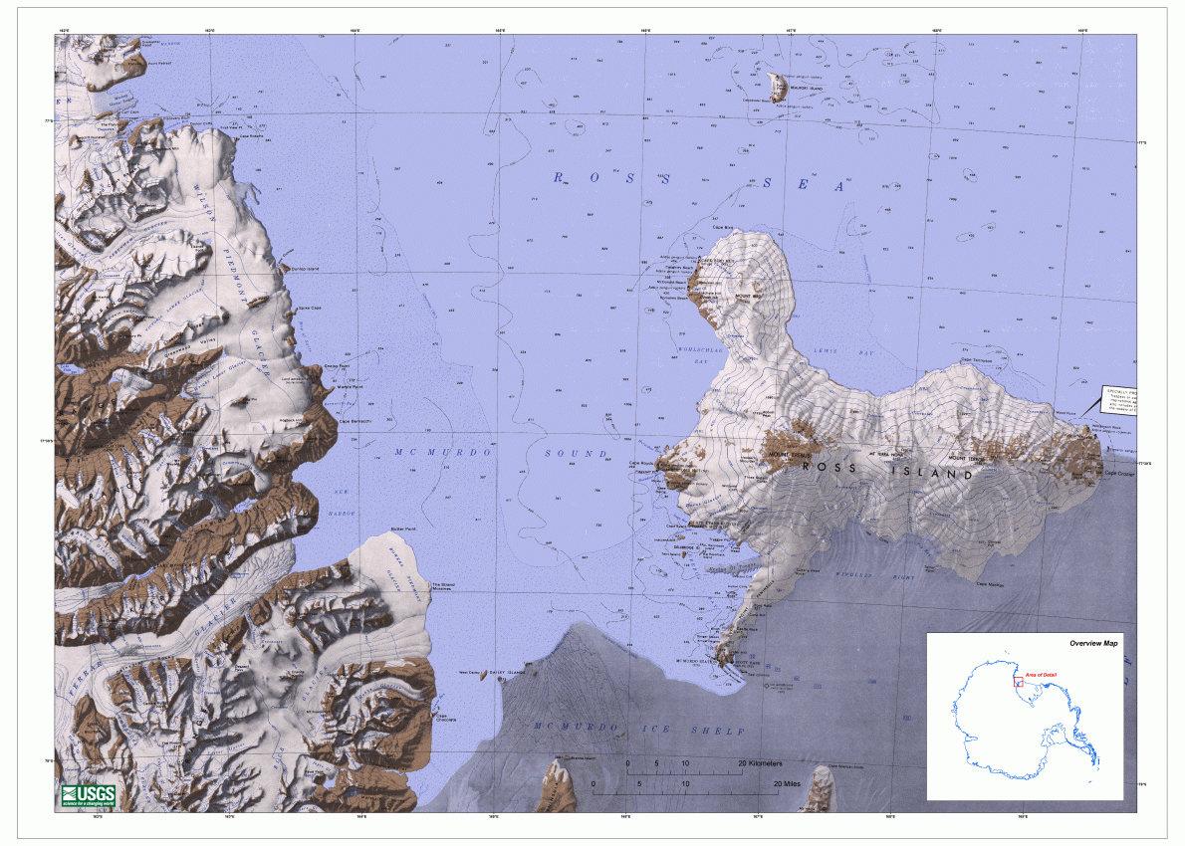
December 2001
Iceberg B-15
November 2003 November 2004
Location of Seals
Notes:
An unusual event happened during the study. B-15 was the largest iceberg ever recorded. It was the approx size of Connecticut. 170 miles long by 25 miles wide. A 25 mile wide, 2000 foot thick piece of ice from here to Phoenix. It splintered into smaller chunks and B-15A (a piece the size of Long Island) blocked most of the entrance to McMurdo Sound.
Ice bergs float and just like an ice only show about 10% above the water.
-If a piece of ice 25 miles wide and 2000’ high was blocking I-17 from here to Phoenix. What would change? Would the food supply be affected? Would it get colder?

Slide 13
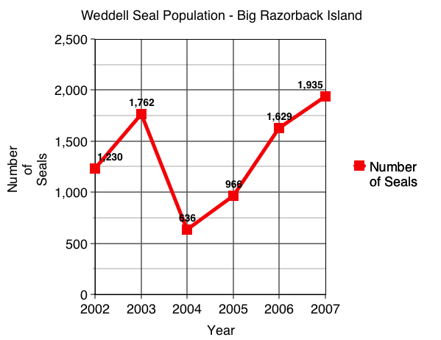

Slide 14
So what conditions could affect Weddell Seal survivability?
Air Temperature
Water Temperature
Food Availability
Predation
Sea Ice Cover
Iceberg – B15?
Reproduction Rates (# of new pups)
Disease

Slide 15
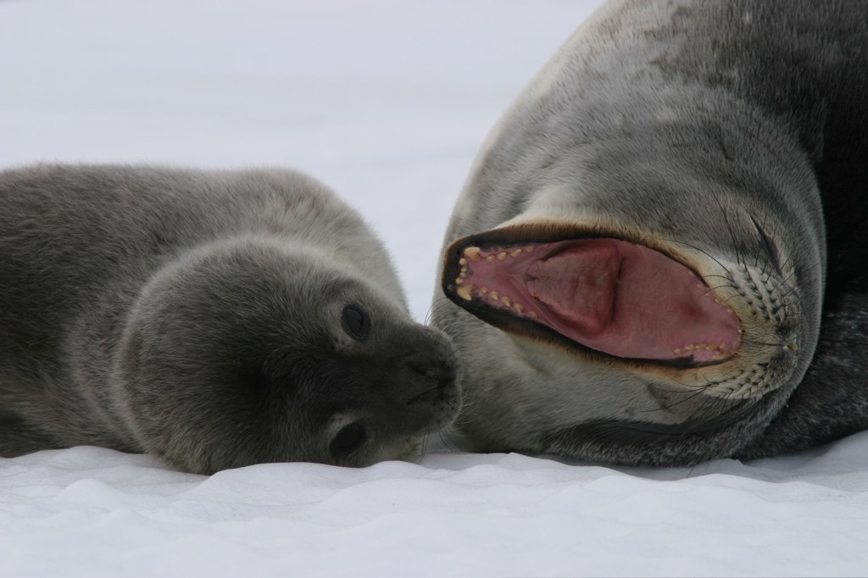
Let’s Look at the data available.

Slide 16
Assignment
Directions
Data Available
In groups of 4 spend 10 - 15 minutes carefully studying the data sheets and graphs.
With your group, formulate a hypothesis (an idea that is supported by data) on why the seal population was lower in 2003 and 2004 and what allowed the recovery in 2005 and 2006. Be prepared to discuss and defend your hypothesis to the class with concrete examples from the data.
In your group, answer the questions 1-4 on the worksheet or whiteboard. Answering the questions will help you to refine your hypothesis.
On your own, answer question 5 in your science journal
Seal Population – Graph
Sea Ice Cover
Average Monthly Air Temperature
B-15 Iceberg Page
Dr. Ainley’s report

Slide 18
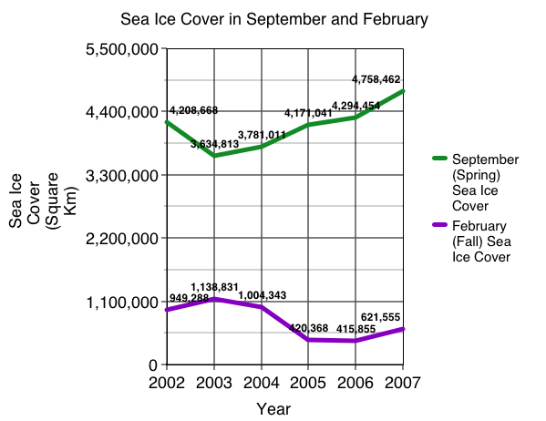

Slide 20
December 2001
Iceberg B-15
A massive iceberg (B-15A) drifted close to the entrance of McMurdo Sound in 2003. Notice that it didn’t block the entrance and you can see open water (dark) in 2003
In 2004 the B-15A almost completely blocked off the entrance to McMurdo Sound. It stayed lodged there until early 2006. In the photo from 2004, notice the lack of open water and that McMurdo sound is completely covered frozen over (totally white). 2005 looked much like 2004.
November 2003 November 2004
Location of Seals

