Slide 1
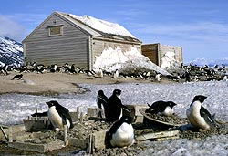

Biological Impact of Climate Change
Sprintt Student at Prattsburgh Central School
H.E.S.
"Whereas in the past human impacts were local, reversible, and escapable through migration, they are now typically, global, irreversible, and inescapable." - Paul Ehrlich

Slide 2
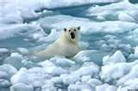
Impact on Animals and Plants
As ice melts, Polar bears are losing their habitats.
As more and more people explore the Arctic they bring diseases.
Birds are also acting upon this, they are laying eggs nearly two weeks earlier.
Blooming and hatching is about 5.1 days earlier.
Many animal and plant populations have declined since 1930’s.
The polar bear must have fallen in the water because the ice was too thin. More heat is absorbed in Earth’s atmosphere. (see the ice that is sloshed around by the polar bear.)

Slide 3
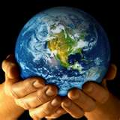
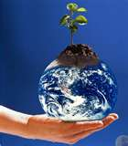
Biological Impact on the Earth
Molecules in the o-zone layer are very fragile
If this action continues, plants will not grow as well on Earth. This will lead to lower food production for animals and the human population.
If this all happened the only things that would be alive are the underwater animals.
Does anyone know why they would only be alive?
The reason the sea animals would only be alive is because it is down far enough where the ultraviolet rays cannot reach them.
There are various conclusions why the o-zone is opening up. One reason why the o-zone is opening up is because human society is polluting the air.

Slide 4
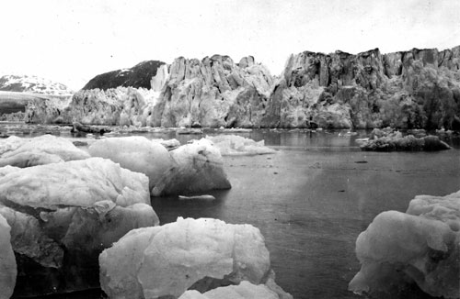
Evidence
Sea levels rising
Melting glaciers
Changes are affecting plant and animal distribution
Reducing extent of sea ice, especially in the Arctic
Oceans are warming up
Temperature has been on the rise
http://www.uwsp.edu/geo/faculty/ritter/geog101/textbook/climate_systems/climate_change.html

Slide 5
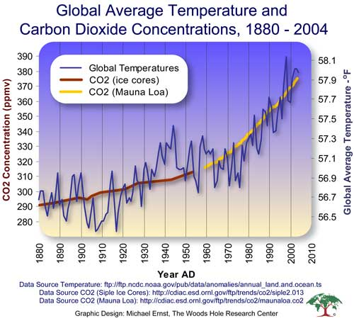
A graph of one point of evidence of the Global Warming

Slide 6
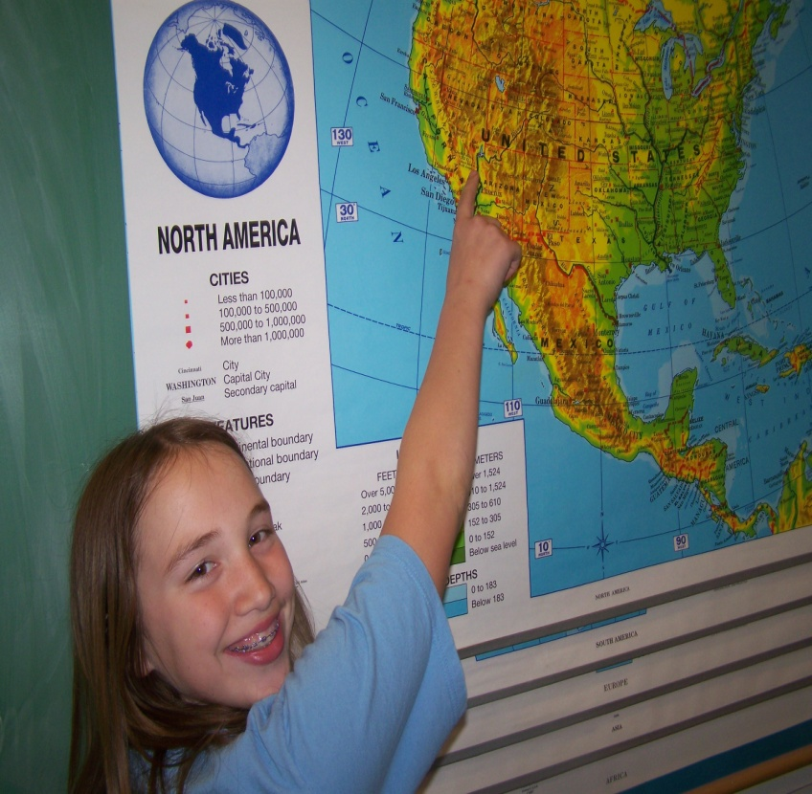
Hi, my name is Hailey. Here I am looking at the locations where some of the climate change is affecting the animals. For my research I am doing “Biological Impact of Climate Change”.

Slide 7
Credit
http://actionbioscience.org/environment/derocher.html
http://www.uwsp.edu/geo/faculty/ritter/geog101/textbook/climate_systems/climate_change.html
http://news.stanford.edu/pr/03/root18.html

Slide 8
The Tundra and the Taiga!!!
Sprintt Studies at Prattsburgh Central School
L.S.

Slide 9
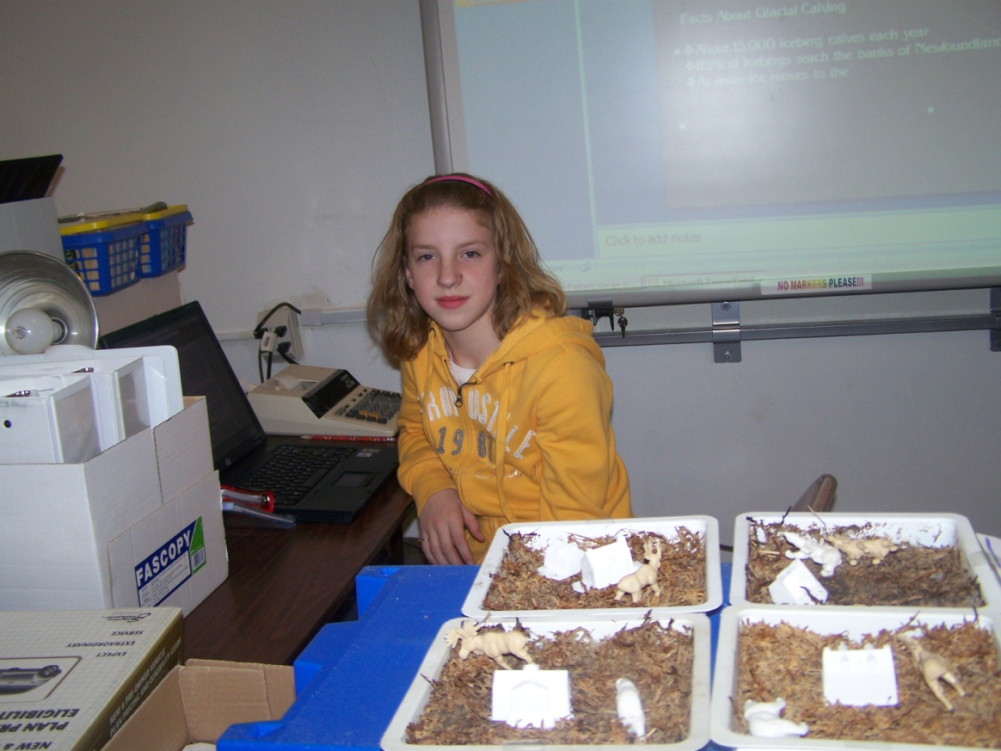
Learning About Sprintt!!!
Hi! I’m Lexi and I’m learning about polar data using NASA resources.
Impact:
Study ecotones to find where the tundra used to be and where the taiga is moving.

Slide 10
Change!
Ice is melting because of global climate change
The taiga is taking over the tundra

Slide 11
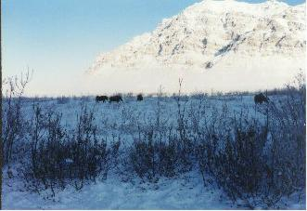
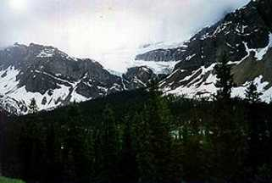
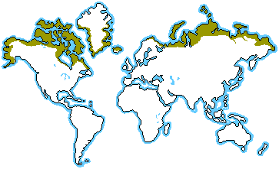
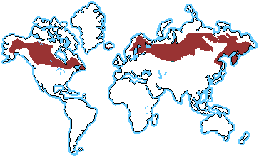
Biomes!
Tundra!
Taiga!
http://blueplanetbiomes.org/tundra.htm
http://blueplanetbiomes.org/taiga.htm

Slide 12
Tundra!!!
The Tundra is the youngest biome!
It was formed 10,000 years ago!
The Tundra is a cold desert with very little snow or rain falling there.
The North American report noted that climate change is posing a significant threat to Indigenous Peoples’ food security and food sovereignty and that Indigenous Peoples’ rights to self-determination, land, water, and cultural practices are essential for the effective action to mitigate and combat climate change.
Impacts currently felt by First Nations Peoples include temperature increases, precipitation changes, disappearing glaciers and snow cover, rising sea level, unpredictable weather and seasons, increased floods, droughts and extreme weather.
http://www.indigenoussummit.com/servlet/content/home.html go to the final report.

Slide 13
Taiga!
The Taiga is the Russian word for forest and is the largest biome in the world!
The Taiga is the biome of the needle leaf forest. Living in the Taiga is cold and lonely.
Another tragedy to hit the Taiga biome is acid rain.
The Taiga consists of these plants: Eastern Fir, Canadian Balsam, Blister Fir, and the White Spruce.
The Taiga is moving in on the places where the Tundra used to be.

Slide 14
Tundra Video!!!
Click on the following link to watch the video on the tundra!!!
http://www.5min.com/Video/Learn-about-The-Tundra-117531340
Taiga Video!!!
Click on the following link to watch the video on the taiga!!!
http://www.5min.com/Video/Learn-about-The-Taiga-Forest-117531027

Slide 15
Credits!
http://blueplanetbiomes.org/tundra.htm
http://blueplanetbiomes.org/taiga.htm
http://www.indigenoussummit.com/servlet/content/home.html
http://www.5min.com/Video/Learn-about-The-Tundra-117531340
http://www.5min.com/Video/Learn-about-The-Taiga-Forest-117531027

Slide 16
Science Exploration and Passage Thru Arctic and Antarctic
Sprintt Studies at Prattsburgh Central School
By: Owen Dlugos

Slide 17
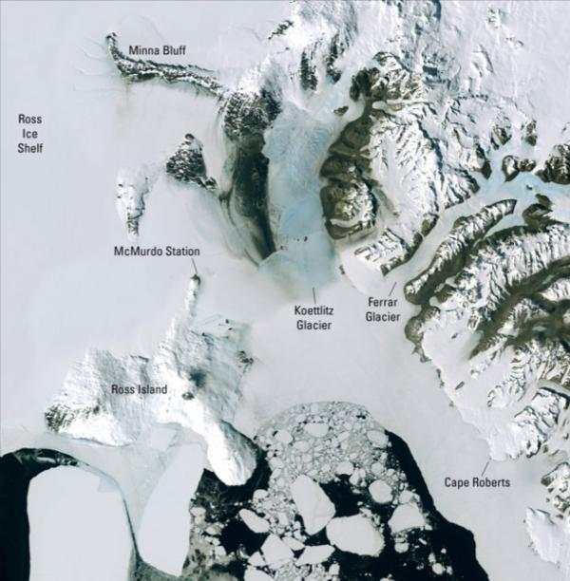
Credit: USGS
Found on webpage:
http://www.sciencedaily.com/releases/2007/11/071127111140.htm
This high resolution mosaic satellite photo has made an amazing breakthrough in Antarctic mapping.

Slide 18
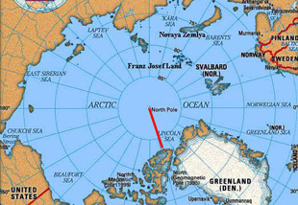
http://hannahmckeand.com/images/arctic_map.jpg
Maps of the Arctic can help track reindeer to find their boundaries. Also, it can teach us more about migration patterns of caribou.

Slide 19
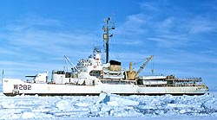
Photo Credit: Warren Hamilton
The Antarctic ship “Eastwind”
This coastguard ship is one of many ice breakers used to break sea ice in the Arctic and Antarctic.

Slide 20
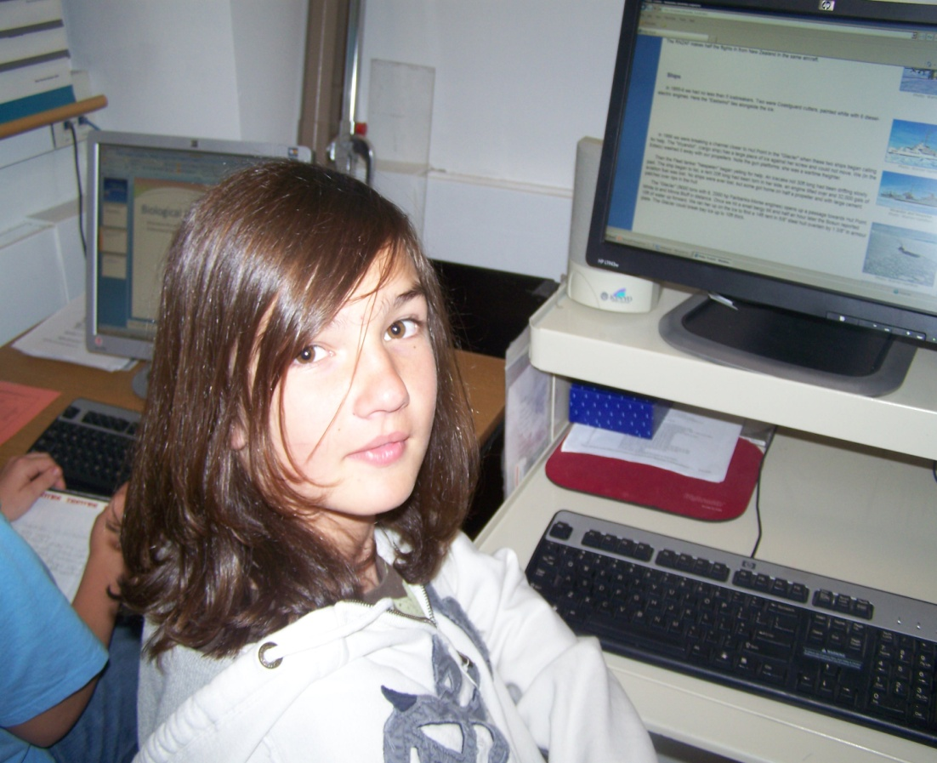
Hey! I’m Owen. Here I am finding information on Arctic and Antarctic mapping.

Slide 21
References:
http://rosssea.info
http://hannahmckeand.com/images/arctic_map.jpg
http://www.sciencedaily.com/releases/2007/11/071127111140.htm
joidedsresolution.org

Slide 22
Glaciers can effect mapping and travel in the Arctic and Antarctic.

Slide 23
Glacial Calving, Iceberg Formation, Mass Movement, and Melting of Ice
Sprintt Studies at
Prattsburgh Central School
T.R.

Slide 24
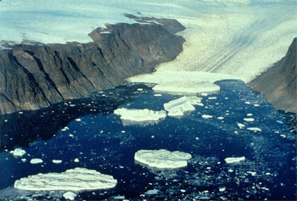
Glacial Calving
http://www.uscg-iip.org/FAQ/Icebergs_1.shtml
Glacial calving is when a piece of a glacier falls off.
Facts About Glacial Calving
About 15,000 icebergs calve each year toward the North Atlantic Ocean
85% of icebergs reach the banks of Newfoundland
As more ice moves to the ocean it raises sea
Levels http://www.youtube.com/watch?v=vc6Wvp6J4Aw&feature=related

Slide 25
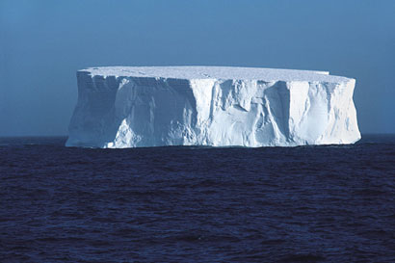
Iceberg Formation
An iceberg is a large block or mass of land ice that has broken off from a glacier or ice shelf. Most of the icebergs in the world's oceans today are descendants of the last glaciation when more than one-third of the Earth’s surface was covered with ice sheets and glaciers during that time.

Slide 26
Mass Movement
Antarctica is Earth's largest reservoir of fresh water.
Mass Movement is said to be the reason of way the iceberg was there when the Titanic sank.

Slide 27
Melting of Ice
The Earth's ice cover acts as a protective mirror, reflecting a large share of the sun's heat back into space and keeping the planet cool. Loss of the ice would not only affect the global climate, but would also raise sea levels and spark regional flooding, damaging property and endangering lives. Large-scale melting would also threaten key water supplies as well as alter the habitats of many of the world's plant and animal species.

Slide 28
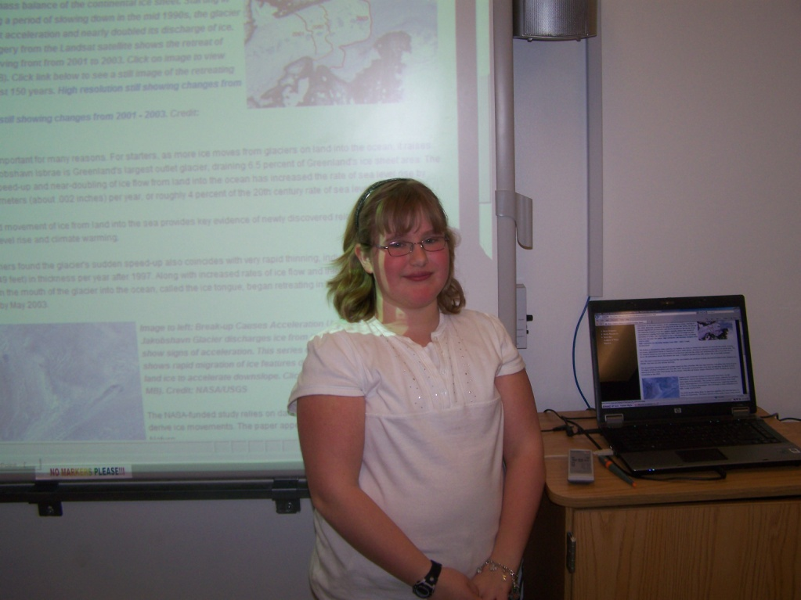
Sprintt Learning
During Sprintt we learned many interesting things. We learned about frozen water. In frozen water we did an experiment with sea ice and ice on land. We also spent a few class times learning about how the Titanic sank because of a ice movement. We next learned about frozen land. We did an experiment with permafrost. After we finish frozen land we will learn about frozen food. While learning we will be working on our finial research projects.

Slide 29
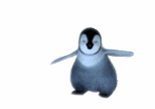


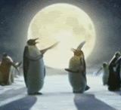
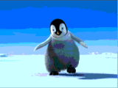

~The End~
Sprintt!!!
Music from www.mp3rocket.com

