Slide 1
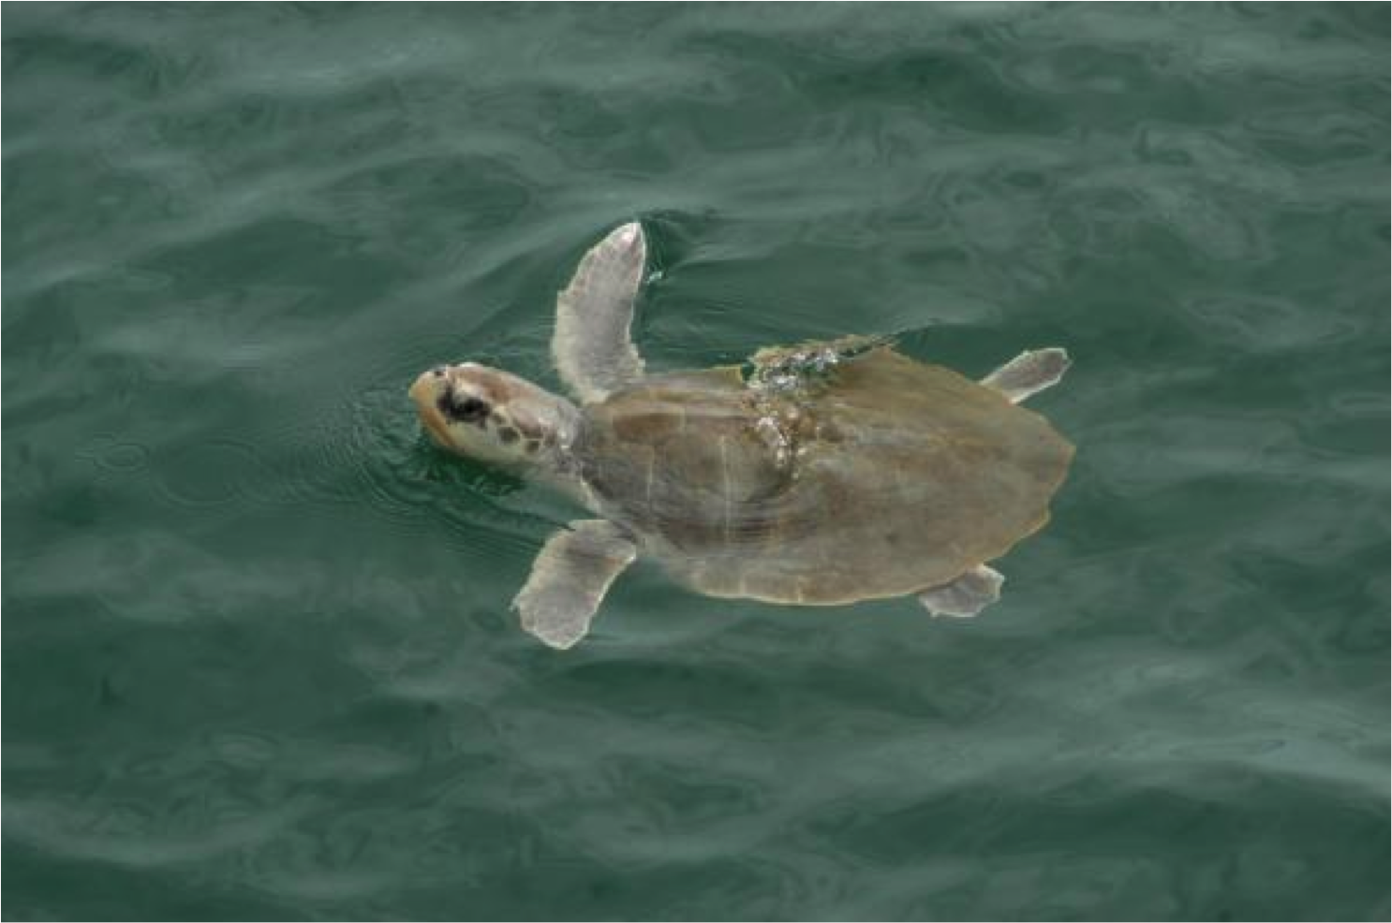
Ursula Kemp’s Ridley Turtle
Parameter: Sea Surface Temperatures

Slide 2
Where Did Ursula Go?
Observed 3 days- 19 January-23 January 2009
Location: the Myrtle Beach, SC coastal region. Her exact positions were:
19 January: 58 km from shore at 33.46 N and 78.16 W
21 January: 48 km from shore at 33.42 N and 78.13 W
23 January :53 km from shore at 33.30 N and 78.54 W

Slide 3
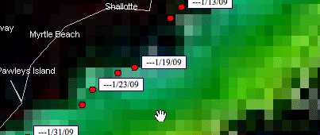
Sea Surface Temperatures
During the observation period, she stayed in waters that averaged 13 degrees Celsius.

Slide 4
What Was Ursula Doing?
Being far off shore, she was most likely moving down the eastern sea coast.
Most likely not looking for food because she is a benthic feeder and is a little far off shore to find crabs, a preferred prey item.
Possibly getting ready to mate and lay eggs in warmer sea surface temperatures

