Slide 1
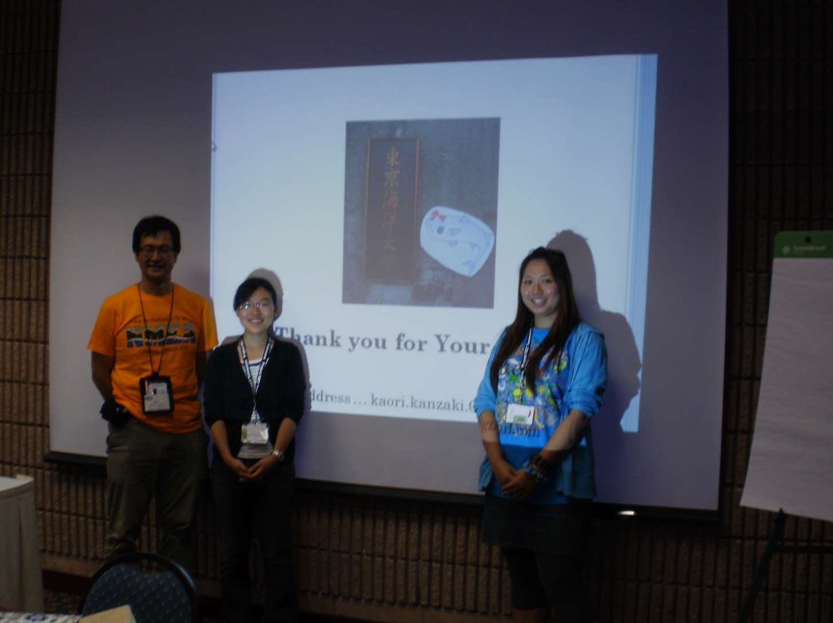
Tricks of the Trade

Slide 2
Learn from your new experiences!
Open up with receptivity. The NASA Endeavor Certificate Program offers an amazing opportunity to you and your students. In my experience, I became aware of organizations that I was unaware of. Almost constantly, I integrated information from NASA and NMEA (National Marine Educators Association) into my classroom lessons. First, I had to baseline where my students were performing in their educational understanding of specific concepts and skills. From that point forward, I would introduce information in a context that was understandable to Prattsburgh Central School students.
Introduce new information and integrate the information into your instruction. At the Annual 2010 NMEA Conference in Gatlinburg, Tennessee I met Dr. Tsuyoshi Sasaki and his students from the University of Tokyo. I shared ideas from their “Mullet Program” with my students.

Slide 3
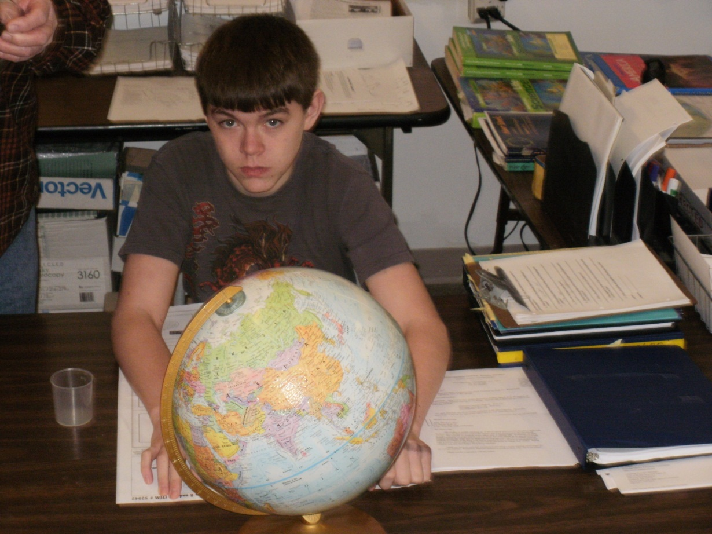
Select a starting point.
Each student offers a unique understanding of planet Earth. Observe and organize the learning environment for individual and group success. Start with resources that are familiar to the student. Build on that learning by integrating NASA resources.

Slide 4
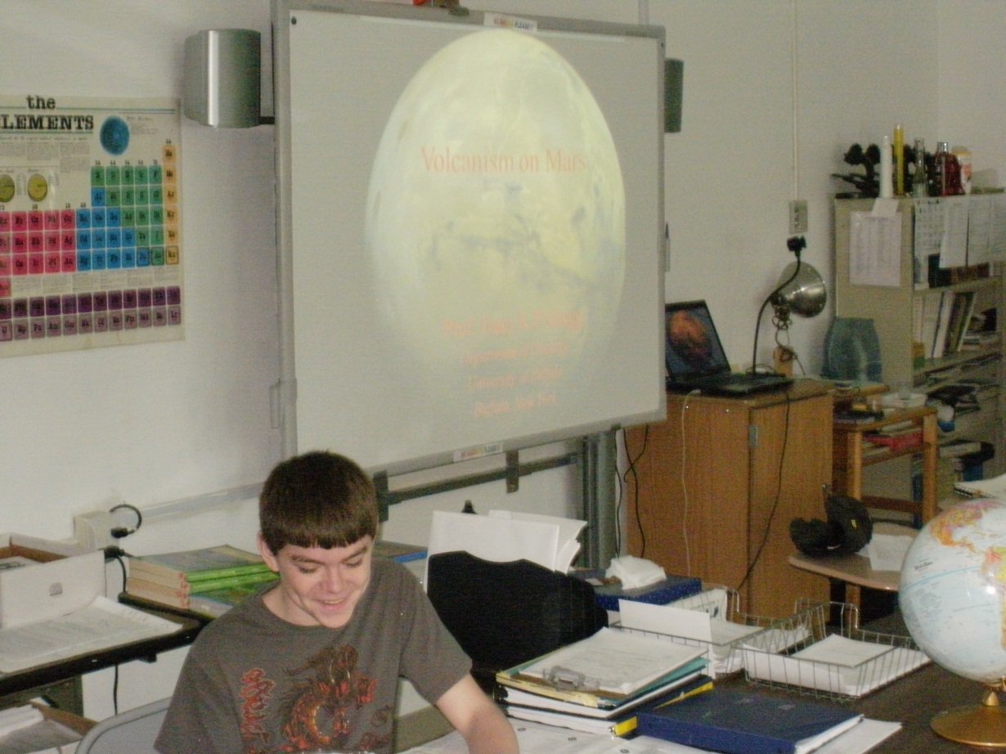
Use each teachable moment effectively!
Determine what the student understands about the concepts and skills that have been presented. Guide inquiry with appropriate questioning strategies. Generalize the knowledge of volcanoes on planet Earth to another planet. Use projections of NASA resources on a Promethean Board to enrich the learning environment.

Slide 5
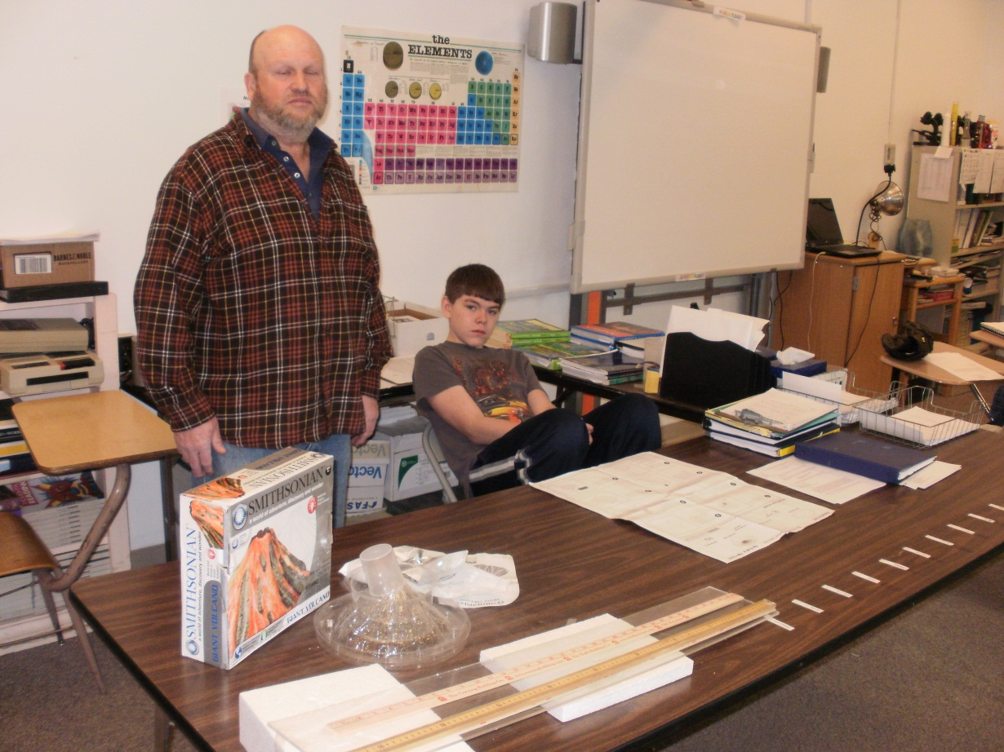
Link Earth Science concepts to a dynamic understanding.
Use model construction and measurement for a “hands on” experience. In order to comprehend data collection as a meaningful endeavor, it is very important for each student to “construct” a working knowledge of data usage.

Slide 6
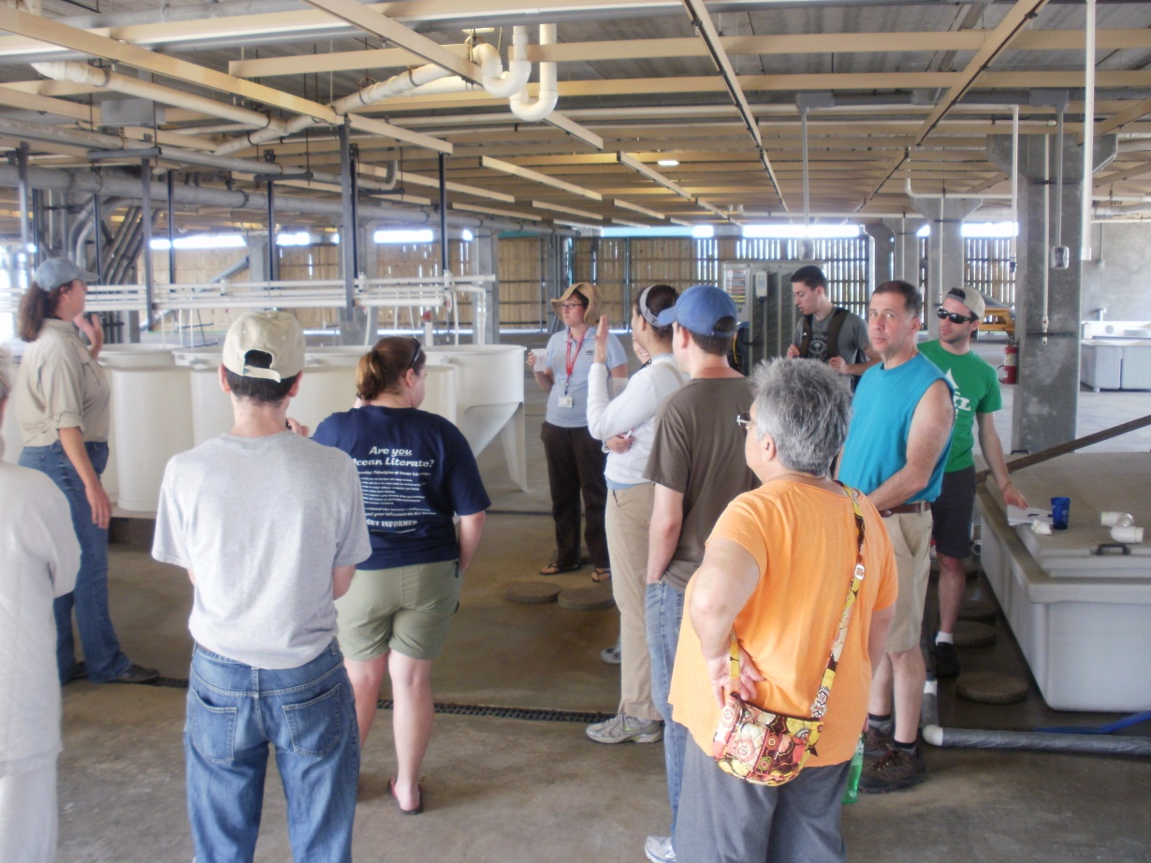
Share your real-life educational experiences.
Your students need to see that their instructors are open to inquiry. What does inquiry reinforce? It reinforces a willingness to extend knowledge beyond the initial understanding that a person has. Input from listening may provoke problem-solving strategies.

Slide 7
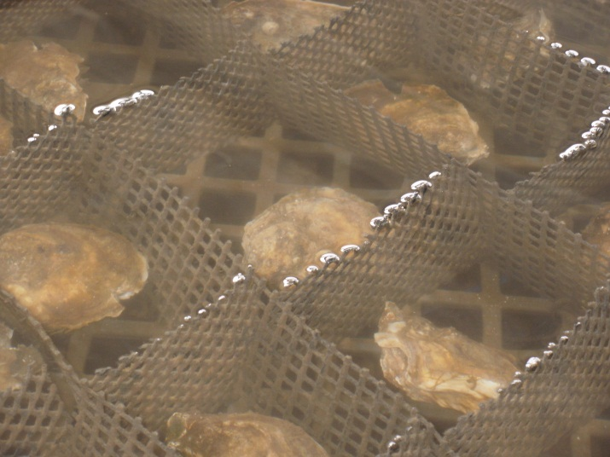
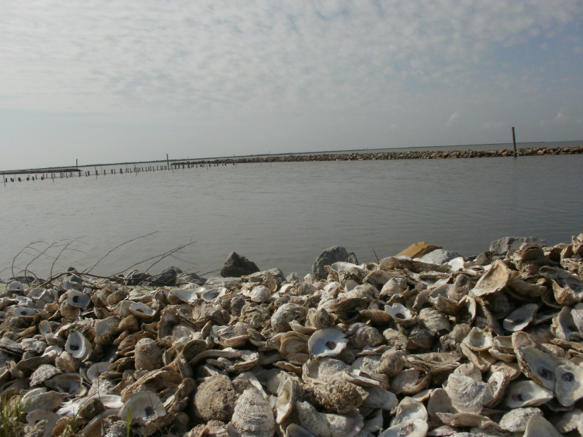
What happens when desalination due to freshwater diversion negatively impacts oyster populations?
It fascinates me to listen to students who employ problem-solving strategies in their abstract thinking. The link that students create to empathize with other families who are struggling to earn a living motivates their thinking.

Slide 8
Works Cited
Gregg, T., (2010) Power Point on Volcanism shown during Earth Science on Mars class, University of Buffalo, Department of Geology Professor
Kanzaki, K., & Sasaki, T. (Dr.) .) 2010 NMEA Annual Conference held in Gatlinburg, Tennessee,
(TUMSAT) Tokyo University of Marine Sciences and Technology, “Mullet Program”
NYSMEA (2011) Gulf Restoration Team and Louisiana Wildlife Staff
Prattsburgh Central School: student, and instructional aide

