Slide 1
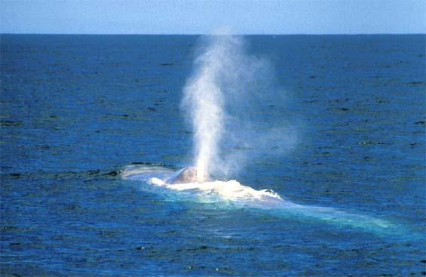
Tracing the Blue Whale’s Evolutionary Tree
With DNA sequencing

Slide 2
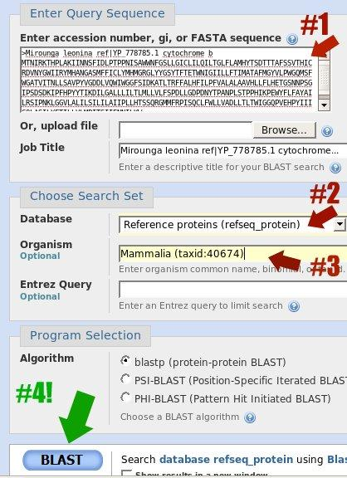
BLAST tool used for finding related protein sequences

Slide 3
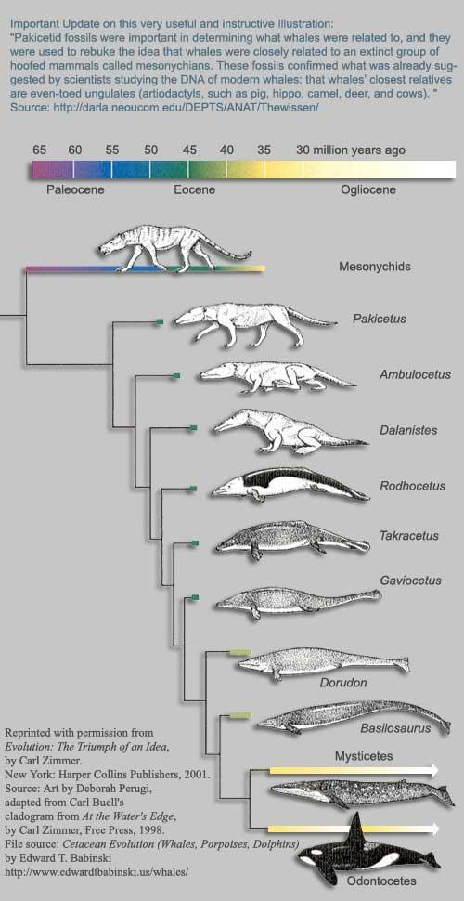
Evolutionary Tree of whale ancestors down to modern whales with approximate time of divergence between animals

Slide 4
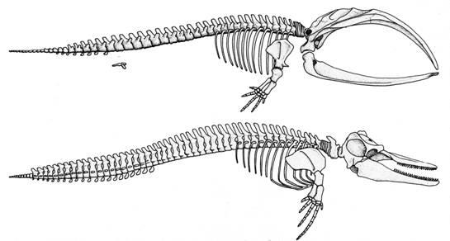
Skeleton of Baleen Whale (Mysticeti)
Skeleton of Toothed Whale (Odontoceti)

Slide 5
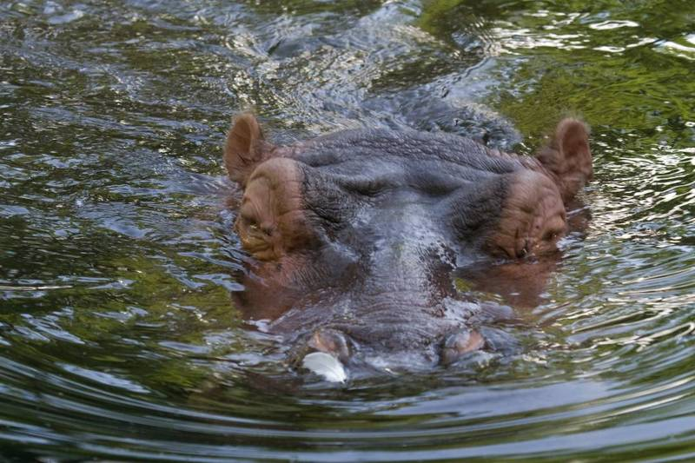
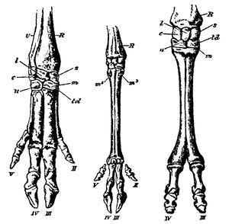
Even-toed Ungulates (Artiodactyla)

