Slide 1
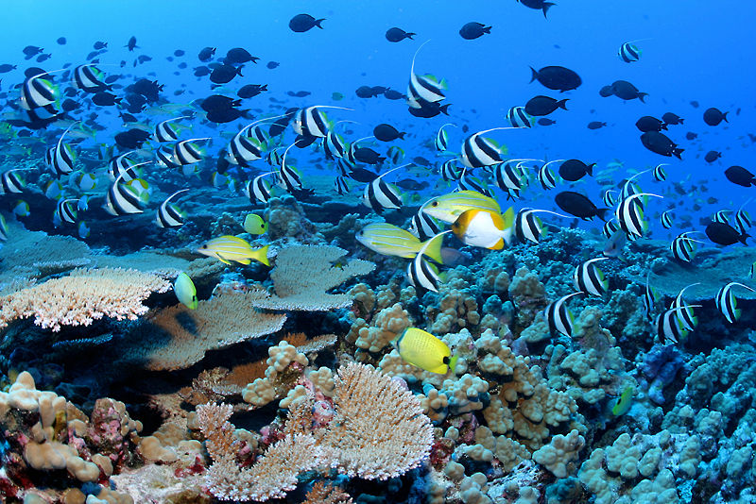
The Science of Ocean Pollution
Prattsburgh Central School,
7th Grade Students
Try to Make a Difference
http://www.hilariousheadlines.com/talk/wp-content/uploads/2009/06/reef-fish.jpg

Slide 2
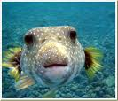
What is your theory about how the Ocean came into existence?
http://www.youtube.com/watch?v=bT_dmI9t9S0
Theories:
mommylife.net

Slide 3
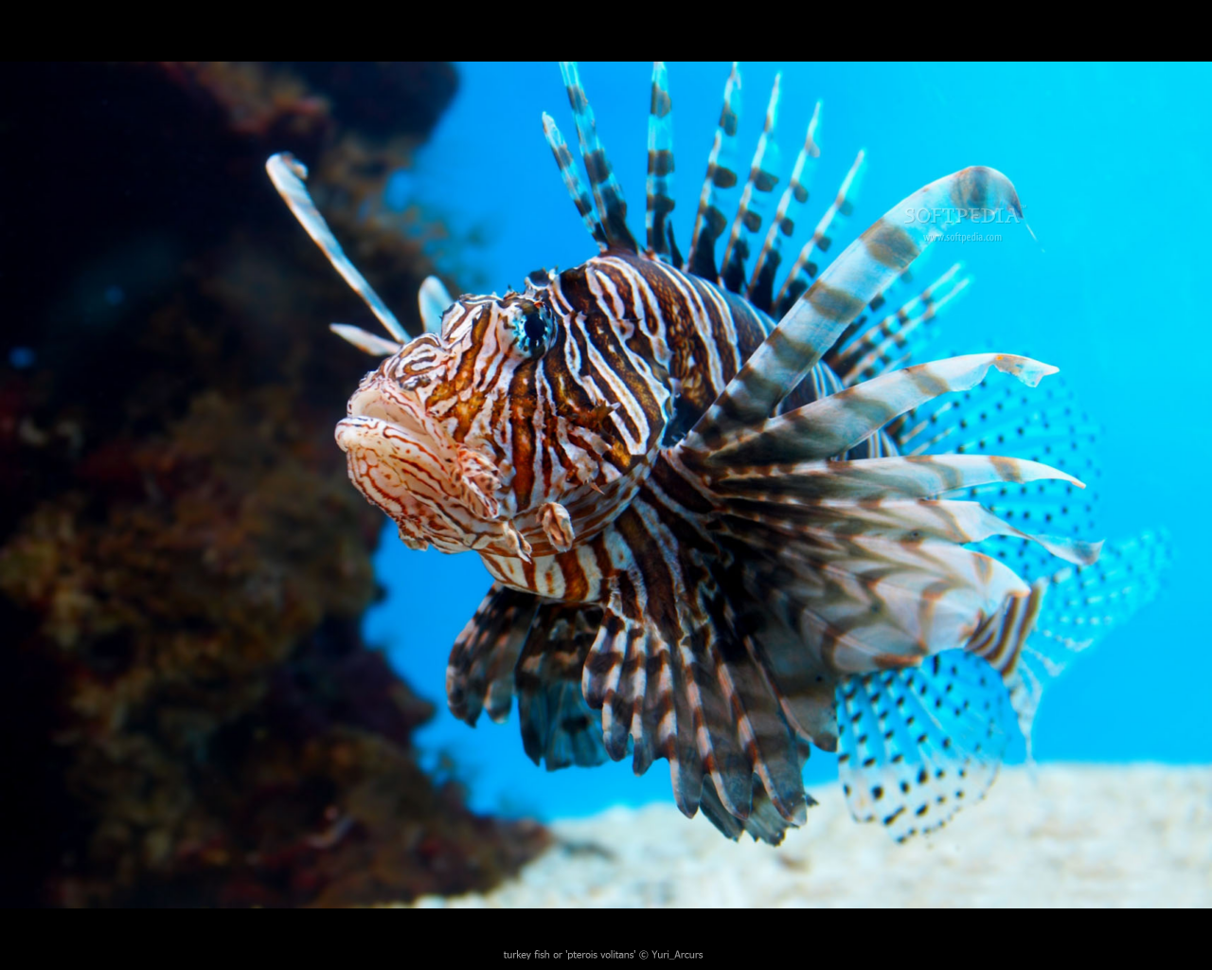
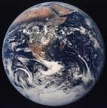
Ocean Pollution
cean pollution is a major problem all over the world. The reason why ocean pollution is a major problem is because biological organisms depend on water. Water is composed of two hydrogen atoms and one oxygen. Dangerous chemicals on the molecular scale can change the chemistry of water. We attempted to study this topic and present our results to you.
softpedia.com

Slide 4
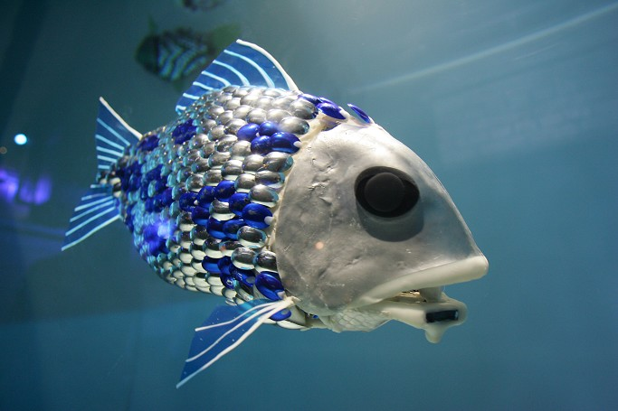
Toxic Wastes
Toxic wastes include: chlorinated solvents, hydrocarbons and ethers, halogens, phenols, plastics, organic agricultural products, detergents, and organic metallic compounds.
This information was retrieved from the following web address:
http://www.environmentalpollutioncenters.org/chemical/pollutants/.
bmt.org

Slide 5

How Do We Impact the Ocean?
All the garbage that we put into the ocean
All the plastics
The birds eat the plastic and then die.
The plastic bag is mistaken as a jellyfish and eaten.
Garbage that we put into the ocean can affect many animals that mistake it for food.

Slide 6
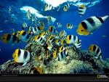
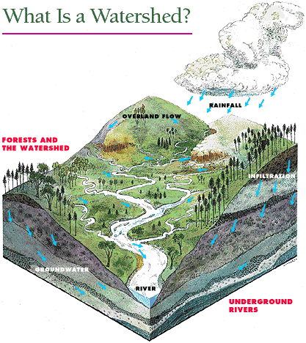
Watersheds!!
A watershed is the entire area that drains into a basin.
A basin is where the water
goes before it drains into the
ocean.
http://www.wallkillriver.org/watershed.gif

Slide 7

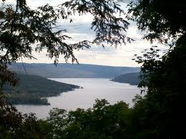
Keuka Lake, New York State
www.newyorkfishinglakes.com

Slide 8

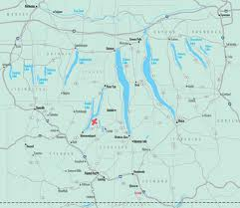
Finger Lakes Region of New York State
www.keukafarms.com

Slide 9

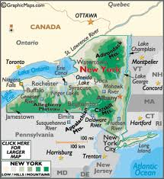
New York State
www.weatherworldatlas.com

Slide 10

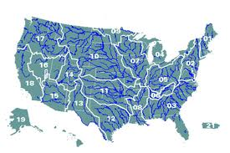
The United States of America
www.biostate.blogspot.com

Slide 11

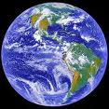
Planet Earth as seen from space
rst.gsfc.nasa.gov/Sect16/full-20earth2.jpg

Slide 12
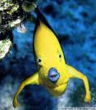
Animals of the Sea
Dolphins
Sharks
Starfish
Manatees
Eel
Puffer Fish
Whales
Shrimp
Crab
Clown Fish

Slide 13
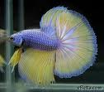
http://www.youtube.com/watch?v=nwlsSZcy0is&NR=1

Slide 14
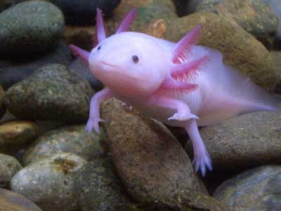
Endangered Animals of the Sea
A few endangered animals include:
Whales
Dolphins
Manatees
Sea Turtles
Sharks
And several varieties of sea life

Slide 15
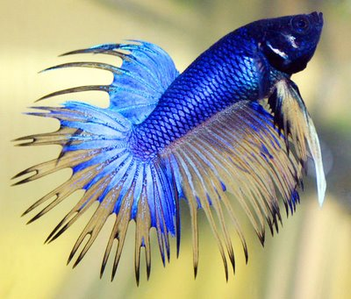
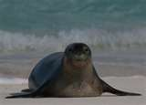
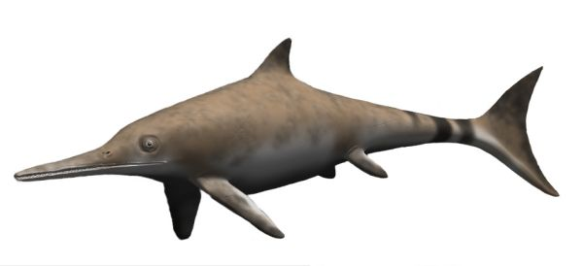
Extinct Animals of the Sea
Caribbean Monk Seal
http://www.bing.com/images/search?q=Carribean+Monk+Seal+Pictures&FORM=IGRE&qpvt=Carribean+Monk+Seal+Pictures#focal=1bdd094f4f708a69db8378f04af0791d&furl=http%3A%2F%2Ftolweb.org%2Ftree%2FToLimages%2Fhawaiianmonkseal.250a.jpg
Icthyosaurus
http://www.discussfossils.com/forum/uploads/1198/Ichthyosaurus_BW.jpg

Slide 16
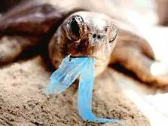
We’ve studied the human impact on water ways. You learned each of the following: what makes up a watershed, the problem of chemical redistribution, and the movement of water to the ocean basin. Redistribution of chemicals into ocean waters is a problem that clearly needs to be solved. Do your part in solving this problem to save planet Earth’s ocean. Thanks! The Prattsburgh Project
Naturalclothingcompany.com

Slide 17

Work Cited
http://www.environmentalpollutioncenters.org/chemical/pollutants/
www.biostate.blogspot.com
www.keukafarms.com
www.newyorkfishinglakes.com
www.weatherworldatlas.com
http://marinebio.org/Oceans/threatened-endangered-species.asp
http://www.youtube.com/watch?v=bT_dmI9t9S0
http://www.youtube.com/watch?v=nwlsSZcy0is&NR=1
Pictures: http://www.bing.com/images/search?q=Carribean+Monk+Seal+Pictures&FORM=IGRE&qpvt=Carribean+Monk+Seal+Pictures#focal=1bdd094f4f708a69db8378f04af0791d&furl=http%3A%2F%2Ftolweb.org%2Ftree%2FToLimages%2Fhawaiianmonkseal.250a.jpg
http://www.discussfossils.com/forum/uploads/1198/Ichthyosaurus_BW.jpg
http://www.hilariousheadlines.com/talk/wp-content/uploads/2009/06/reef-fish.jpg
Naturalclothingcompany.com
rst.gsfc.nasa.gov/Sect16/full-20earth2.jpg
www.mommylife.net
www.softpedia.com
http://www.wallkillriver.org/watershed.gif

