Slide 1
Student Motivation in the Flipped Classroom
Heather Haberman

Slide 2
The Flipped Classroom?????
Students are assigned video lectures as homework and do their “homework” during class time (it’s flipped).
Will students be responsible enough to watch the video lectures as homework so they’re prepared for class activities the next day?

Slide 3
Lit. Review & Plan
VERY little research has been published on the flipped classroom model and the use of technology in the classroom.
I assigned students one video lecture (6-9 min.) a week from the start of the semester in January.
Students had to take notes on the video.

Slide 4
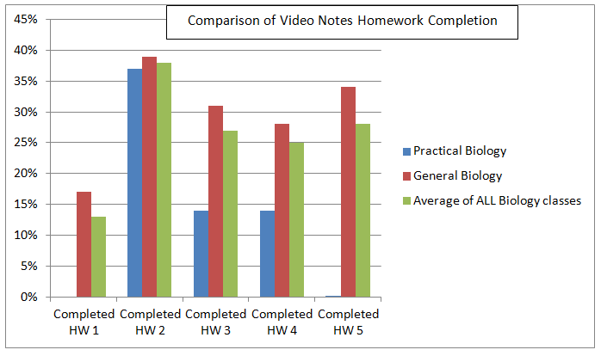
Data/Results
I never got higher than a 39% participation rate from my students in the 5 weeks I collected data.
There was an even 1/3 split on the percentage of students that preferred the long class lectures, short video lectures and those that had no preference.

