Slide 1
Solar flares
Sarah Slater

Slide 2
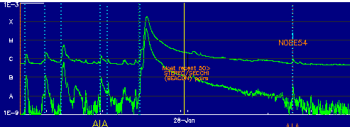
Goes 14 x-ray
January 27, 2012
Peak x-ray event
http://www.lmsal.com/solarsoft/last_events/

Slide 3
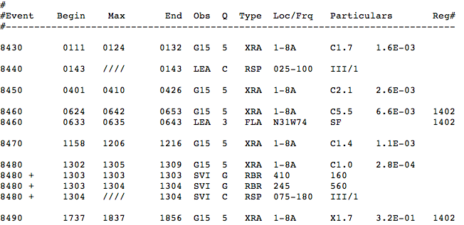
MAX X-RAY Emission
18:37 on January 27, 2012
http://www.swpc.noaa.gov/ftpdir/warehouse/
2012/2012_events/20120127events.txt

Slide 4
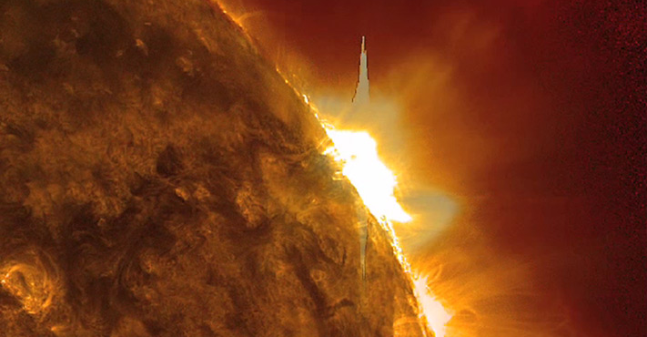
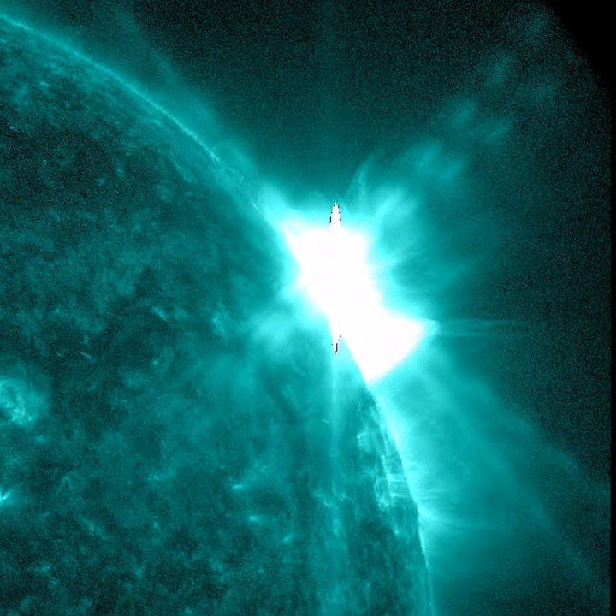
Profiled blast January 27, 2011 from Solar dynamics observatory
http://sdo.gsfc.nasa.gov/gallery/
potw.php?v=item&id=86

Slide 5
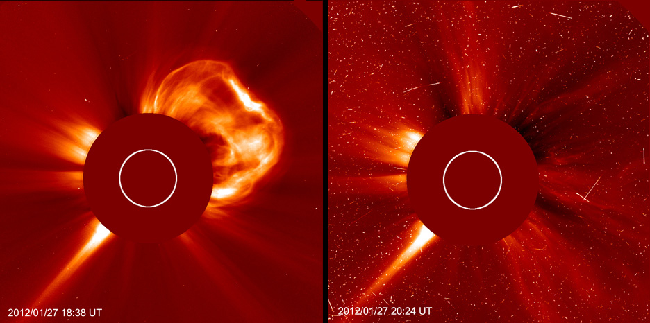
Proton Storm caused by coronal mass ejection January 27, 2012
http://soho.nascom.nasa.gov/pickoftheweek/old/03feb2012/

Slide 6
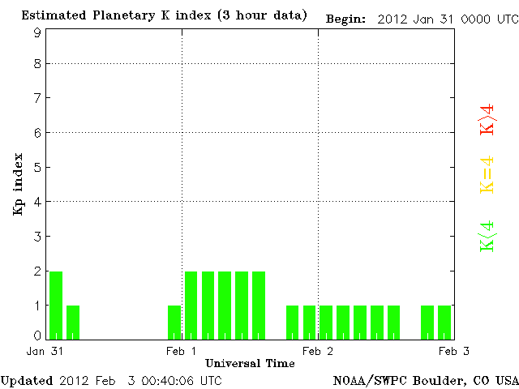
Planetary kp index (Magnetosphere)
February 1, 2012
Magnetosphere Disruption
After X-ray Emission
http://www.swpc.noaa.gov/rt_plots/kp_3d.html

