Slide 1
Solar Unit
Cappi Coleman

Slide 2
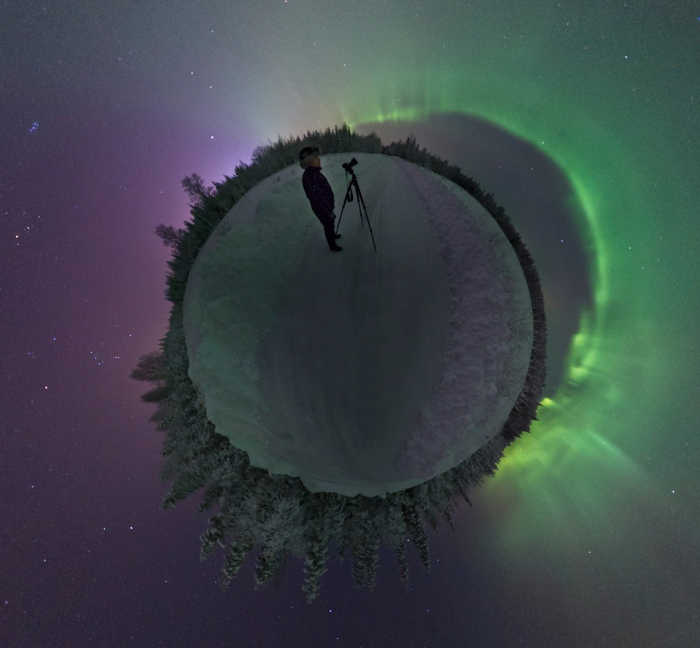
Lesson 1
What are auroras and what causes them.
Show the video clip of Galileo’s examination of sunspots. Integration of history. http://www.teachersdomain.org/asset/ess05_vid_galileosun/.

Slide 3
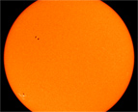
Lesson 2
Show a Film clip from similar to what Galileo was observing and drawing over several days. http://sohowww.nascom.nasa.gov/gallery/Movies/spotzm/spotzm.mpg.
Sunspots flip chart

Slide 4
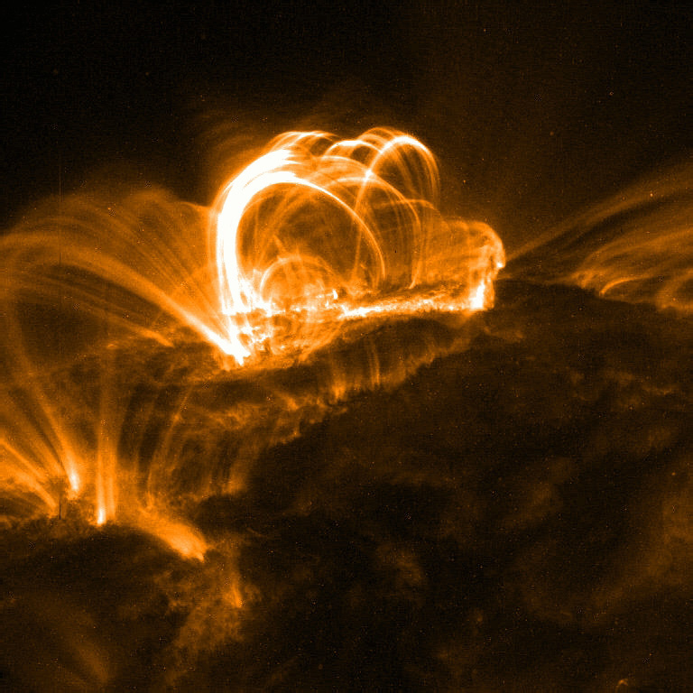
Lesson 3
Show students what a solar flare is at SOHO, Solar and Heliospheric Observatory http://sohowww.nascom.nasa.gov/hotshots/X17/.
Solar storm flip chart and accompanying data collection sheet

Slide 5
Lesson 4
video clip from teacher’s domain. Solar Wind. http://www.teachersdomain.org/asset/ess05_vid_solarwind/.
Magnetosphere Flip Chart

Slide 6
Lesson 5
Auroras Flip Charts
Need to find a video clip for this lesson.

Slide 7
Assessment
I like using video clips to introduce concepts and sometimes for giving assessments. Only problem with this is some students need longer than others so many times have to wait until they complete questions. It might be necessary to have an alternate test with printed pictures for these students. Another assessment option is having students create a PowerPoint from the material they have learned. In the lesson plans I have specific questions they must answer but still have to create a rubric for grading their power points.

Slide 8
Technology and Online resources
My population of students is 7th through 12th graders, approximately 20 per class. I would probably use this for 7th through 9th grades.
Computer with projector
student computers for research
Provide links to video clips and web pages used. Our school does not always have computers available for classes to use so I am prepared to use only my smart board to display graphs, photos, video clips etc.

Slide 9
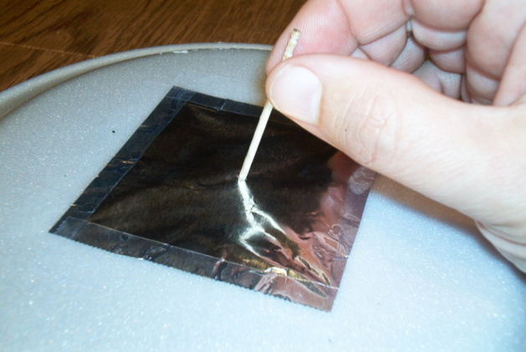
Create a Sun Viewer

