Slide 1
Solar Storm
Cappi Coleman

Slide 2
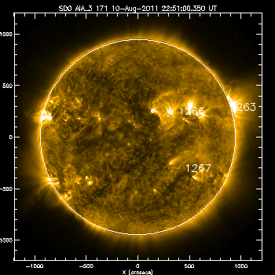
An X6.9 Solar Flare occurred on August 9, 2011 at 8:05 am. Coronal Mass Ejections also occurred with this flare. Coronal Mass Ejections do not have to occur with a solar flare. This picture shows a good example of post coronal loops or “feet”. This phenomenon has to do with the sun’s magnetic field realigning itself.

Slide 3
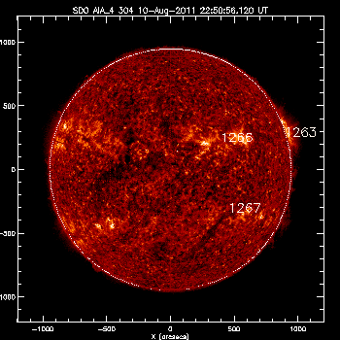
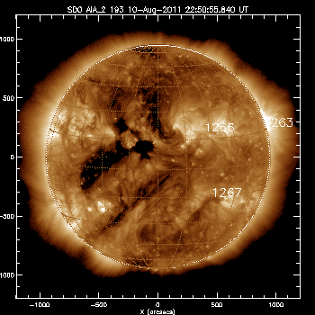
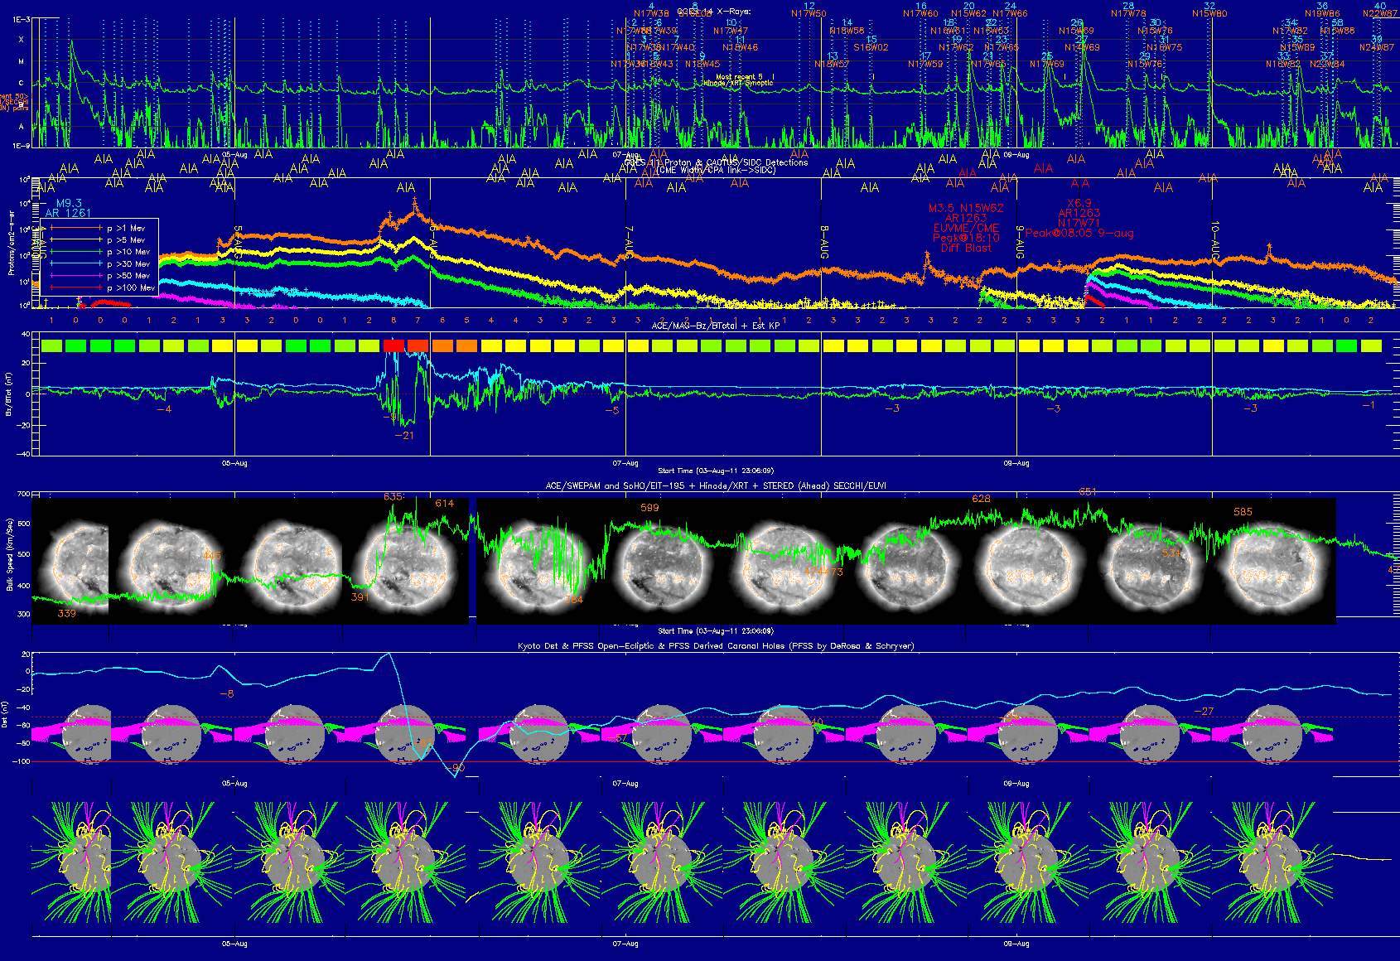
X-Ray Emissions
This peak on the graph indicates the occurrence of a Solar Flare on August 5th
Proton Emissions
Magnetosphere Activity
This graph activity is the beginning of the effects from the August 5th Solar Flare.

Slide 4
This would have been a great time to see Aurora Borealis in the southern US states.
There appears to be similar phenomena of quick movement of large particles occurring after the X6.9 flare.
This area was interesting but I could not find the previous 3-4 days of data. Could this area of interest be the large particles from the flare reaching the earth sooner than 3-4 days? I would like to find the August 1-3 data to see what activity occurred.

Slide 5
References
Goddard Space Flight Center http://sdo.gsfc.nasa.gov/
Solar Soft http://www.lmsal.com/solarsoft/last_events_20110810_2322/index.html
Heliophysics http://science.nasa.gov/heliophysics/

