Slide 1
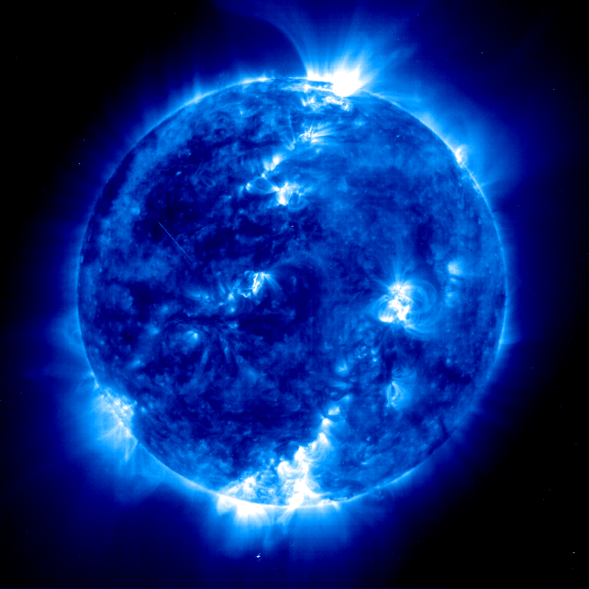
Solar storm hw
Brian Thompson - NASA Endeavor Cohort 4
Tracking a Solar Storm

Slide 2
Predicting a Solar Storm
We have radiation and particle detection instrumentation on the surface of Earth and aboard satellites in orbit.
These devices can sense electromagnetic and particle emissions from the sun.
Because EM waves travel much faster than particles of mass, the former are harbingers of the latter.
Being able to accurately predict an upcoming onslaught of particles can help us prepare for its inevitability.

Slide 3
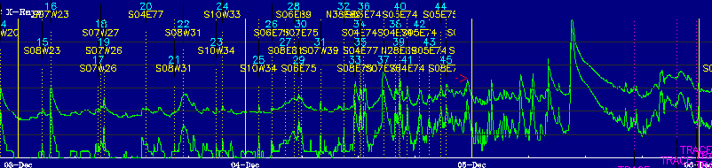
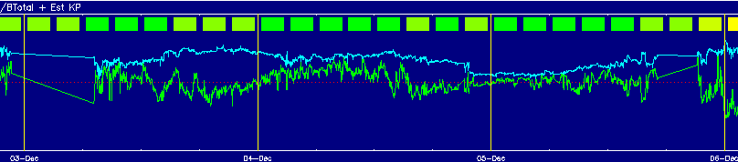
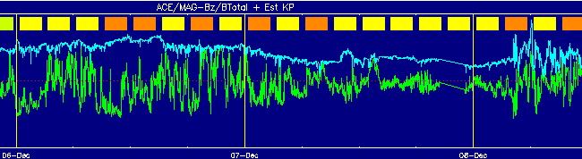
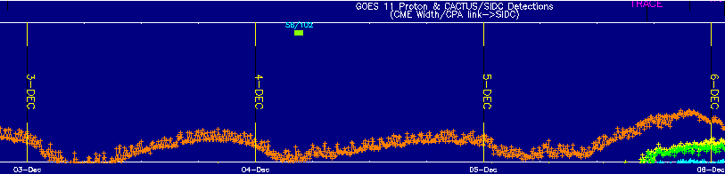
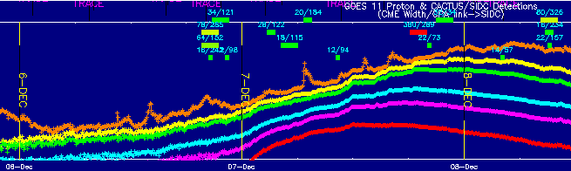
X-ray Emission
Magnetosphere
Activity
These data is from NASA’s Space Weather Action Center collected from December 3, 2006 through December 8. X-rays reliably arrive at Earth long before solid particles do after a
solar event. The magnetosphere reacts to charged particle bombardments (shown below).
Proton Emission
The red lines connecting the top two graphs show the correlation between X-ray emissions
and the eventual magnetosphere reaction to the slower, massive particles. December
third 3 ushered in a period of new solar activity which resulted in Earth magnetosphere
activity. This delay is typically three to four days.

Slide 4
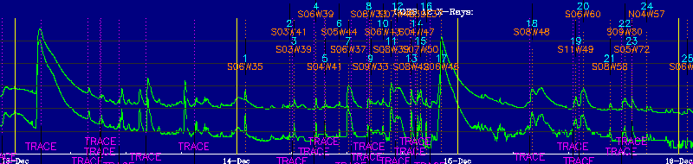
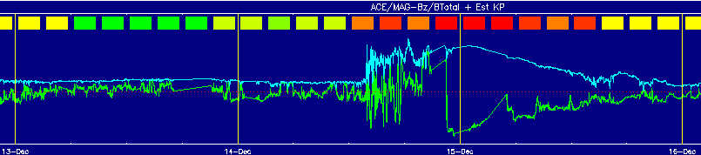
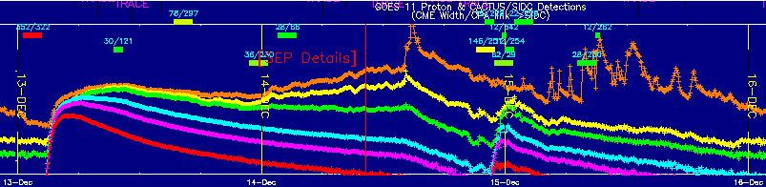
Here’s your bonus.
These data occurred from
Dec 13-16, 2006. An X-ray
blast is detected at about
0215 on the morning of the
13th. At approximately
0245 – just half an hour
later – massive particles
arrive and the magneto-
sphere reacts with some
attenuation of its previous
behavior. This happens
again just before midnight
on December 14th.
This doesn’t make sense according to science as I know it now. The data bothered me to
the point of having to say something about it even though that wasn’t part of the
assignment. The data reflects a shower of charged particles of multiple energy levels
following the initial electromagnetic indicators by merely thirty minutes. They are
traveling too fast. And it happens twice.
What is up with that? ☺

Slide 5
Sources
ESA Science News, 1999 (blue solar image) http://carlkop.home.xs4all.nl/soholost.html
Space and Weather Action Center (raw data charts) http://sunearthday.nasa.gov/swac/data.php http://www.lmsal.com/solarsoft/protons/eit_protons_20061213_0200.html

