Slide 1



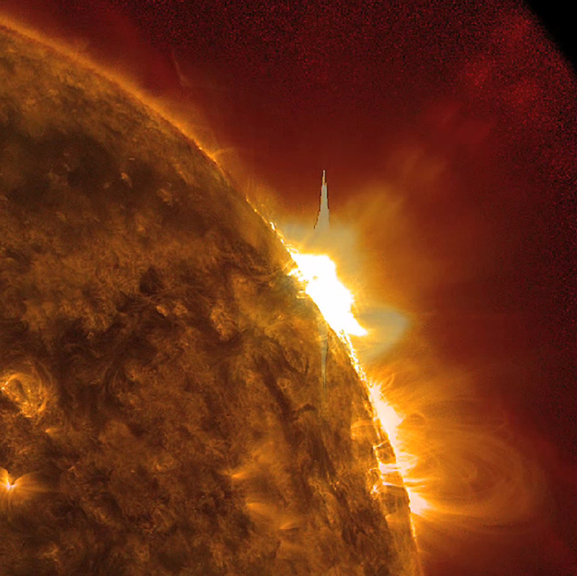
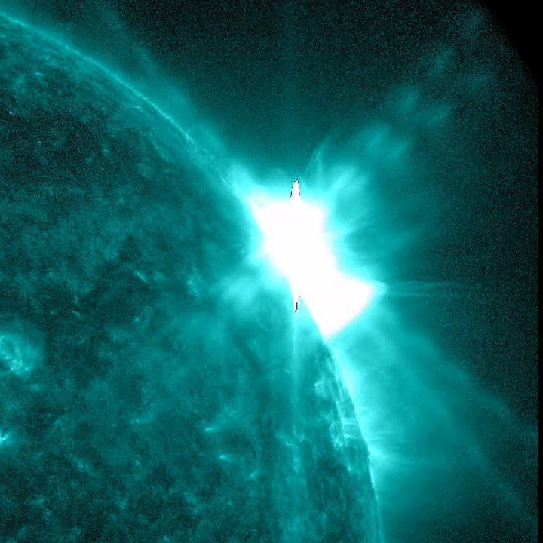
This is a coronal mass ejection that occurred on January 27, 2012. The last week has been fairly mild according to reports from Space Weather.
 | Profiled Blast
Photos retrieved from http://sdo.gsfc.nasa.gov/gallery/potw.php?v=item&id=86

Slide 2
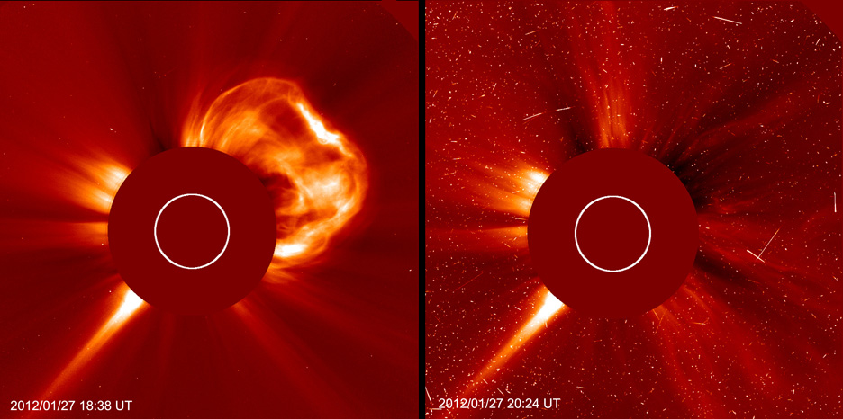
A solar flare and coronal mass ejection from the sun also from the January 27th, 2012 occurance.
Photo retrieved from http://soho.nascom.nasa.gov/pickoftheweek/old/03feb2012/C2_x1.6flare.jpg

Slide 3
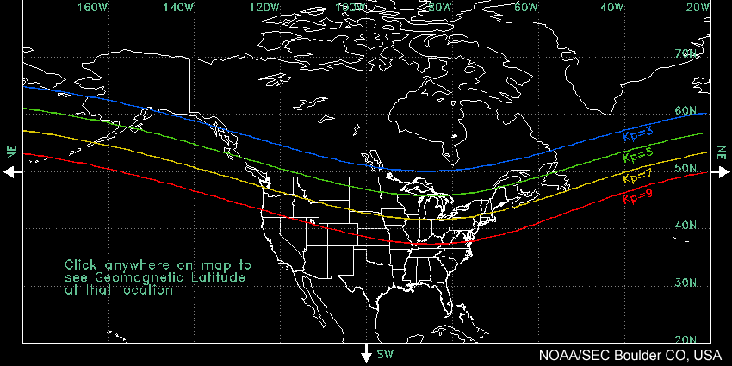
The mild green bars from the previous slide would be interpreted as auroras that could be seen only in Canada and the furthest reaches of the US. The yellow bar which indicates an increase in magnetic activity could be seen in most Northern boarder states.
Photo retrieved from http://www.swpc.noaa.gov/Aurora/globeNW.html

Slide 4
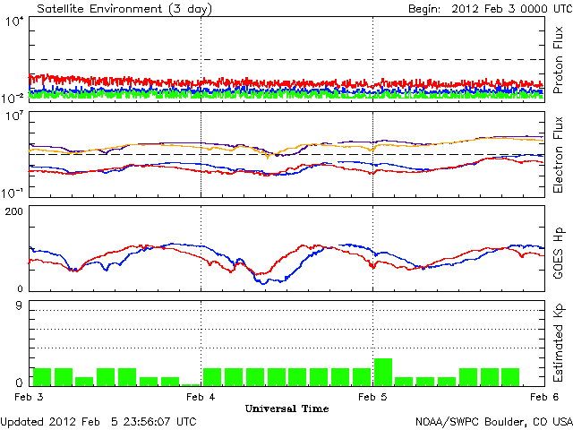
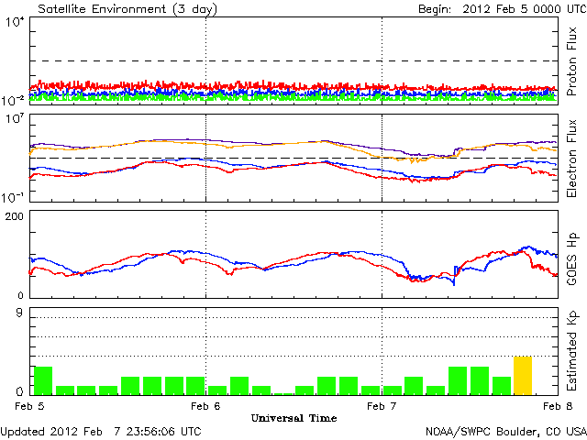
This week was a quiet week with little activity compared to recent solar flare activities on January 27th. On February 7th moderate magnetic change is recorded as a yellow bar. It was shortlived.

Slide 5
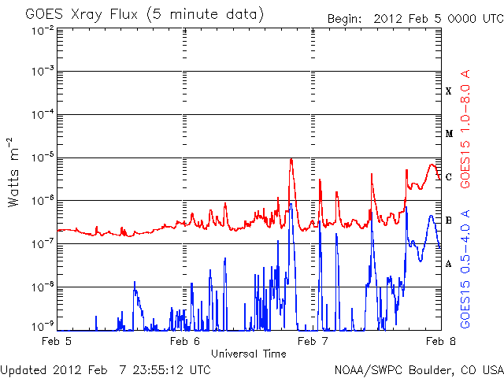
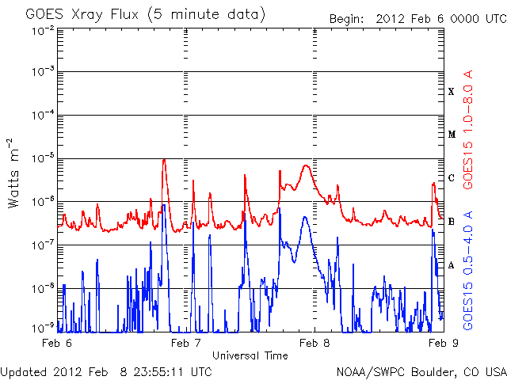
A solar flare should be apparent on February 5th because of the KP activity on the 8th. I could not find the source of these GOES x-ray flux graphs to find the needed graph.

