Slide 1
Scientific Study of Water Flow from Watersheds to Ocean Basins
A Power Point Presentation by Mark Barone and
five 6th grade students: Owen, Megan, Taylor, Lexi, and Hailey.

Slide 2
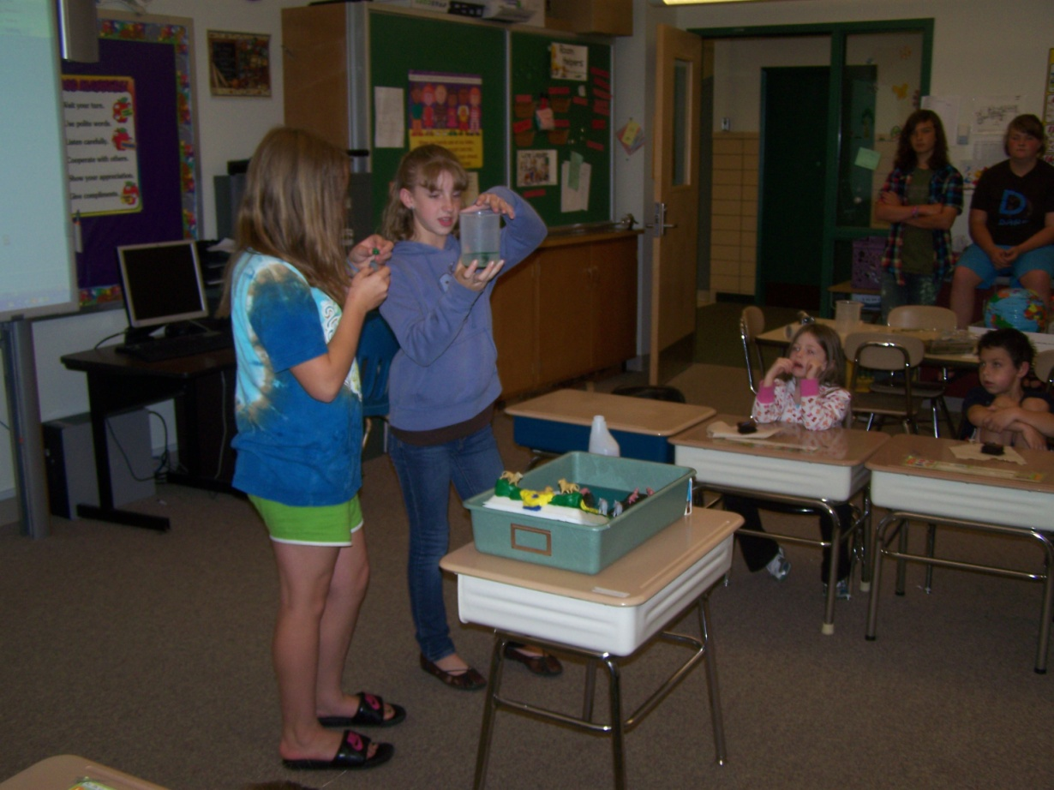
Getting Started:
What happened when a group of sixth graders with great intentions worked together? Four students had completed their research for Sprintt. They were ready to learn about the ocean. They requested that their friend Megan become a member of their group. Complete with data and analysis, this group of students mapped the flow of water from local watersheds to the ocean.

Slide 3
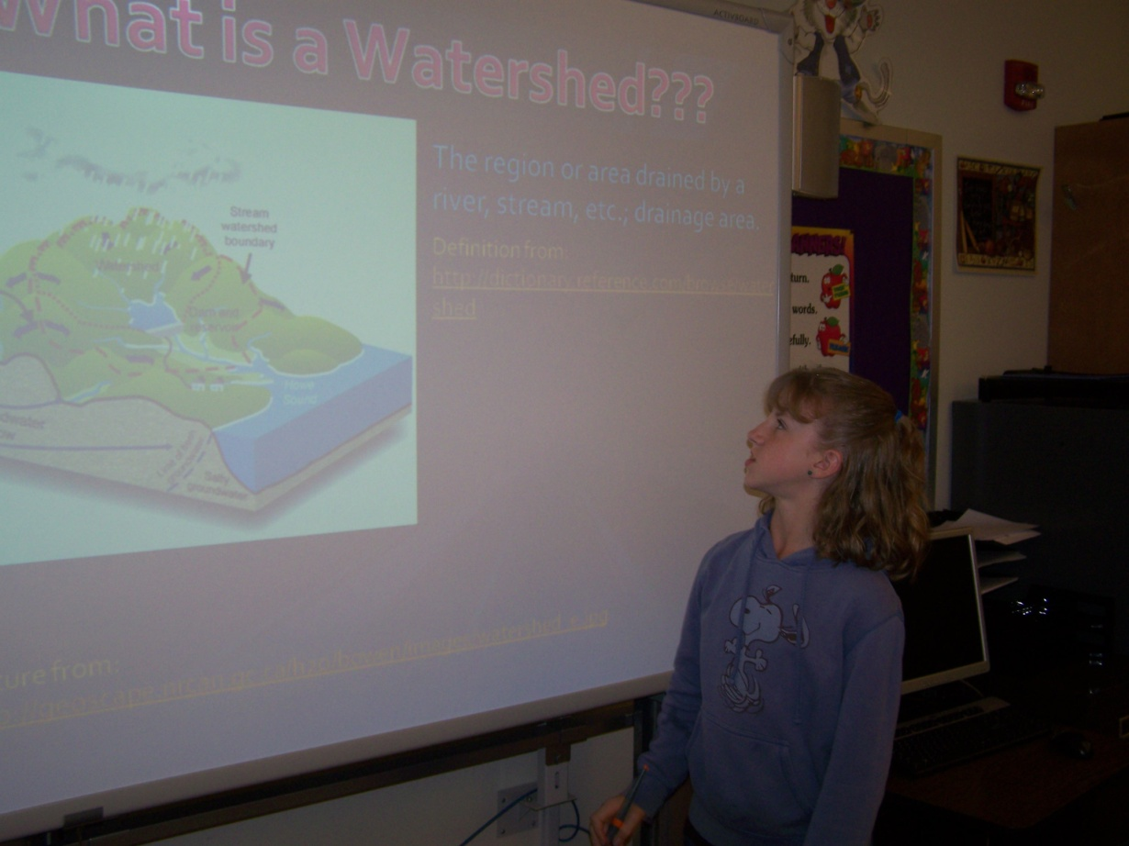
What is a watershed?
In this slide, Lexi is explaining to a kindergarten class the importance of understanding the flow of water in a watershed. The kindergarten students wanted to investigate the movement of water by looking at a model. Lexi had a demonstration model for the kindergarten students. The classroom teachers would encourage their students to construct a model with clay.

Slide 4
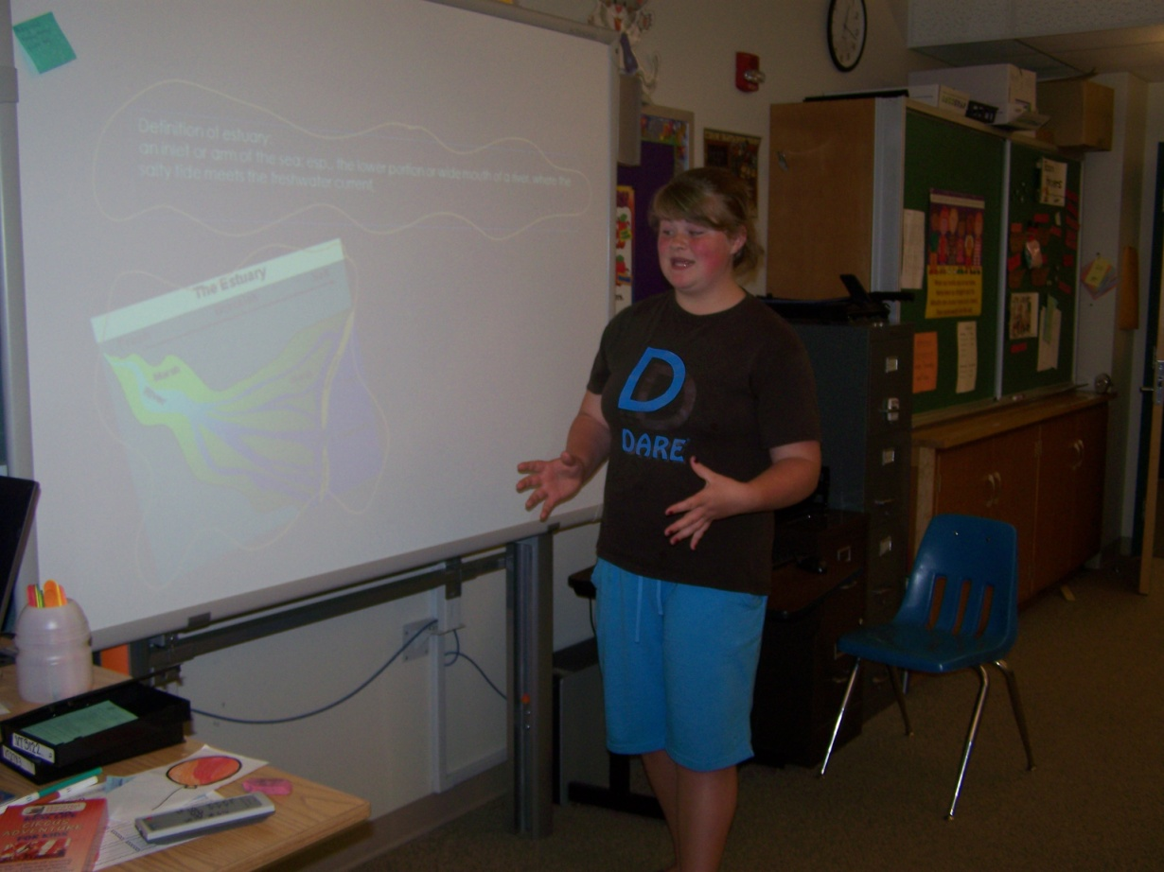
An estuary has a beautiful sound.
Megan was so excited with her newly found knowledge. She wanted to share her thoughts and feelings with the kindergarten class. How did Rachel Carson feel when she wrote Edge of the Sea (Carson, 1955)? Perhaps, she was bursting with enthusiasm over her newly acquired knowledge. As Megan gave her presentation, I wondered if the kindergarten students could feel the water moving between their toes. Megan did an excellent job in describing the passage of water in an estuary.

Slide 5
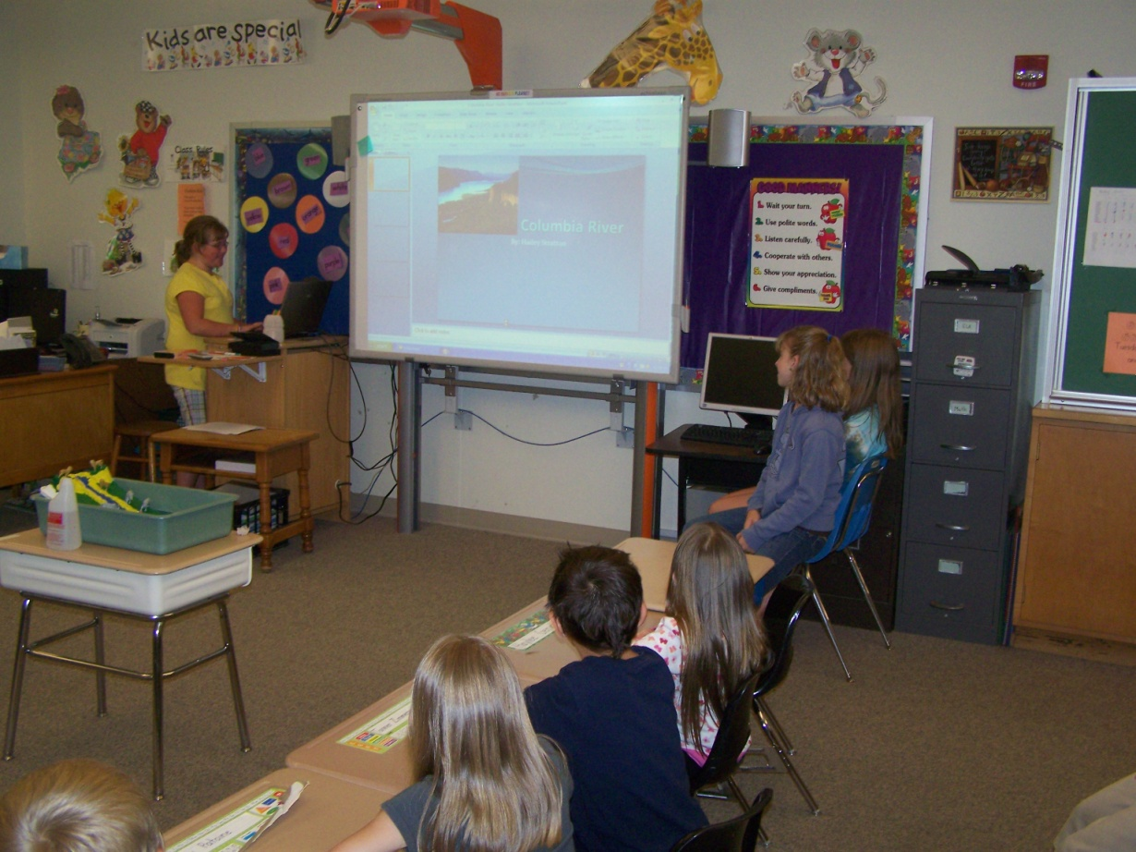
Where will we be led when we follow the course of water?
Taylor pointed out where the water flows to a kindergarten audience. Although, Taylor had been assigned to follow the flow of the mighty Mississippi River, she decided to work with her friend Hailey on her slide presentation. Hailey followed the cool Columbia River to the Pacific Ocean Basin. Hailey and Taylor spoke about the impact of human disposal on the Columbia River. Lexi demonstrated with a piece of a plastic candy wrapper flowing down through her model watershed. Kindergarten students showed a good level of understanding when questions were asked. They watched in suspense as the wrapper made its way to the larger water basin.

Slide 6
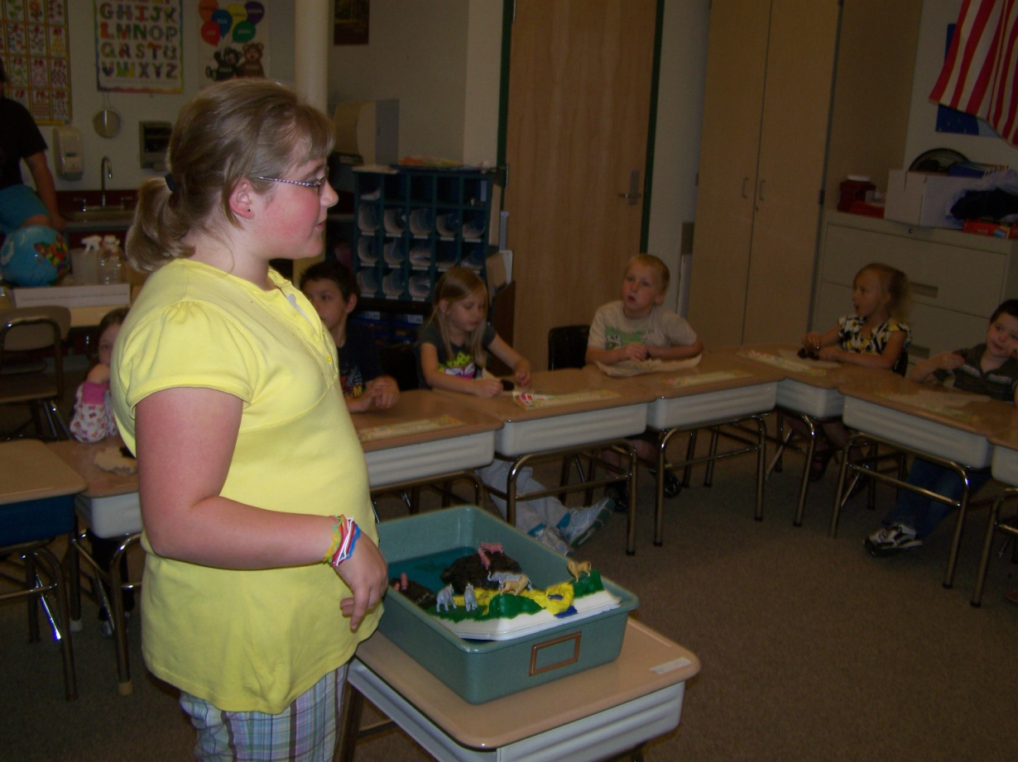
What is your connection to the ocean?
Taylor wanted to know about kindergarten ocean perceptions, and so she asked the kindergarten students. One student said that she has a relative who lives in Florida. The students who were presenting used maps to show the locations of the Gulf Coast and the Florida Atlantic continental shelf. They used simple explanations, such as you are here and this is Florida. The kindergarten students responded with enthusiasm.

Slide 7
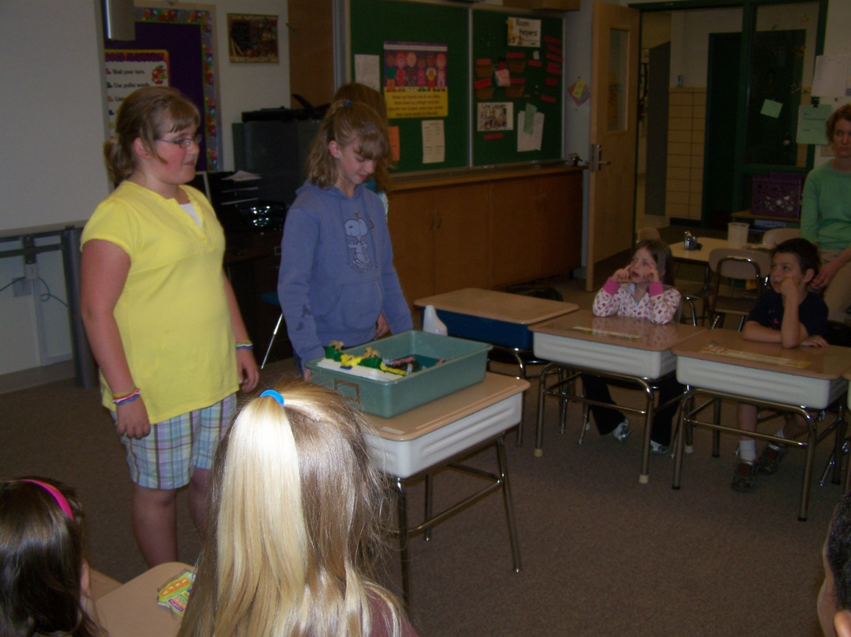
What is happening to the water in the ocean?
Taylor and Lexi used some clear examples to describe ocean pollution. Hailey and Lexi showed what happens to water when oil is added. Taylor used this as an opportunity to probe for student understanding. She asked if anyone knew about the oil that has been released into the Gulf of Mexico. Several students chimed in with concerns over visual images they had seen on the television news. They were especially moved by watching images of suffering marine life. It touched my heart to see kindergarten students affected by the accidents of adults. We asked what they could do to solve such big problems.

Slide 8
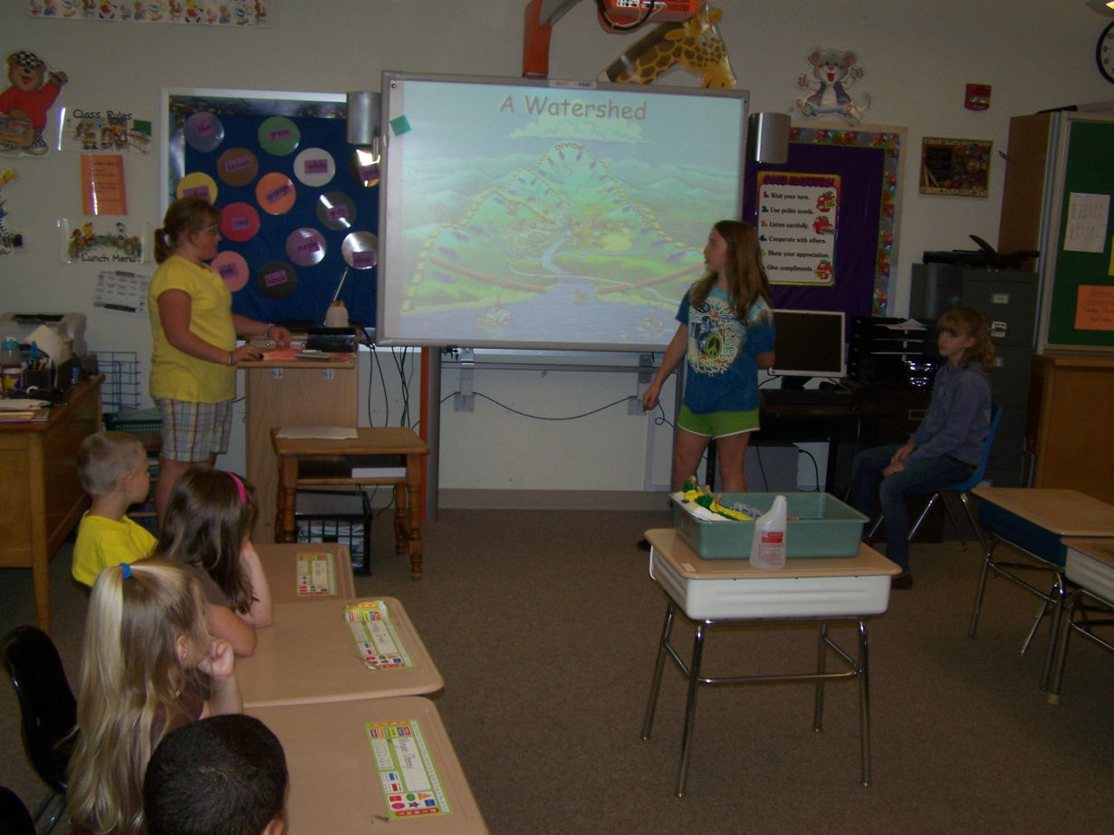
What are the first steps that we could take to solve such big problems as ocean contamination.
First and foremost , we must educate students about the necessity of taking care of natural resources. Students need and deserve to know about human impact on the ocean biome. It is responsible behavior to develop ocean literacy. This project-based student simulation convinced me that students as young as kindergarten age are interested in learning about the ocean.

Slide 9
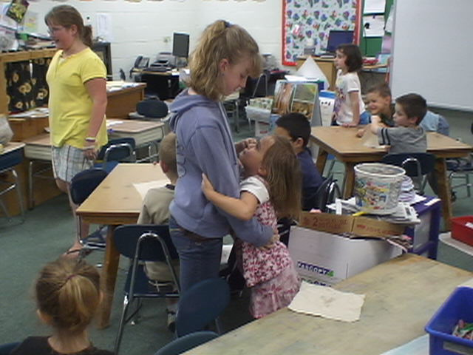
What does it mean to reduce, recycle, and reuse?
According to the EPA @ http://www.epa.gov/osw/conserve/rrr/index.htm, conservation in a contemporary global environment requires that each person does his/her part. By following their guidelines to : reduce, recycle, and reuse we are making a better world for both young and old. Marine organisms will live a healthier life when we live up to our responsibilities. Students in the kindergarten classes were very thankful for the time that five 6th grade students took with them in order to share this very important lesson about watersheds and the water connections to the ocean basin.

Slide 10
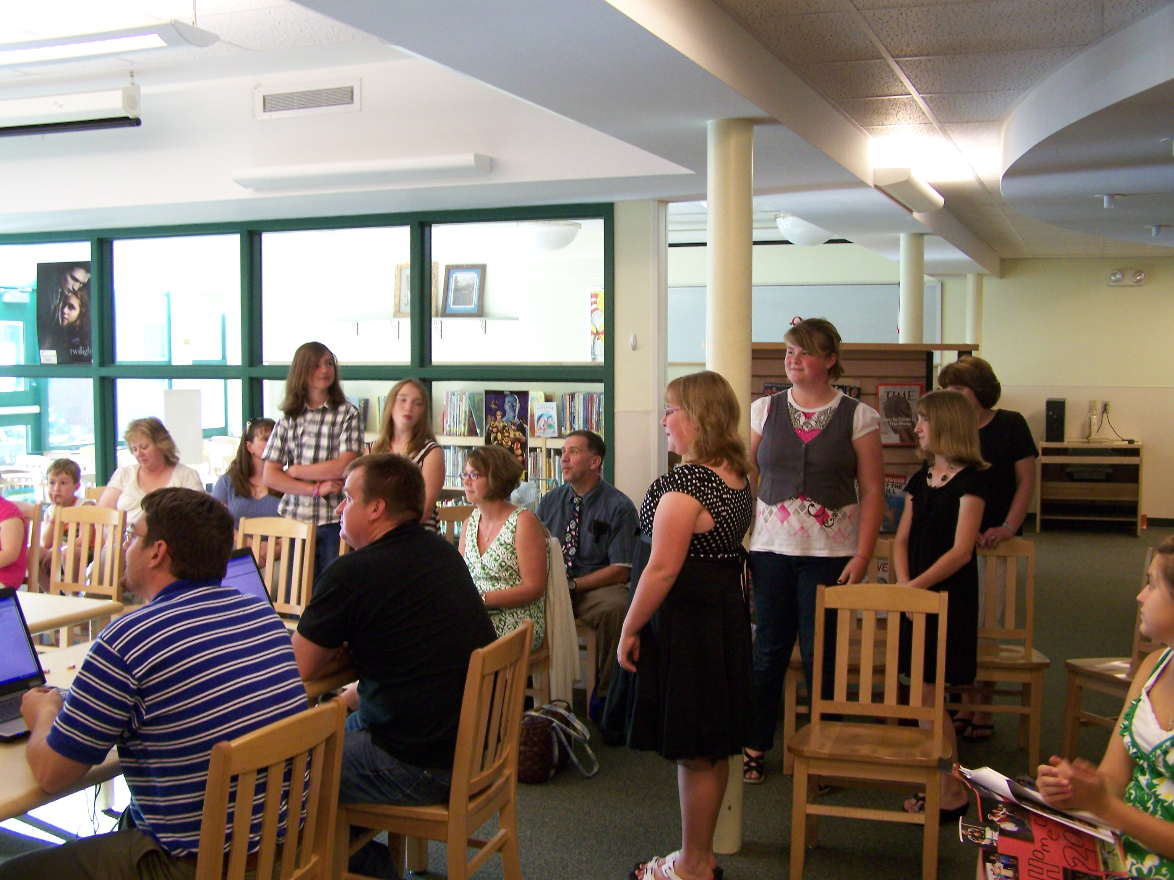
Should we take our ideas to the Prattsburgh Board of Education?
We were confident that our efforts had made an educational impact to the Prattsburgh community. Our research group was invited to report our educational endeavors at the June scheduled Board of Education meeting. Each 6th grade student who was involved with the presentations to the kindergarten students received a gift. The gift was a NASA reusable bag complete with an authentic logo. The bags were ordered from the Kennedy Space Center. Inside each bag was each student’s research binder complete with their investigations. In addition there were some favored treats for fun. The 6th grade students were motivated to continue and they appreciated recognition of their accomplishments by the Prattsburgh Board of Education.

Slide 11
An email To Prattsburgh Principal Kory Bay to Recognize Student Accomplishments
TO: Mr. Bay,
RE: Presentation to the Board of Education
Good Evening Board Members, Administrators, Students, Teachers, and Guests,
What happened when a group of sixth graders with great intentions worked together? During the spring semester of 2010, four talented Prattsburgh Central School students were selected to participate in the National Science Foundation’s funded SPRINTT research. The four students included: Owen Dlugos, Taylor Randall, Lexi Sanford, and Hailey Stratton. They worked diligently to conduct their research, and went on to participate in a national SPRINTT Symposium. This was followed by a well attended parent conference that showcased their knowledge and technical expertise. They requested that their friend Megan McAllister would join their group to share her desire to study the ocean environment. Their wish was granted. Through a well-coordinated team effort, they have served as role models to two classes of Kindergarten children (The classes of Mrs. Clark, and Mrs. Groen). Recently they provided simulated learning experiences for the Kindergarten classes. The topic of “Watersheds” progressed throughout the United States to major estuaries and to the ocean. Their Power Point presentations were visually powerful and literally dynamic. We are very thankful to each of the following: First of all, those students who gave of their time to learn S.T.E.M skills, their families for supporting their involvement, Prattsburgh Board of Education, Administration, Teachers, and the Endeavor Teaching Certificate Project sponsored through NASA and Columbia Teachers College.
Each student will receive a NASA bag complete with their 3 ring binders/notebook.
I will show them the S.T.E.M. certification that I recently received from the U.S. Satellite of NASA.

Slide 12
References
Carson, R. (1955) The Edge of the Sea, Houghton Mifflin Company
http://www.coexploration.org/oceanliteracy/documents/OceanLitChart.pdf
www.epa.gov/osw/conserve/rrr/index.htm

