Slide 1
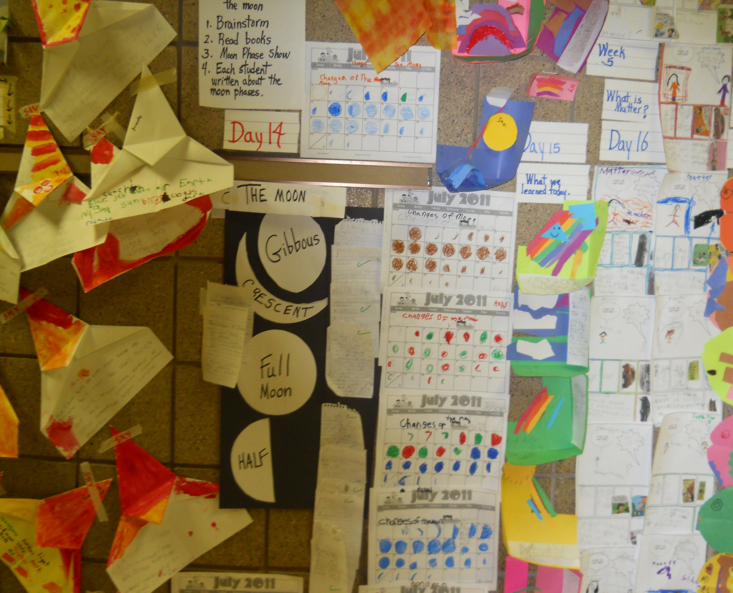
Science Literacy Learning Wall
by Maria Singh

Slide 2
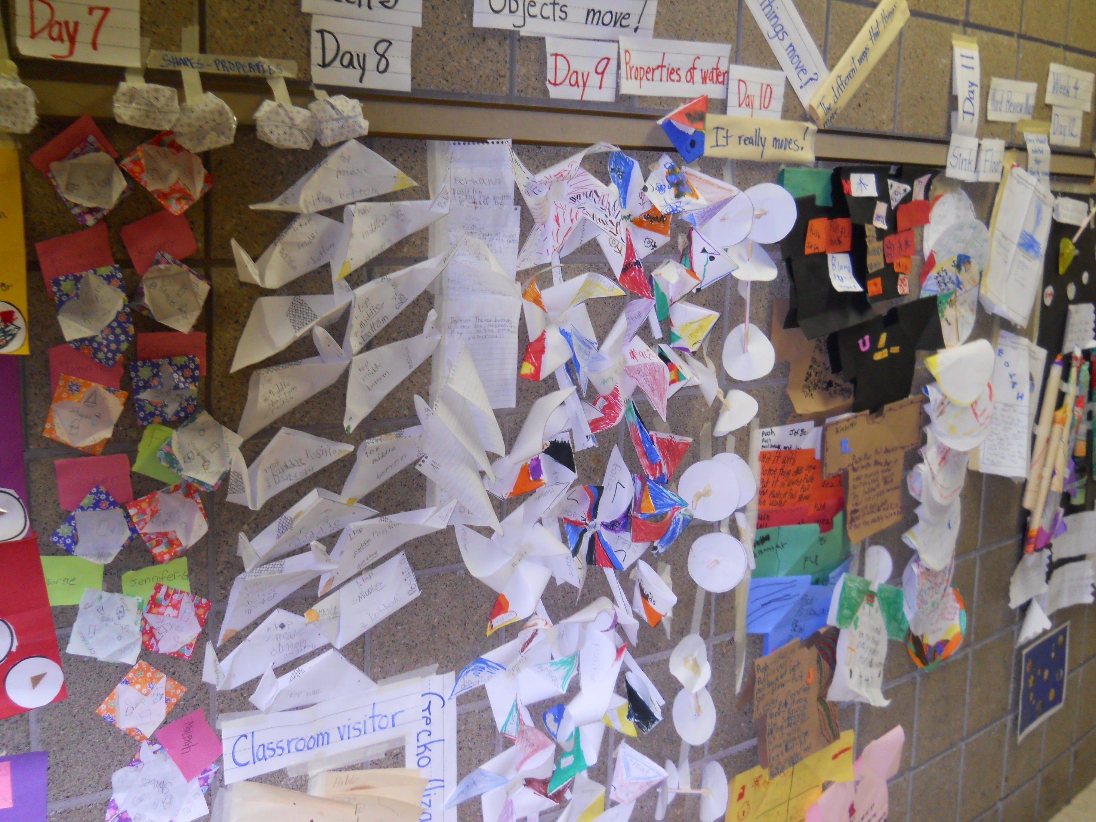
First Grade Summer
Science Literacy

Slide 3

NASA Science Literacy
Ideas implemented in the class.

Slide 4
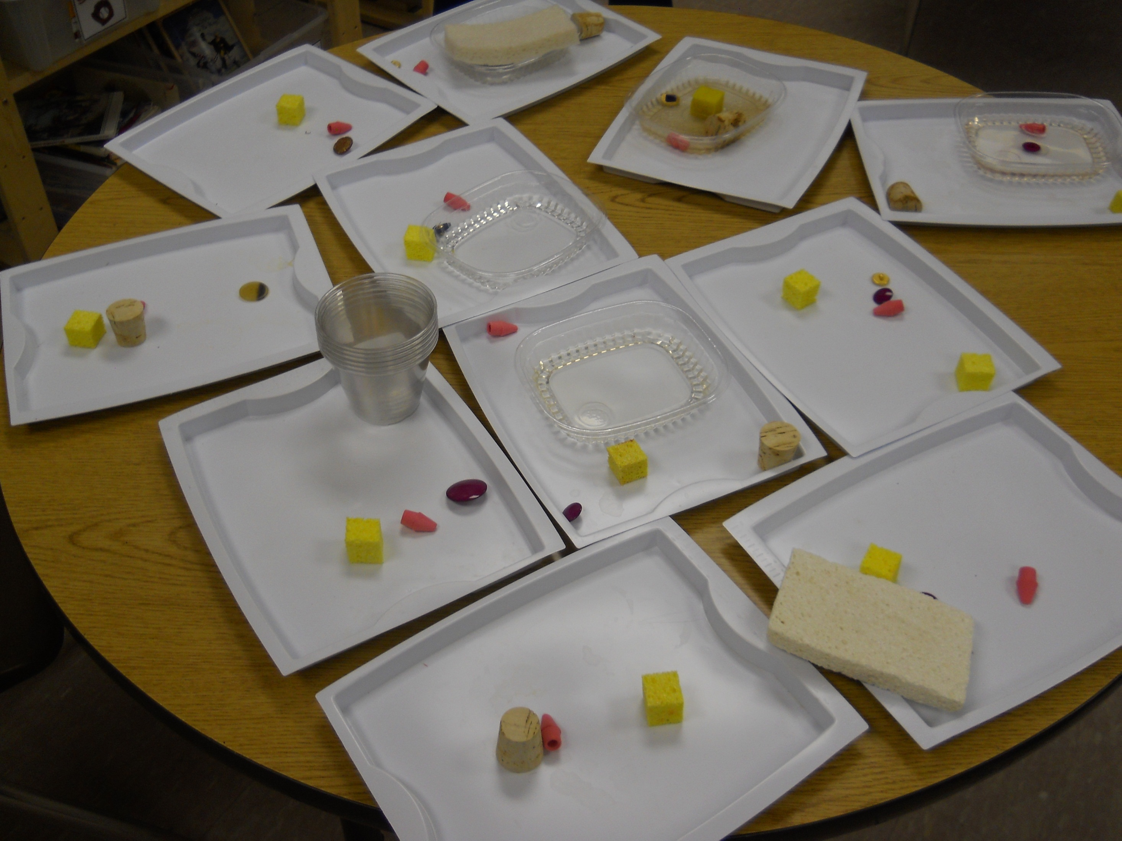
Science Experiment
Identifying Properties

Slide 5
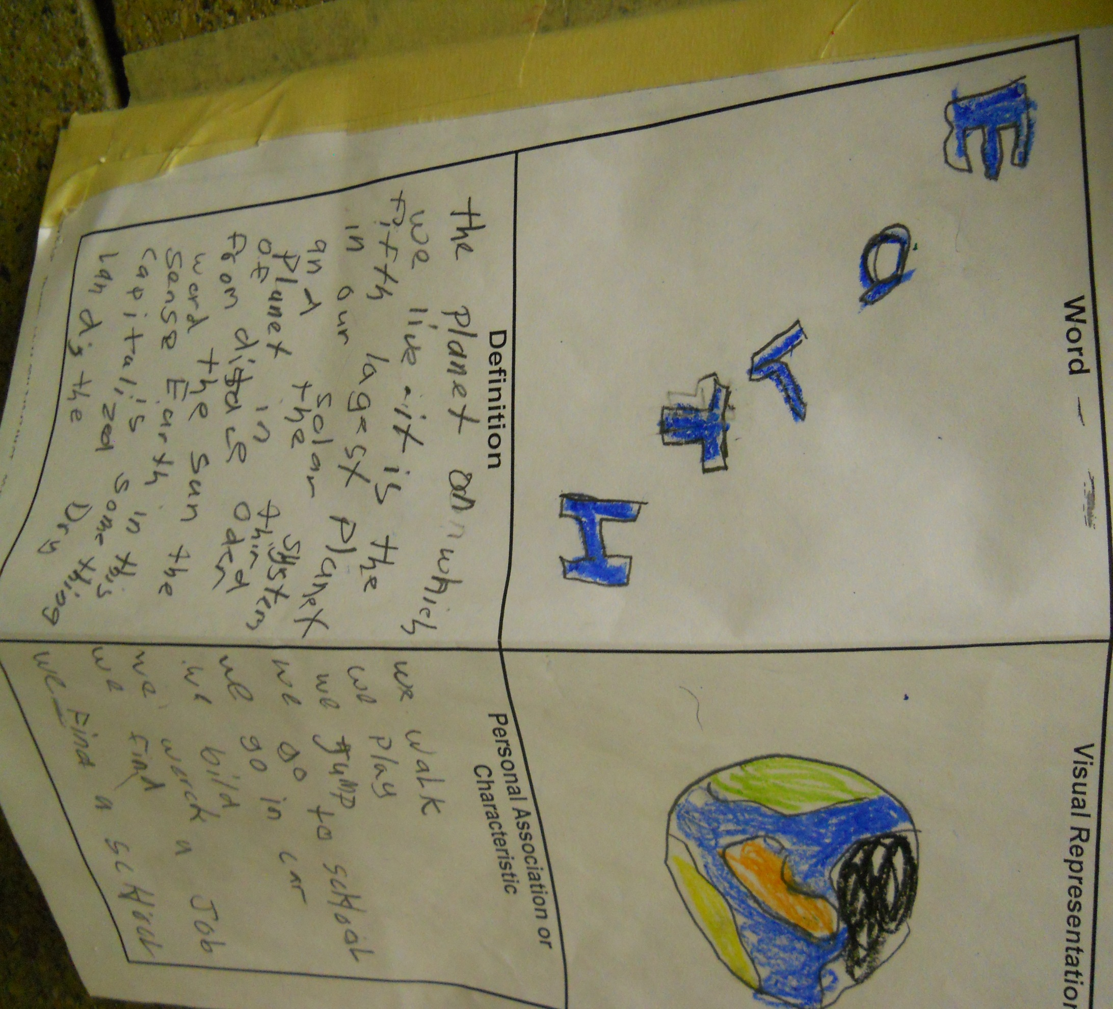
Word Identification

Slide 6
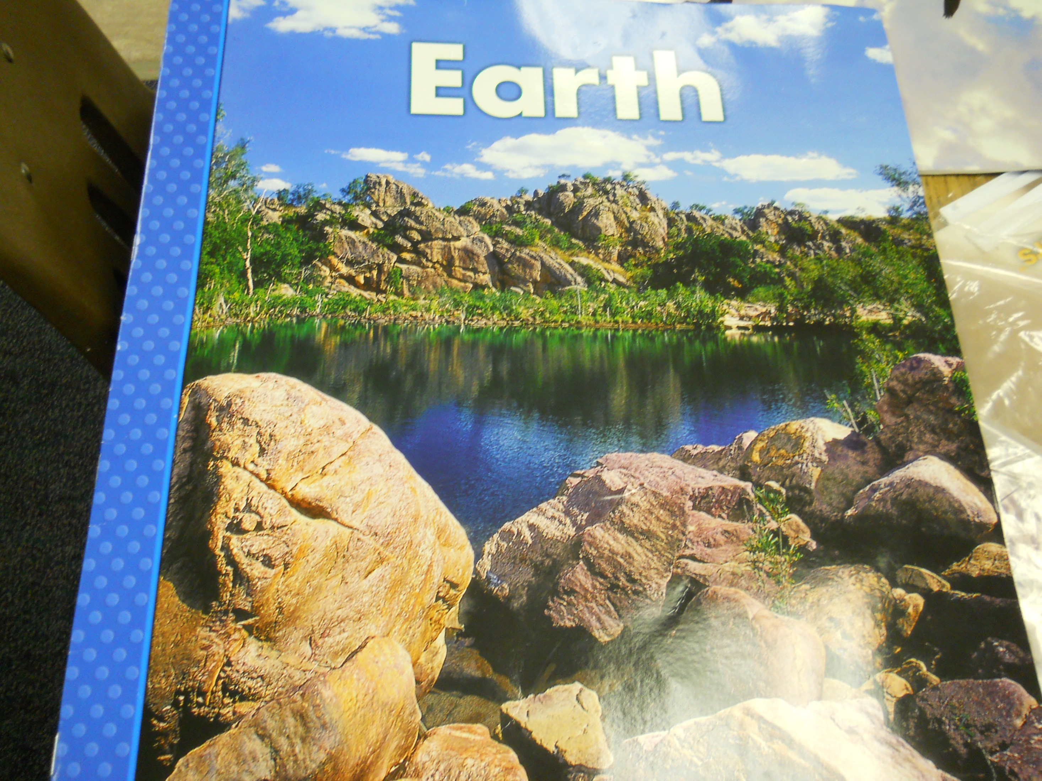
Delta Science Curriculum

Slide 7
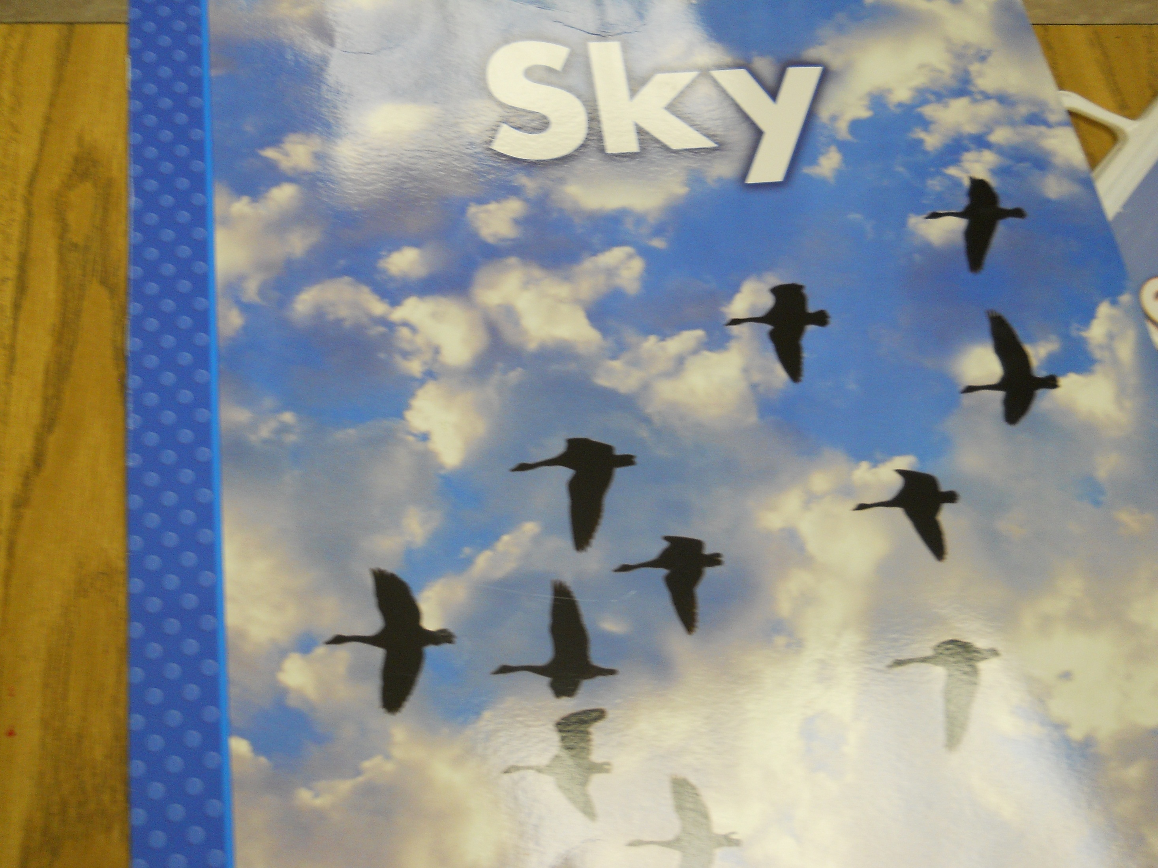
Delta Science Curriculum

Slide 8
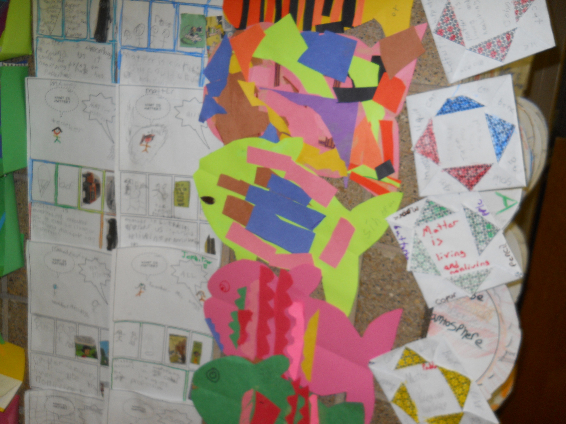
Students using Comic Life
To define what Matter is.

Slide 9
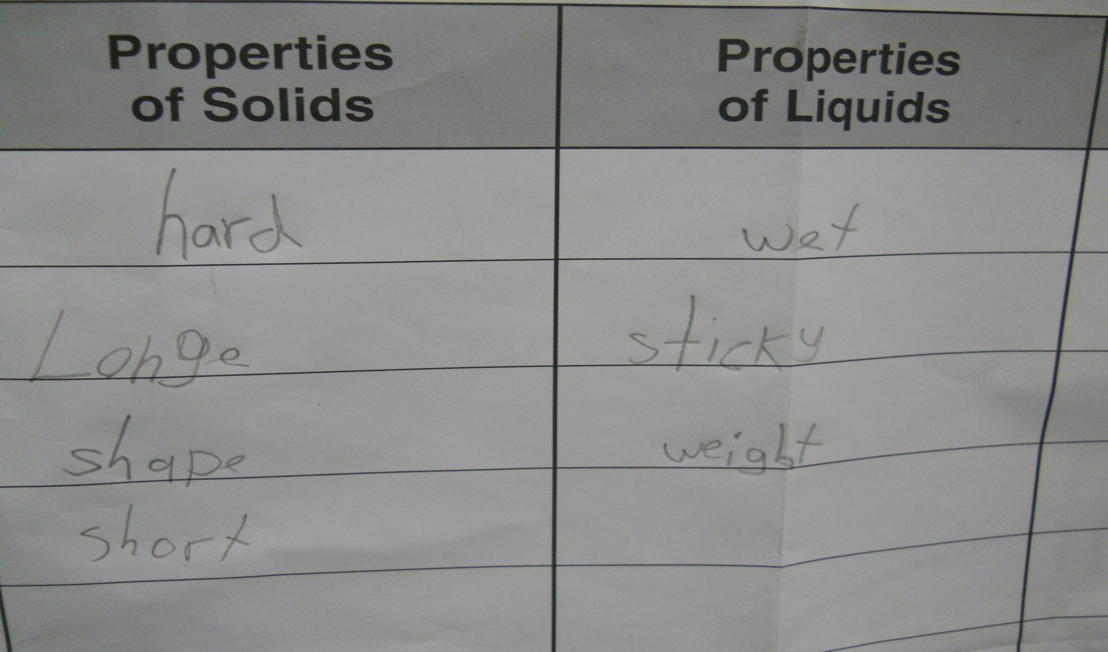

Slide 10
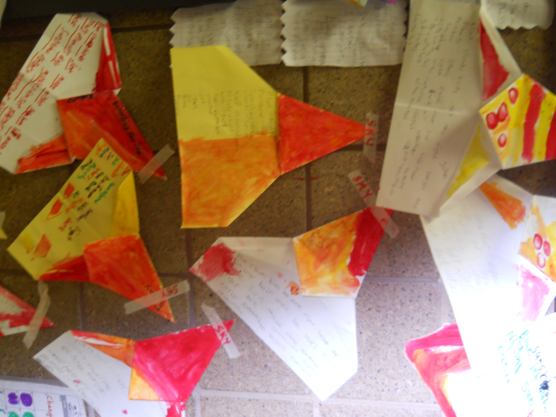

Slide 11
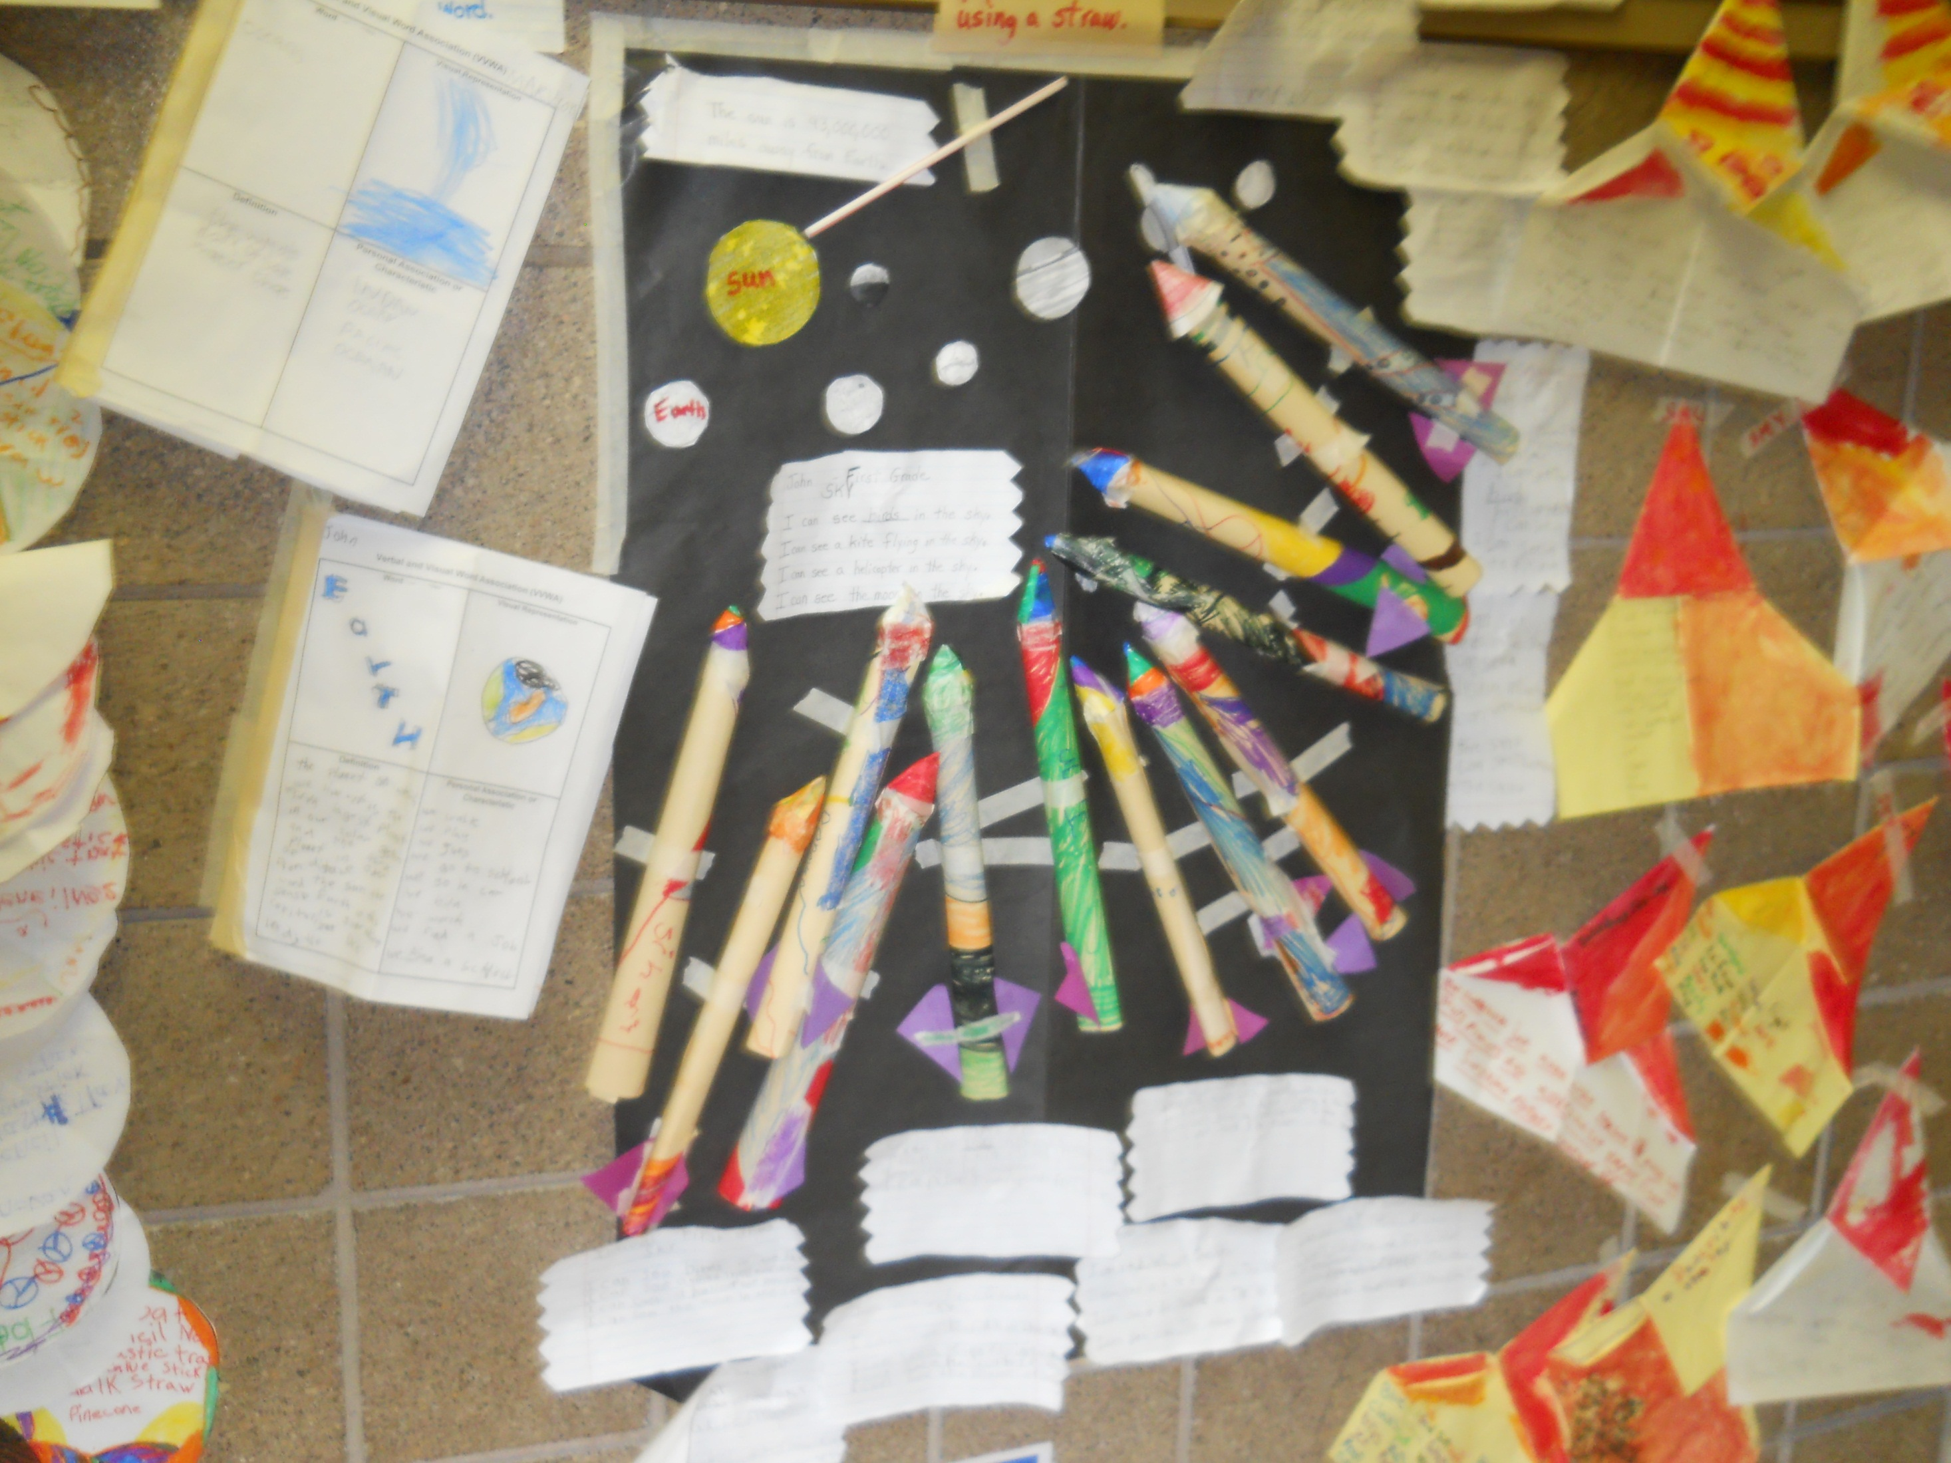

Slide 12
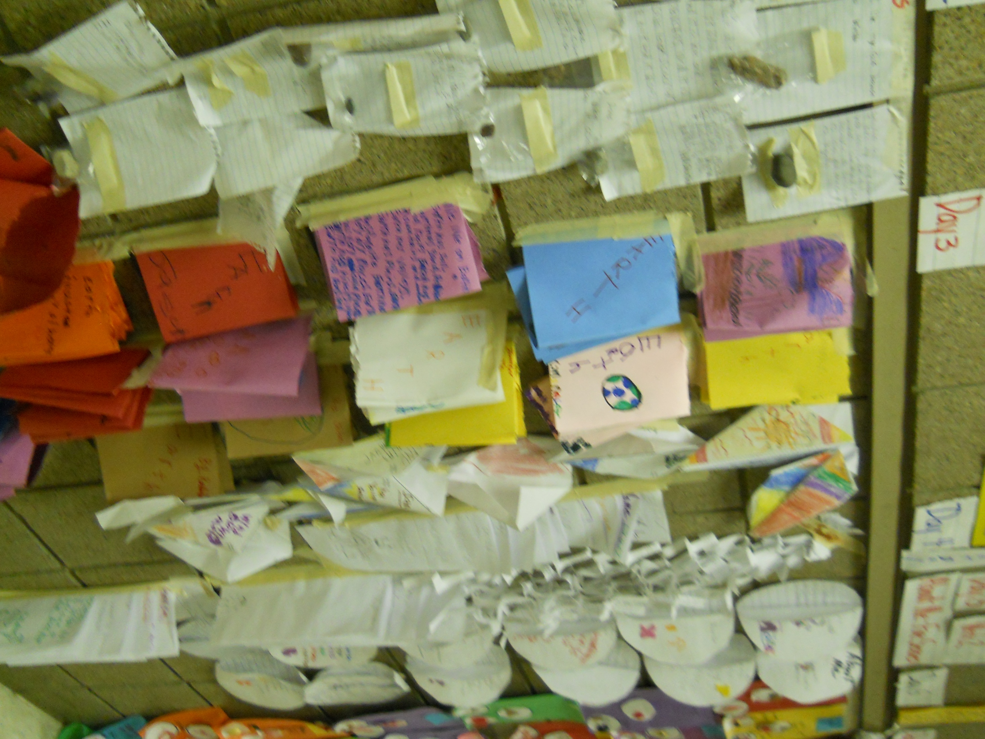
Science Literacy Booklets

Slide 13
