Slide 1
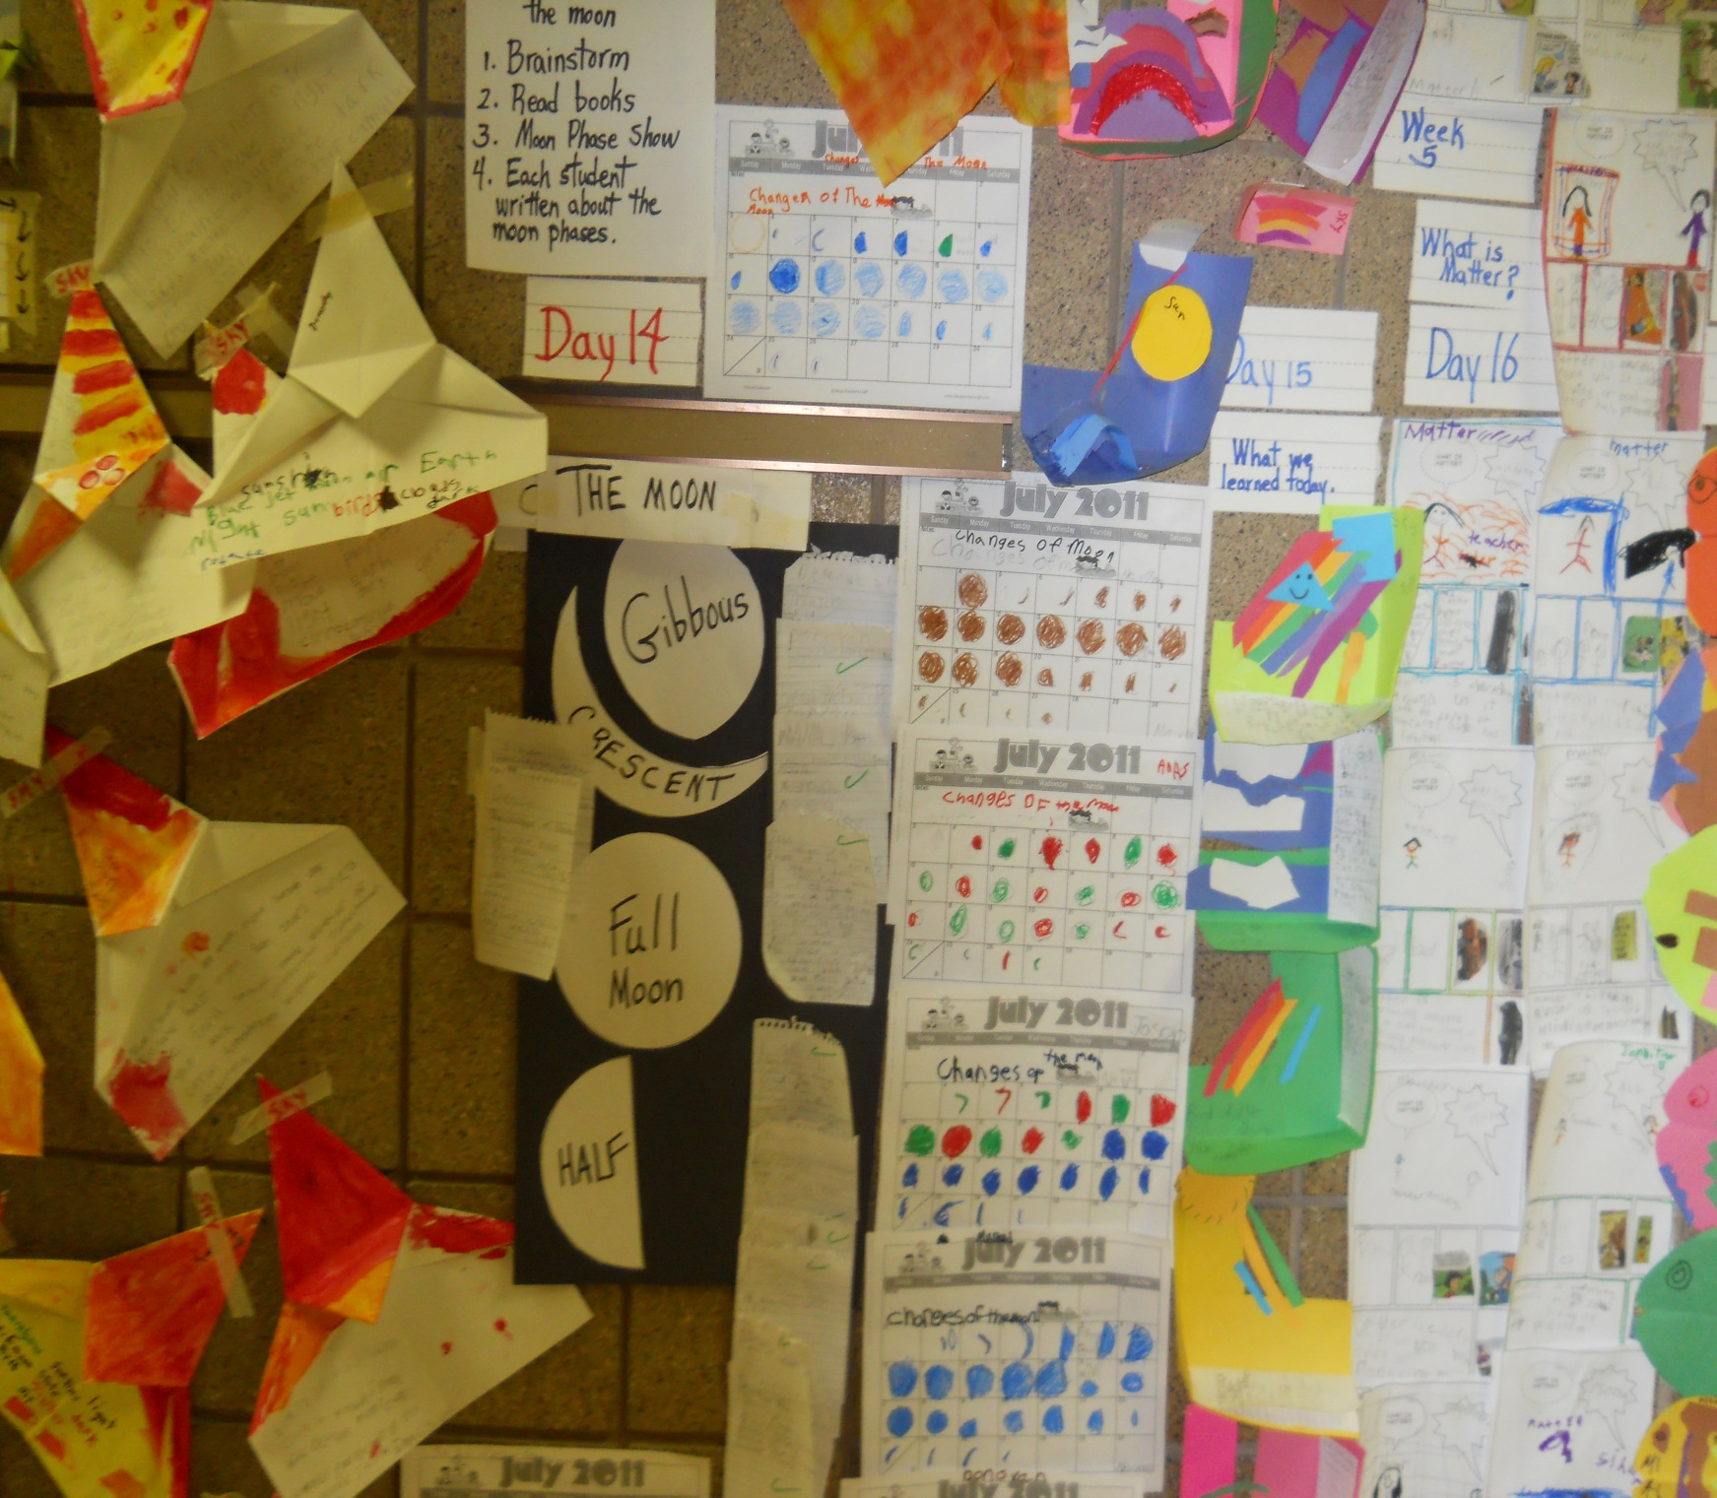
Science Literacy Learning Wall
by Maria Singh

Slide 2
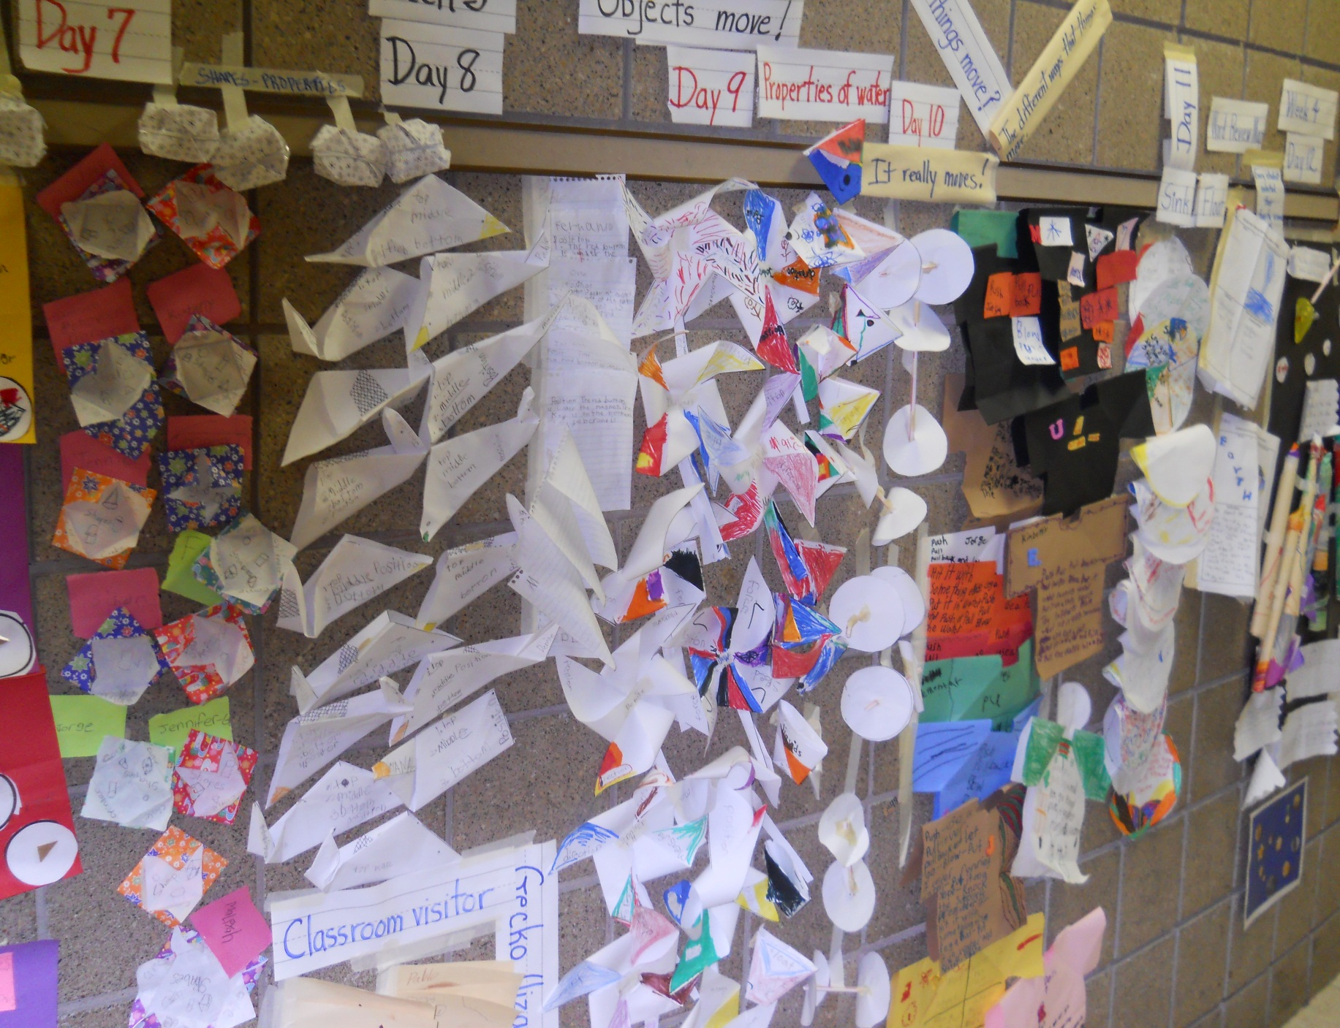
First Grade Summer
Science Literacy

Slide 3

NASA Science Literacy
Ideas implemented in the class.

Slide 4
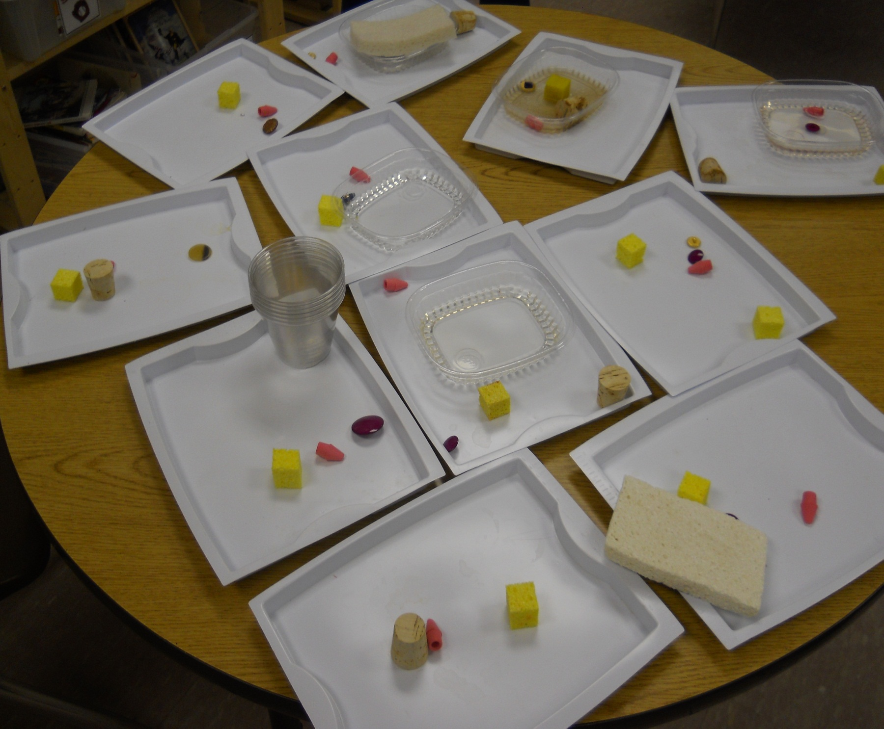
Science Experiment
Identifying Properties

Slide 5
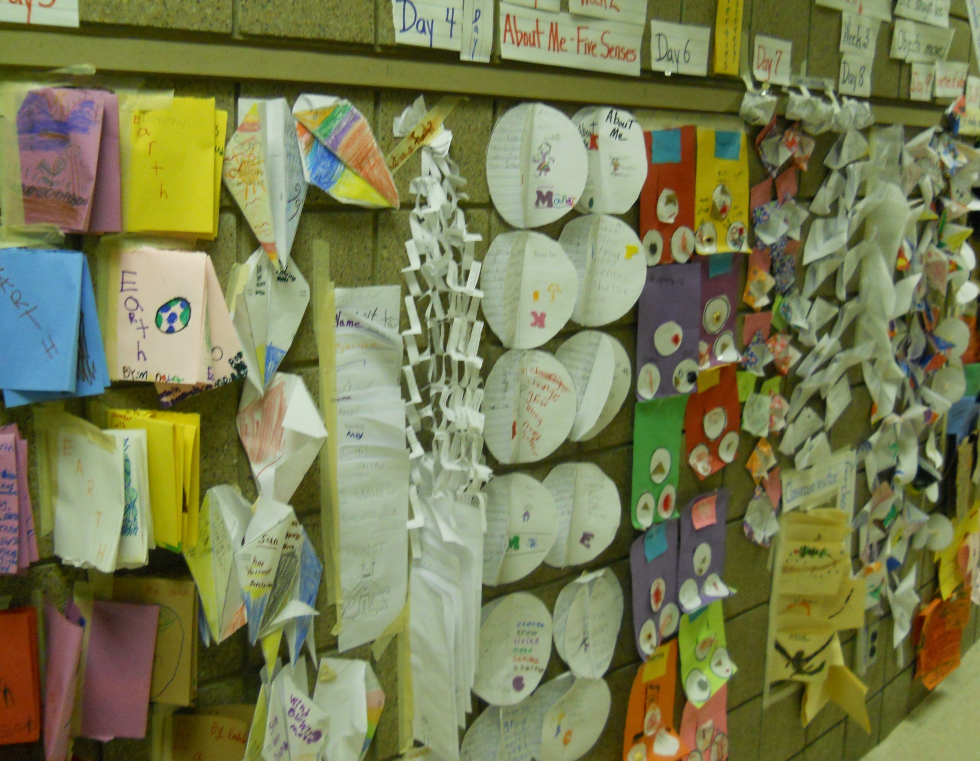
Word Identification
Science Literacy
Learning Wall Two

Slide 6
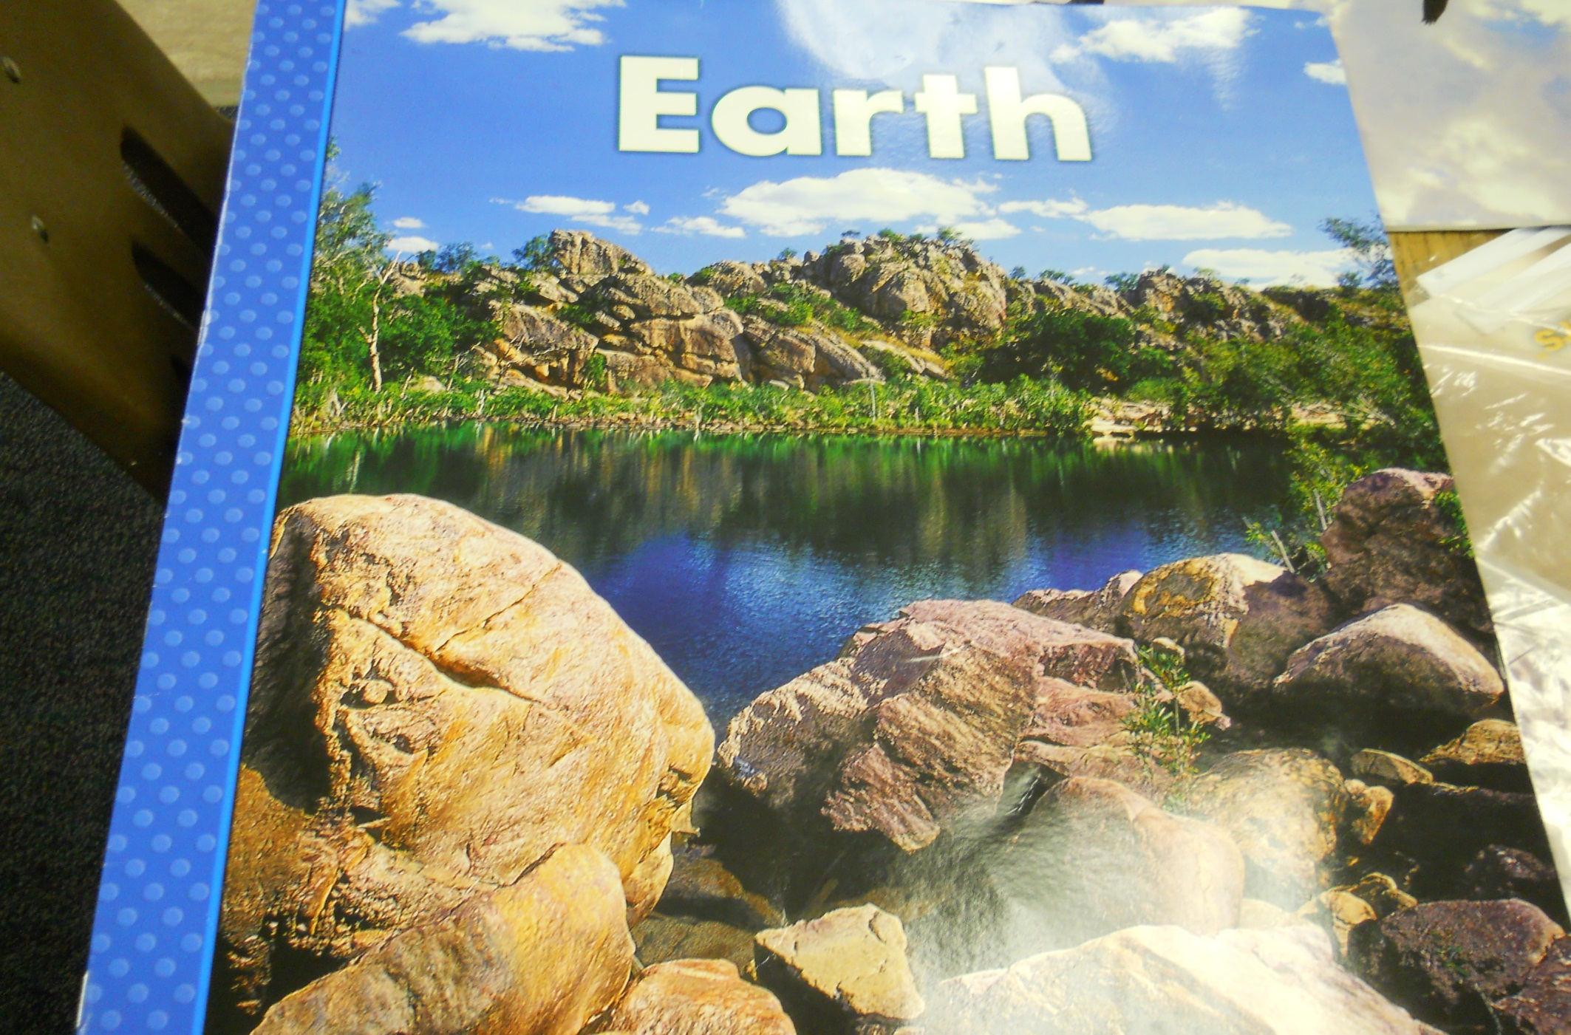
Delta Science Curriculum

Slide 7
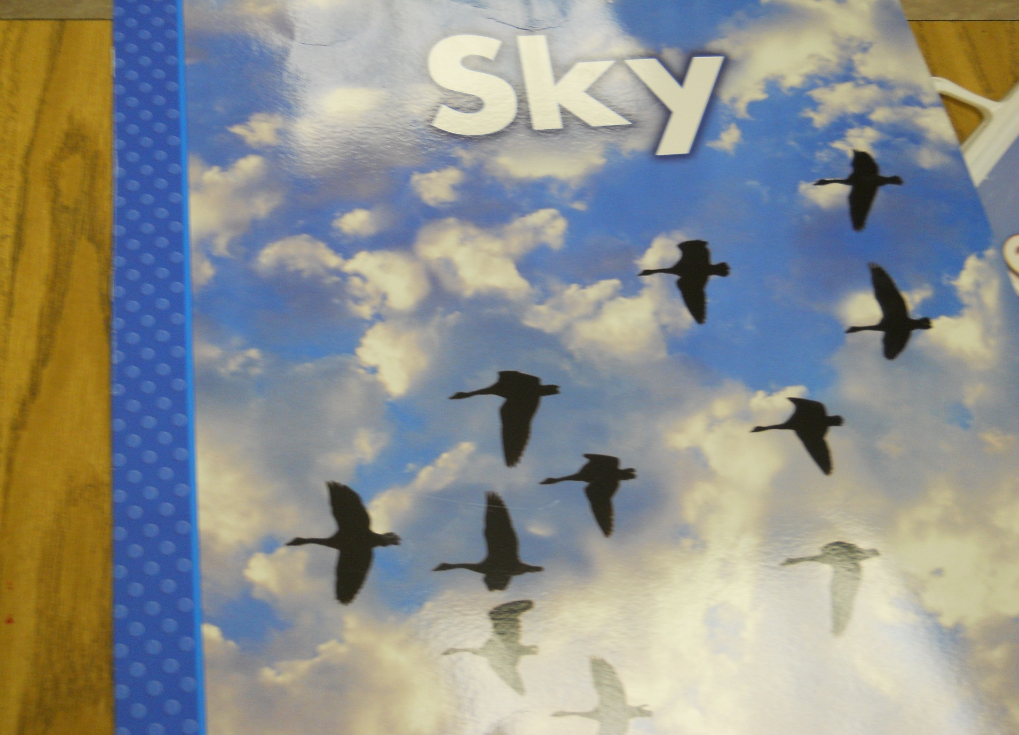
Delta Science Curriculum

Slide 8
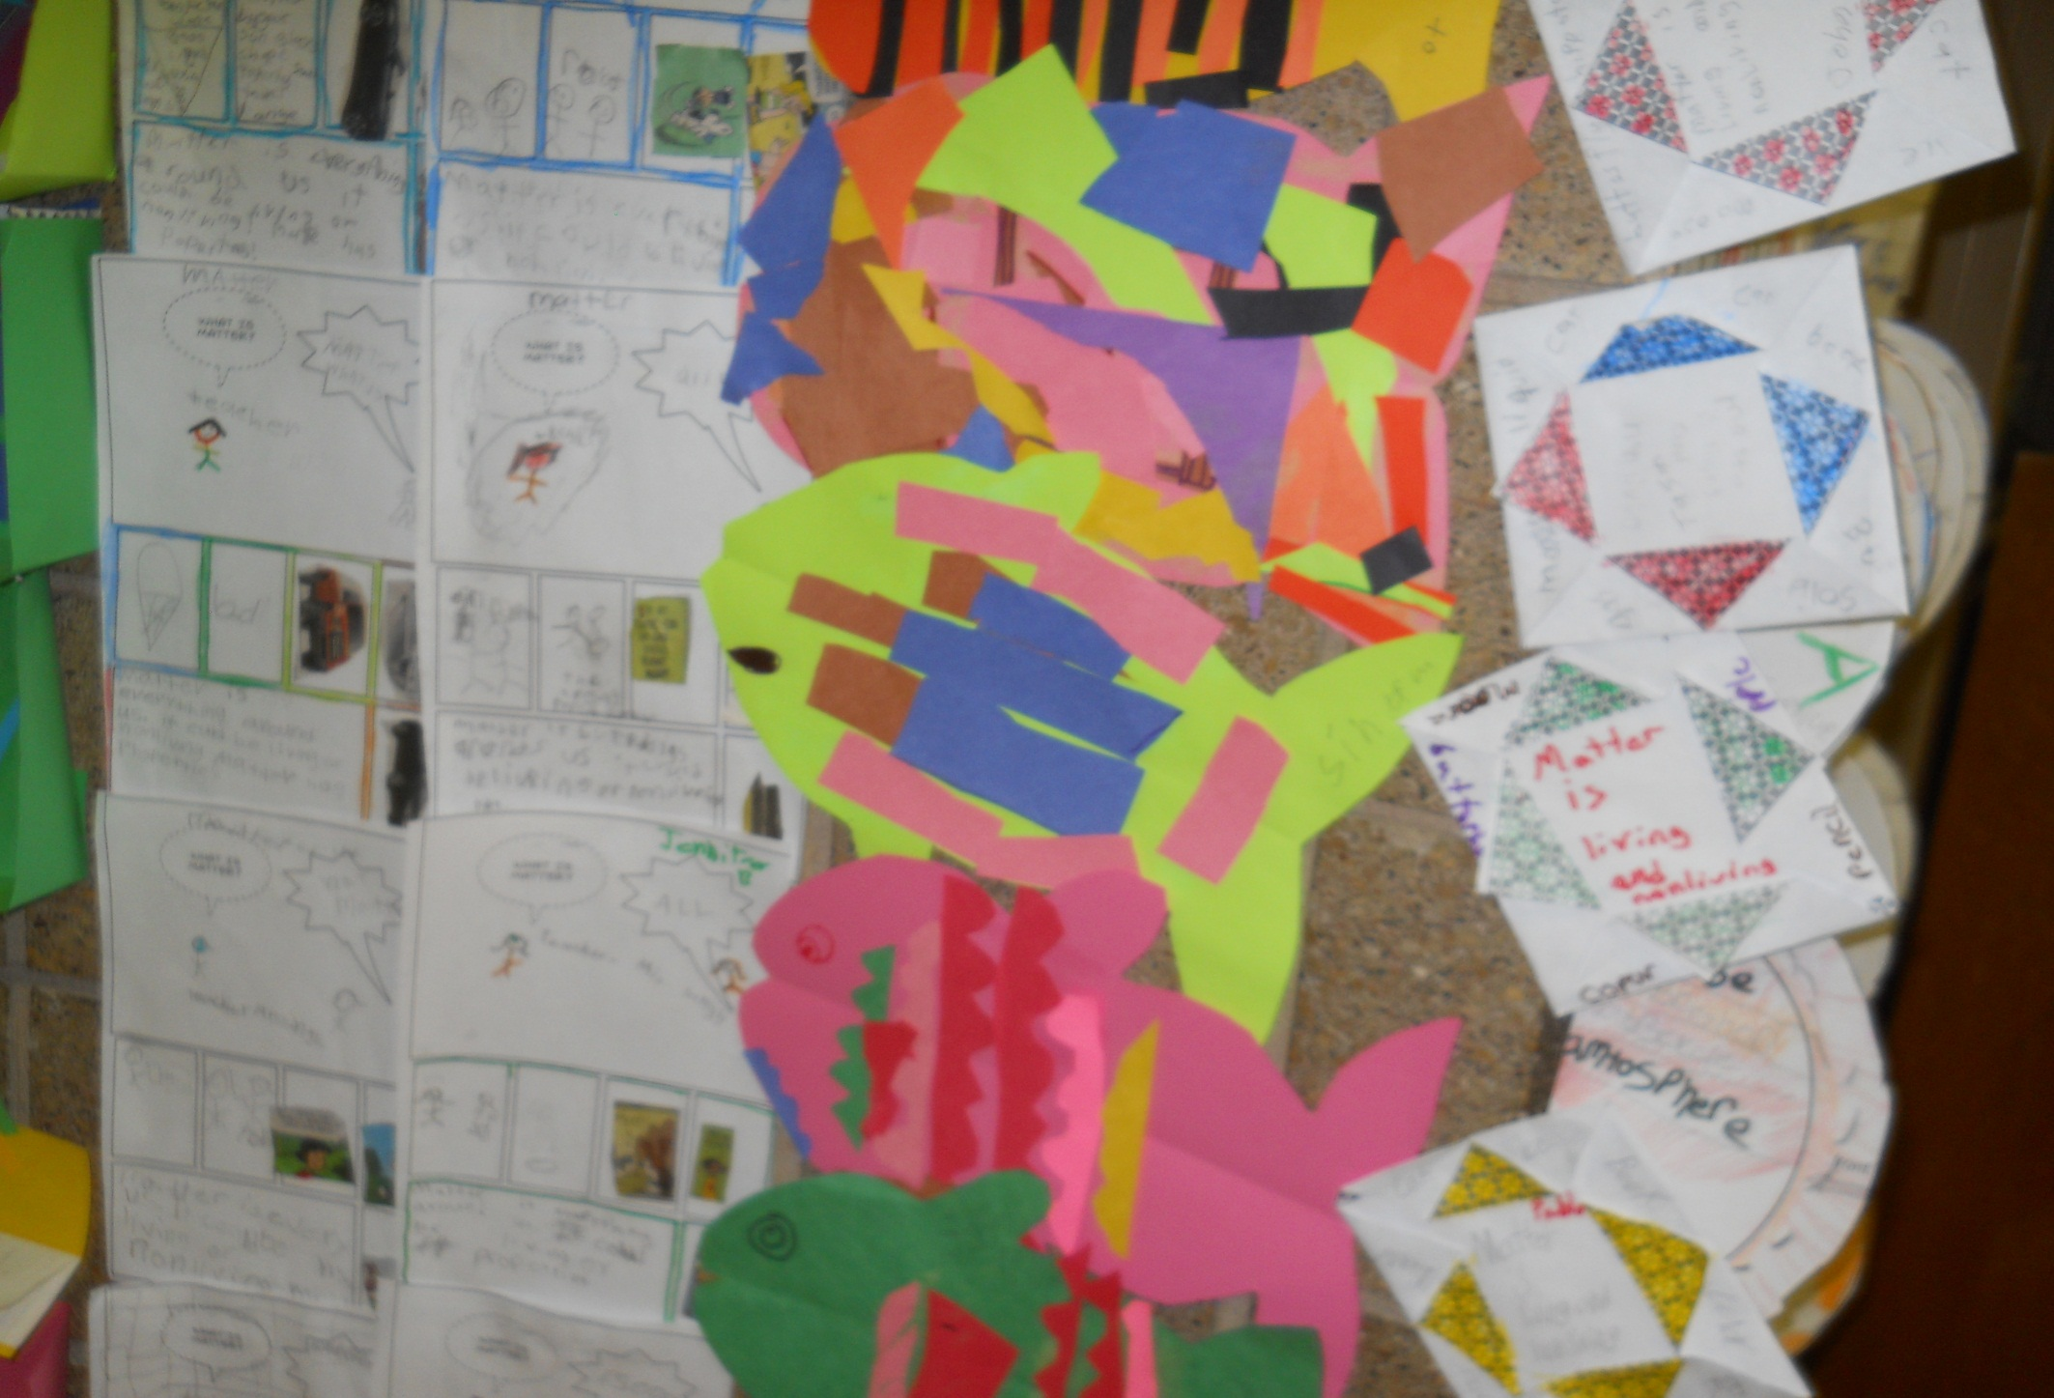
Students using Comic Life
To define what Matter is.

Slide 9
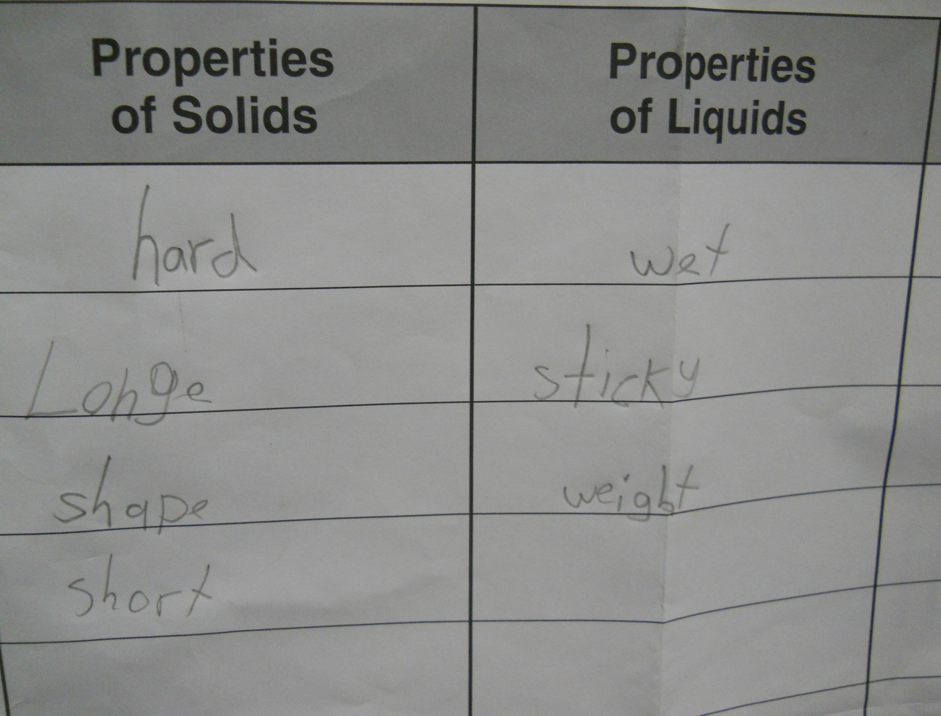

Slide 10
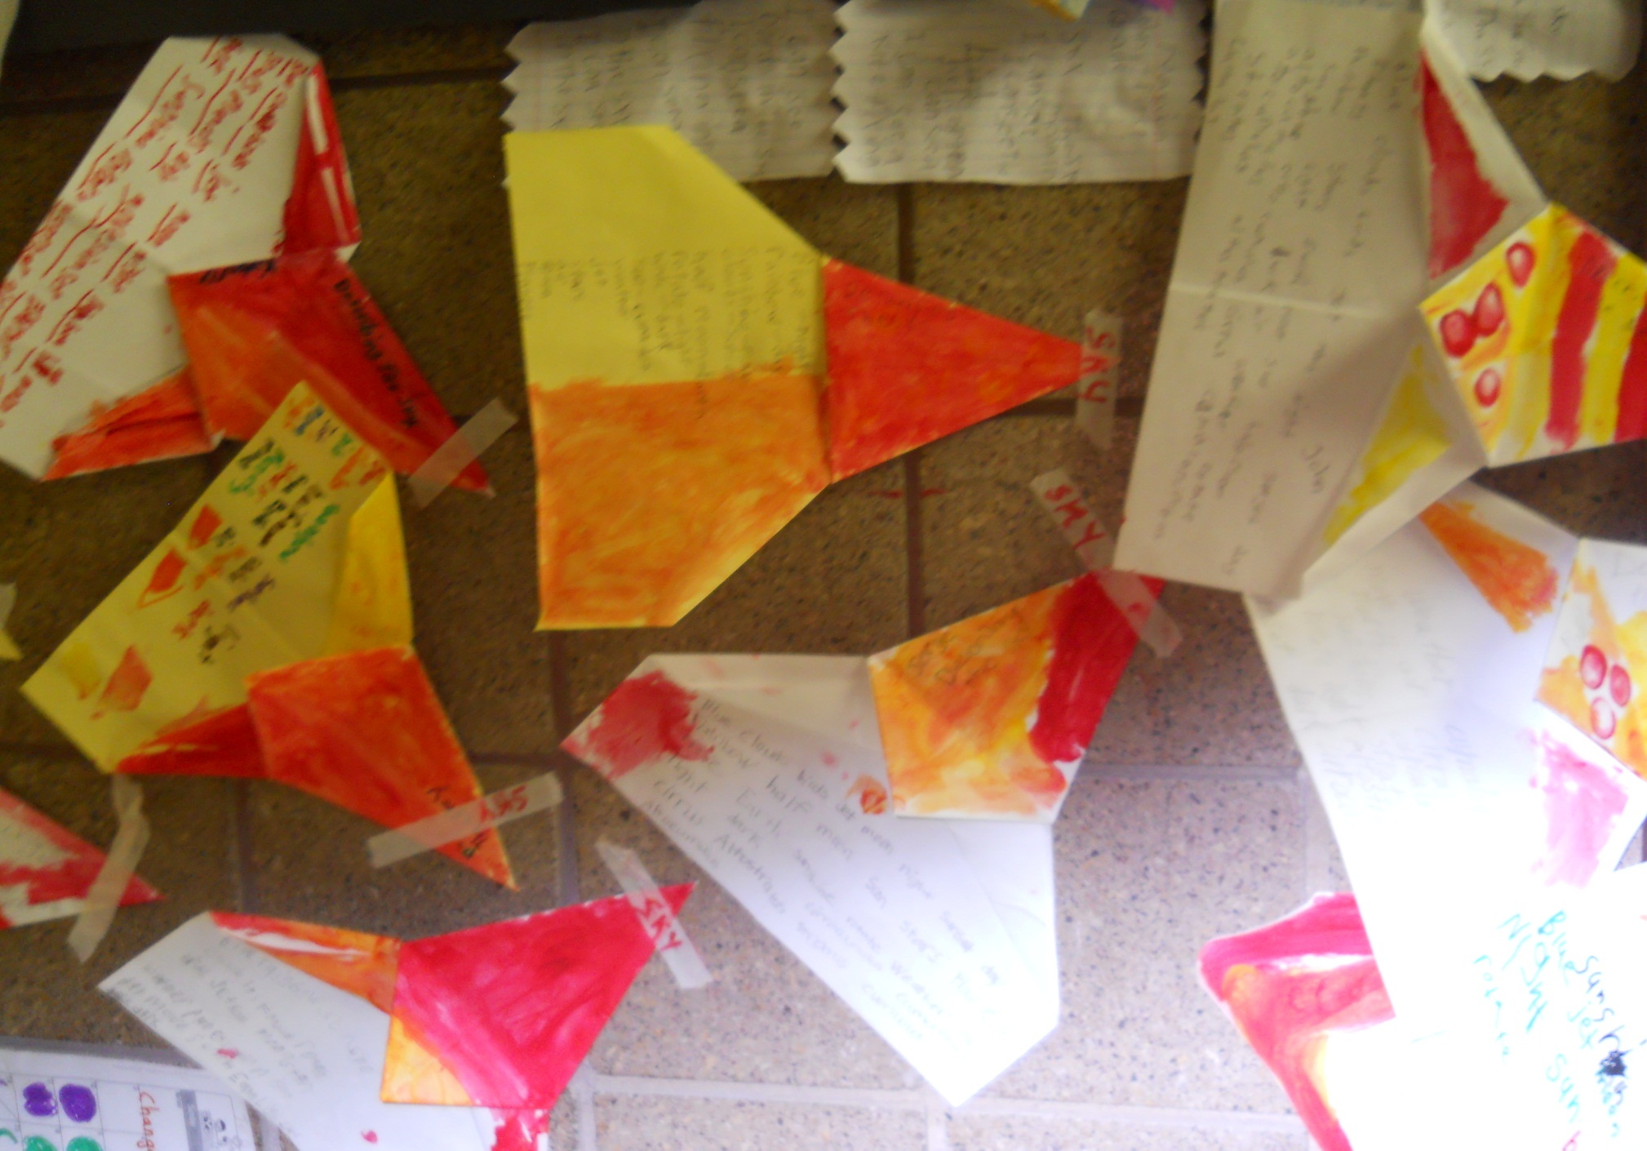

Slide 11
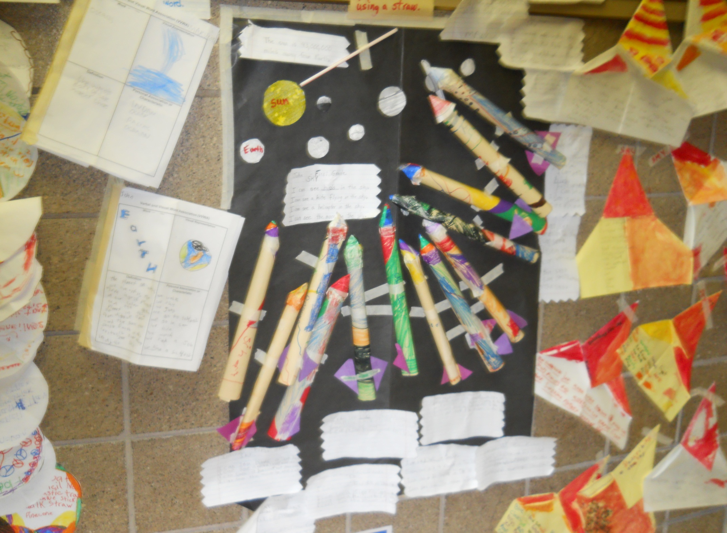

Slide 12
Science Literacy by Maria Singh
Everyday we incorporated the art and reading activities into science.
We read stories from the Delta Science Books.
I designed the hands-on wall display.
The first grade students will add everything into their envelope portfolio on the last day.
This wall helped all teachers to understand that science comes in many colors.

Slide 13
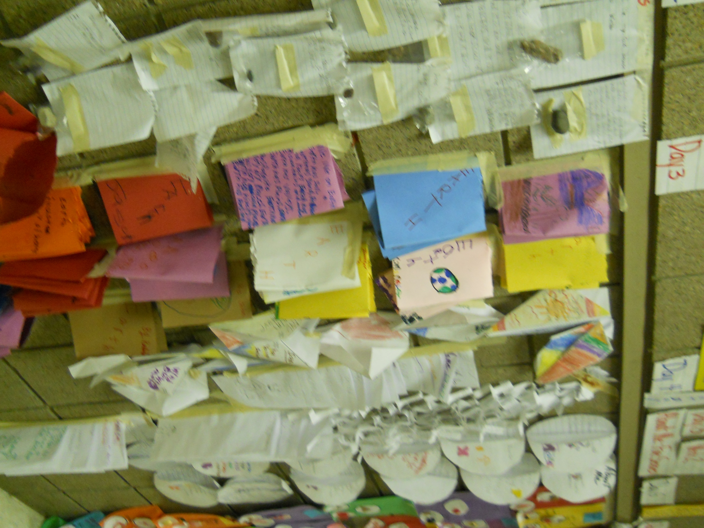
Science Literacy Booklets

Slide 14


