Slide 1
Integrating science and literacy by Maria Singh

Slide 2
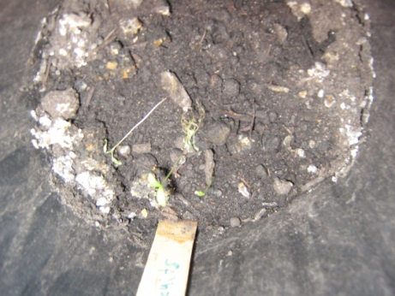
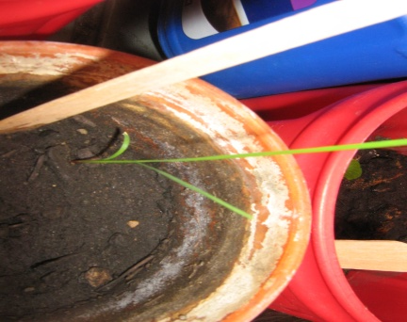
Grade Level : 33 fifth grade Students Topic of Focus: which soil will help plant growth faster. using both top soil and organic compost.
Top Soil Versus Earthworm Compost

Slide 3

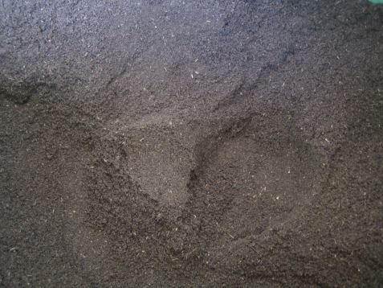

Planting Soil Types
Top Soil
Earthworm Compost
Earthworm compost and Top Soil Mixed

Slide 4
Minnesota Science Standards
1. Science is a way of knowing about the natural world, is done by individuals and groups, and is characterized by empirical criteria, logical argument and skeptical review.
2. The student will understand the process of scientific investigations.
3. The student will recognize that science and technology involve different kinds of work and engages men and women of all backgrounds. The student will explore the structures and functions of Earth systems.
4. Scientific inquiry requires identification of assumptions, use of critical and logical thinking, and consideration of alternative explanations
5. The surface of the Earth changes. Some changes are due to slow processes and some changes are due to rapid processes.
6. Living things are diverse with many different characteristics that enable them to grow, reproduce and survive.
Students know plants are the primary source of matter and energy entering most food chains.

Slide 5
Lesson Planning- A
1. Each student will have their science notebooks to write down their findings and data.
2. Each student is assigned a plant name. Each student will have their own seeds to observe. The students will decide which soil they want to use. Options are: A. Top Soil B. Earthworm compost C. Neighborhood Soil
3. The students will take a small sample of their selected soil and place it on the stage of the microscope. They will write down their findings daily.
4. They will plant the seeds into the soil preferred. 5. They will keep data on their seeds daily.
5. The students will make sure that they have read the seed packets to ensure proper growth of their seeds.
6. Students are encourages to work cooperatively. Mainly, I will have six to seven groups.

Slide 6
Science Learning Groups
Material Scientist
Notebook Scientist
Rubric Scientist
Presenter Scientist
Discussion Scientist

Slide 7
Science Learning Groups
Material Scientist: Collects and distributes materials using a checklist designed by the teacher.
Discussion Scientist: Creates discussion questions. Have the group members ahead time develop questions for discussions. The scientist evaluate the questions. The discussions are within their groups.
Notebook Scientist: Make sure that every student records the date and other necessary information into his/her notebook.
Rubric Scientist: Every group is given a rubric. The rubric must be completed by the groups before and after lab work in order to ensure understanding about the task.
Presenter Scientist: Makes sure that every student in the group gives feedback in different ways about their findings. The presentation can be videotaped . A calendar is given for them to sign up. The presentations are 5 minutes only.

Slide 8
Lesson Planning Time B
1. Obtain several flowerpots, different types of soil, a record chart, several seeds.
for each pot, and water.
2. Students will discover that plants take mineral nutrients from the soil. The minerals found in the
soil depend mainly on what was in the rock the soil came from.
3. Fill the flowerpots with soil from the following locations; Either topsoil from the neighborhood or Earthworm compost.
4. Plant several seeds in each pot.
5. Keep pots well watered and place them in a sunny location or artificial light.
6. Compare the rate of growth using data sheet.

Slide 9
Objectives
The students will be able to know which soil provides the nutrients the seed needs to grow.
The students will classify soil by texture and particle size;
The students will create a model of local soil layers.
The students will use different measuring tools to verify their findings.

Slide 10
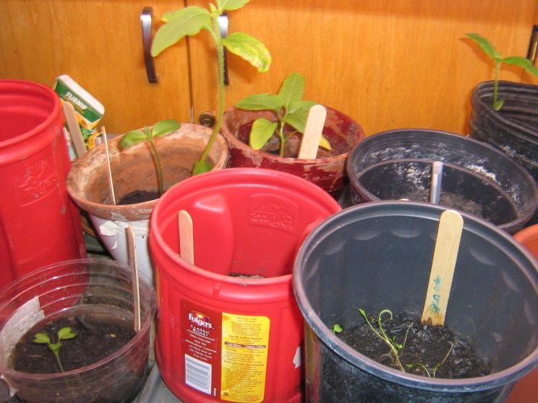
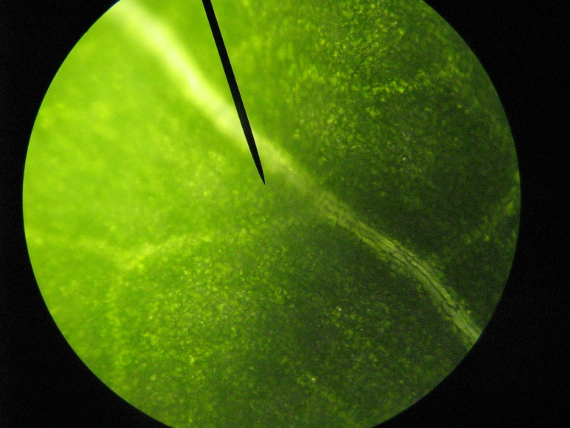
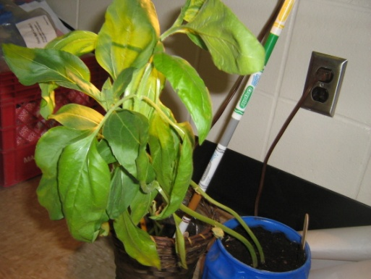
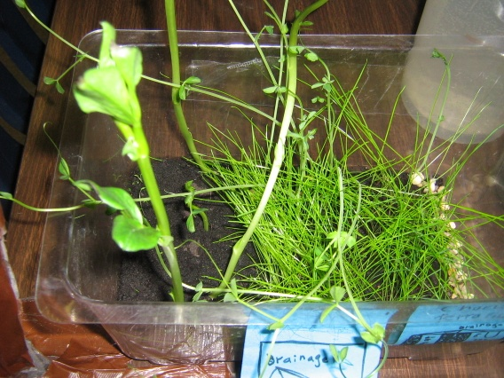
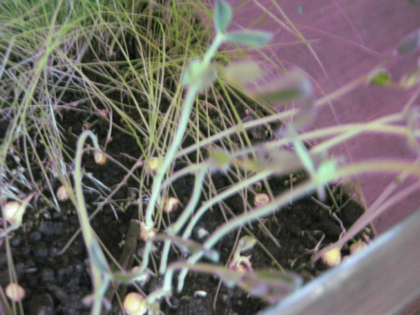
Snapshot of growing process as of March 24, 2010

Slide 11
Lesson Objectives
Students will:
Classify soil by texture and particle size
Identify soil horizons. Read stories about different soil across the continents.
Learn how to use the microscope during their investigation.
Create a model of local soil layers. To read about how soil layers are formed.
Will use a design model to construct a planting pot.
Will explore the scientific steps.
Conduct lab activities to support their findings.

Slide 12
Website Learning Experiences Which integrates science and literacy
http://www.brainpopjr.com/science/land/soil/grownups.weml
http://soils.cals.uidaho.edu/soilorders/orders.htm
http://www.tomsnyder.com/products/productextras/SCISCI/presenter.asp
http://soil.gsfc.nasa.gov/
http://www.Promethean Planet.com

Slide 13
Website Worksheets
http://www.zephyrus.co.uk/printableworksheetsoil.html
http://soil.gsfc.nasa.gov/students.htm
http://www.kinseyag.com/SoilAnal.htm#SendingSamples
http://www.docstoc.com/docs/18642218/What-is-in-Soil
http://www.globe.gov/tctg/sectionAndChildren.jsp?sectionId=409

Slide 14
Ways to compost
1. Obtain two clear plastic cups. In one cup place several inches of topsoil and plant a seed.
In the other cup, put a small amount of soil and plant a seed. Observe growth differences
in both. Note the differences in the amount of soil and the amount of room for roots to
grow.
2. Place a few earthworms into a tall pickle jar full of soil. Watch the soil as it goes back
and forth, fertilizing and bringing air into the soil. Ask students to write a short story or
poem about the activities of an earthworm.
3. Teach students about composting. Have students bring to class some cut grass, vegetable
or fruit peelings, a half pint milk container of soil and a plastic pail. Select three students
to be in charge of the compost project a day before the starting the project. Ask each
student to bring a small baggie of vegetable or fruit peelings or cut grass. The three
students in charge will tape the name of each student on the baggies as they are brought in
the morning. The three students in charge will empty each baggie into a plastic pail as
they identify the contents. After every ten baggies, sprinkle a little soil. When all
materials are in the compost pail, ask students to predict what will happen to the peelings
and grass (decomposing), and what it is turning into (soil for growing). Also note to
students that soil is formed only by nature.

Slide 15
Science Classroom Rubric
• Today I discovered that……… I also learned that………The most interesting part of the
experiment was……..I am still wondering………..
• Today I experimented with……..My hypothesis was……..I concluded that……..My next
experiment will be about…………..
• Today I observed……..I predict that………I also measured…………I concluded that………….
• Today I learned about (vocabulary word). I discovered that (vocabulary
word)………………
• Today I observed (topic). I now know what happened to ………….I am still unsure
about………………
• Today I conducted a science lab on (topic). I predicted that ………….I analyzed my
results and concluded that…………Another question that I have is……………………
Science Journal
Scientist: _________________ Date: ______________
Science Journal Rubric
3 = Satisfactory 2 = Needs Improvement 1 = Unsatisfactory
Standard:
Completed journal and wrote down information accurately
3 2 1
Clearly showed knowledge learned
3 2 1
Provided detailed descriptions using scientific terms
3 2 1
Made correct conclusions
3 2 1
Total Points Earned: _____
Total Points Possible: 12

Slide 16
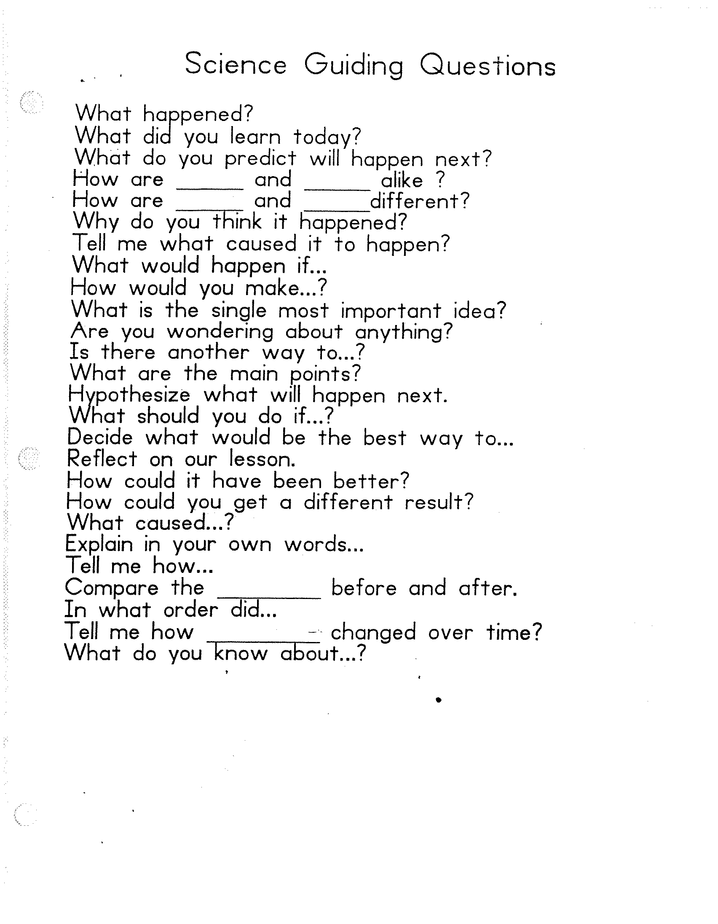
Guiding questions to use with the lesson.
Source: http://www.westwood.k12.mi.us/buildingwebs/daly/PDF/Science%20Guiding%20Questions.pdf

