Slide 1
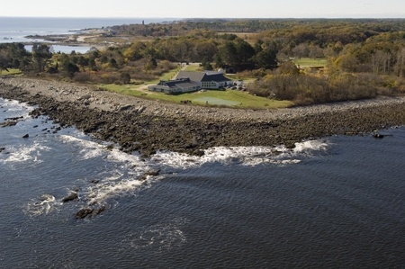
Science Education in Engaged Settings means piecing together information from coastal landscapes and Gulf and Oceanic Seascapes.
Take a Virtual Field Trip to Rye, New Hampshire
Virtual Field Trip to Rye, New Hampshire
Seacoast Marine Science Center
Presenters: Kate Levitt, and Steve
Description of intertidal zone
71% of Earth is ocean.
Carbon emissions come from natural sources such as: breathing, deforestation, and volcanic eruptions
and through artificial means such as, burning of fossil fuels, and automobile exhausts.
Seawater generally has a pH of 8.0 to 8.3, but carbon acidifies the seawater.
Some marine organisms are especially sensitive and have a susceptibility to the chemical/biological impact to ocean acidification.
These organisms include but are not limited to the following:
Phytoplankton
Sea urchins
Sea stars

Slide 2
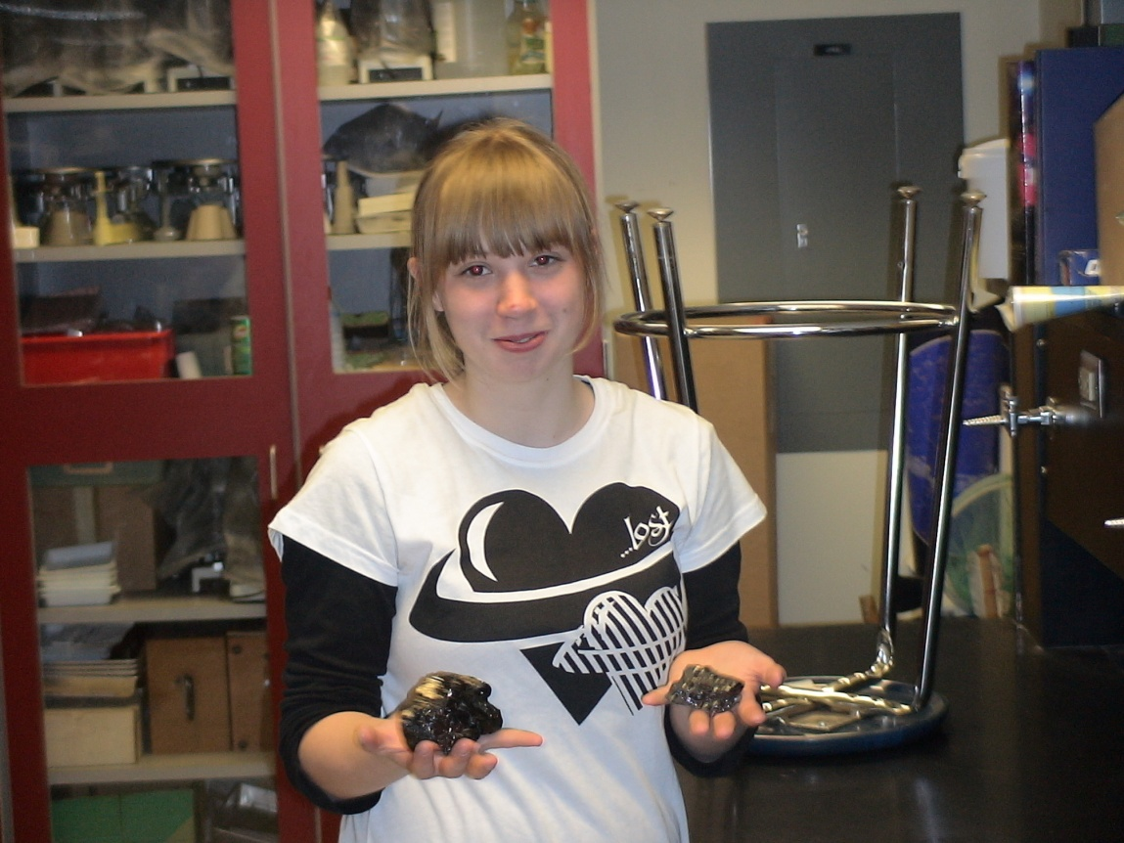
Students need to interact with the world around them.
The Earth Science laboratory studies gives young people an opportunity to experience a part of Planet Earth. Skills and concepts are learned as students apply insight into their observations. First they compare and contrast, as they look and touch a piece of Planet Earth.

Slide 3
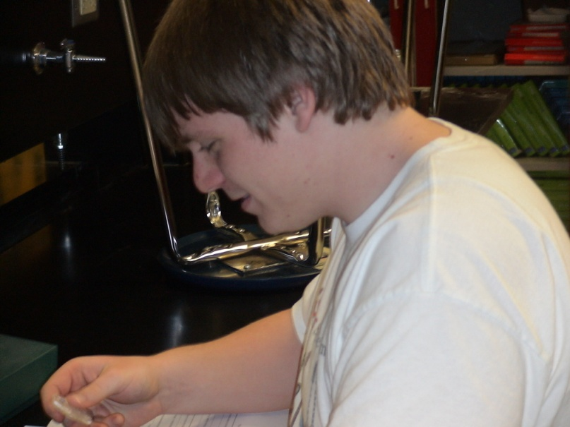
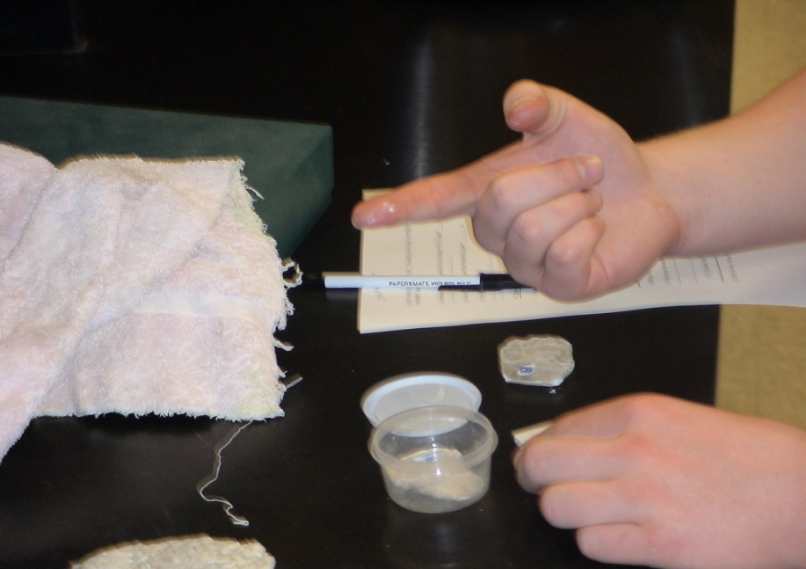
Students want to gain confidence in what they are learning. Testing and sampling of materials tend to give students the expertise they want.

Slide 4
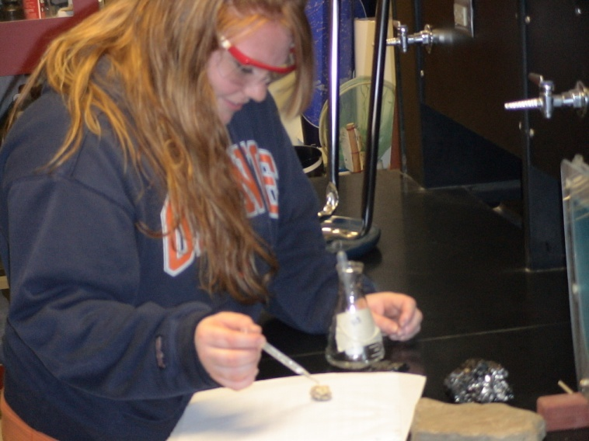
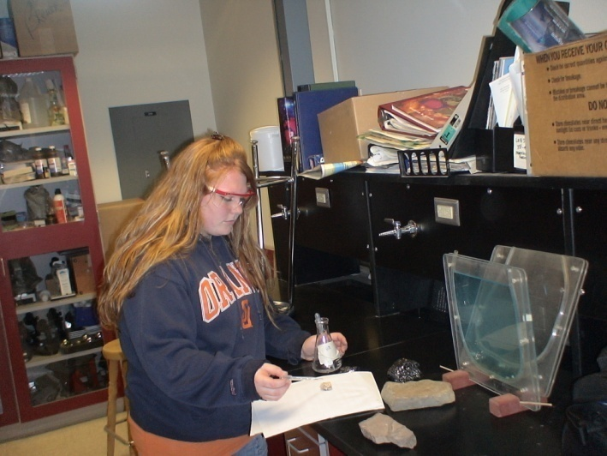
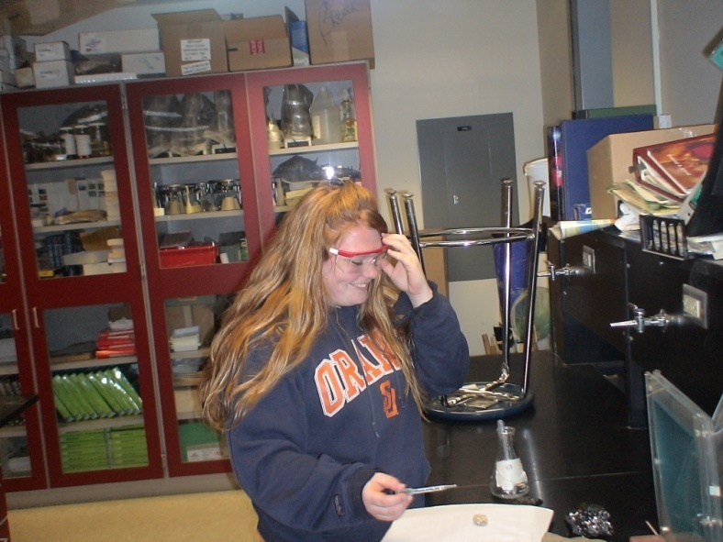
Employment is a goal for many students who give their best on a daily basis. Occupations in science become reality as students apply the skills they learn in Earth Science.

Slide 5
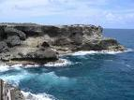
Thanks to the students and faculty of Prattsburgh Central School.
A special thank you to the staff of Seacoast Science Center for a virtual field trip entitled, “Ocean Acidification: How our marine world is handling increasing levels of carbon dioxide.”
http://www.youtube.com/watch?v=Gjzkf1xiQ-8

