Slide 1
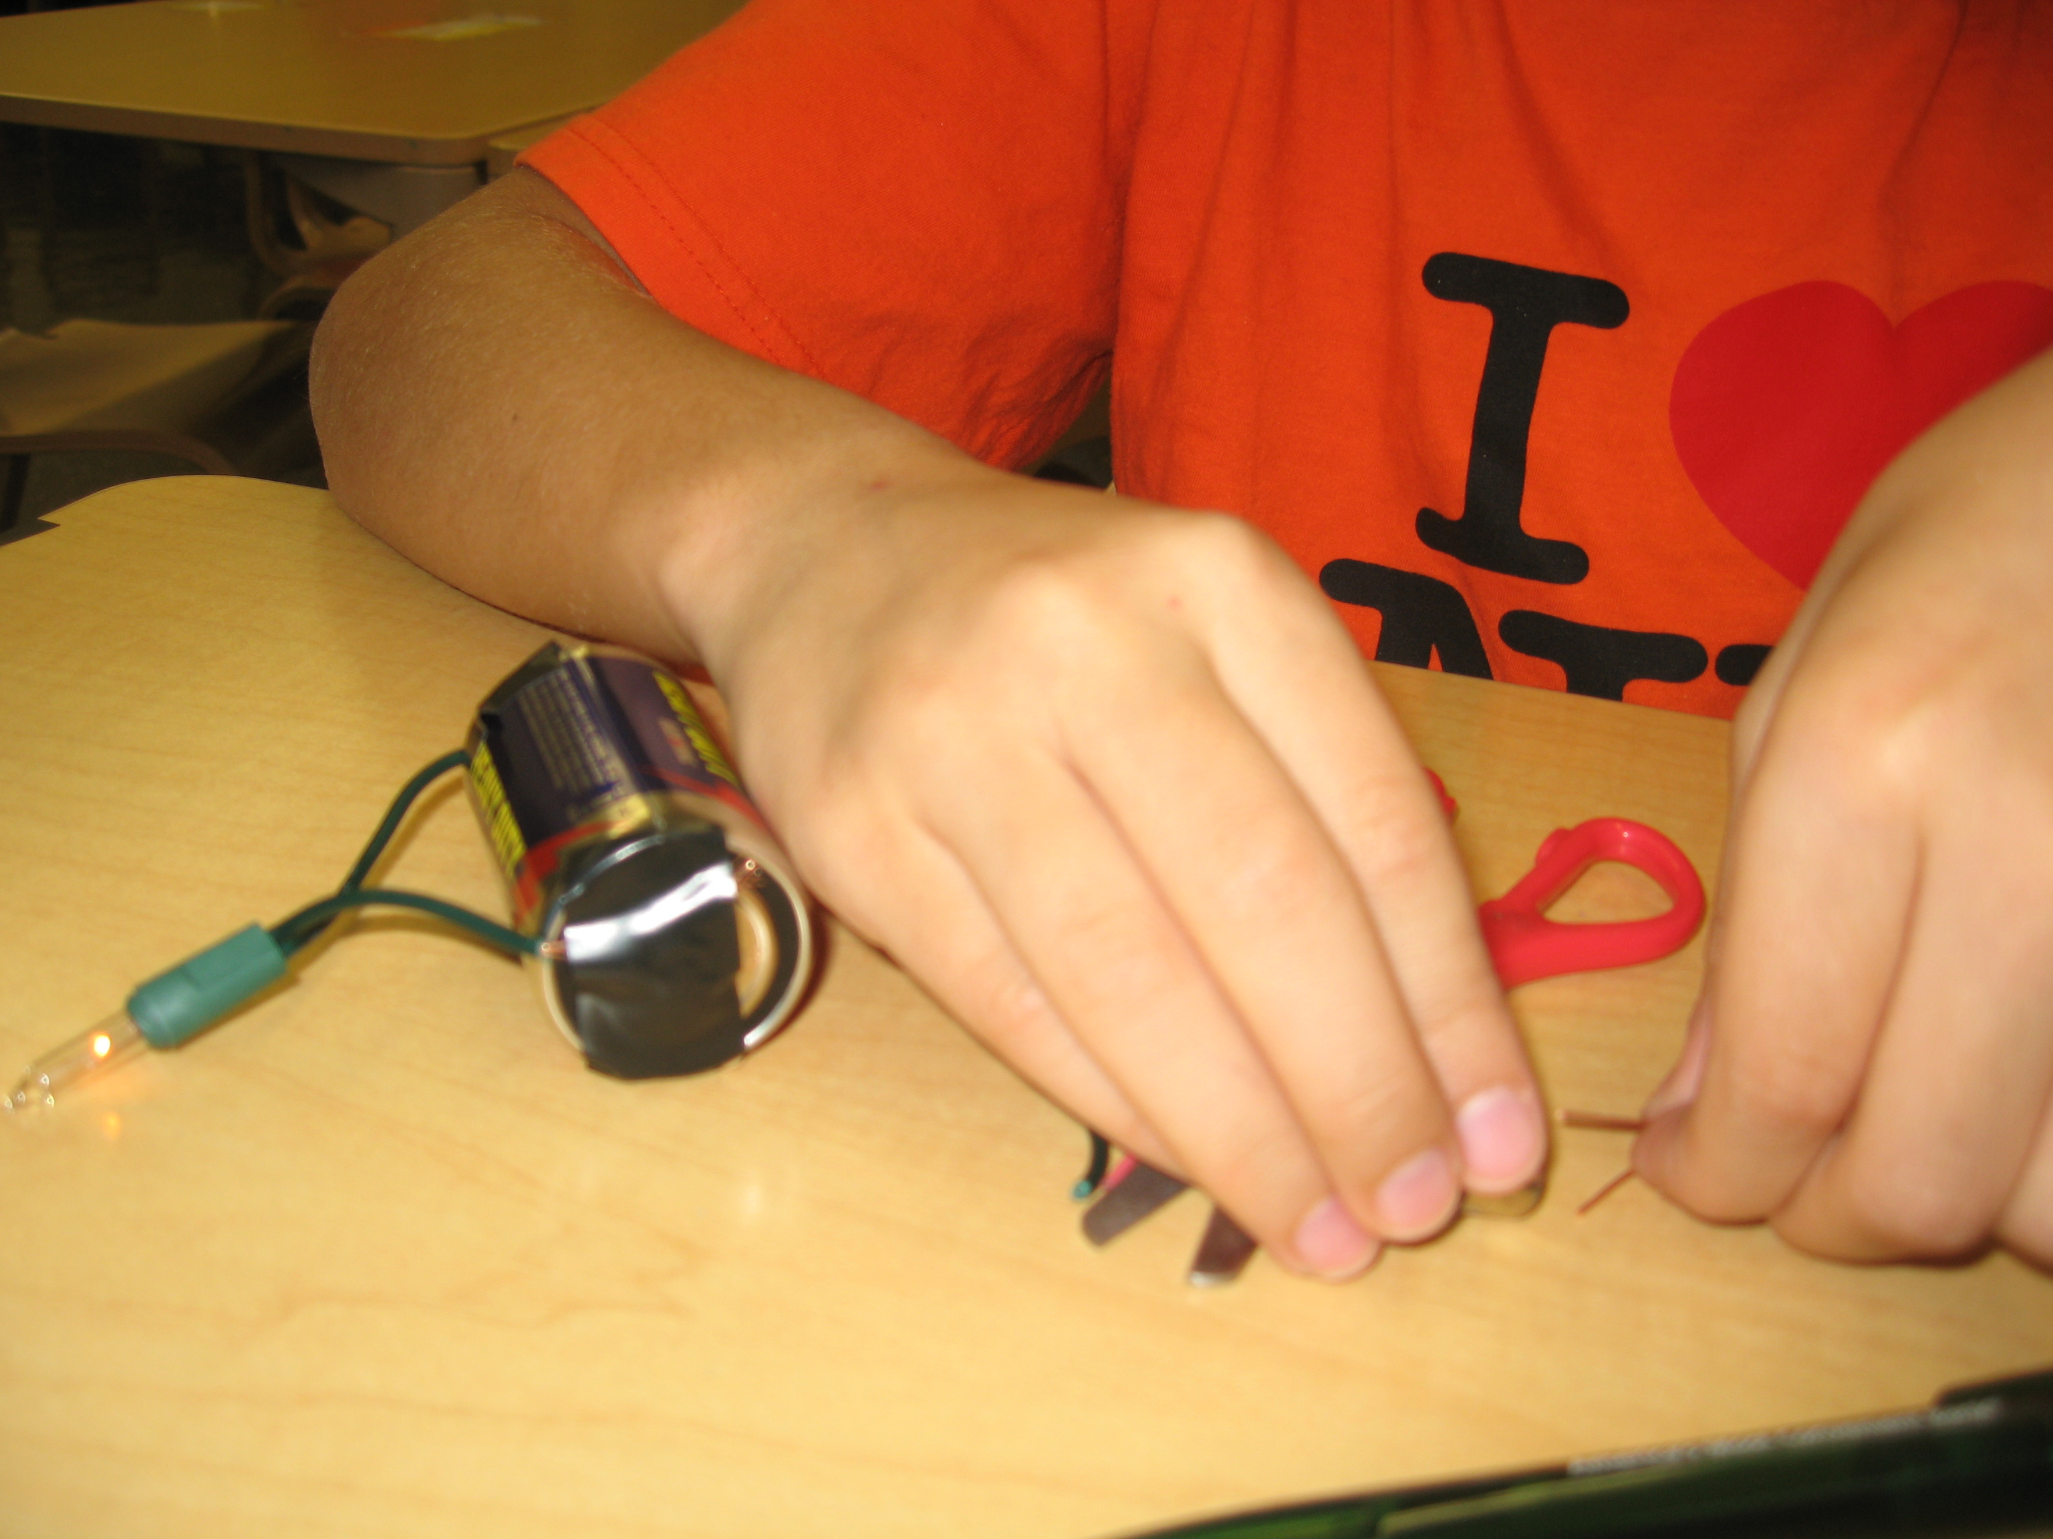
Early Engineers
3rd grade students collaborate to build a lunar growth chamber
Shakira Castronovo
December 7, 2009

Slide 2
Every week a group of third grade students came to school
an hour early to work on the Moon Munchies project.
I called them the “Early Engineers,” and they were all excited
to jump in and build something. The students are all extremely
creative, and at our first session together on October 21st they wanted to completely design their own type
of invention for helping plants grow on the Moon. I had to reign
them in order to follow the lessons in the Design Challenge.

Slide 3
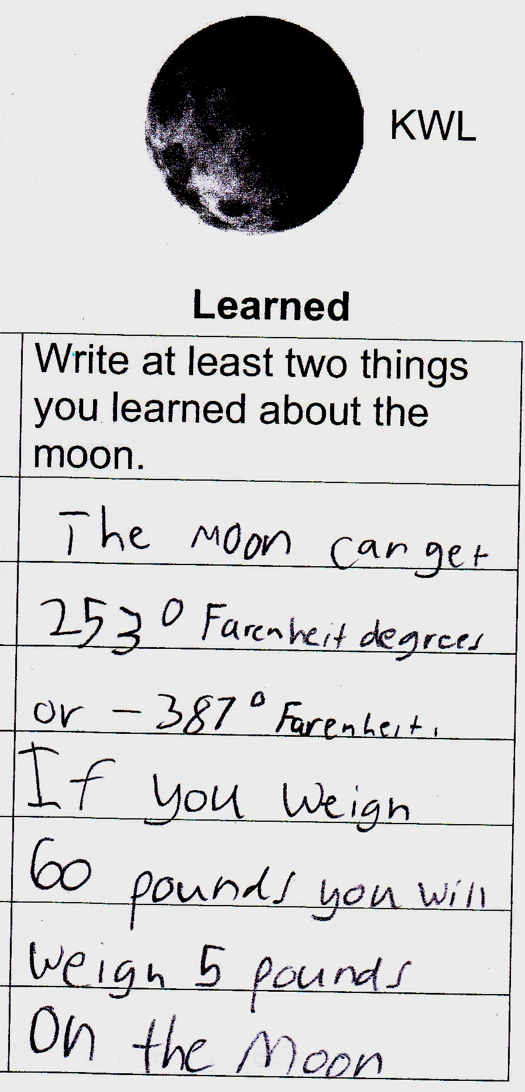
The Context
This group of students is interested in outer space, and they had no problem understanding that astronauts would need to be able to harvest their own food. After learning about the Moon, the students considered the soil, the temperature, the lack of sunlight, the need for compost or vitamins, and they especially thought about the air that both humans and plants would require.

Slide 4
Quality Air Control
Since we were a small group working together, it was natural that we would all hear each other’s ideas and work them out as a team. We can’t remember who first thought of it, but one student in our second session on October 28th discussed the idea of capturing astronauts’ exhaled carbon dioxide and storing it in a spot in their helmets, to be released at a later time for the plants. Everyone was immediately on board, and all the students were excited to sketch pictures of their ideas for “Air Exchange Helmets.”

Slide 5
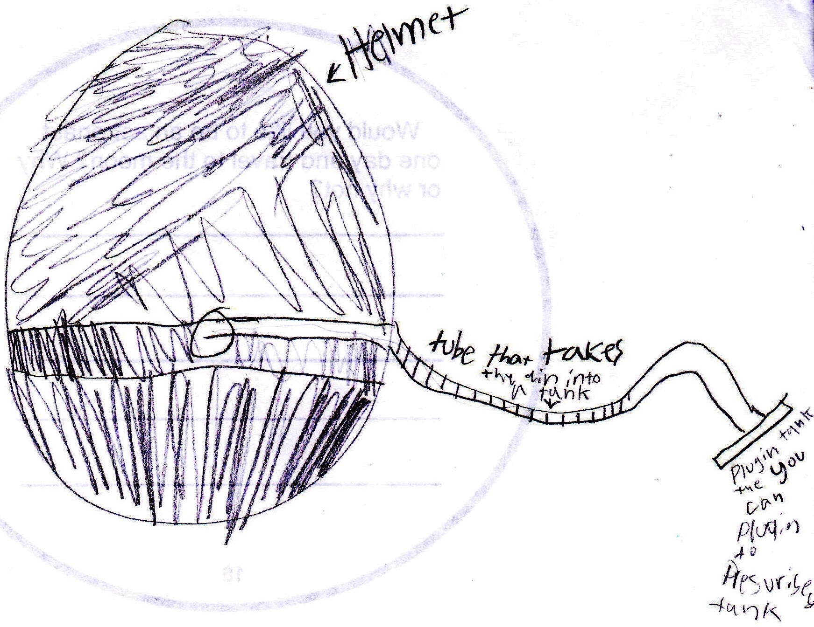
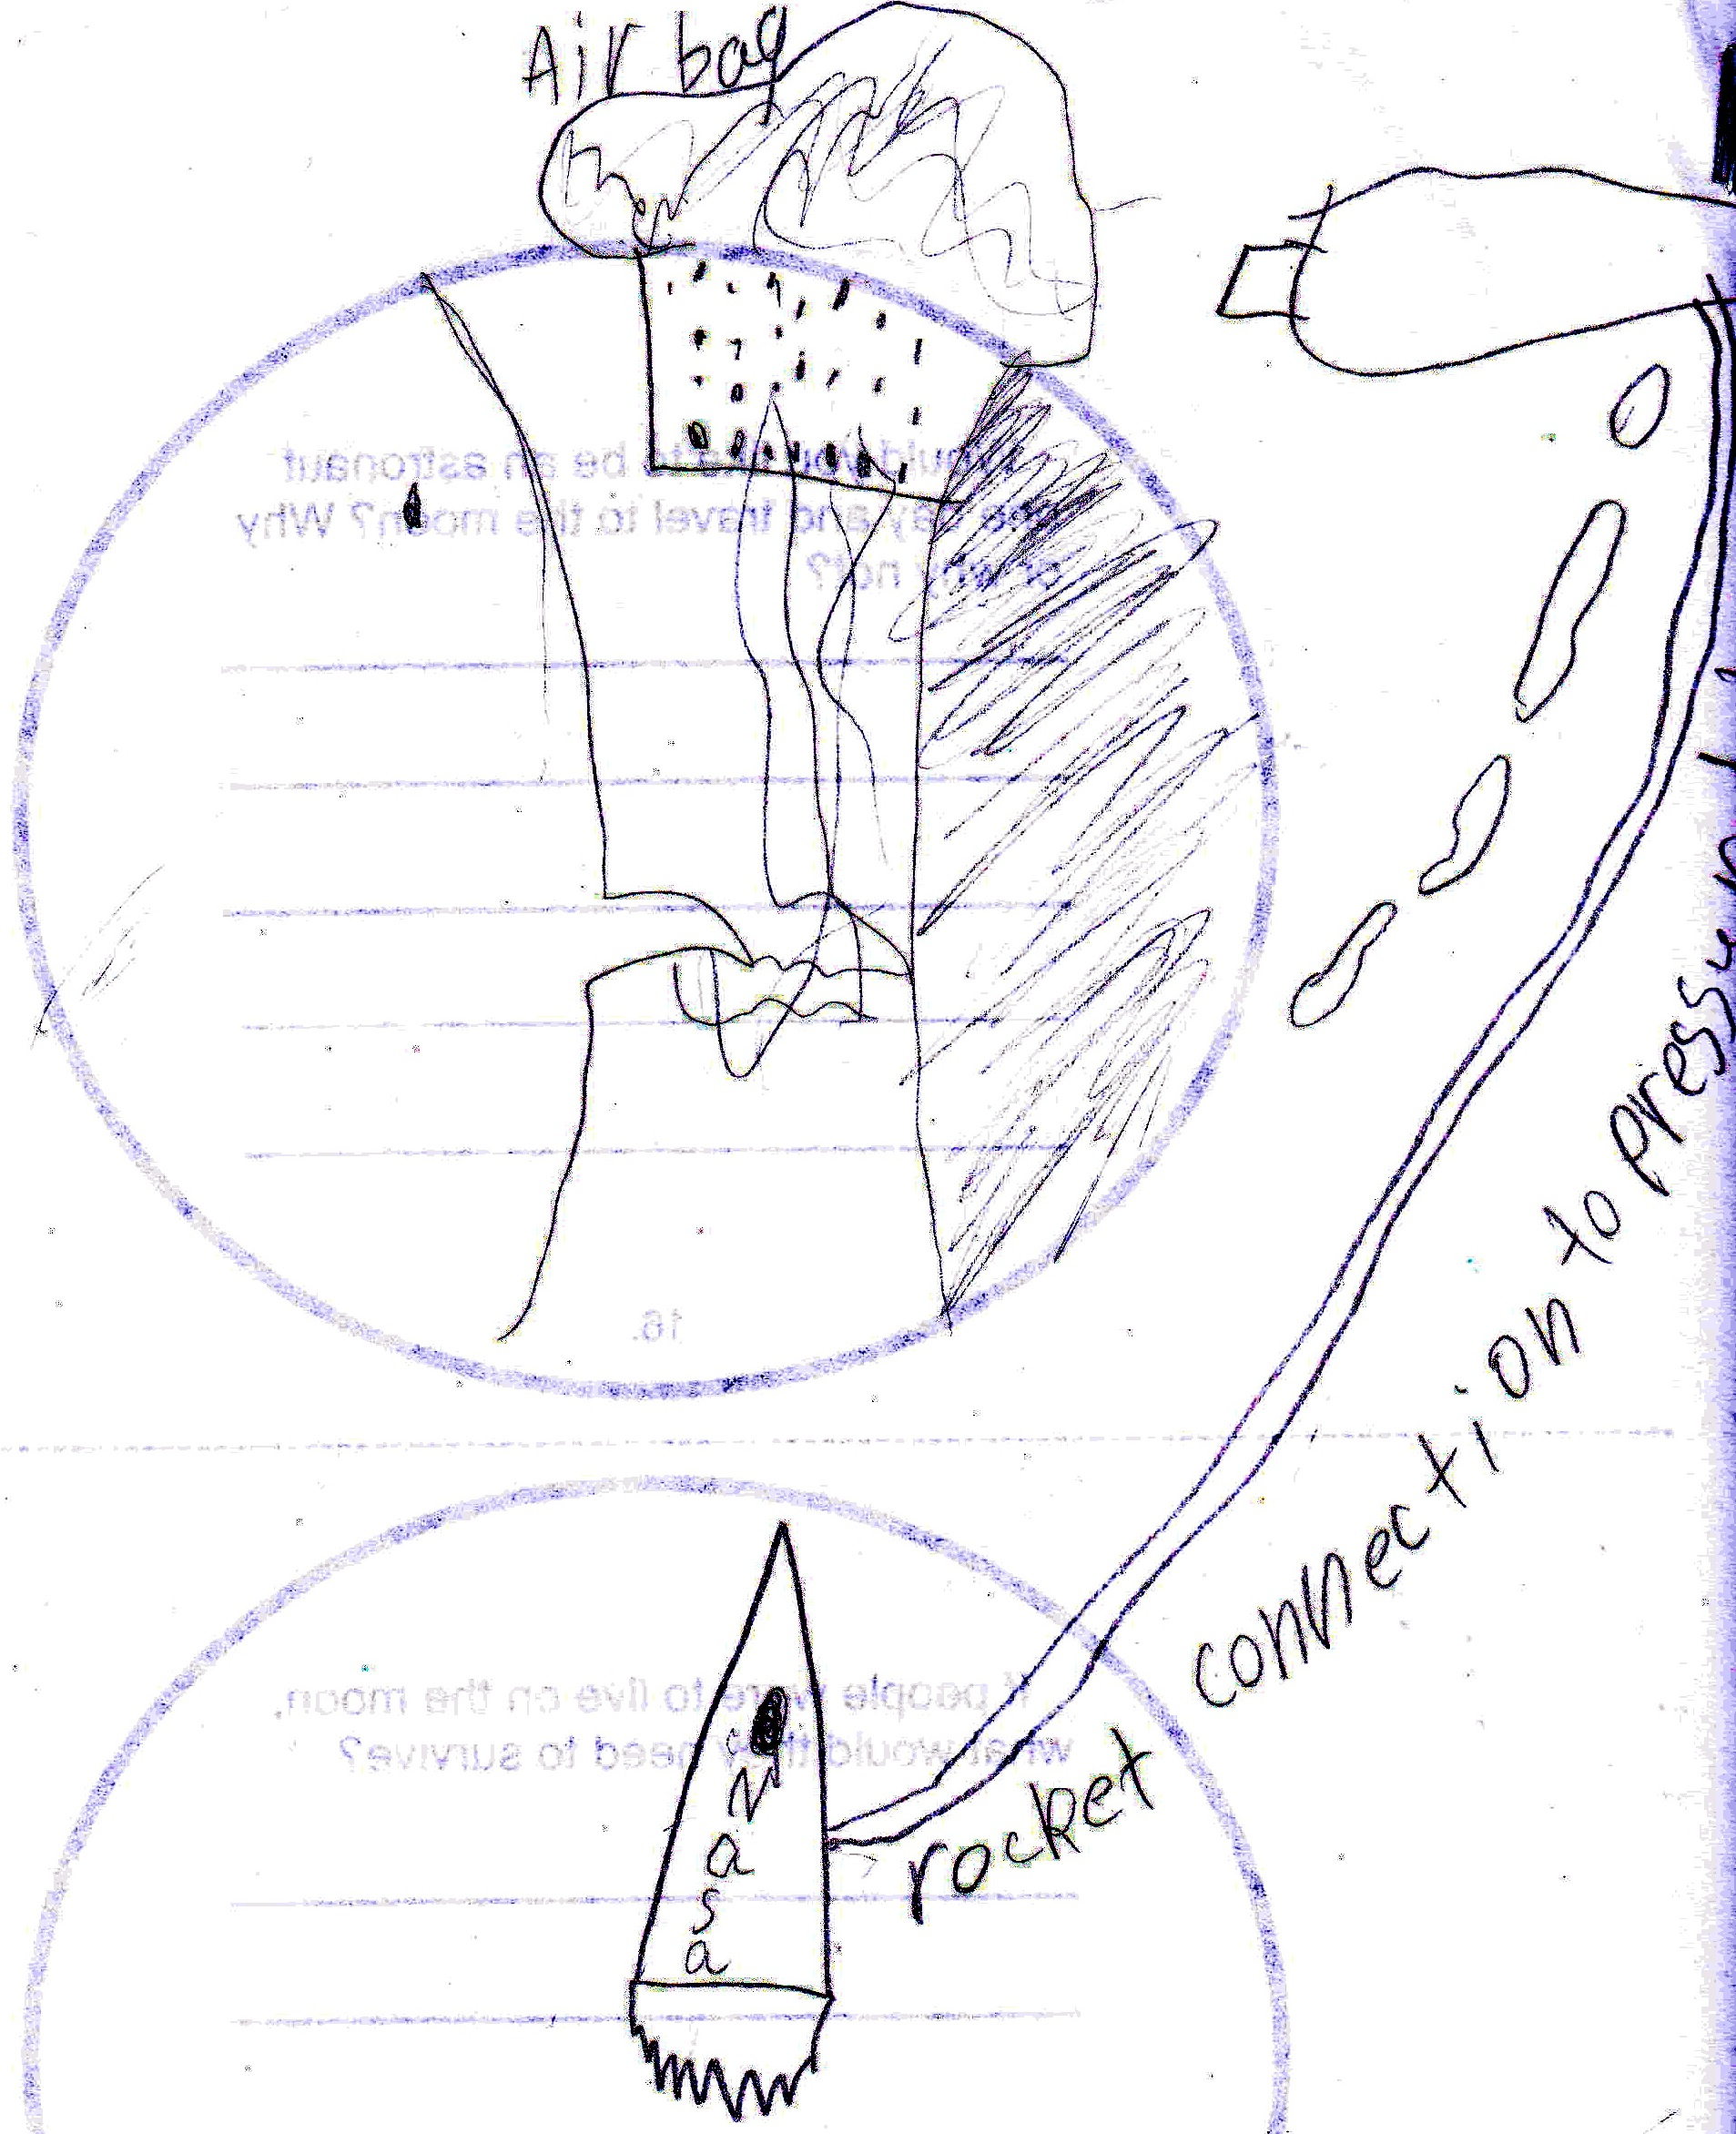
Air Exchange Helmets
All the students designed helmets

Slide 6
Learning about electricity
Students enjoyed working with batteries, wire, and lightbulbs to investigate how to produce light via a closed electric circuit

Slide 7
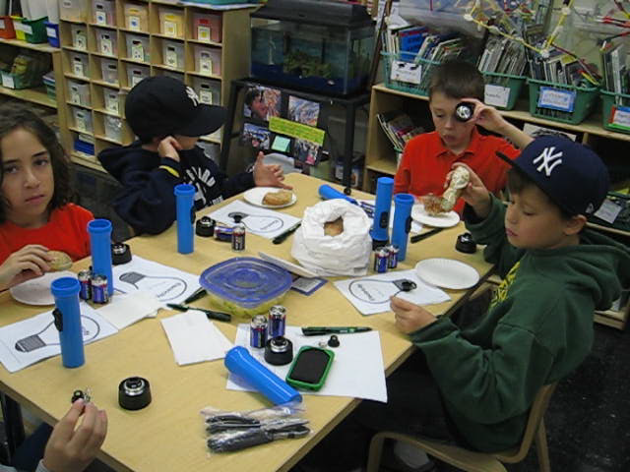
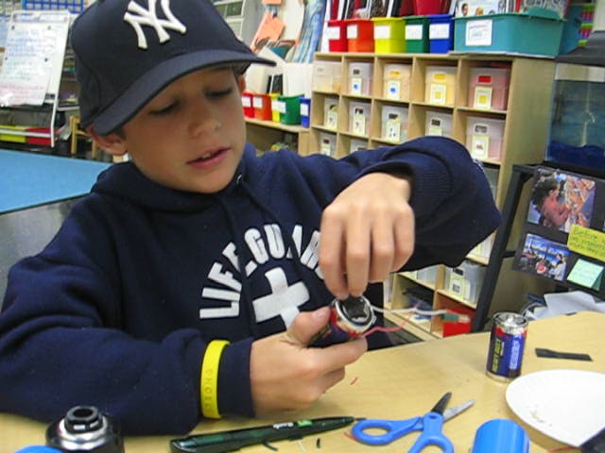
Researching electricity

Slide 8
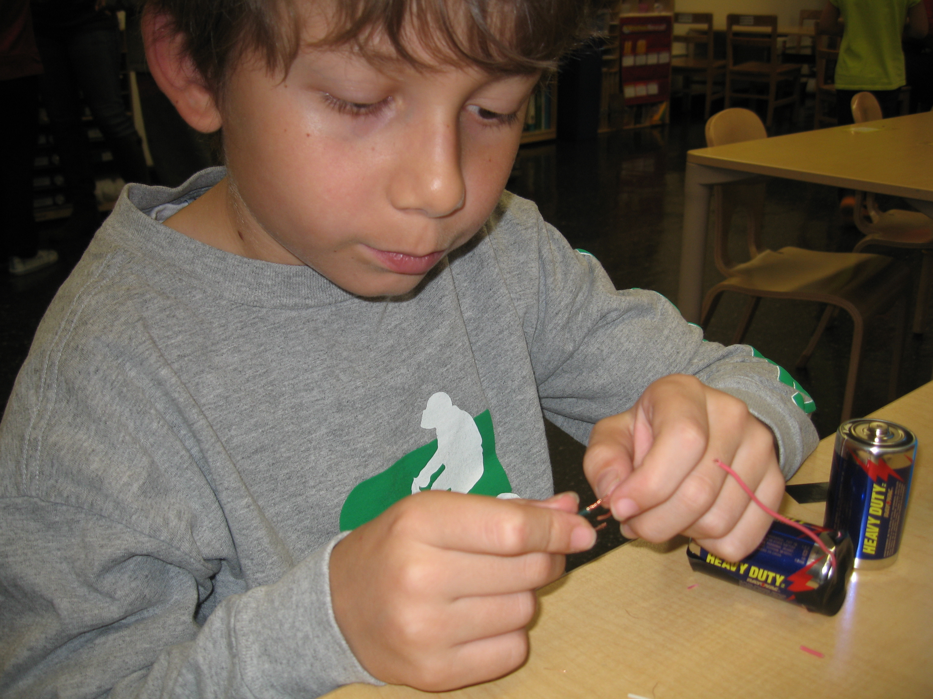
Experimenting

Slide 9
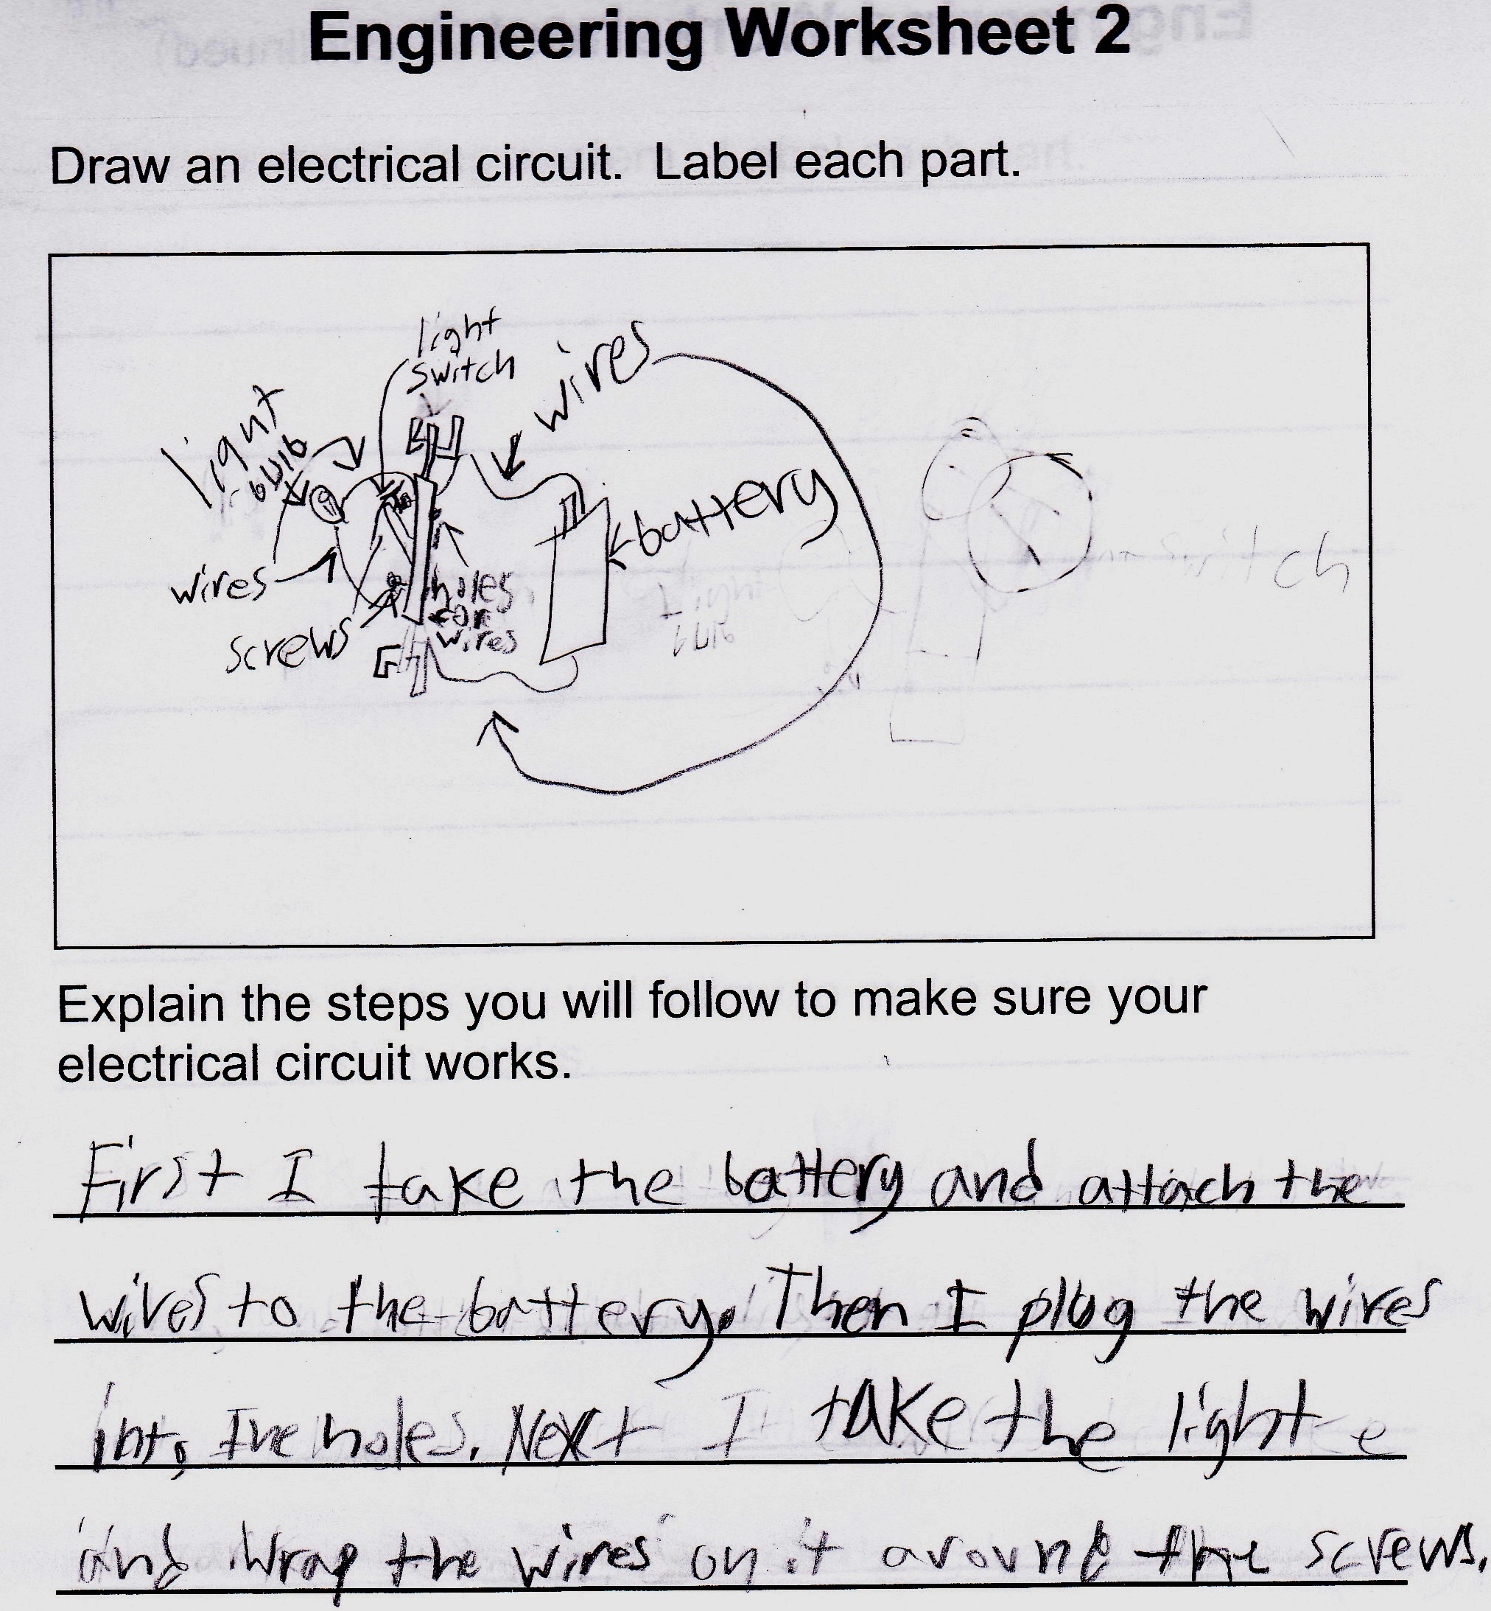
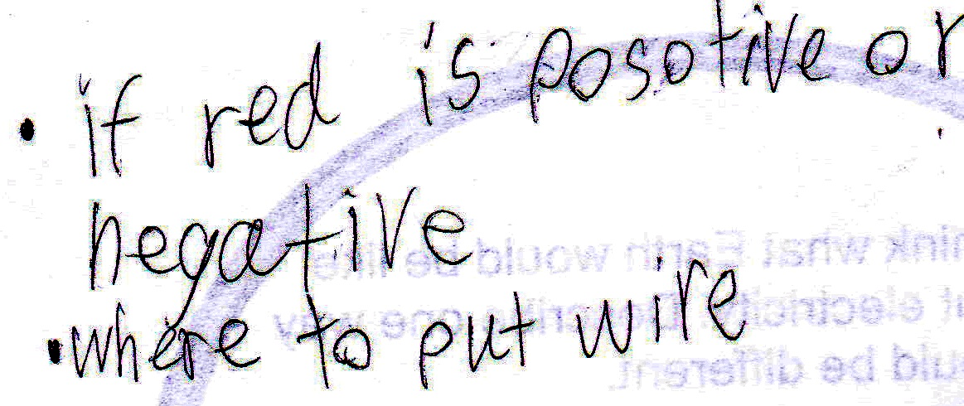
Observations and a To Do List
Students gave themselves tasks to complete or research to conduct

Slide 10
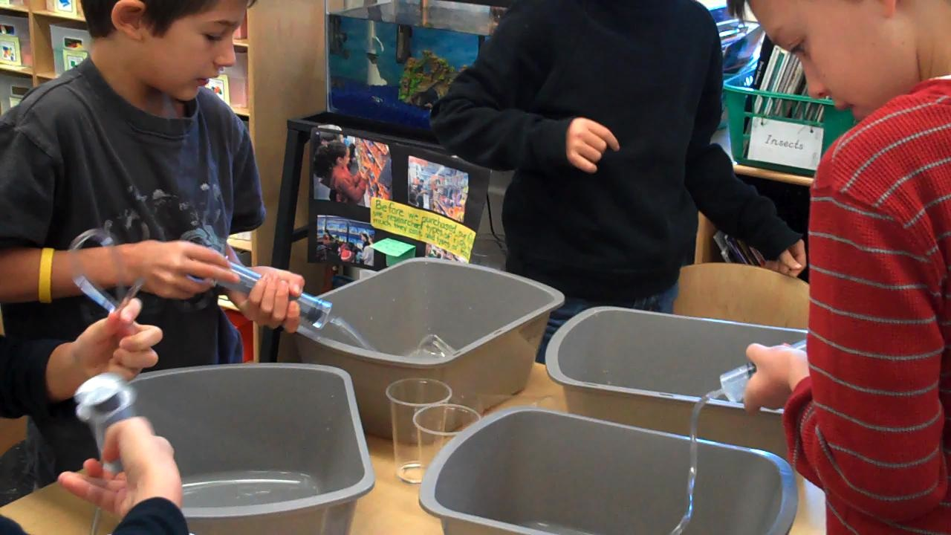

Where’s the water?
Students loved learning about how water travels through tubes.

Slide 11
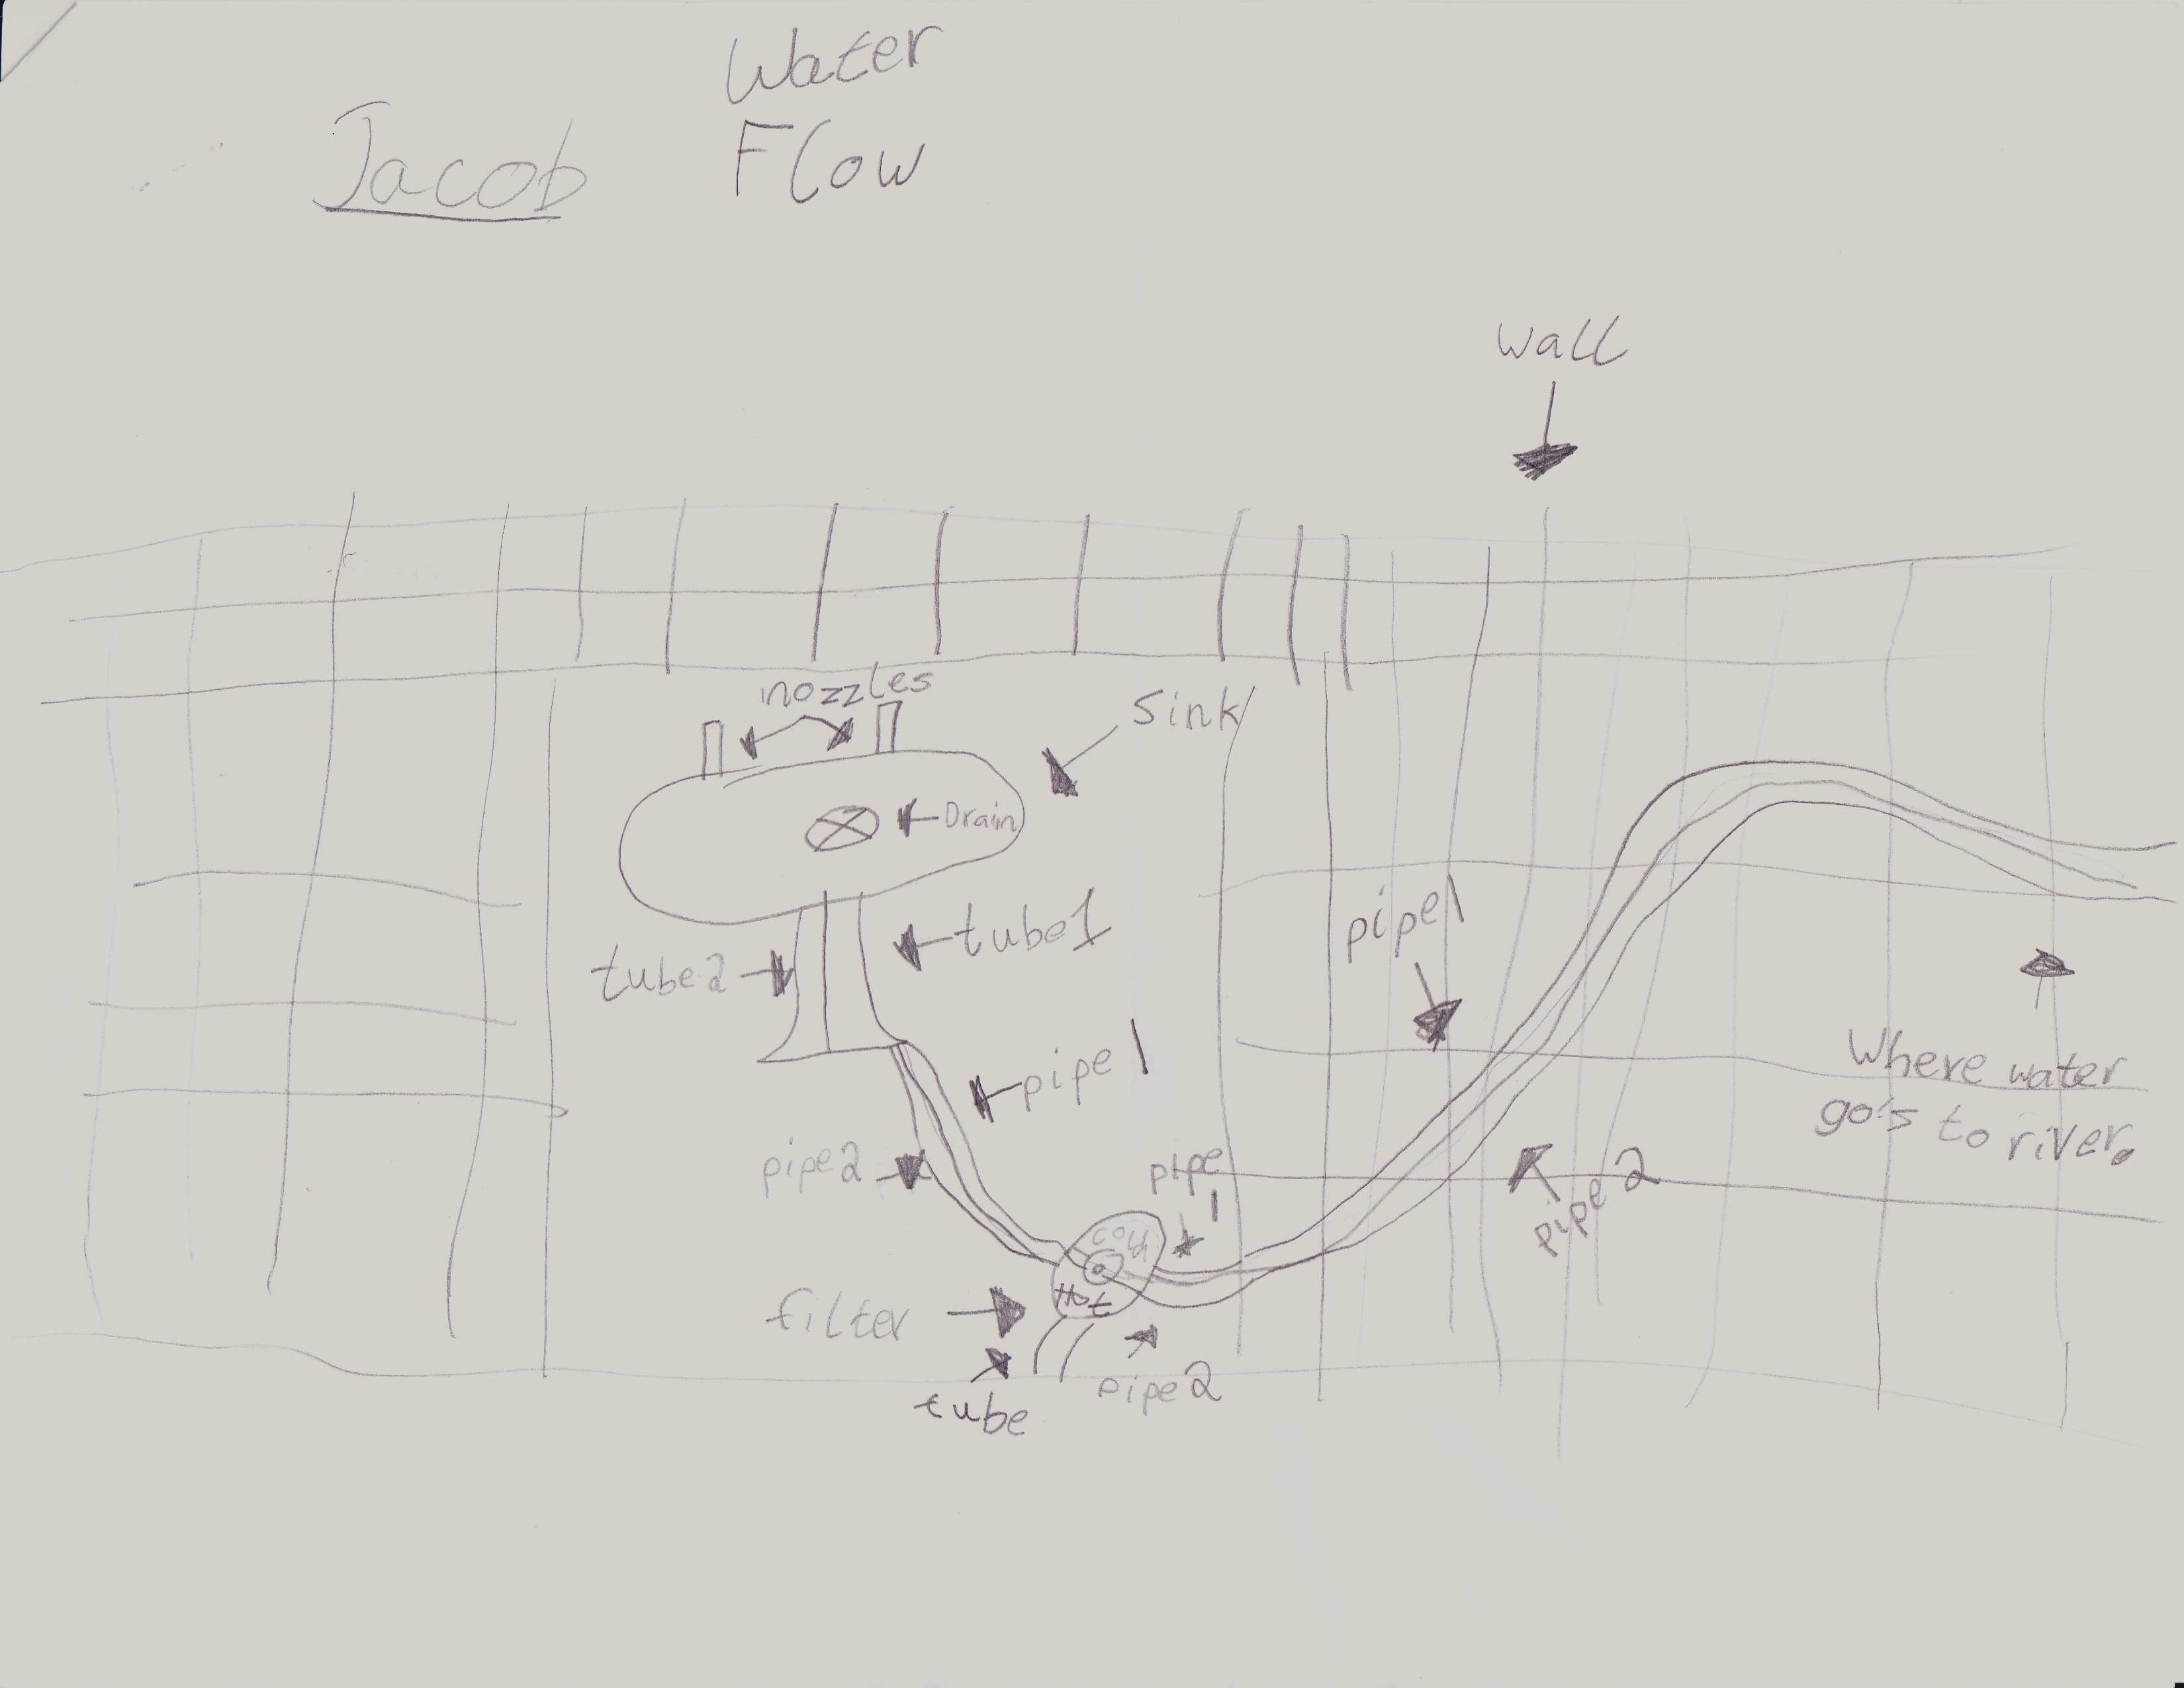
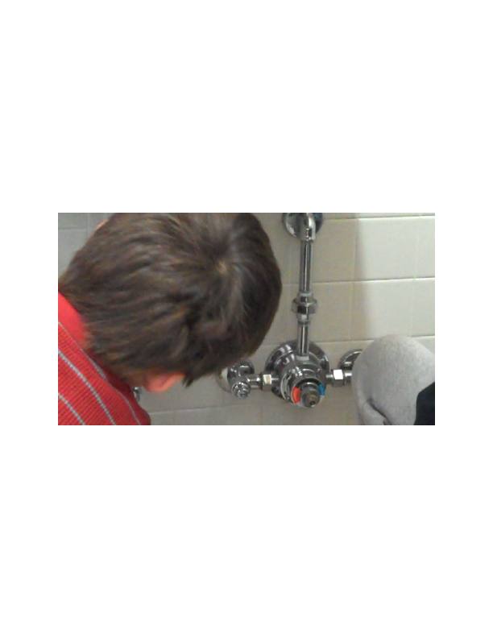
Understanding water systems
We took a field trip to
our bathroom sink.

Slide 12
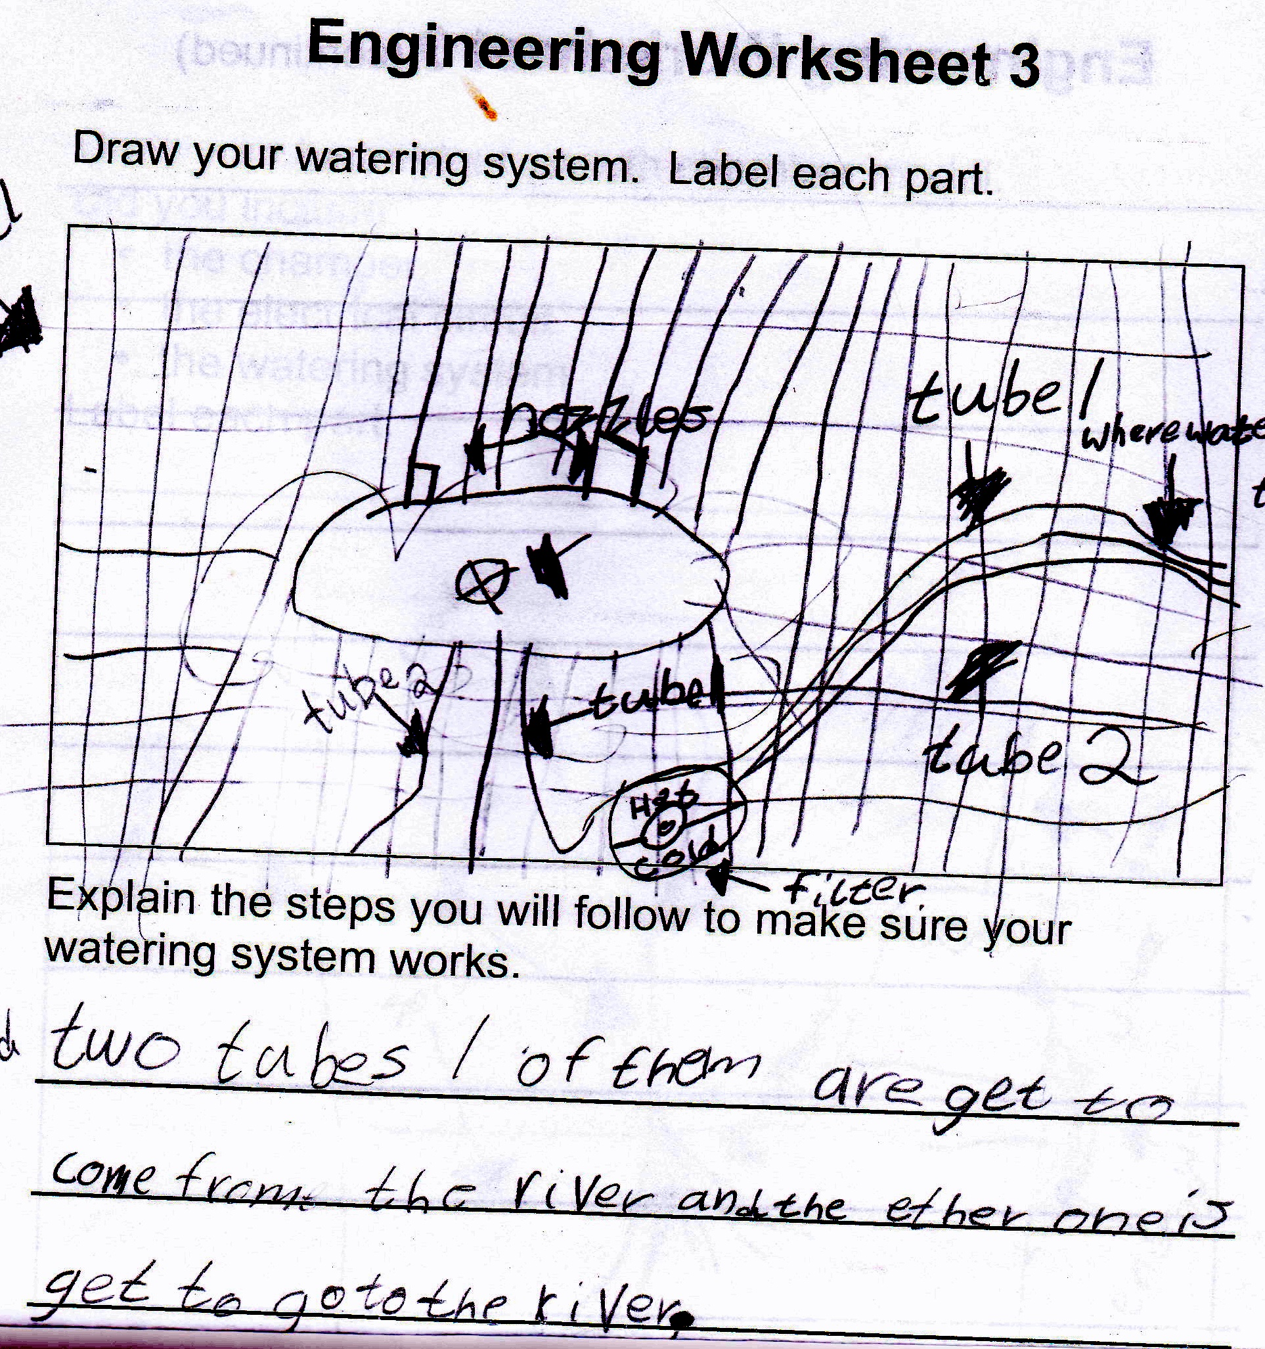
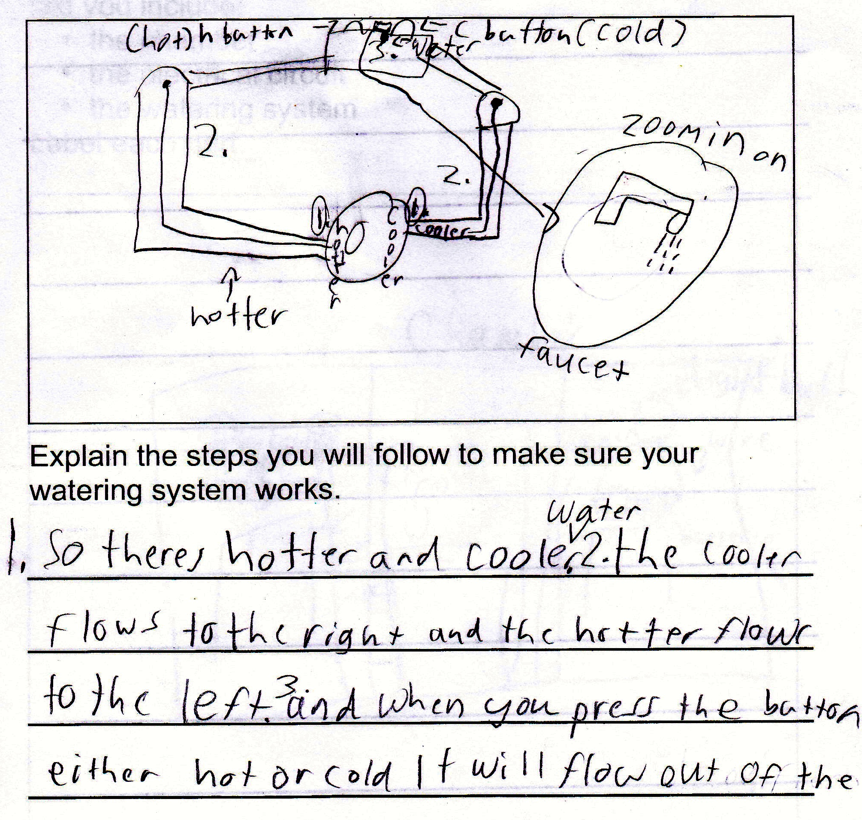
Water work

Slide 13
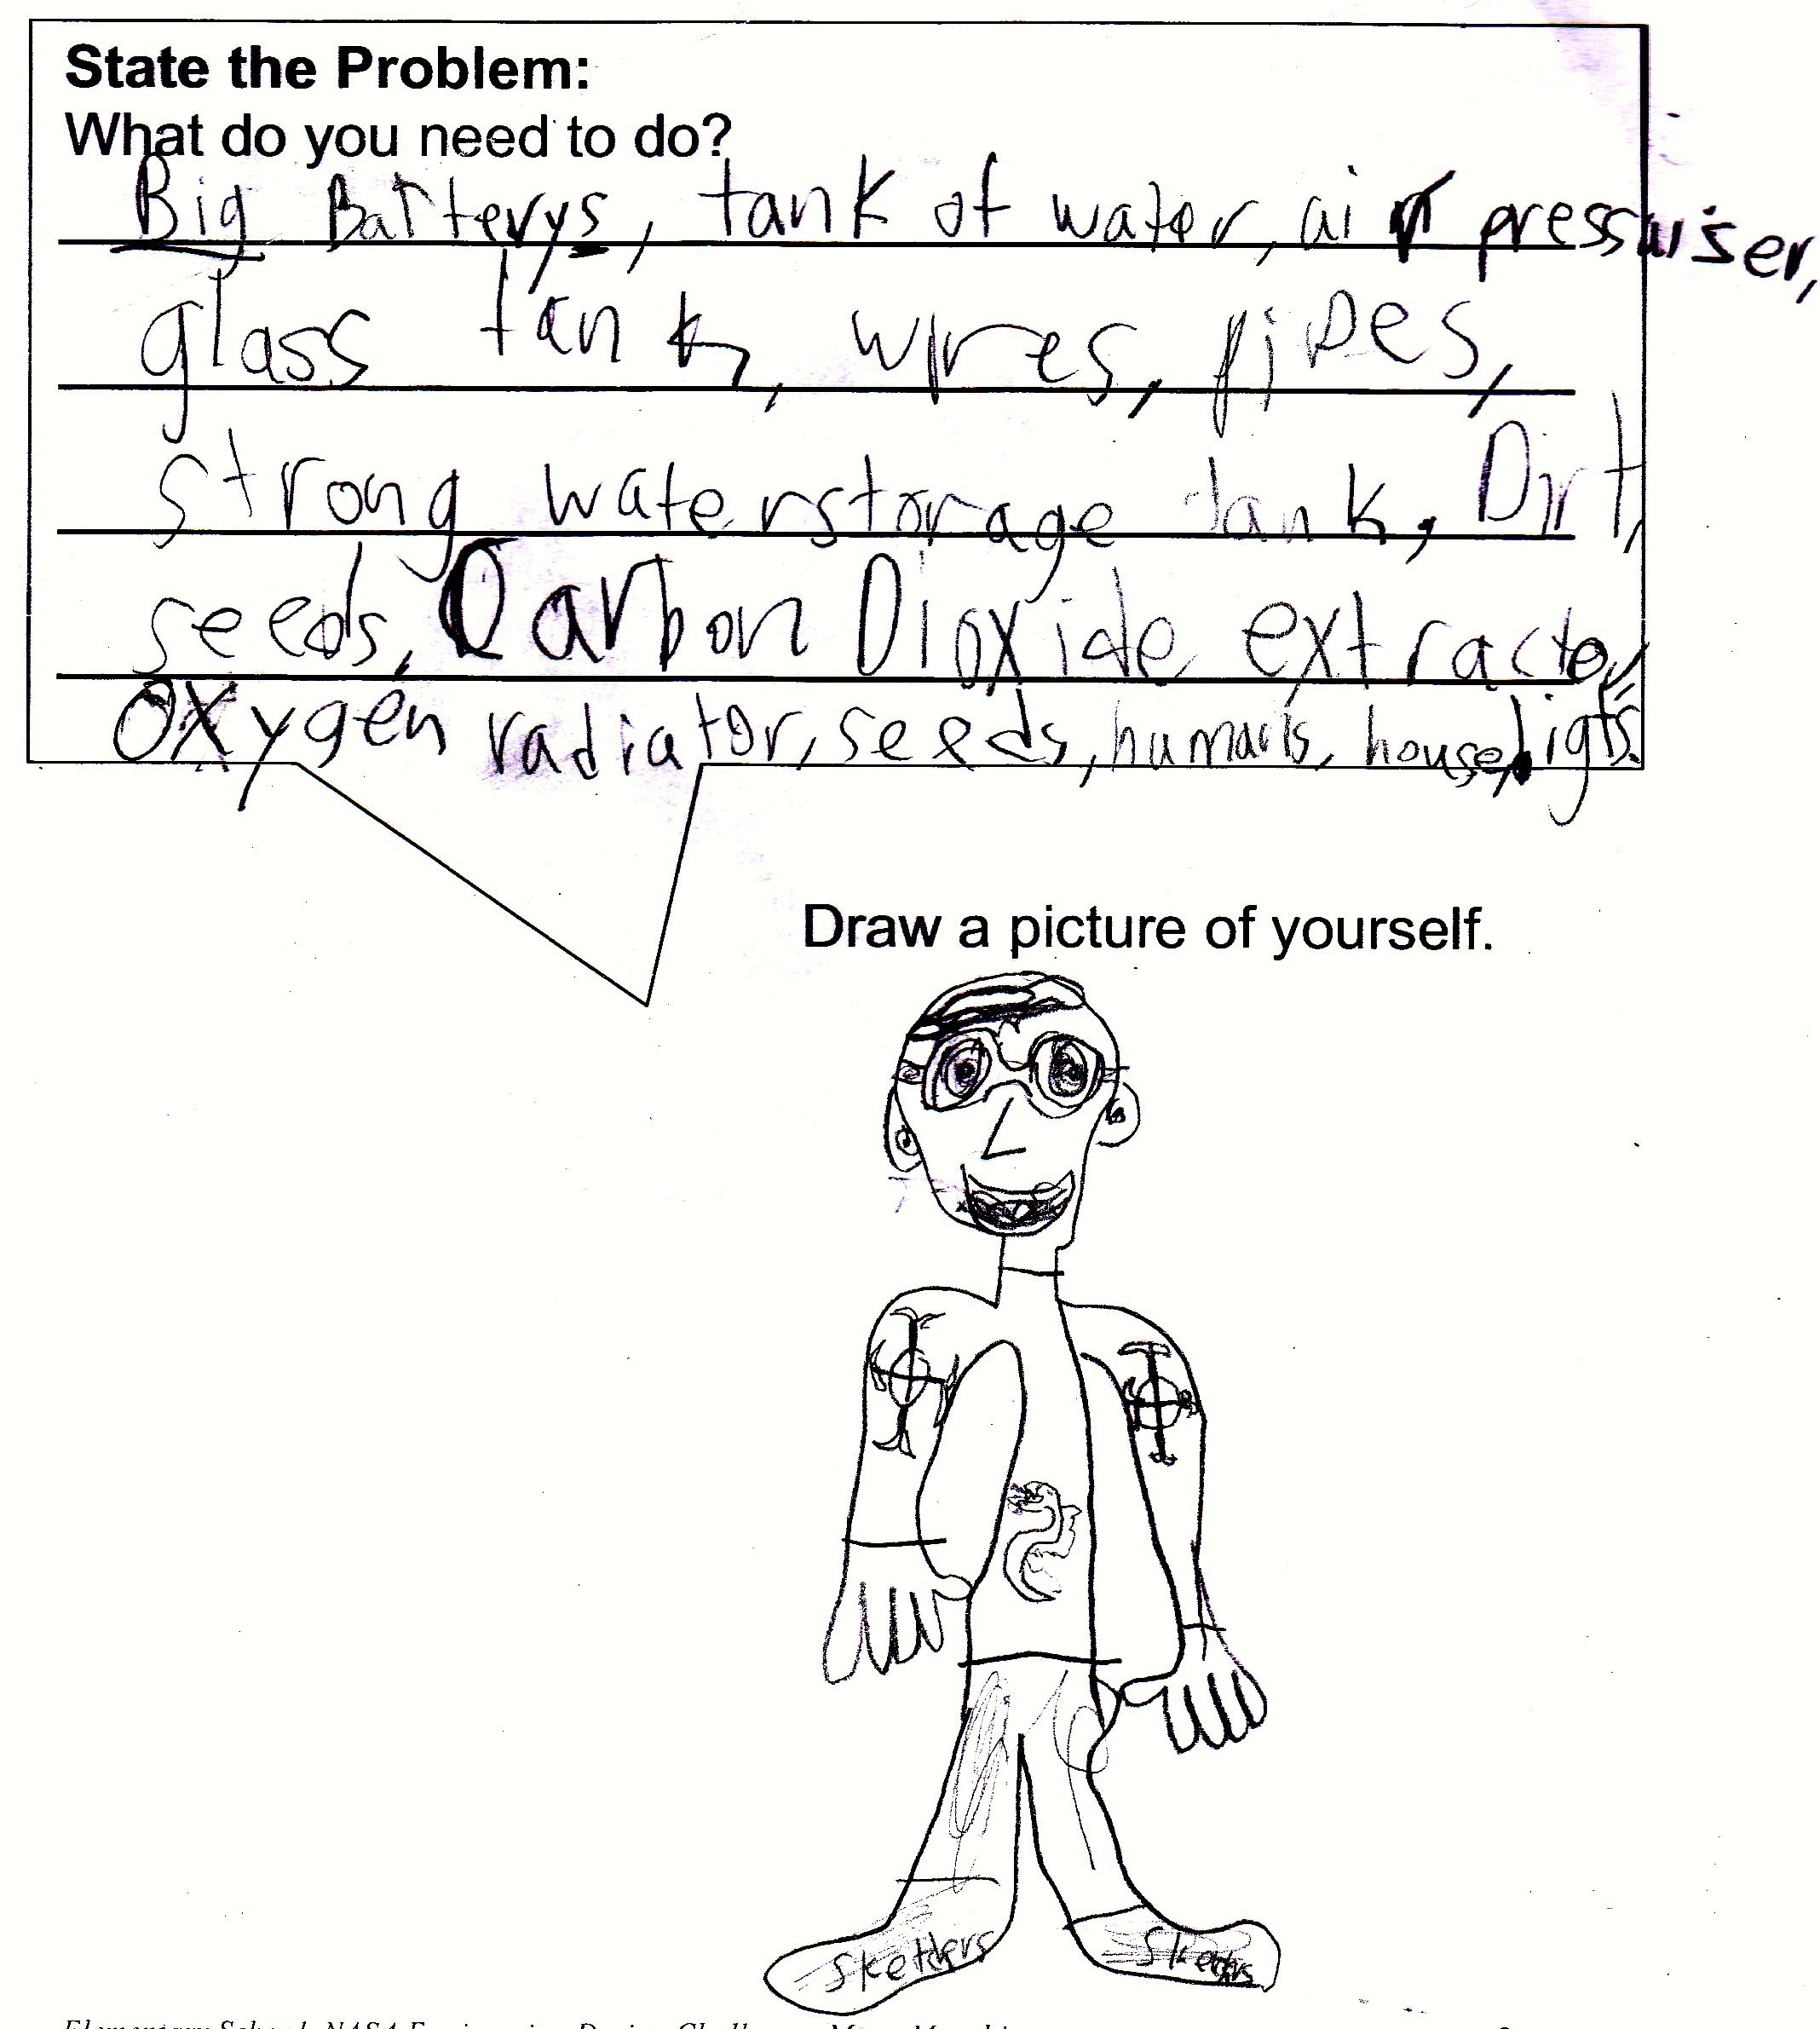
Time to Design
After we finished our research, it was time to put our new found knowledge to work.
Students understood that they needed to create a space for plants to grow on the Moon.
In addition, students all agreed that their designs would need to include watering systems and electrical circuits.

Slide 14
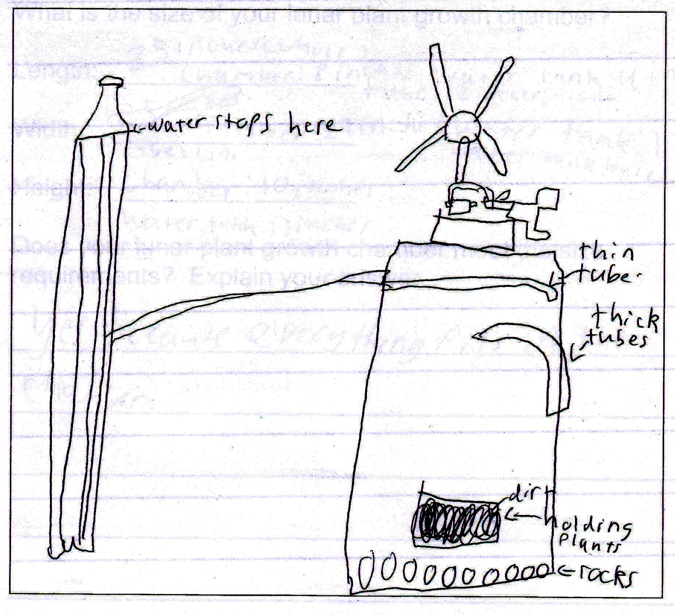
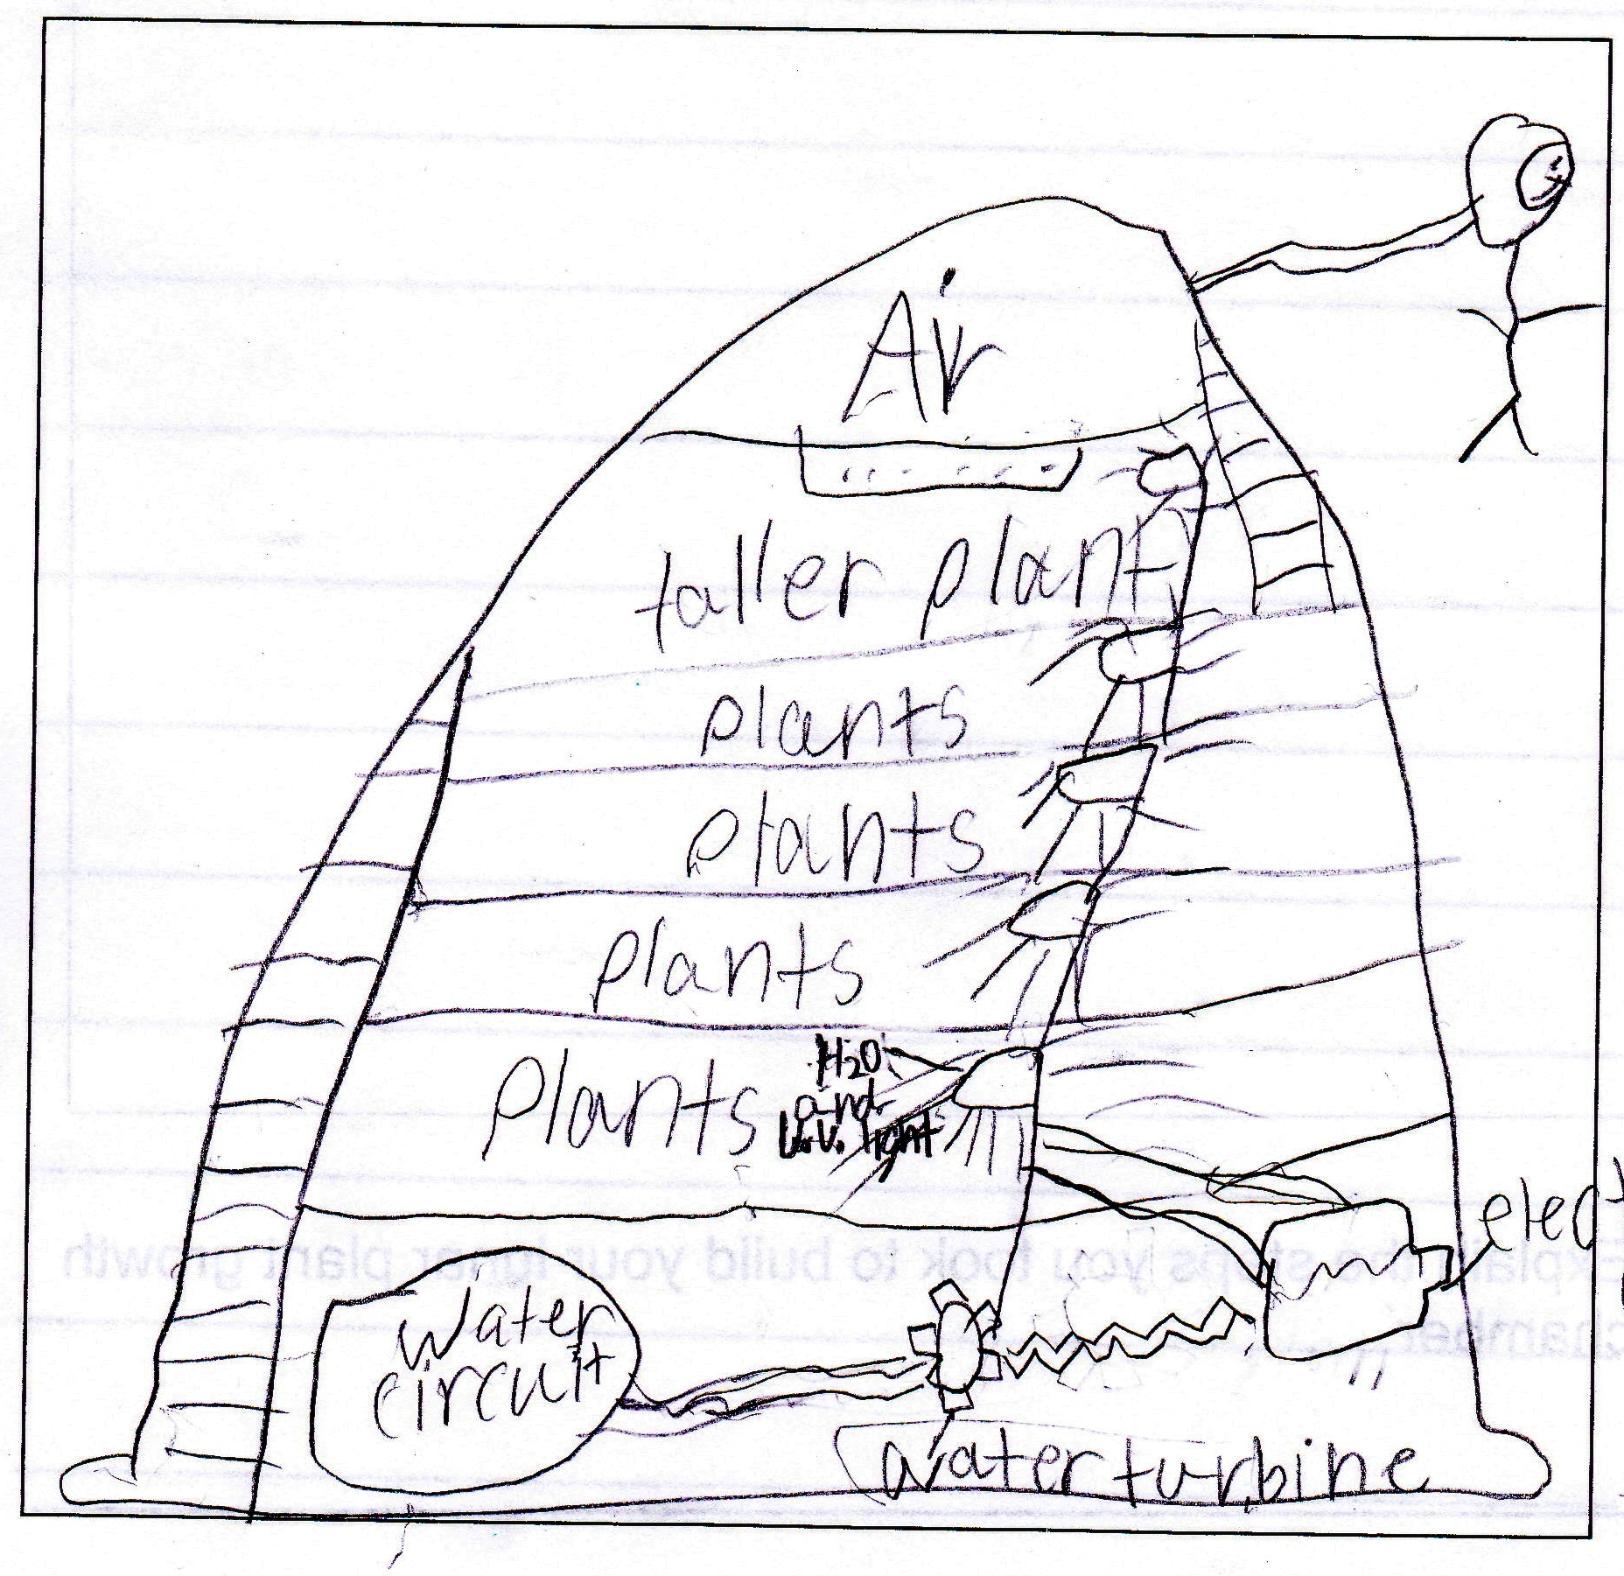
Design Time

Slide 15
The students enjoyed sketching out their ideas, and they understood that it was important to include labels and other important words. They absolutely loved sharing with each other, and they were so respectful and encouraging of everyone on the team. It was wonderful to watch these engineers interact with each other and listen closely to new ideas, while still feeling confident enough to explain their own thoughts in detail. They noticed many similarities and differences each time they shared.

Slide 16
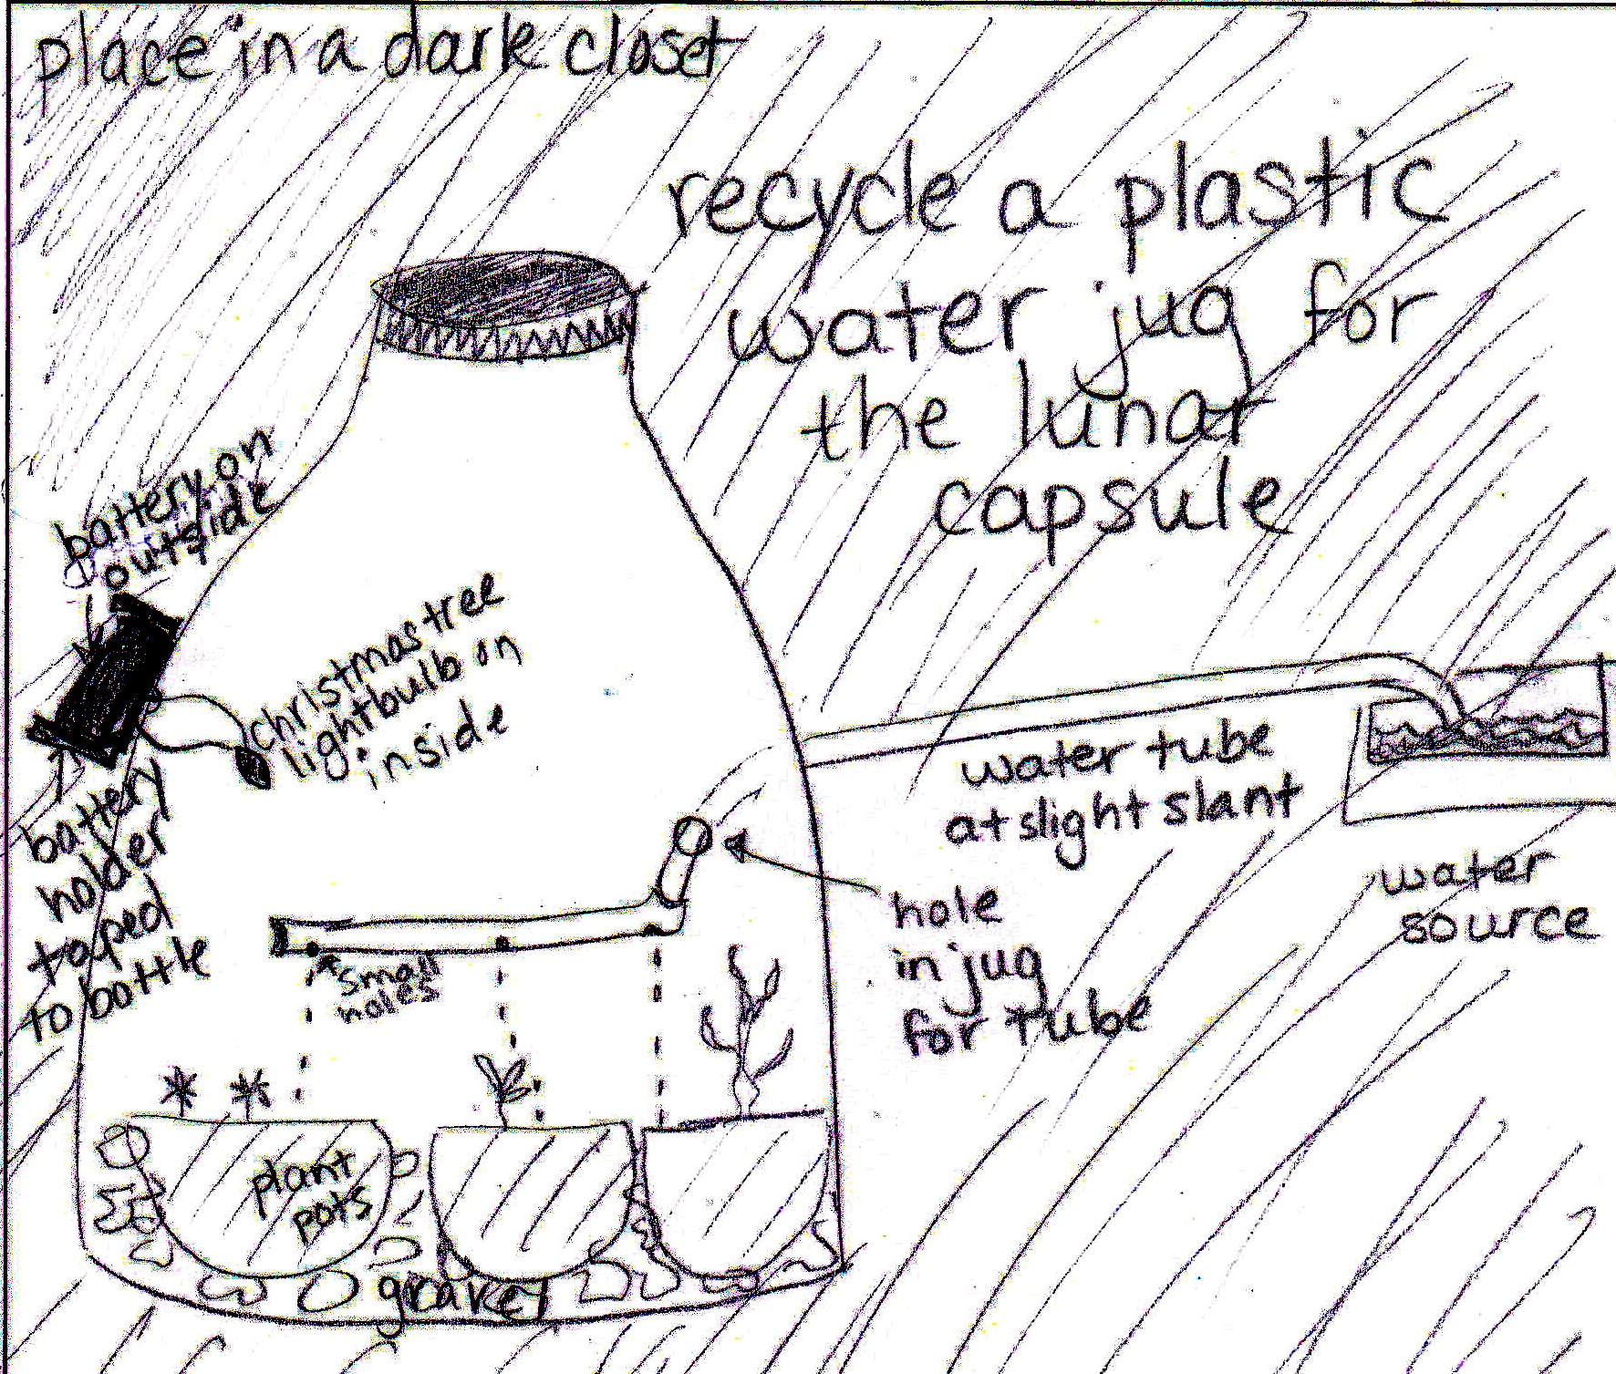
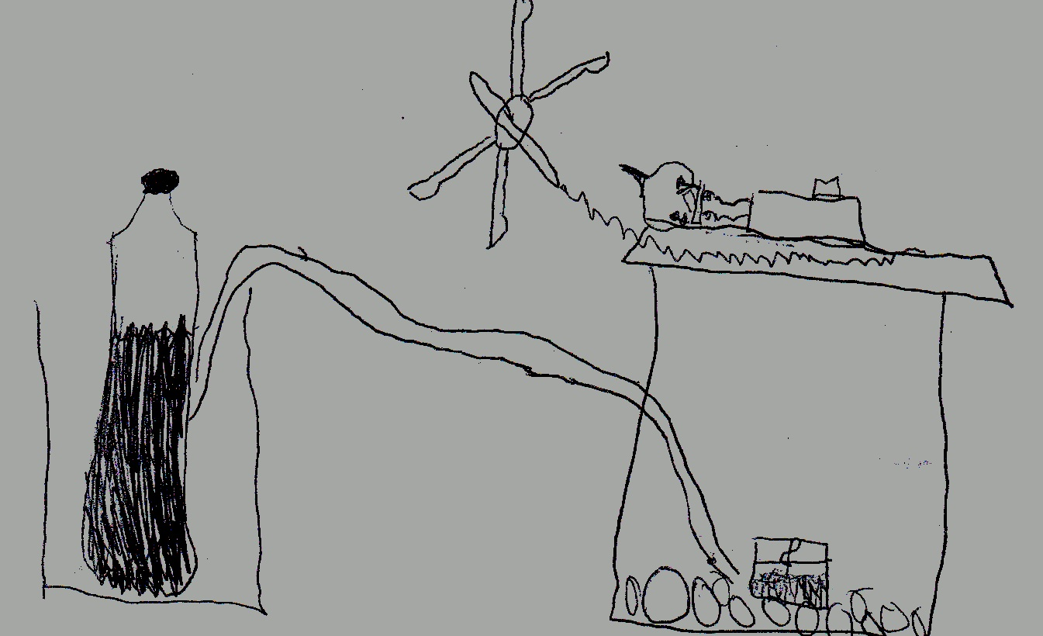
Adjustment: let’s use recycled materials for the chamber.

Slide 17
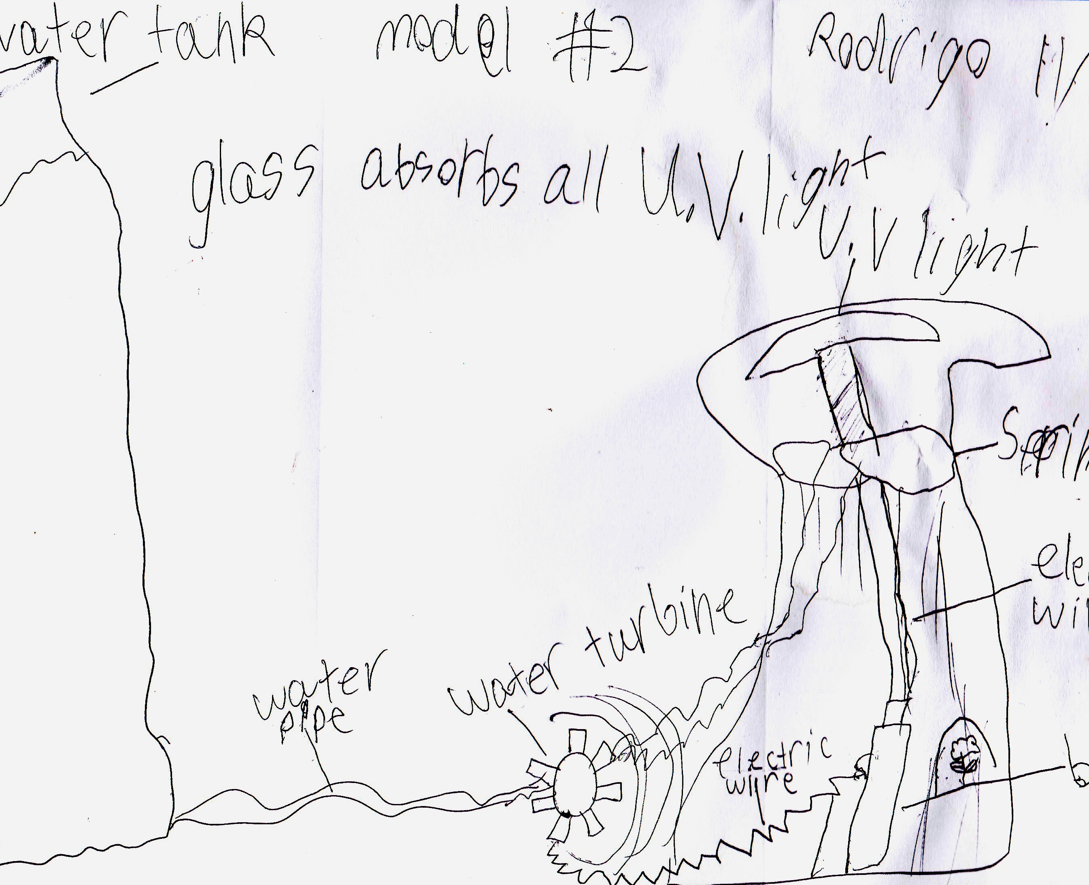
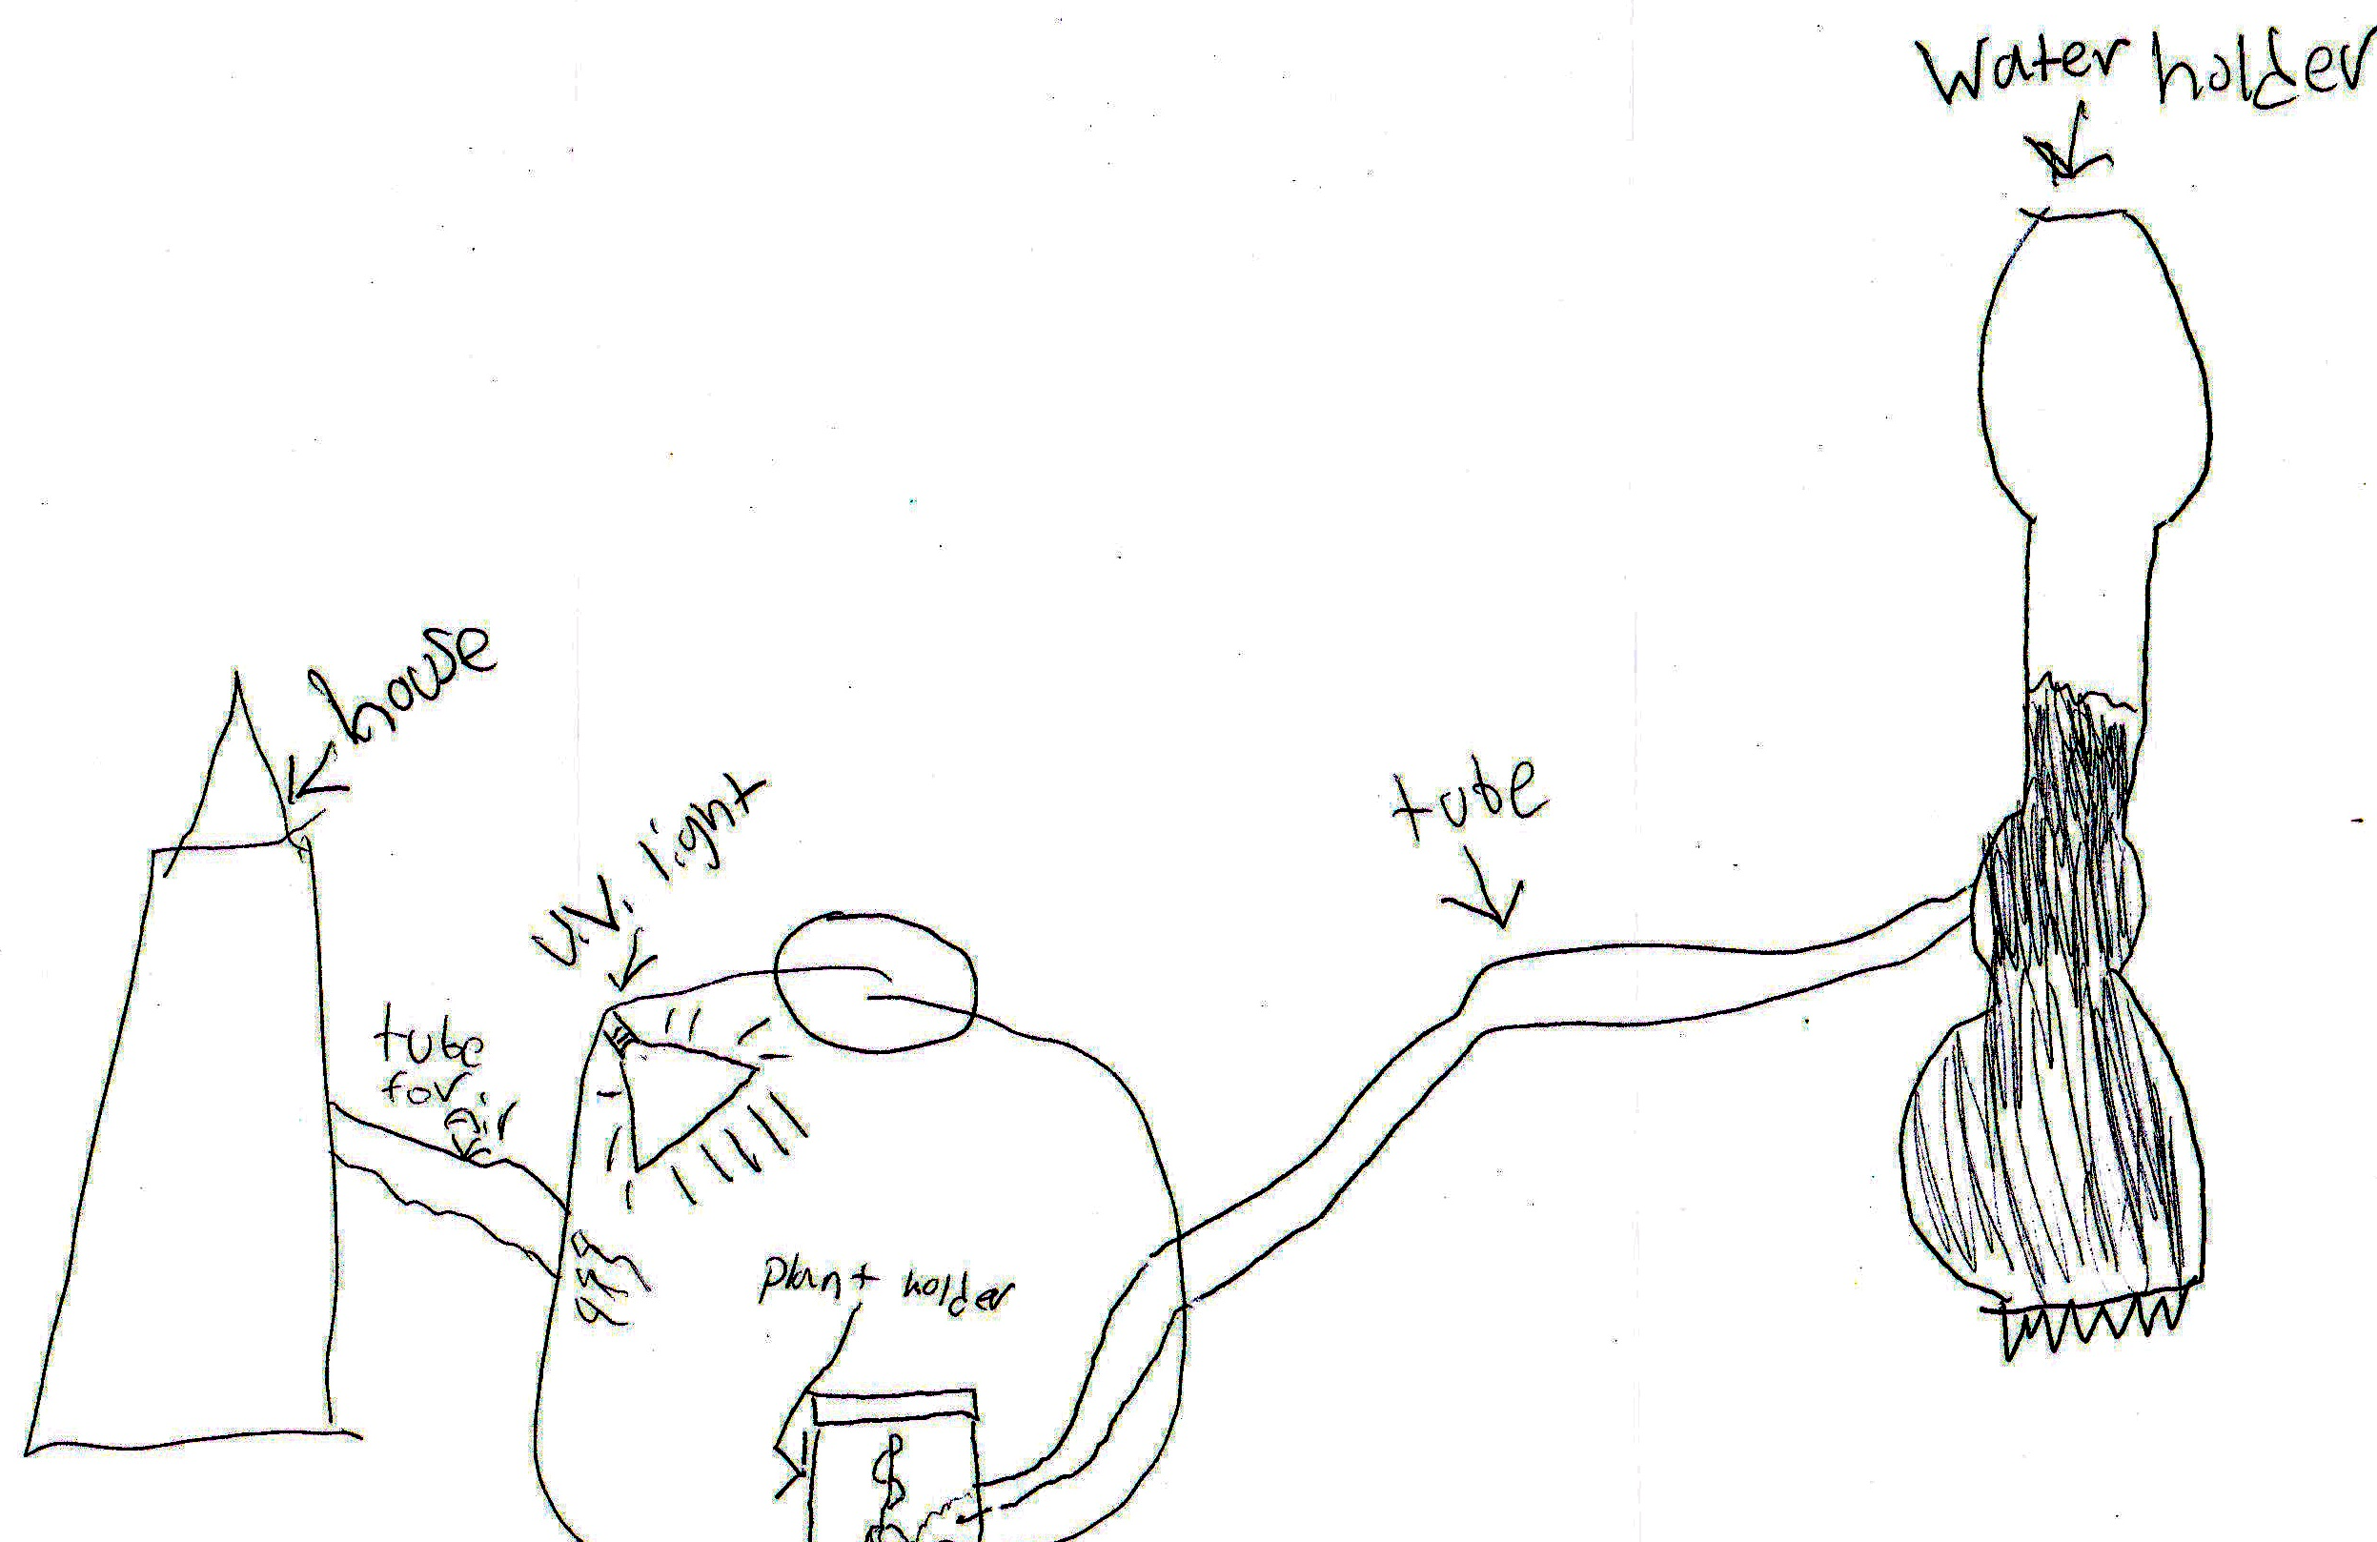
After sharing, students realized the need to make new sketches

Slide 18
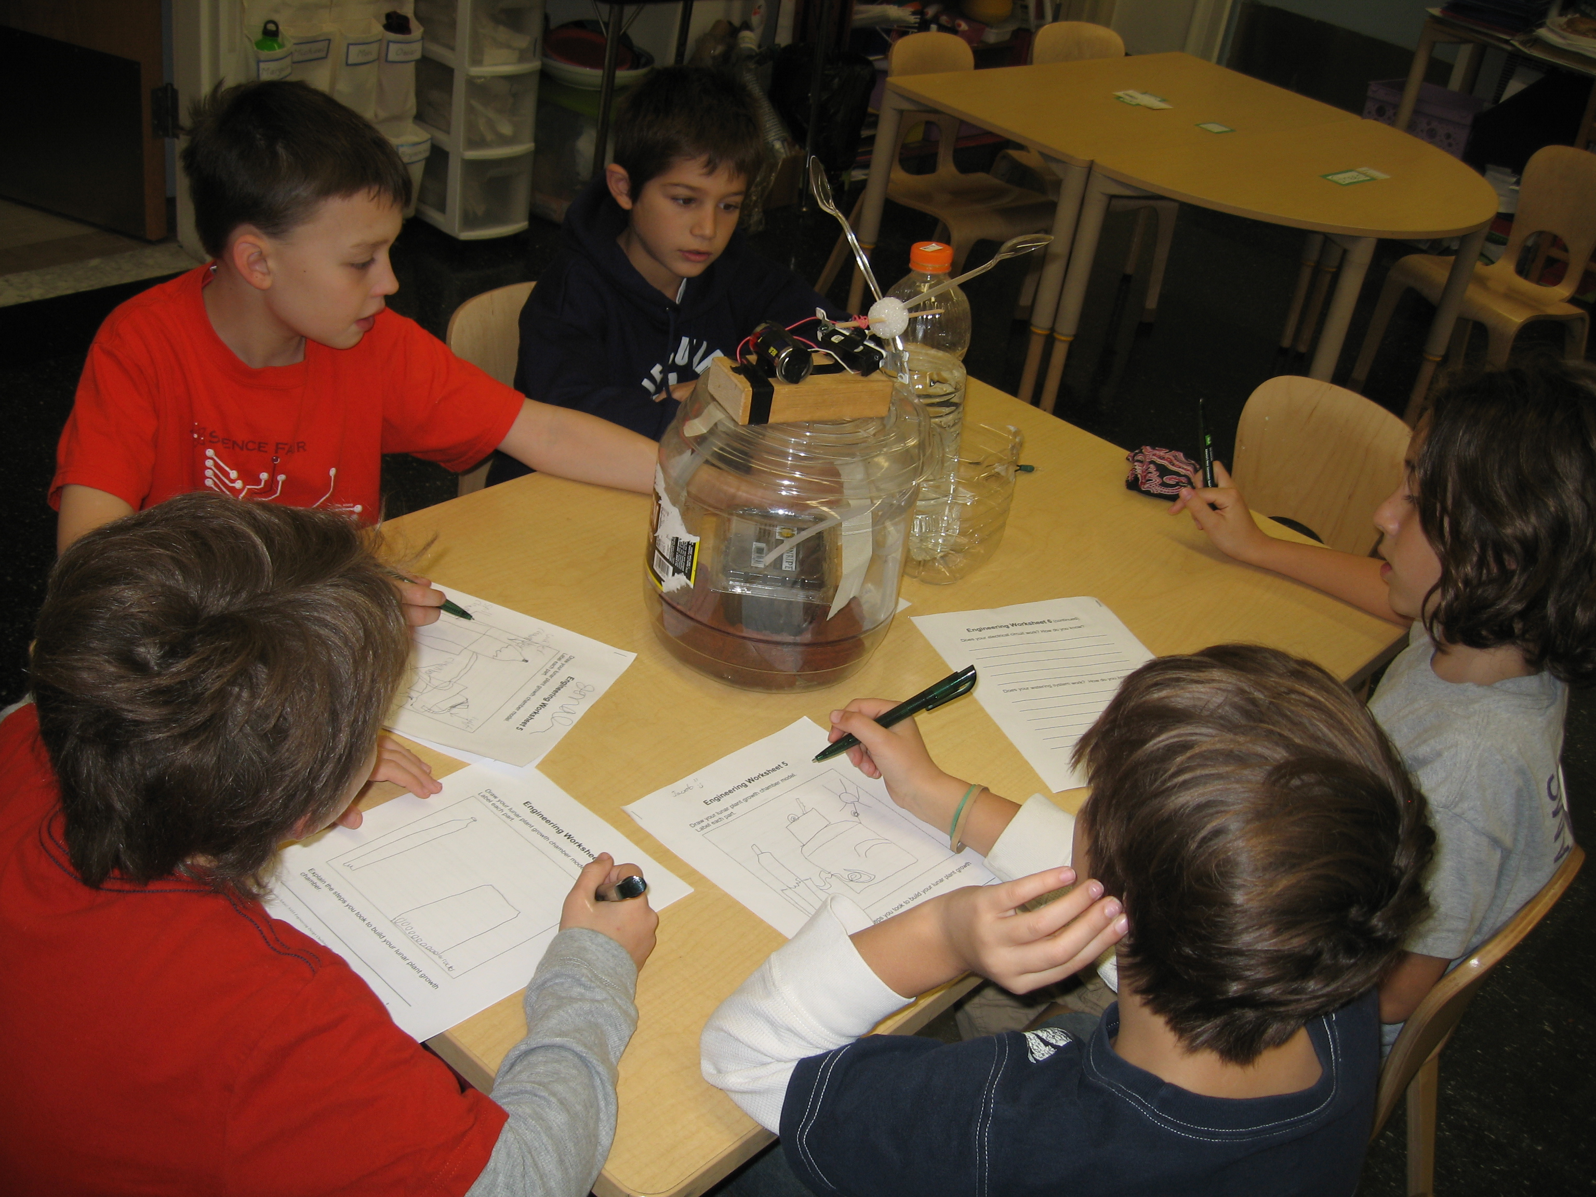
First Construction
The group melds together and agrees to make one lunar plant growth chamber on November 18th. They listen closely to each other, yet make sure that their important ideas are heard.
The students use recycled materials for the chamber, water tower, and seed holder. After the first construction, they are not so happy with their watering system.

Slide 19
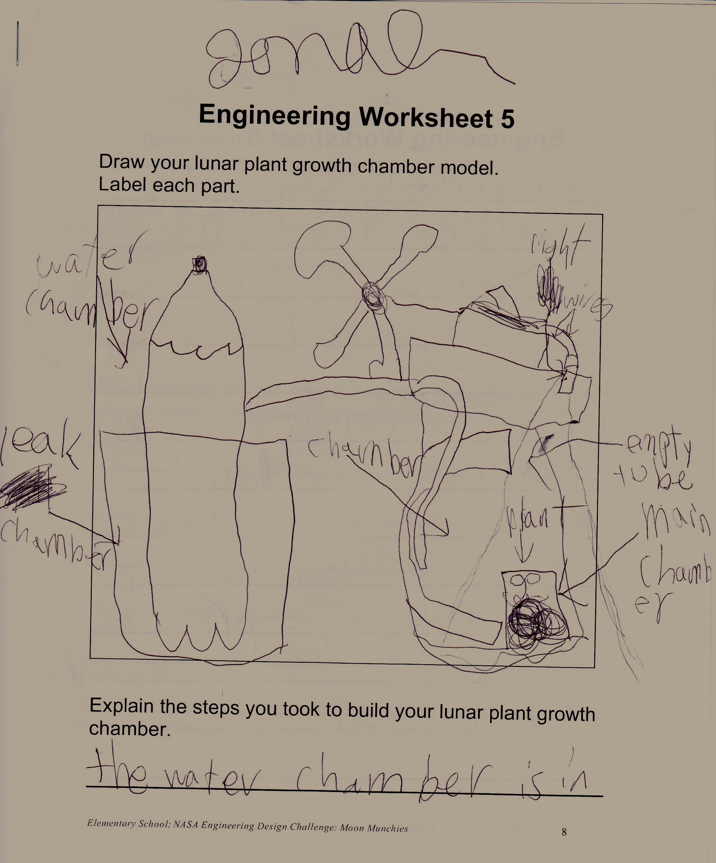
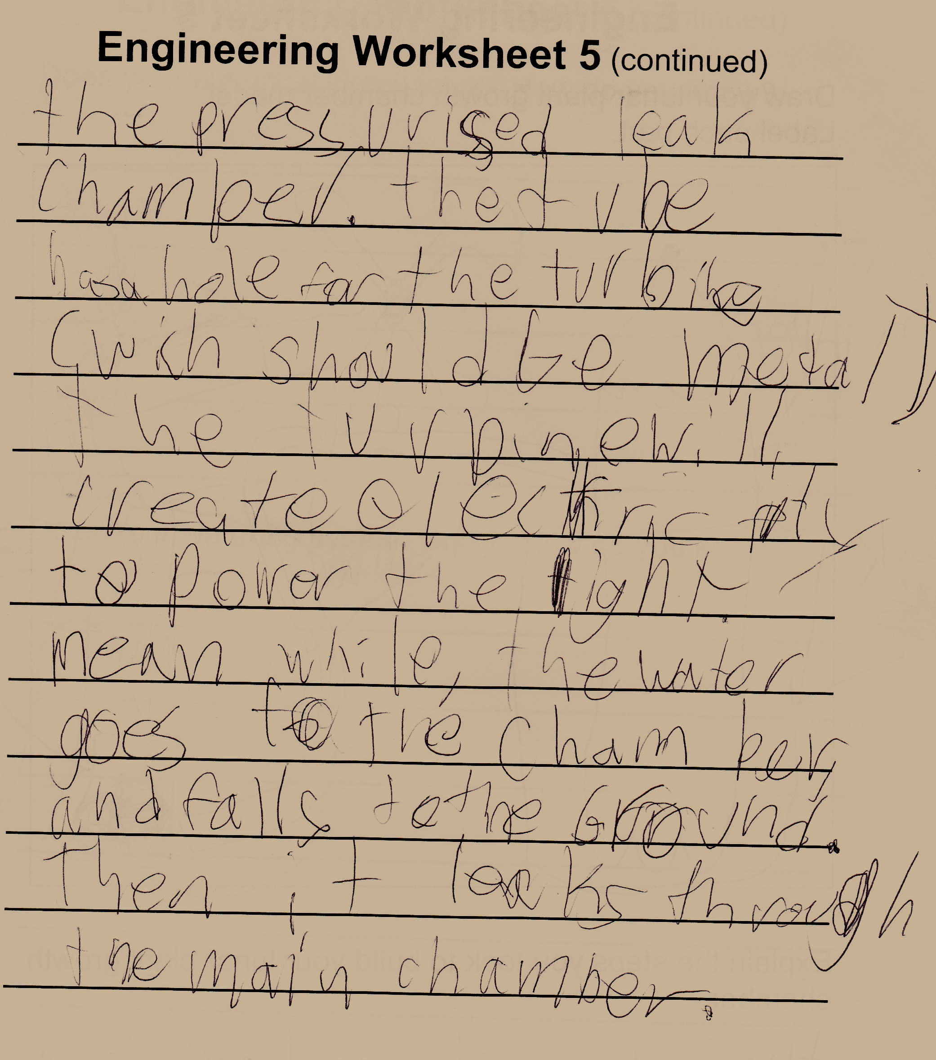
Testing and Evaluation

Slide 20
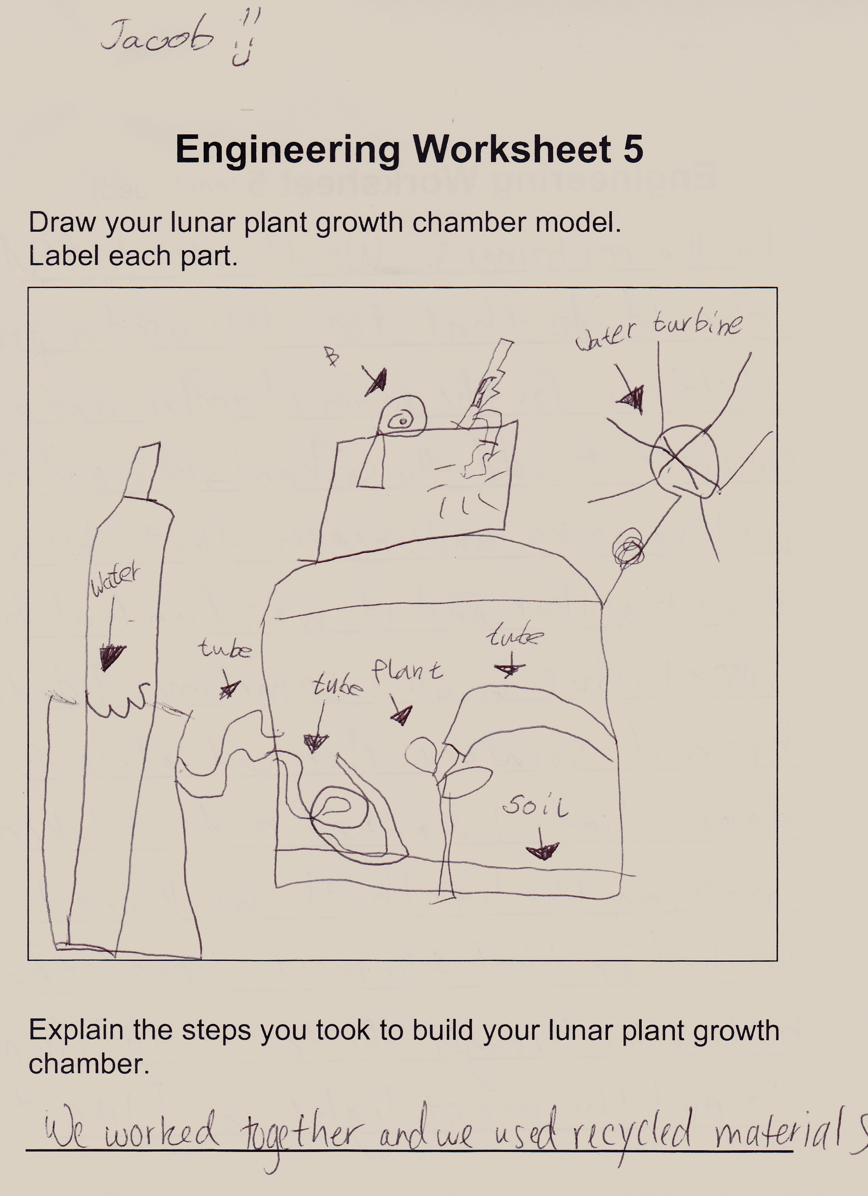
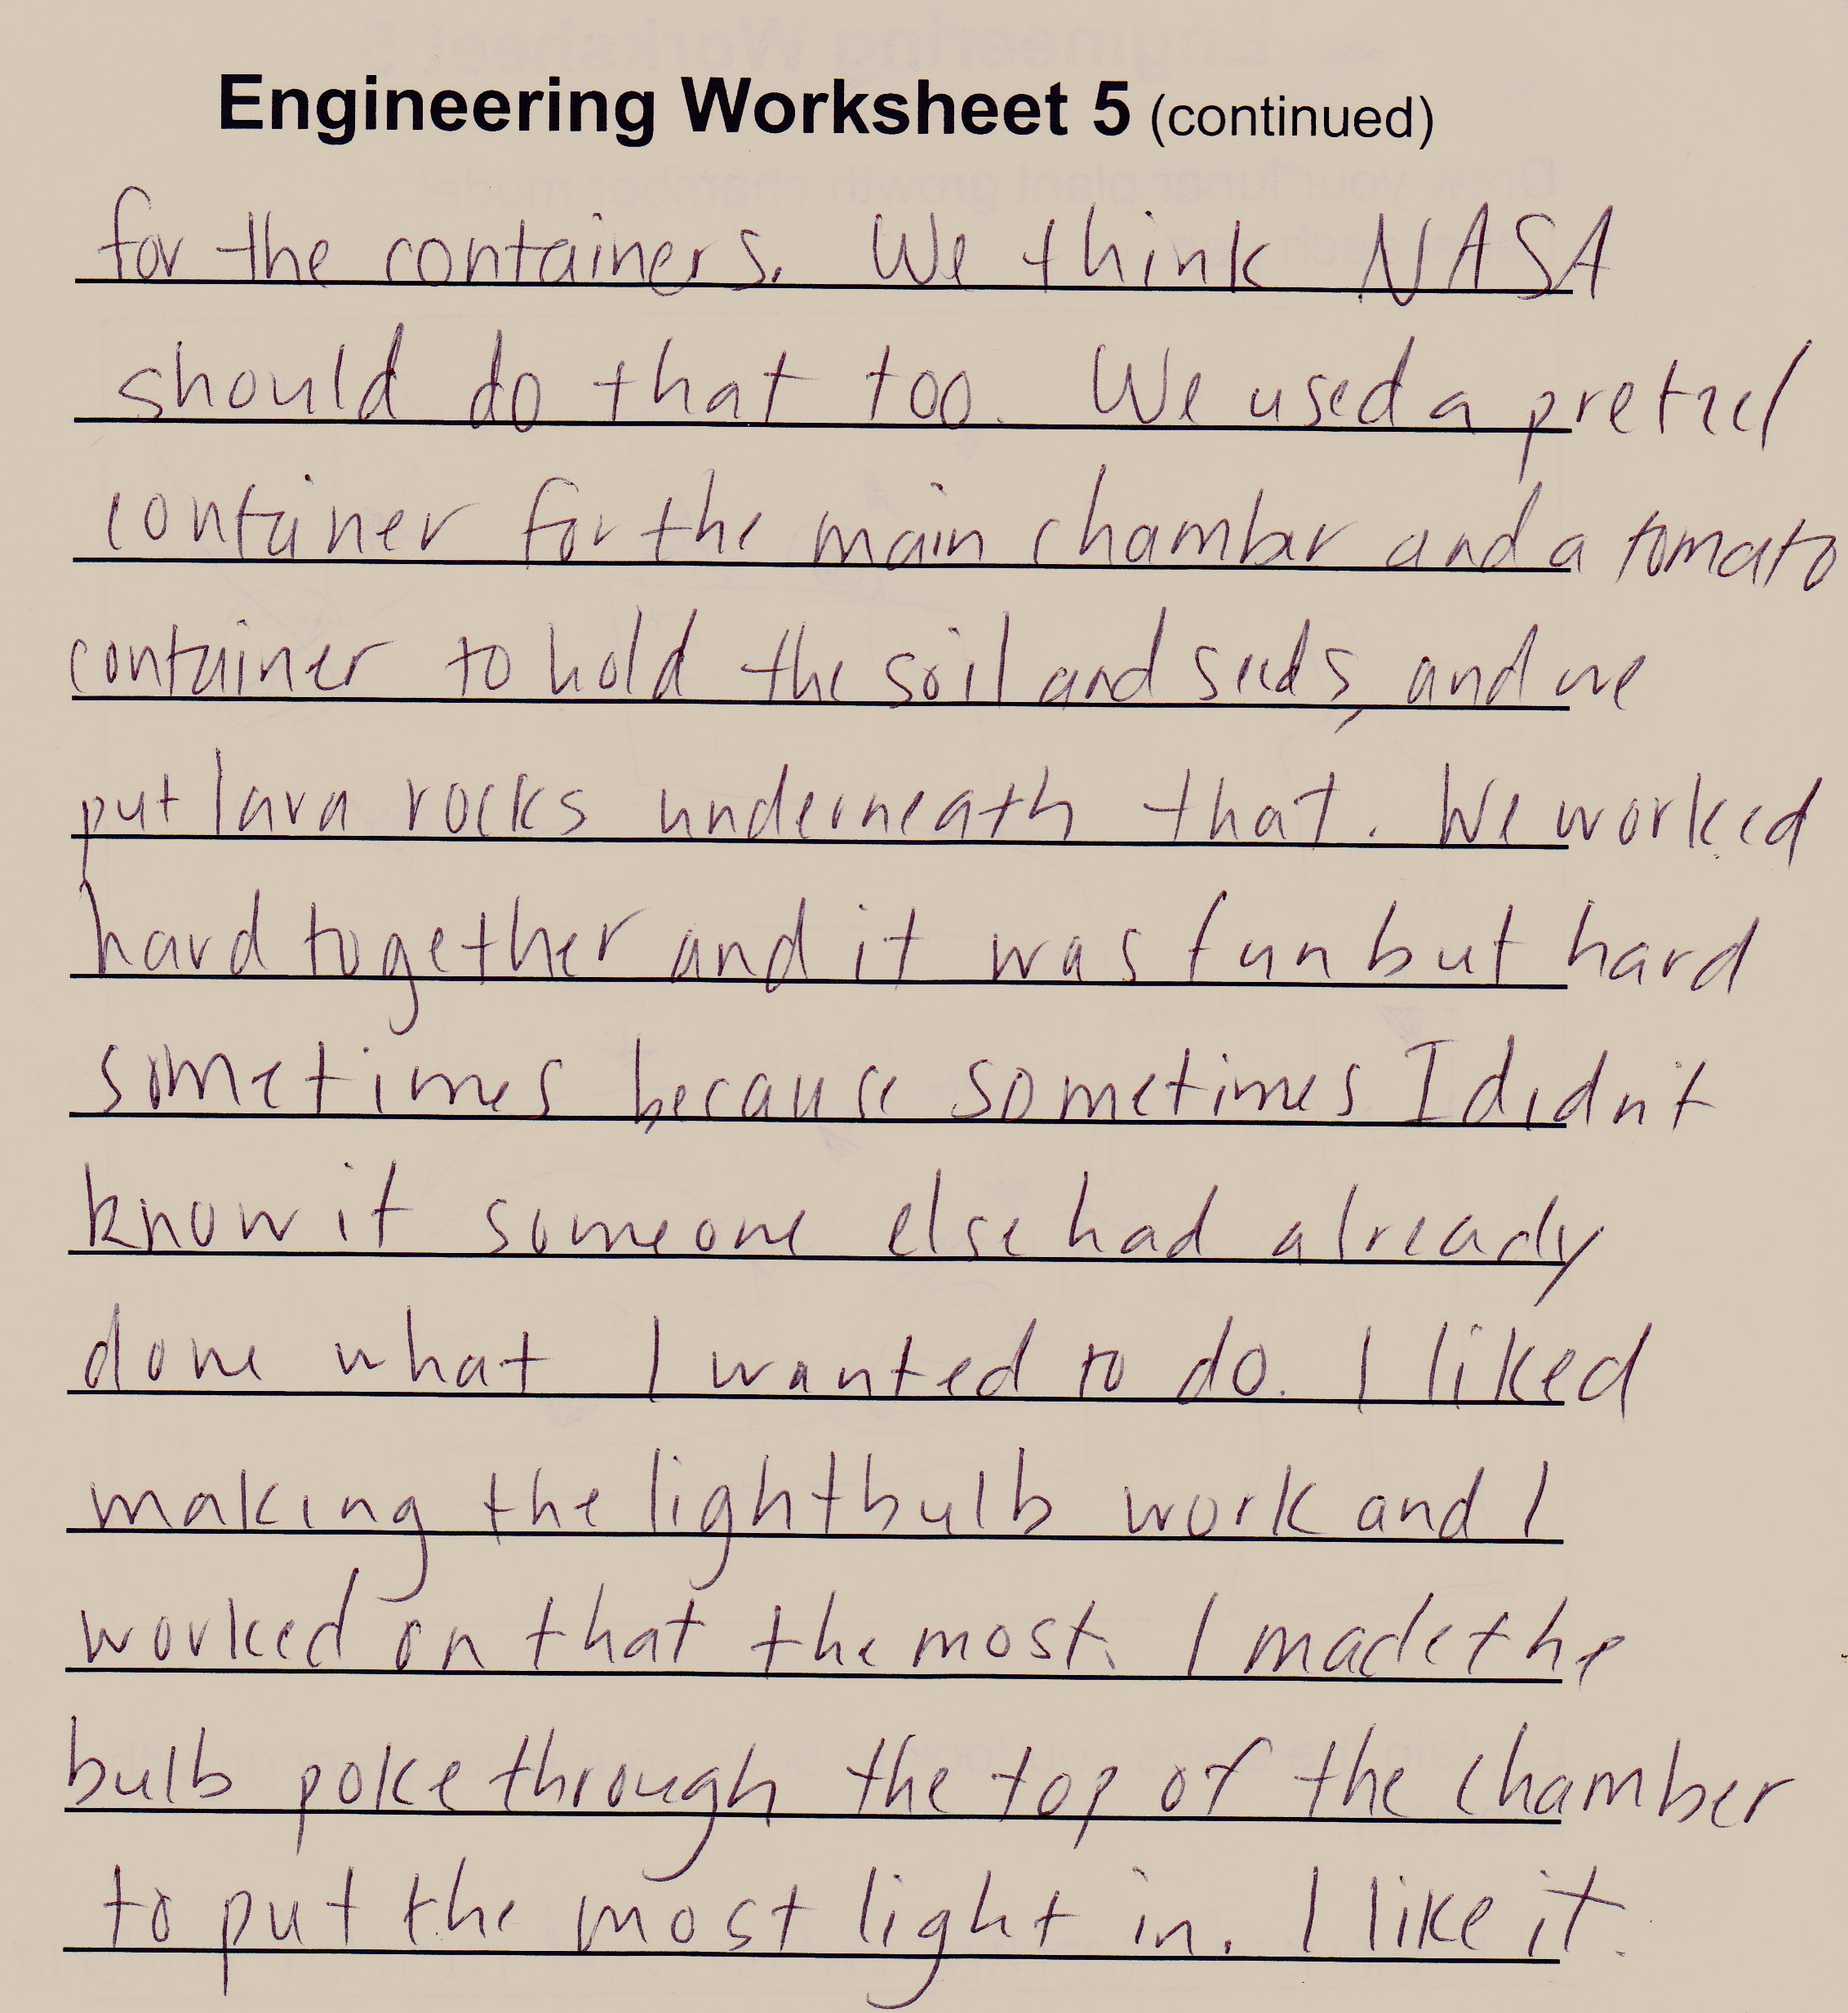
Testing and Evaluation

Slide 21
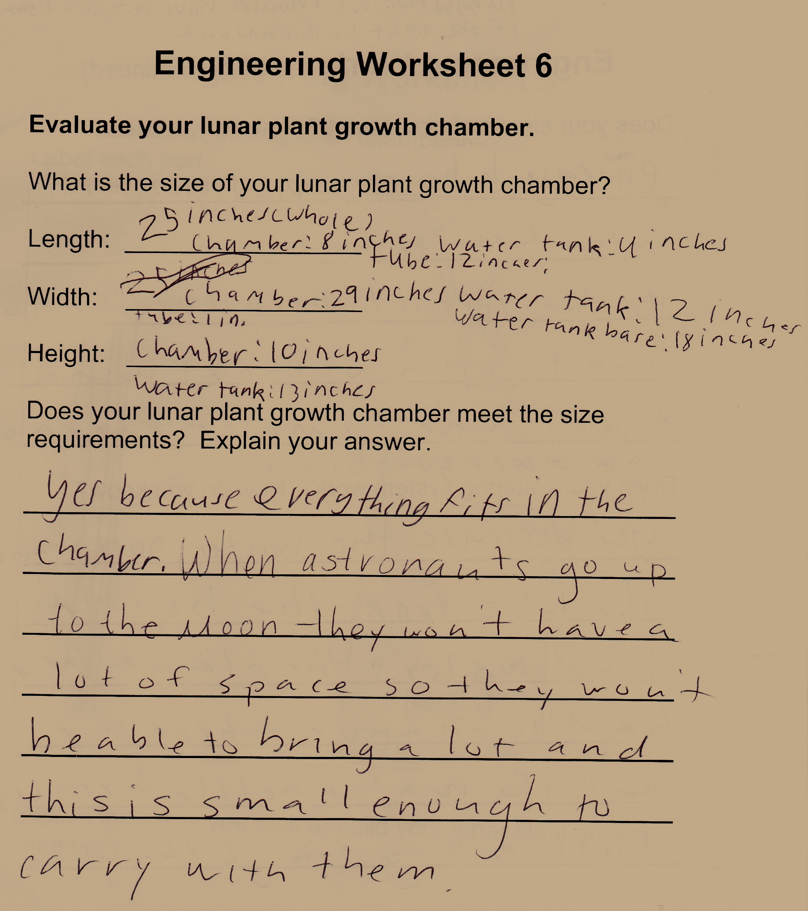
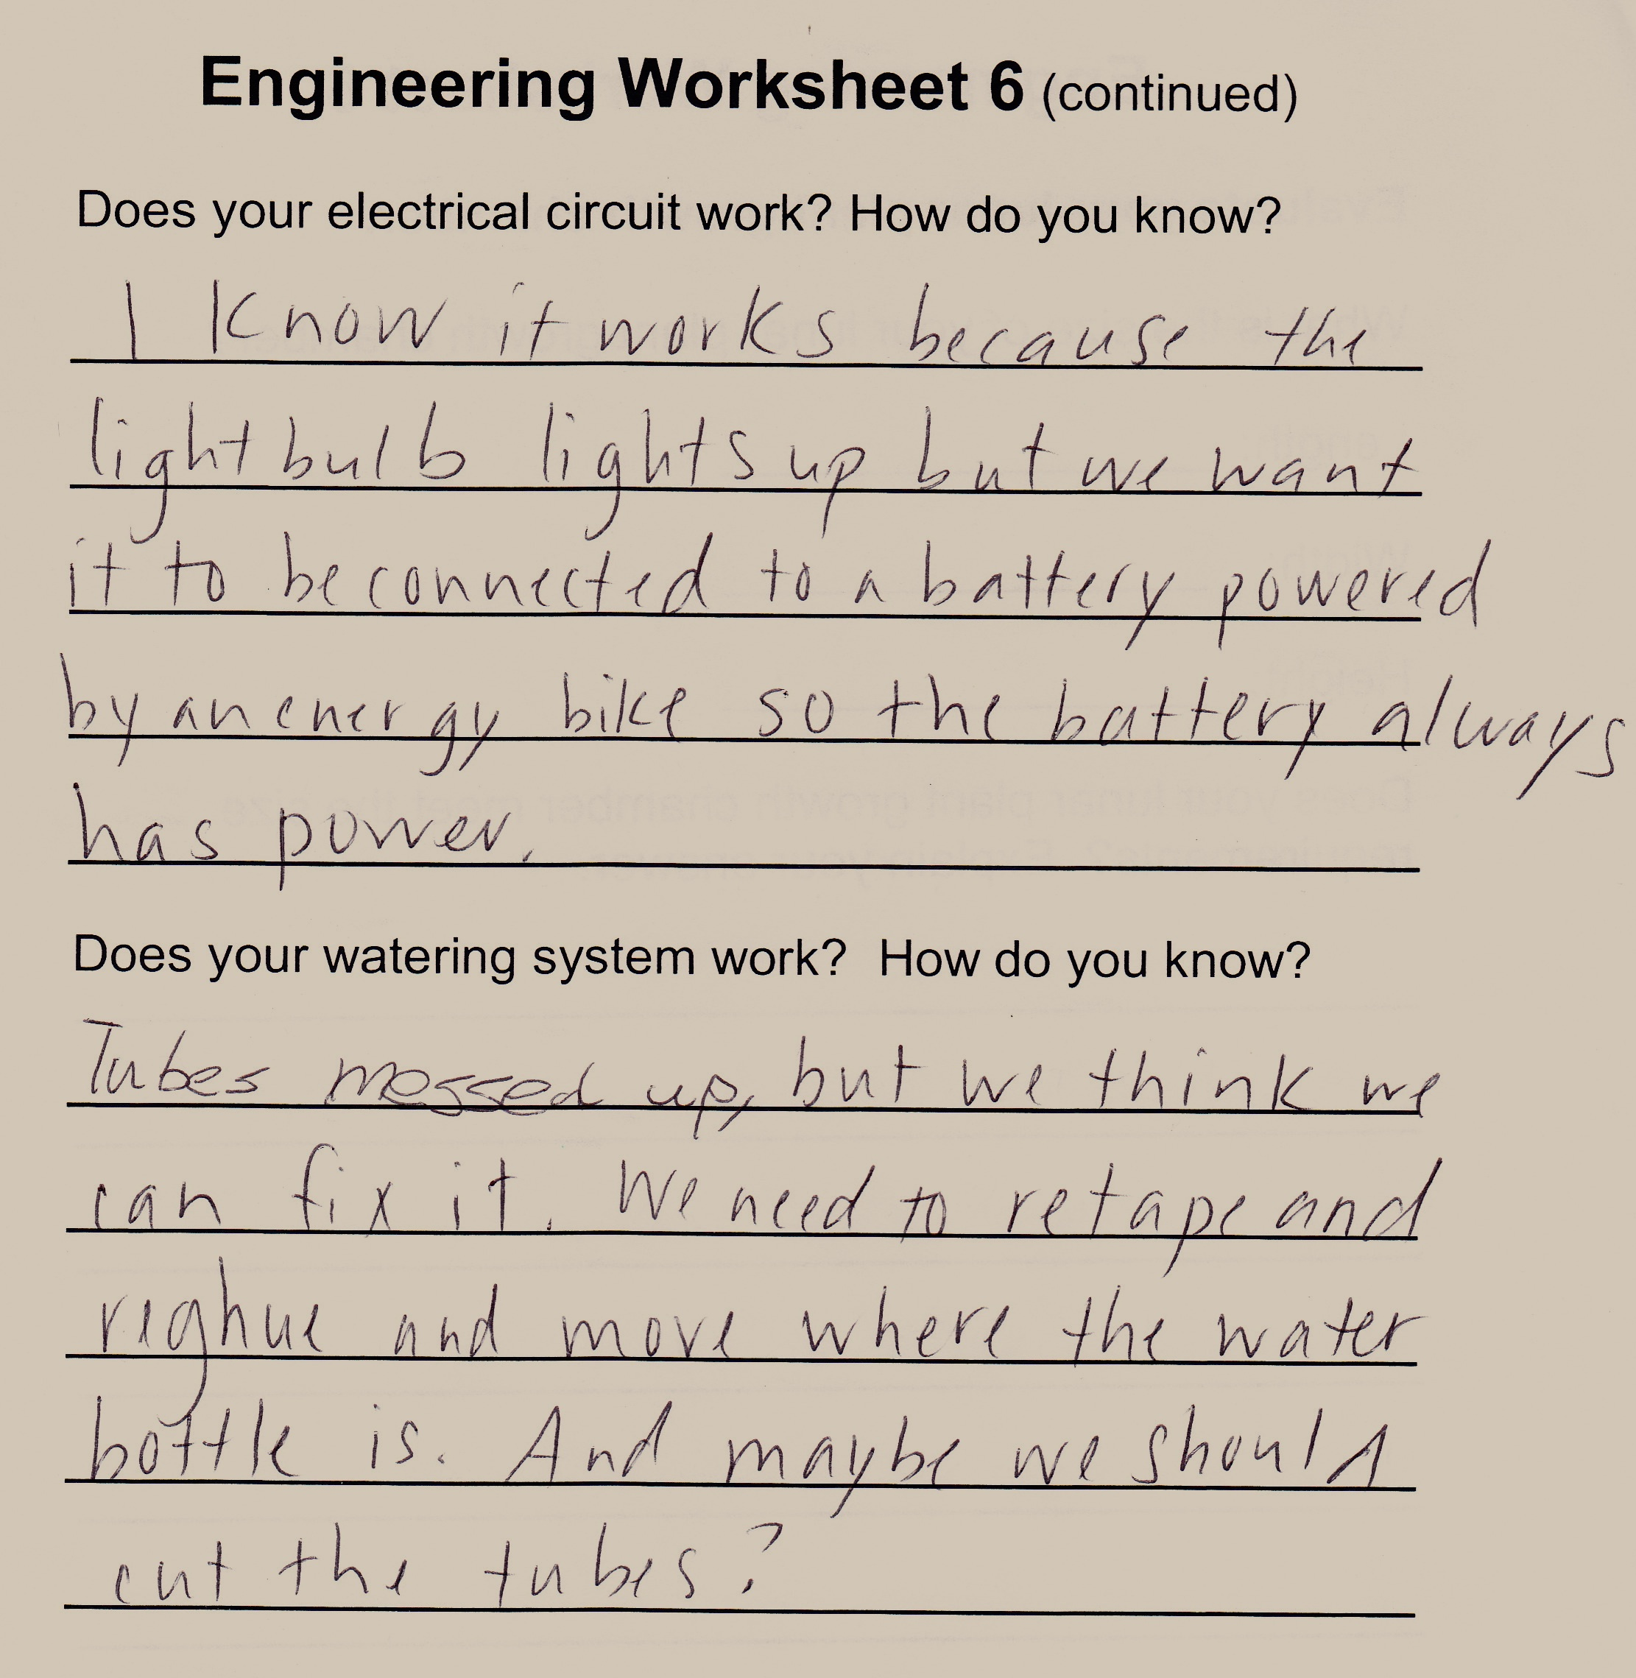
Testing and Evaluation

Slide 22
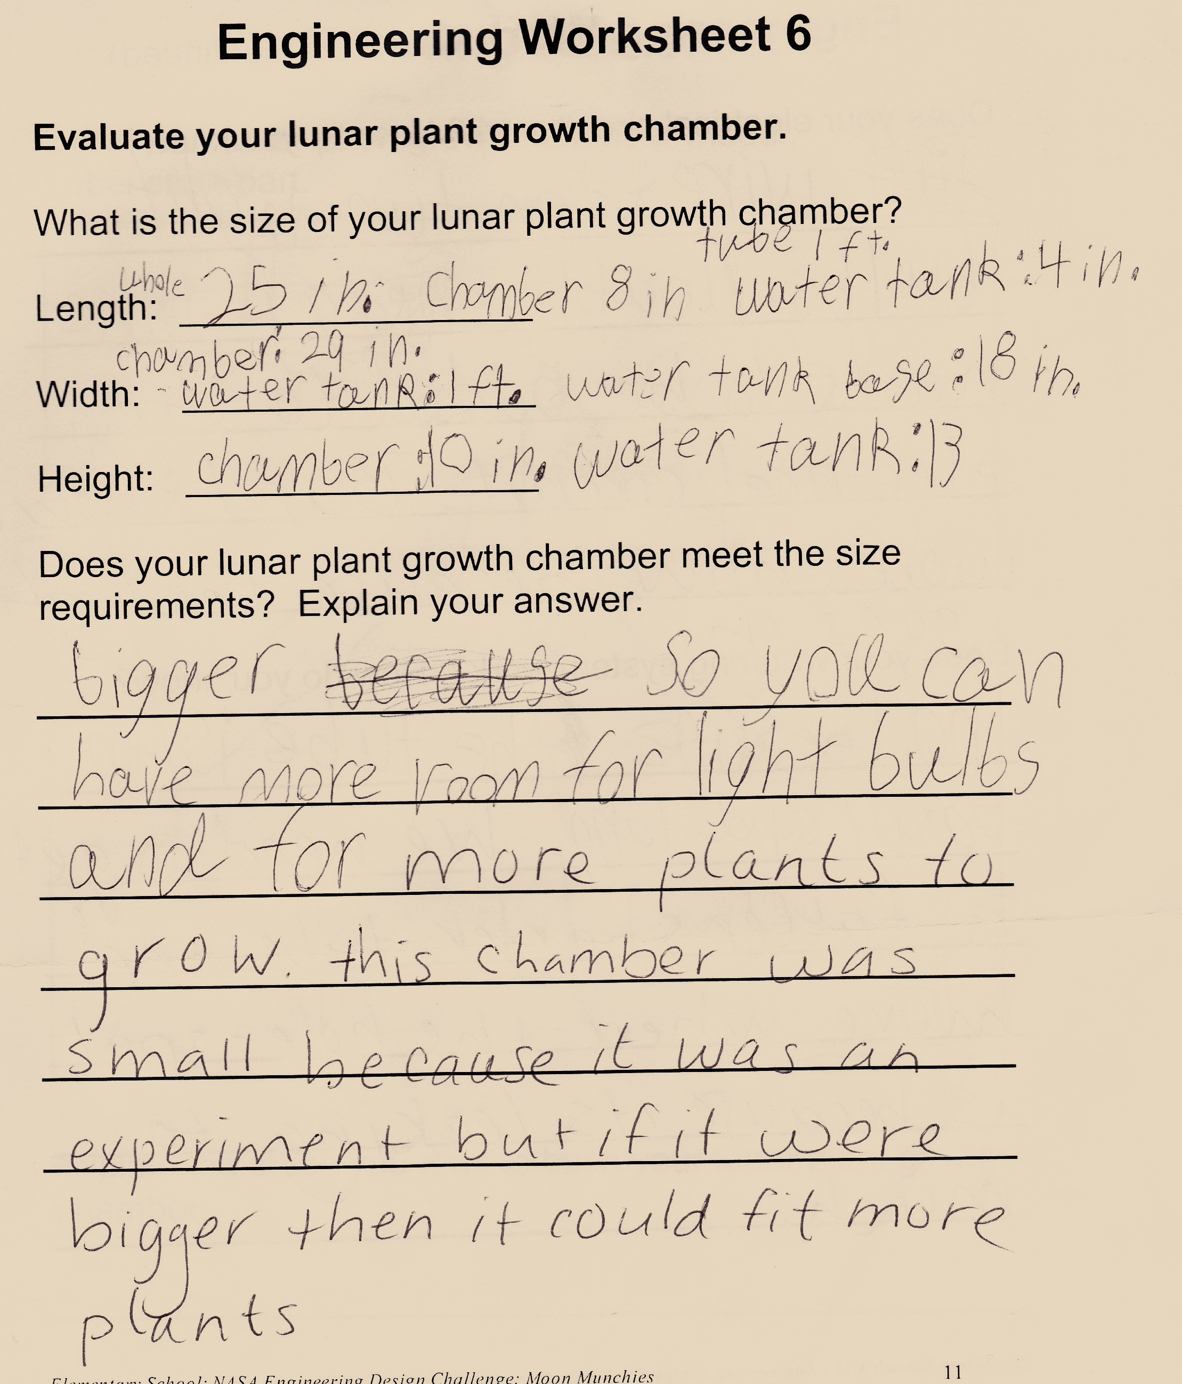
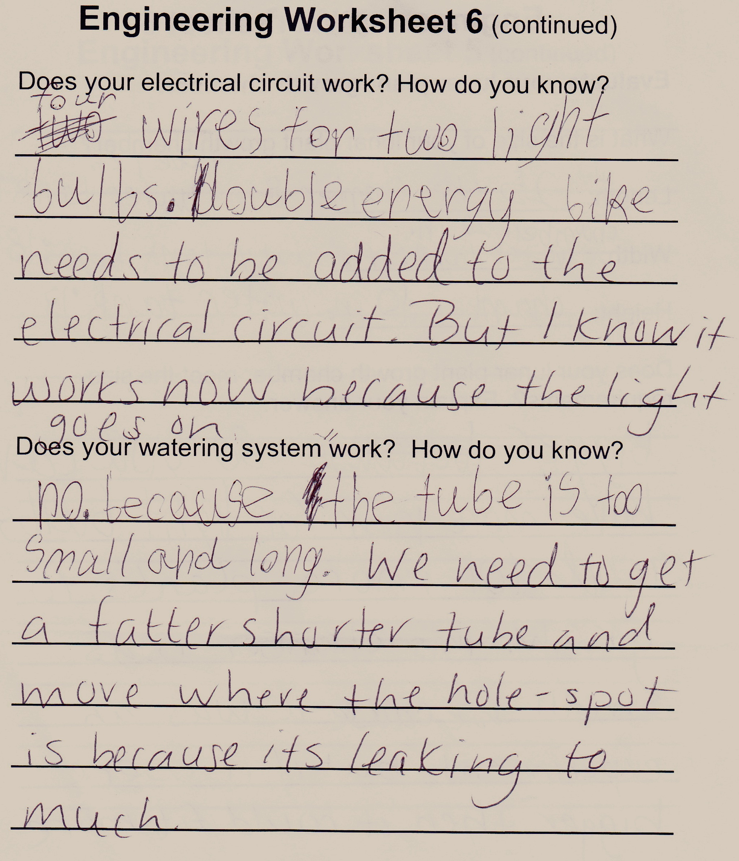
Thoughts and opinions

Slide 23
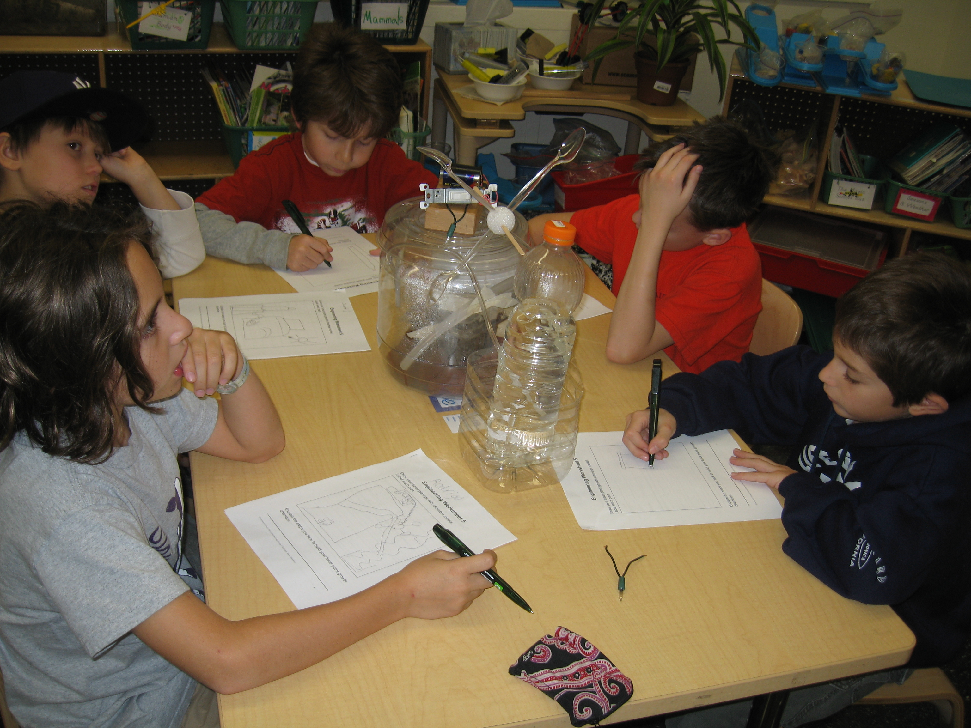
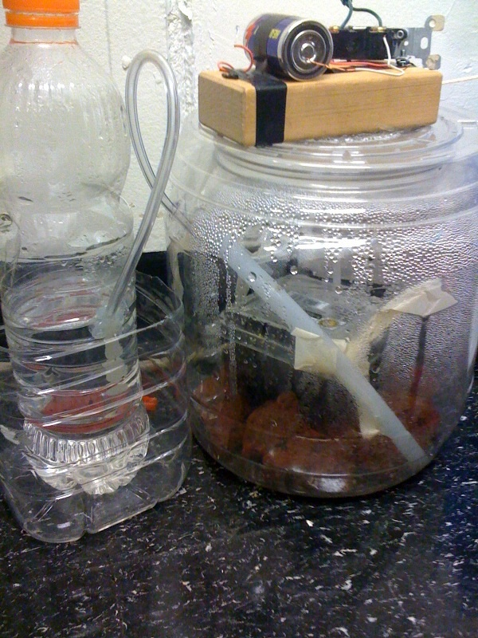
Lunar growth chamber

Slide 24
Building the chamber

Slide 25
Final Thoughts
After a couple sessions in late November of evaluating, modifying, checking, tweaking, and pondering, the students decided to let the chamber sit. Although they felt that they could still improve the chamber, we were all worried that the seeds would be disrupted if they were jostled too much.
Our basil seeds are growing, and the Early Engineers check on them frequently. They are quite proud of their construction, and they wanted to share their work with their peers. The engineers worked on posters to hang up in the hallway, and we also showed the other third grade students the video that I put together.
Next on our list of things to do: Write a letter with recommendations to NASA…

Slide 26
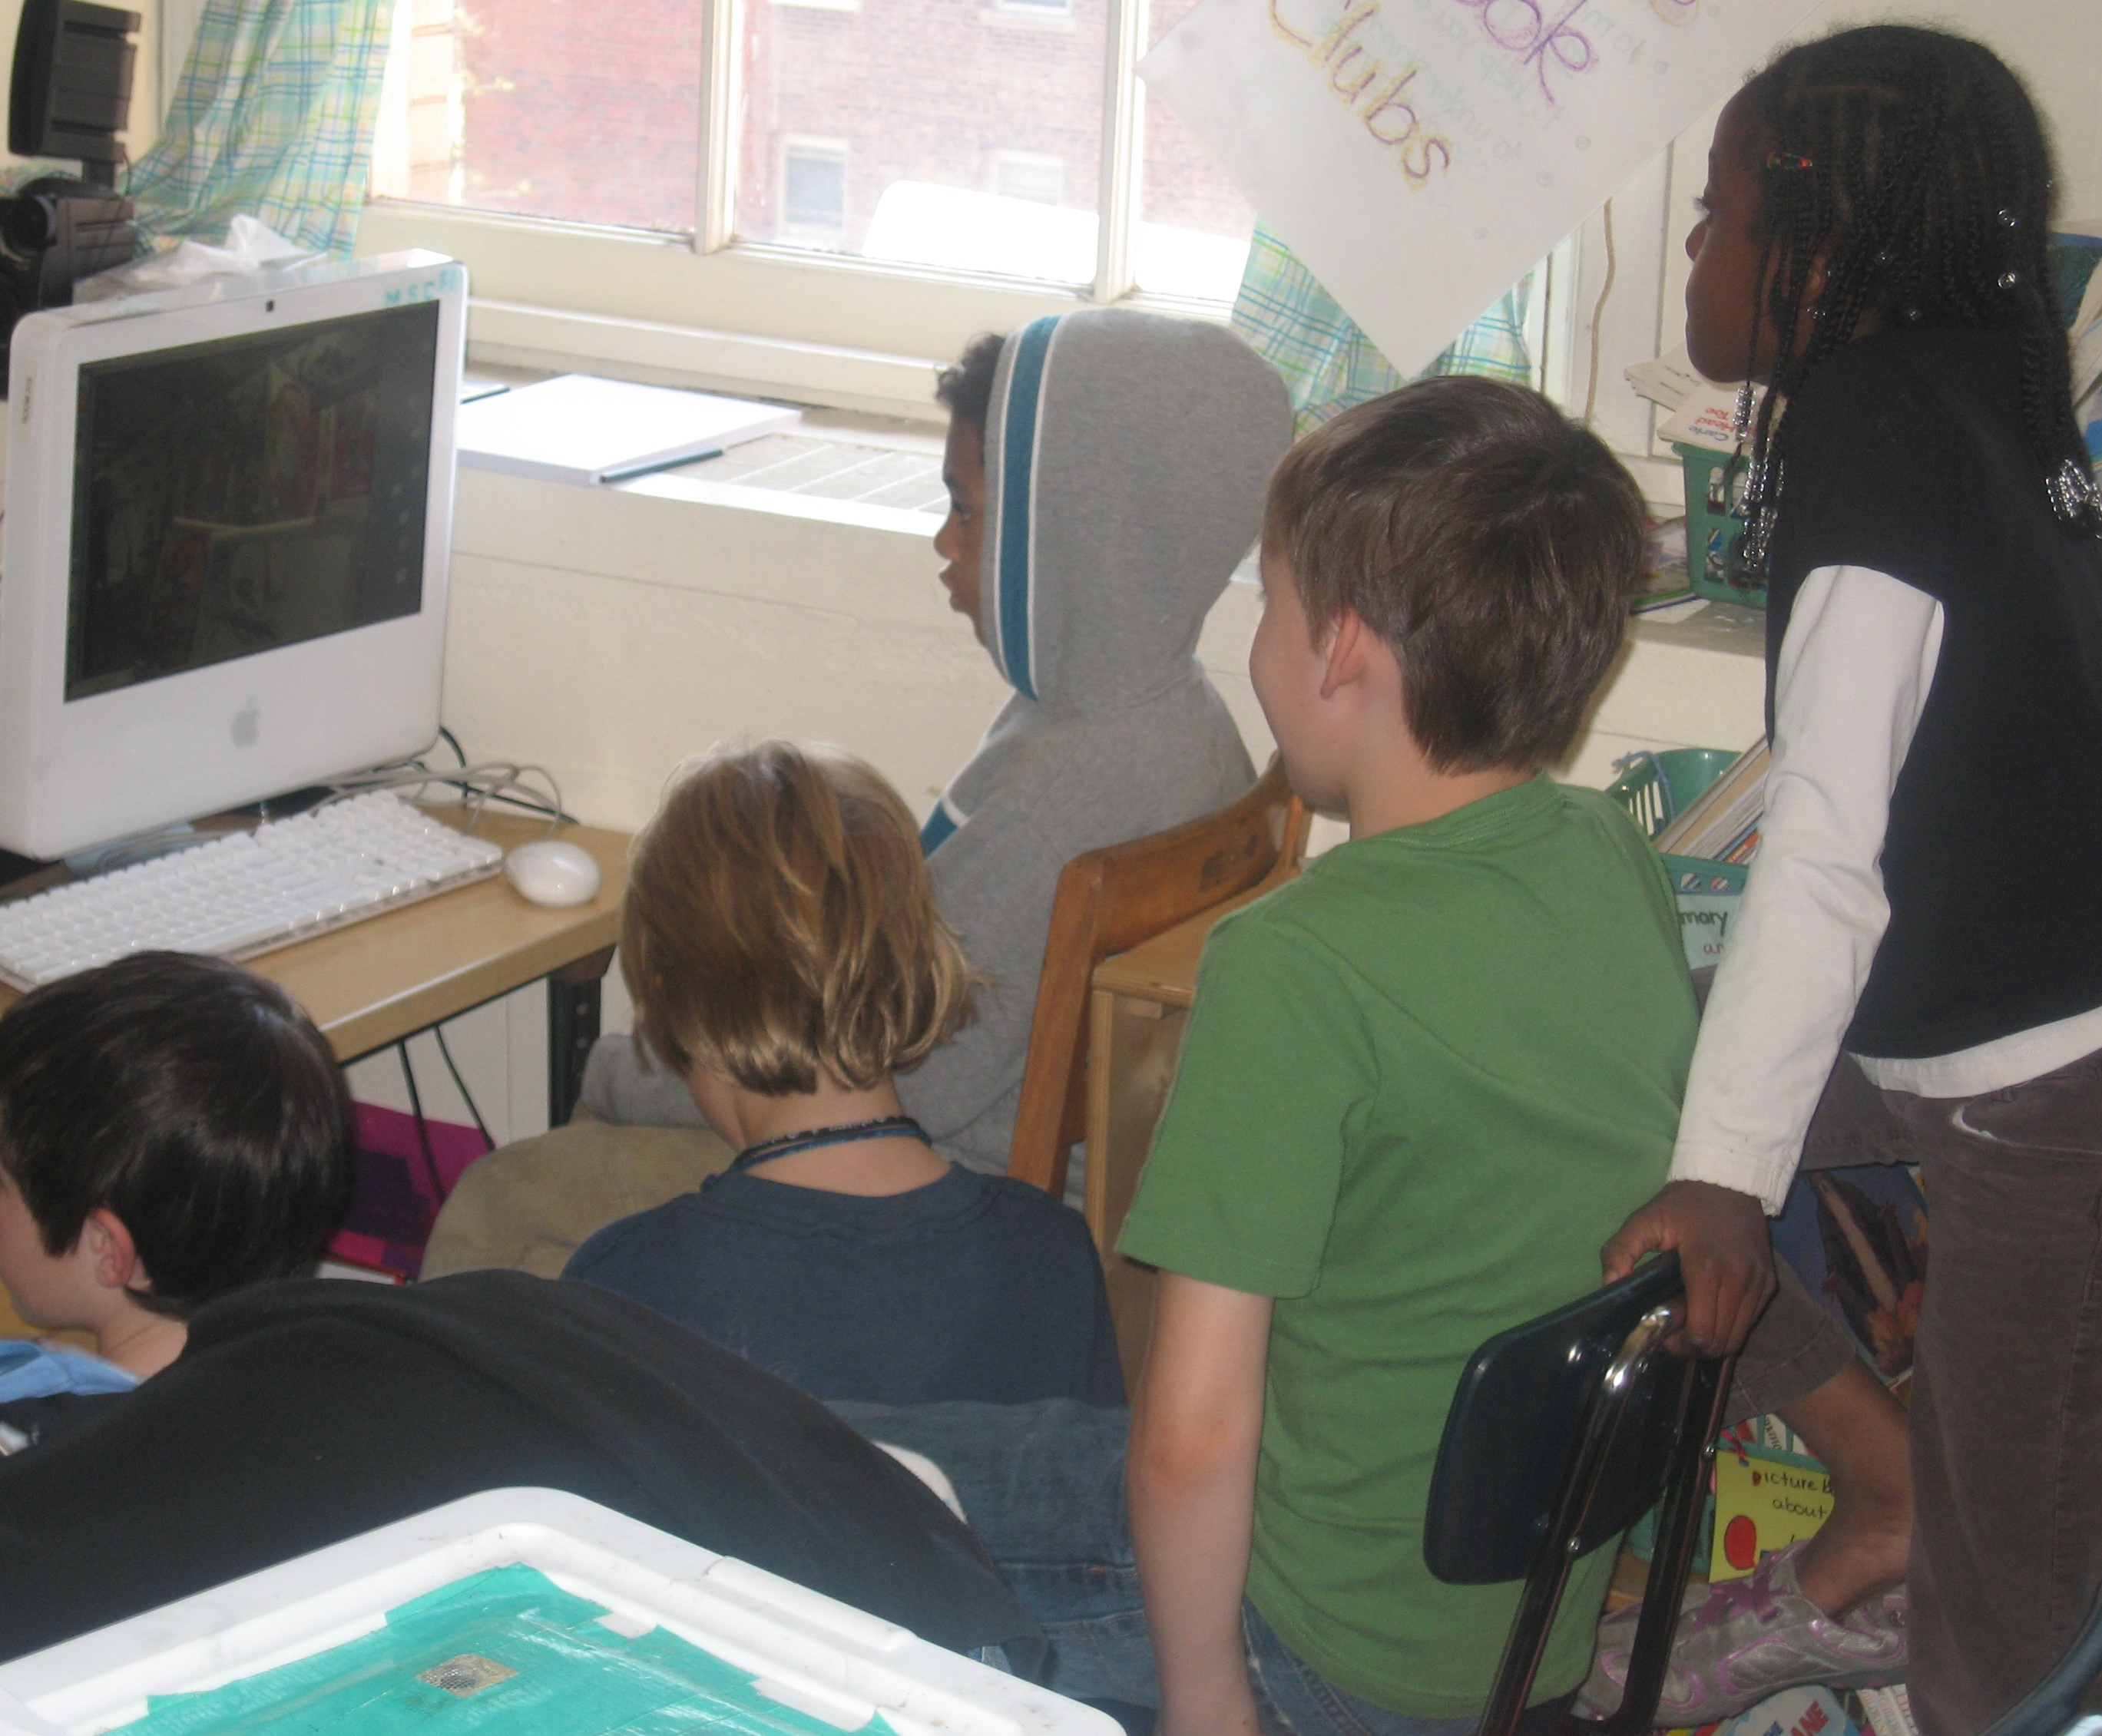
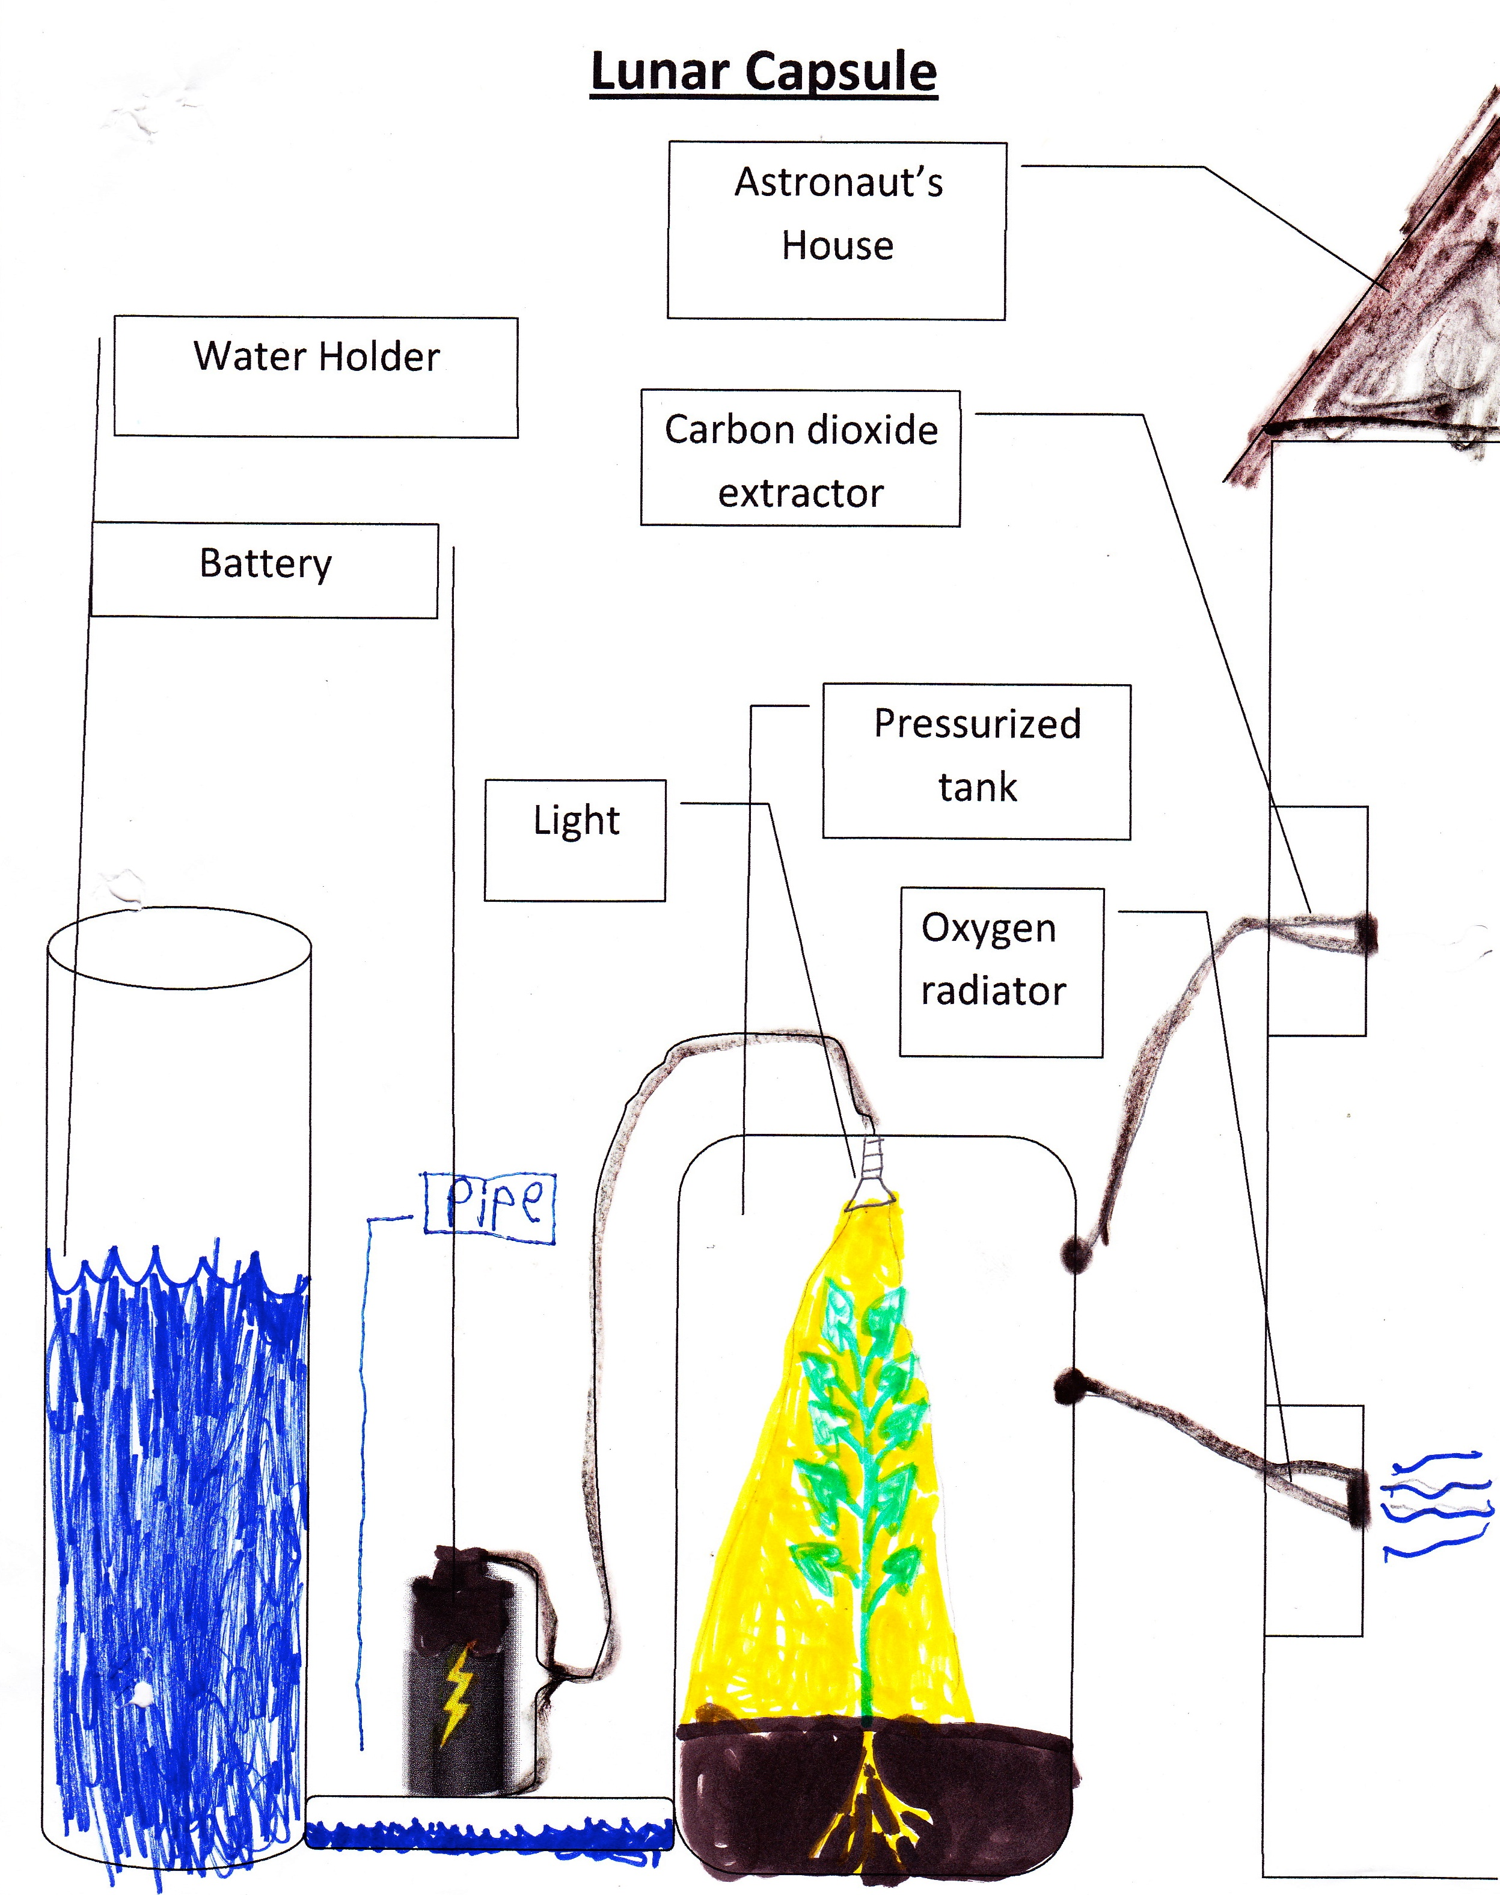
Sharing our results
Showing our movie to classmates
A poster hung up in the hallway

