Slide 1


Lucy Goes Zero G
June 23rd –July 3rd, 2011

Slide 2
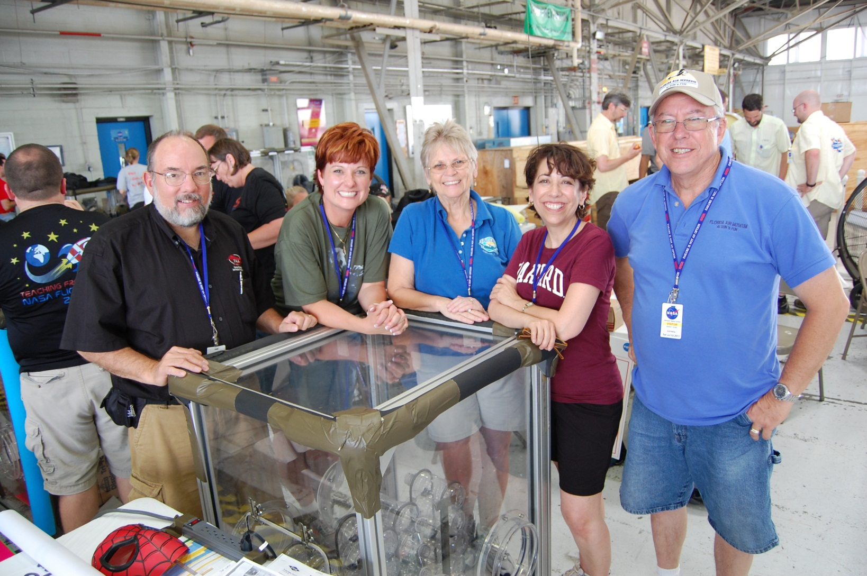
Starring…
George Bartuska, Lori Bradner, Joyce Sanborn, Ana Cecchin
And Ernie Sanborn from the CENTRAL FLORIDA AEROSPACEACADEMY
OF KATHLEEN HIGH SCHOOL, FLORIDA AIR MUSEUM and HARVARD

Slide 3
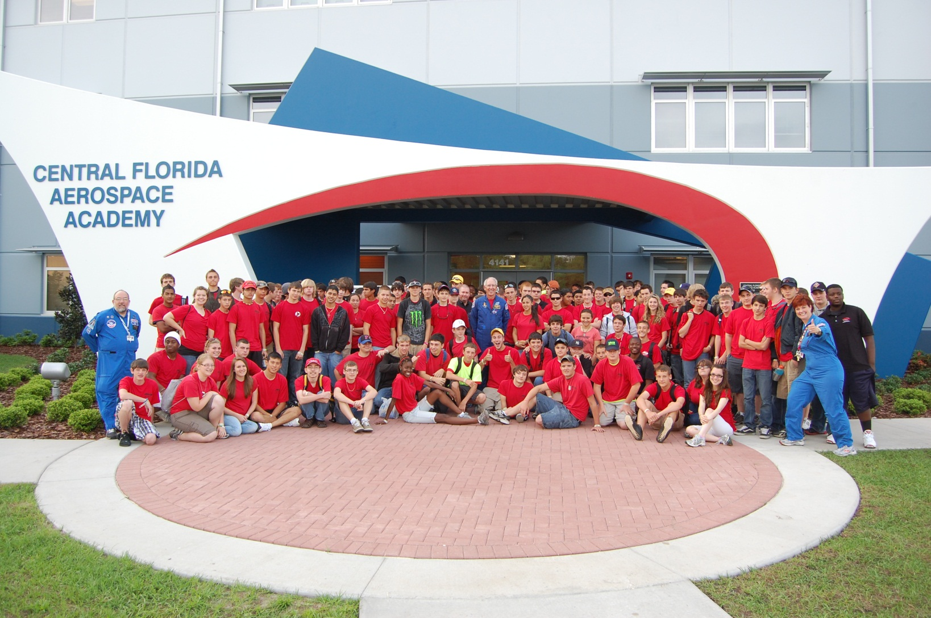
And…the students from CFAA
(The real stars of the show)

Slide 4
The experiment:
In continuation with the research already done with colloidal polymer mixtures on the Russian Space Station Mir, the STS 95 and the current research being conducted on the ISS, the students desired to study the reaction of common colloidal polymer mixtures in the micro gravity and high gravity environment offered by parabolic flight. The experiment addresses the concepts of the physics of colloids in spaces, states of matter, and fluid dynamics.

Slide 5
The Hypothesis:
The polyurethane polymer colloidal when sprayed in a microgravity environment will maintain a uniform spherical shape in the Plexiglas container due to the microgravity environment and equal pressure exerted on the colloid suspension on all sides given the free fall nature of the parabolic flight. The high gravity 2G portion of the flight will force the suspension to one side of the container allowing it to adhere to the Plexiglas glove box given that the polymer is still in the semi liquid state and has not yet begun to harden in the time between the micro gravity and high gravity portion of the flight. Although the polymer colloidal can be used as insulation and to fill gaps in a “normal gravity” environment, this same suspension will not spread to fill gaps or insulate the box due to the lack of gravitational pull. The students believe that all 5 polymer colloids will react the same under the conditions in micro gravity and high gravity despite the chemical and dispersion differences.

Slide 6
Equipment:
Equipment Description
50 clear plastic 2 liter bottles with lids labeled A, B, C, D,
Lids may be configured with small vent/valve straws if laboratory controls show unexpected increase of pressure inside the bottles.
8 containers of Dow Chemical Great Stuff polyurethane sealant.
(2 of each of the following: Big Gap, Fire Block, Gaps & Cracks, Windows & Walls) Class 2-controlled storage per MSDS temperatures no greater than 120F due to contents under pressure
Graph paper to cover backs of 2 liter bottles for quantitative measure
Metric rulers for measuring
Markers or grease pencils to note expansion on outside of bottle
Stop watch to calculate time of spray, expansion, curing and adhesion
5 single video/flip cameras for continual filming during flight
Mounting bracket to hold 5 liter bottles, separate camera for each bottle and spray can container holder next to corresponding bottle
Class 3-no special requirements

Slide 7
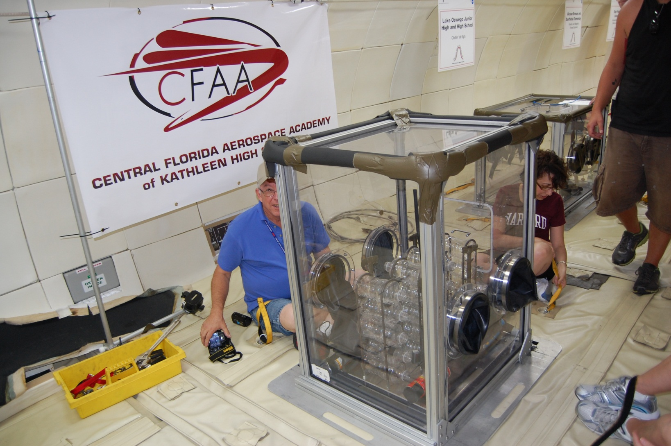
Locked and Loaded

Slide 8
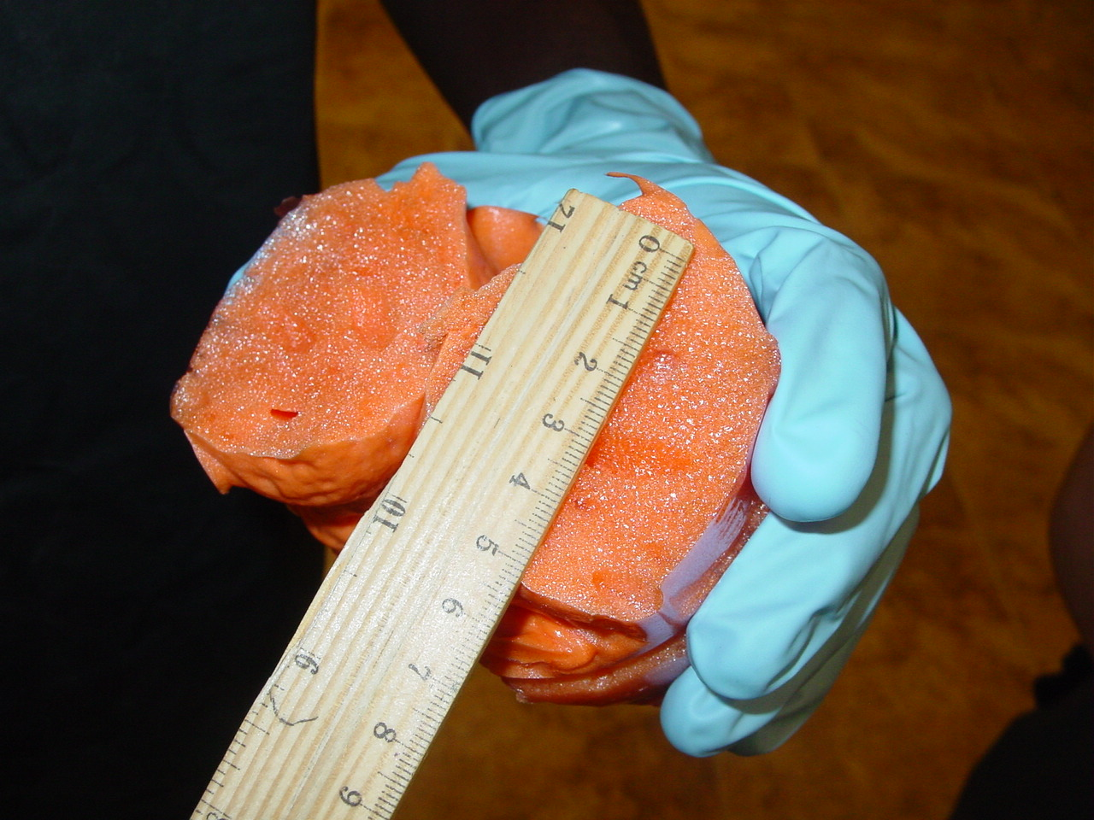
Initial Data:

Slide 9
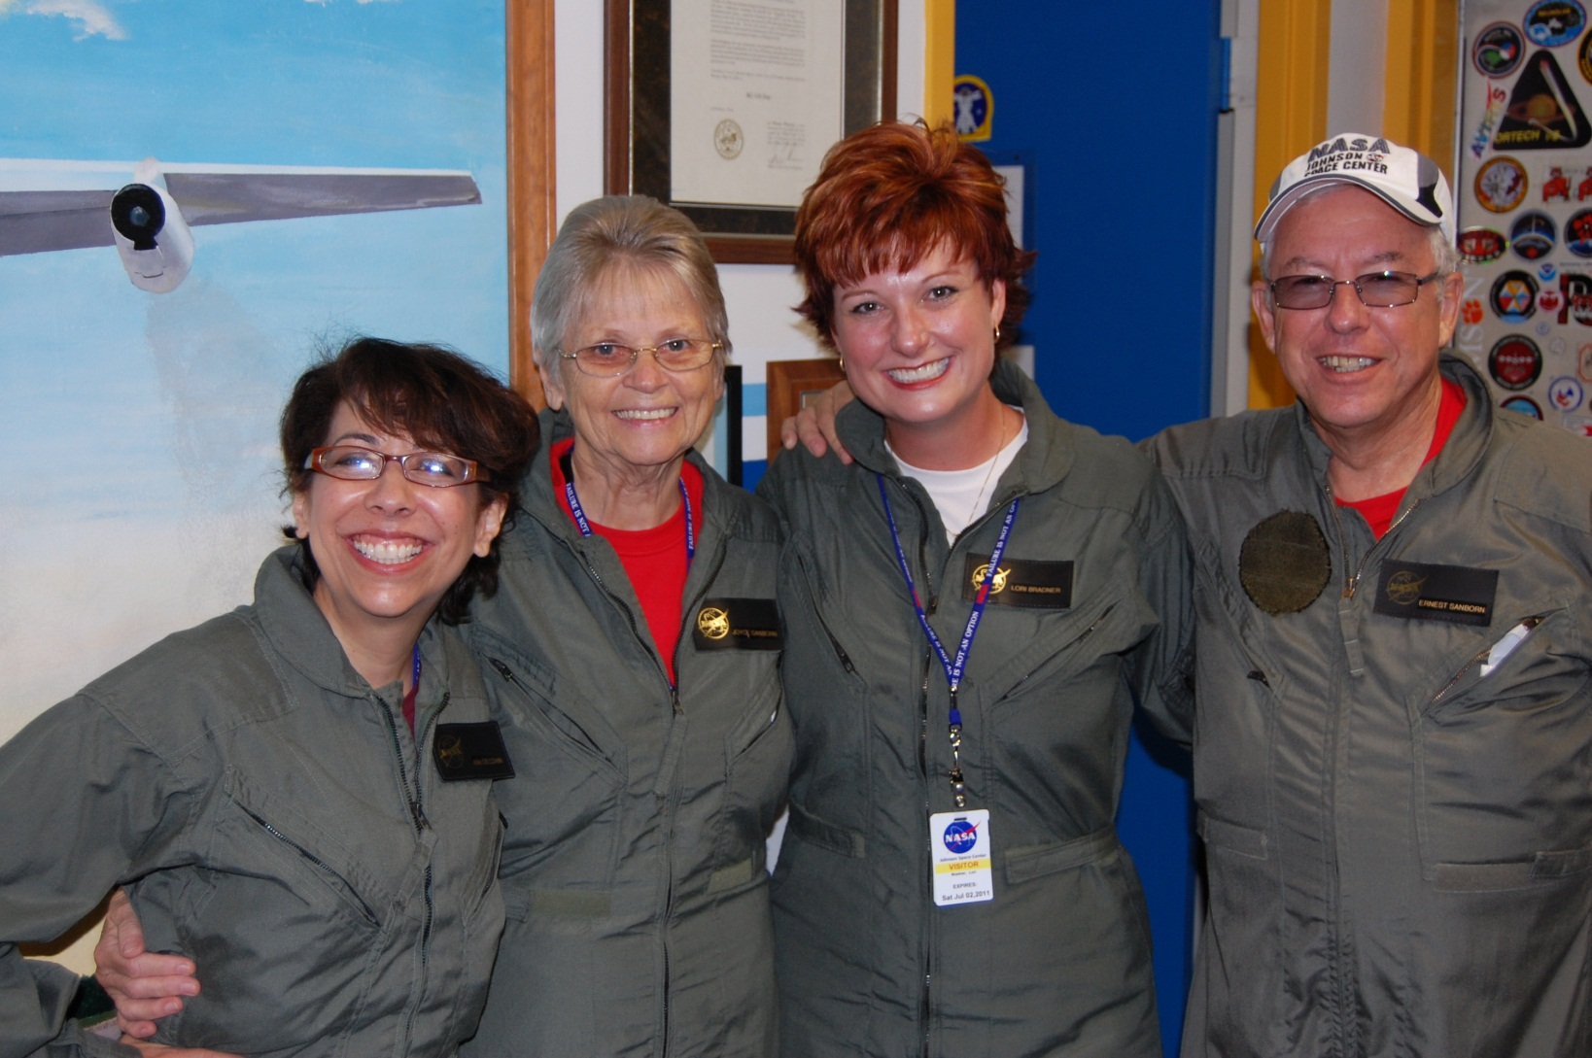
The first flight for the CFAA-A-Team
June 28, 2011

Slide 10
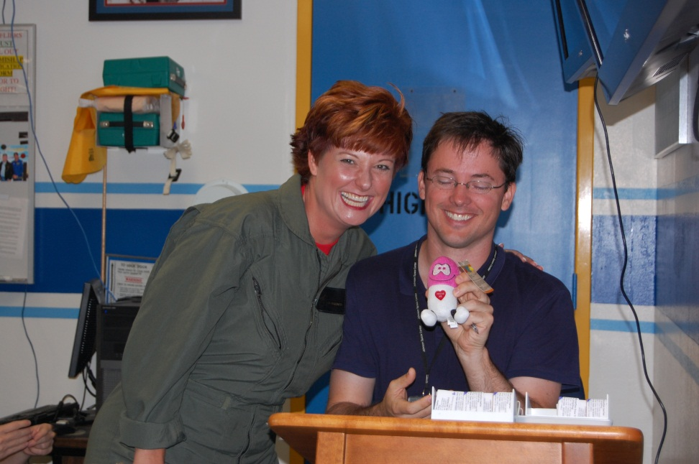
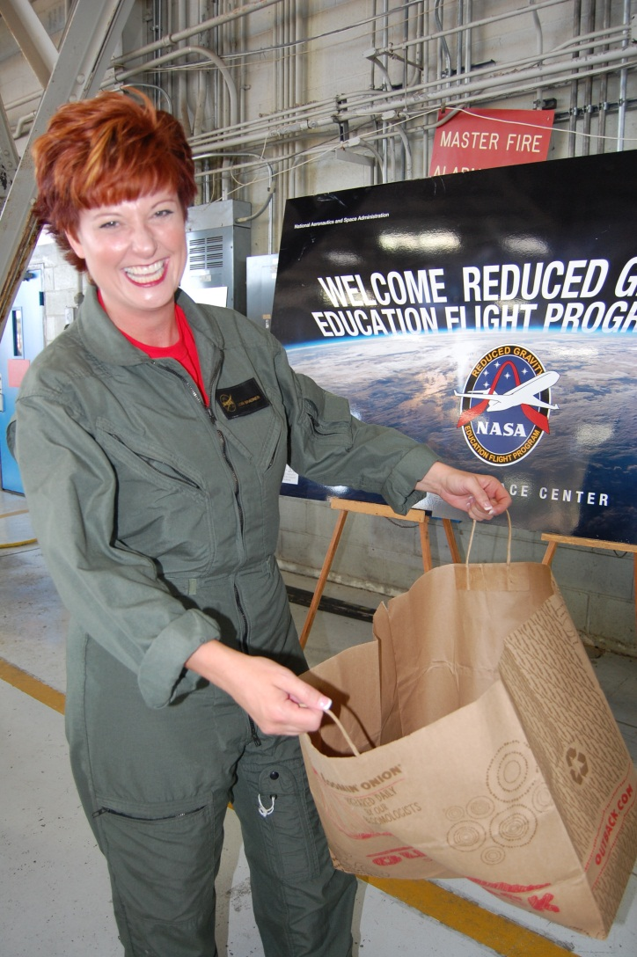
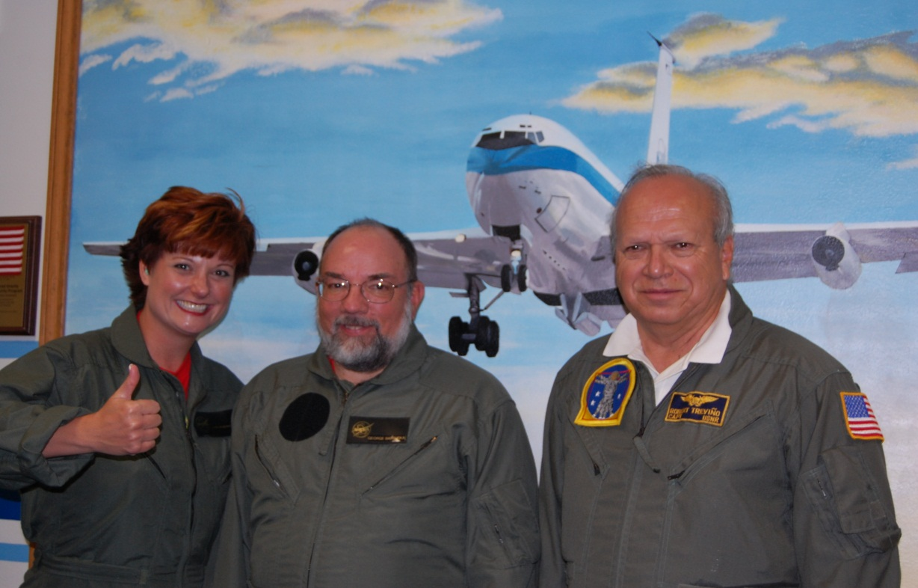
Ready for the flight

Slide 11
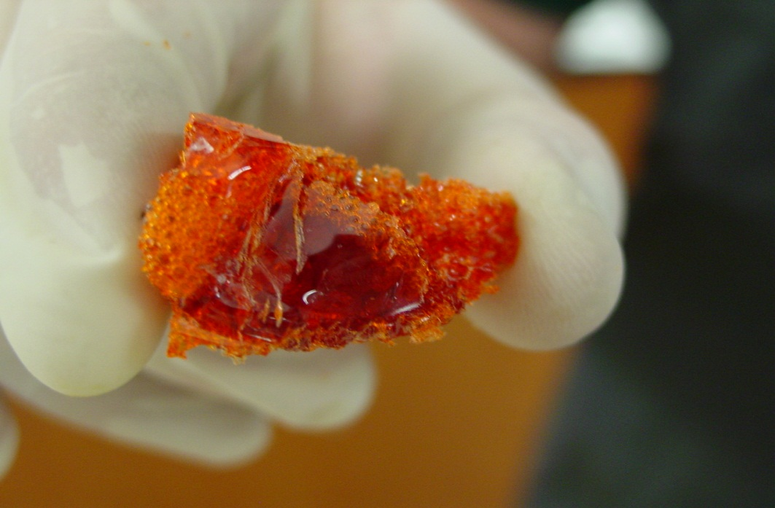
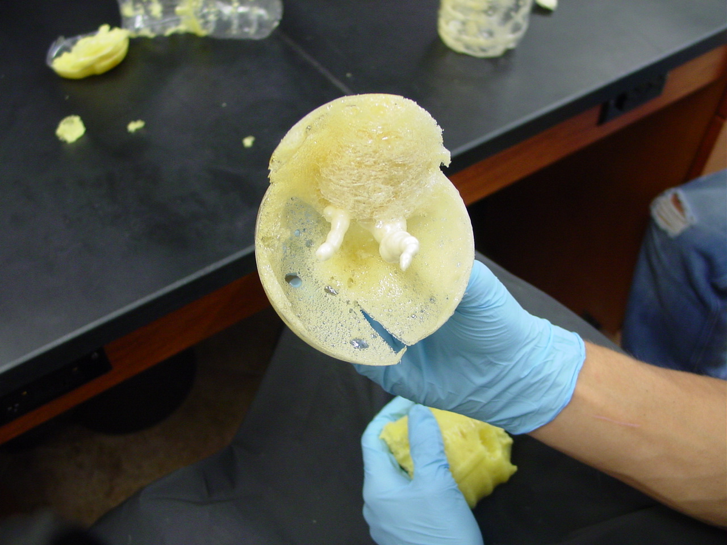
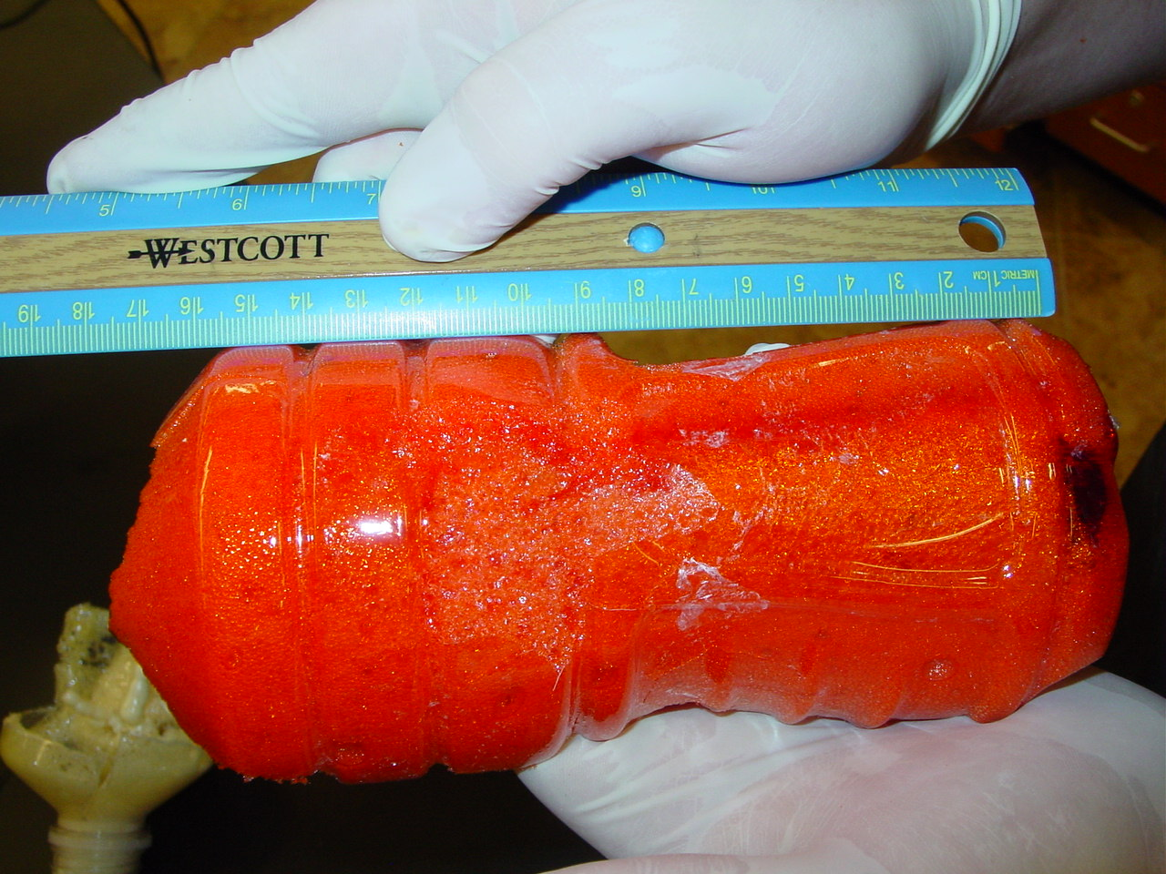
Flight Data:

Slide 12
Purpose Revisited:
The purpose of the project is to analyze how 4 different types of colloids will react in micro and heavy gravity situations. The students chose 4 different types of Great Stuff. The students ran the controls in the lab by setting up the experiment in the 1G environment. 5 tests were performed with each type of colloid. The bottles were stabilized horizontally. One student timed and another sprayed the colloid into the center of the bottle. Each can comes with a thin spray nozzle allowing the students to spray directly into the center of the bottle. The students sprayed the foam from the can for exactly 3 seconds and observed the results. No lids are necessary due to the consistency of the colloidal foam. The students repeated the experiment 5 times and continued to chart the results from each bottle. This was done for each of the 4 types. Once the colloidal foam was dry, the students were able to cut the clear bottles in order to analyze and measure the air pockets inside the colloid. Each of the different types of colloidal foam had a different internal "bubble pattern". Based on the research the class has done, they expect to see far different results in the expansion of the different colloids, as well as in the internal structure. The internal structure analysis will be done by the students this summer in the lab unless time allows for us to "dissect" the foam while in Houston. This project is a spin off from some of the work being done at JPL as can be seen in the bibliography.

Slide 13
Conclusion:
After analyzing the bottles after the flight, the students found that the inner structure of the cell size for all the colloids tested was less than half the size as those originally tested in the lab. They also discovered that the foam seemed to crystallize within the bottles creating these hard amber like “rocks” (as they described them). Given this data, unfortunately, these particular colloids would not be ideal in the construction of a lunar base.
The students feel the discrepancy in the data is due to the 34 parabolic arcs and the constant change from microgravity to heavy gravity compressing the colloid foam before it had time to cure.
Ideally, the foams should be tested utilizing a long term microgravity flight (ISS testing as an example) in order to truly assess the effectiveness of the colloids as a basis for building materials for a lunar/space base.

Slide 14
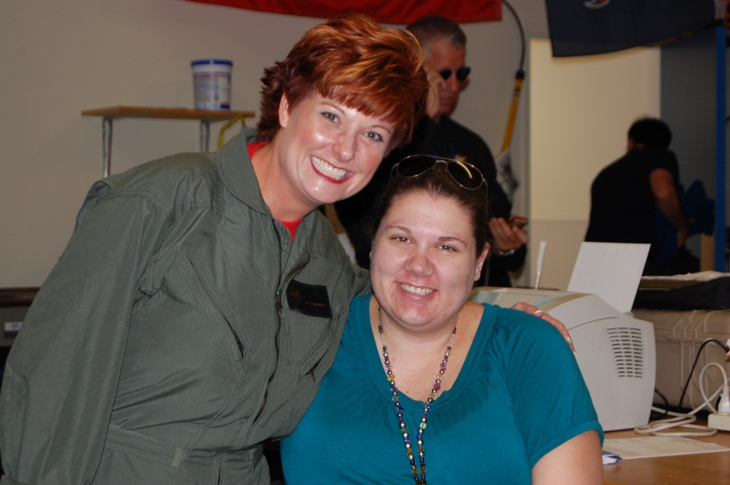
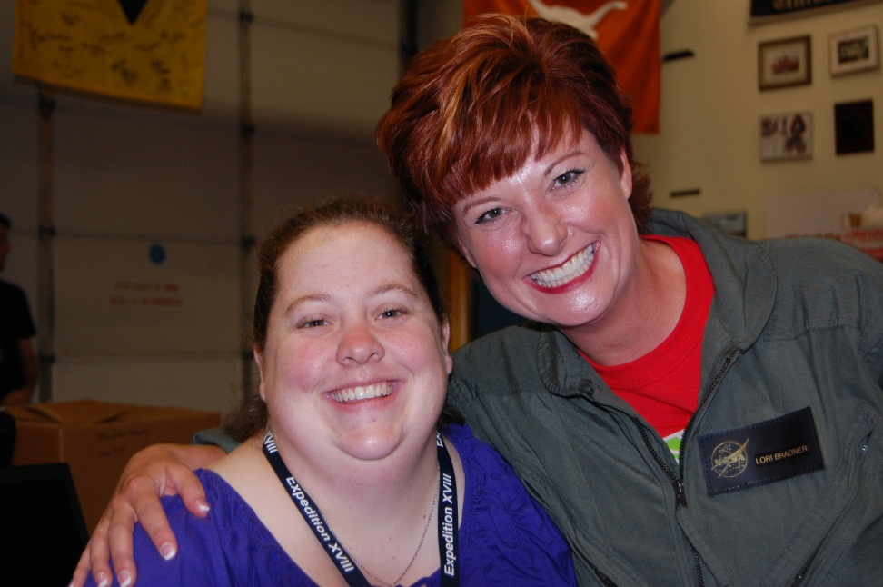
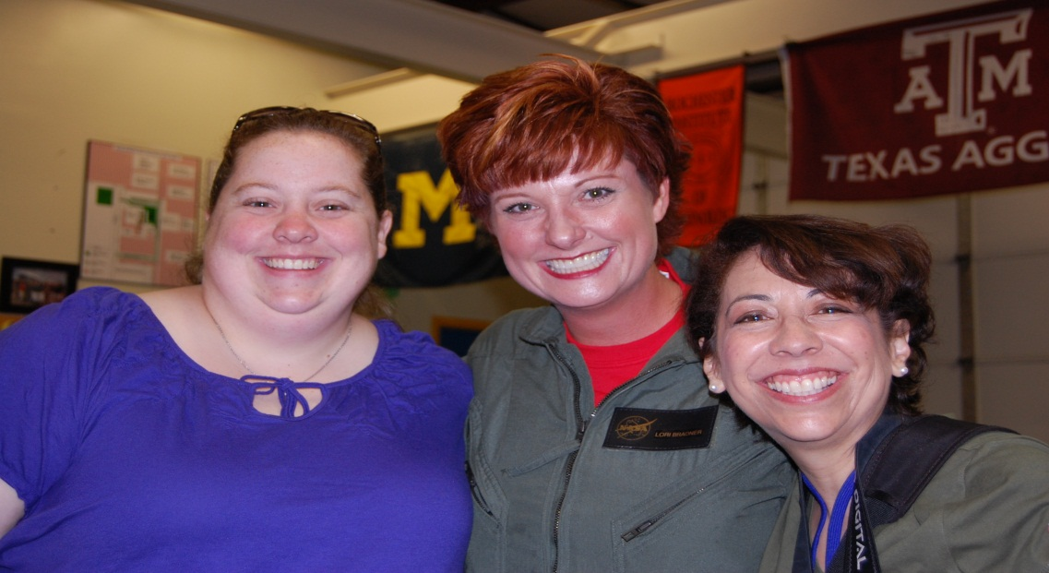
Special Moment and Special Thanks..

Slide 15
Bibliography
Bibliography/Literature Search
Primary Literature Search and Research Dr. DavidA Weitz, Harvard University:
•"Universal gelation of particles with short-ranged attraction," Peter J. Lu, Emanuela Zaccarelli, Fabio Ciulla, Andrew, B. Schofield, Francesco Sciortino, and David A. Weitz, Nature, 453, 499-504 (2008).
•"Designer emulsions using microfluidics," Rhutesh K. Shah, Ho Cheung Shum, Amy C. Rowat, Daeyeon Lee, Jeremy J. Agresti, Andrew S. Utada, Liang-Yin Chu, Jin-Woong Kim, Alberto Fernandez-Nieves, Carlos J. Martinez, and David A. Weitz, Materials Today 11 18-27 (2008).
•"Structural Rearrangements that Govern Flow in Colloidal Glasses," Peter Schall, David A. Weitz and Frans Spaepen, Science, 318, 1895 (2007).
•"Dripping, Jetting, Drops, and Wetting: The Magic of Microfluidics," A.S.Utada, L.-Y.Chu, A. Fernandez-Nieves, D.R. Link, C.Holtze, and D.A.Weitz, MRS Bulletin, 32, 704 (2007).
http://www.nasa.gov/mission_pages/station/research/experiments/EXPPCS.html
http://www.grc.nasa.gov/WWW/RT/2003/6000/6728doherty.html
http://courses.washington.edu/overney/Colloids%20and%20Emulsions.pdf

Slide 16
Thank you for the time of our lives..
Reduced Gravity Office
NASA
Johnson Space Center
Zero G Crew (Love Ya, Tim)
Sara Malloy
Becky Kamas
Dom Del Rosso
Doug Goforth
Rachel Kraft
Terry Lee
Robert Trevino and the entire team that made our dreams a reality

Slide 17

We will never forget you…
Love, Ricky (George), Lucy (Lori), Little Ricky (Ana), Ethel (Joyce) and Fred (Ernie)

