Slide 1
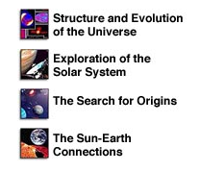
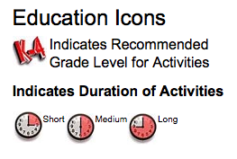
CERES Project Resource Review Alice Cook Henke CERES Project Nasa/msu bozeman-ceres project. (2004). Retrieved from http://btc.montana.edu/ceres/default.htm Project Dirctor: George Tutill
Components:
NASA Themes
Educational Activities
National Mathematics and Science Education Standards
K-12 Students
Focus on Astronomy and Astrobiology
Structured and Scaffolded
Broken Into Activities
Answers not included
Classroom Resources
Virtual missions to Jovian Planets and Jupiter
Astronomy Data Internet Resources
Some links broken, the level of complexity is high for some sites
Internet Courses
Offered through the National Teachers Enhancement Network
Cost

Slide 2
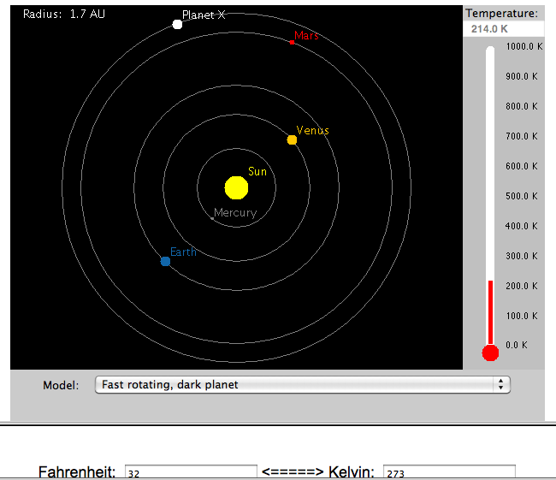
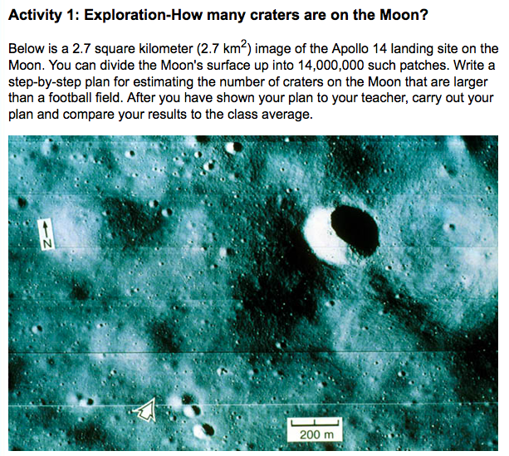
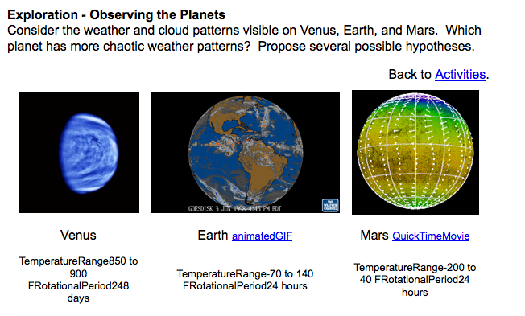
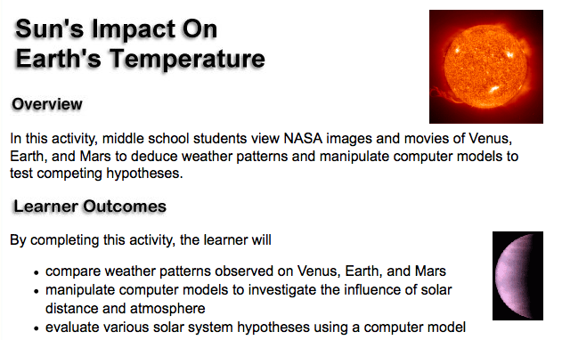
Implementation in Summer School Educational Activities and Lessons: “Sun’s Impact on Earth’s Temperature” (functions and patterns), “How Much Do You Weigh on Distant Planets?” (quadratic functions, variables, patterns), “The Drake Equation: Estimating the Number of Civilizations in the Milky Way Galaxy” (estimation, reading graphs, patterns, equations)
Highlights:
Use of technology (see applet at right)
Connections to other programs (like Space Math)
Very structured with great use of visuals
Excellent connections to math (estimation, functions, etc..)

