Slide 1
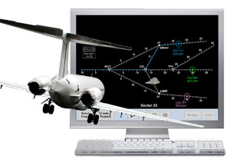



Tami McDonald
Project Idea
NASA asset: The Smart Skies: LineUp with Math program is a NASA Asset I found while searching for ideas in the NASA Explorer Schools Program. After very little explanation, found it very user friendly and adaptable for my fourth grade students. It is all located online so it is free and easily accessible.
Why this topic/concept: I chose this topic because I felt it would be a good introduction to the very first math unit I teach each year, geometry. Geometry vocabulary is very difficult for fourth graders so I thought it might be helpful for them to see lines, line segments, rays, angles, points, intersecting lines, parallel lines, etc. in a real world setting while using a fun exciting program to solve distance-rate-time problems.
What’s New for Me: The LineUp With Math project is completely new for me. I also have not previously used a simulator for the kids to check their work or test their solutions.

