Slide 1


Full “STEM” AHEAD!

Slide 2


Slide 3
Why am I Here?
Originally…….to spread news about Temecula’s plans to become a “STEM” City and promote the 2nd Annual Science and Technology Fair
http://www.livebinders.com/play/play?id=854284
NOW…..to promote “STEM” in our schools!

Slide 4
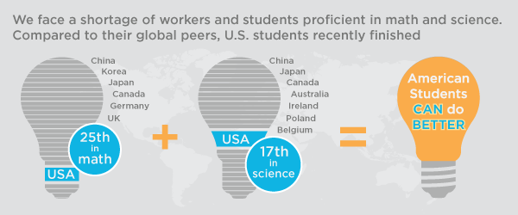
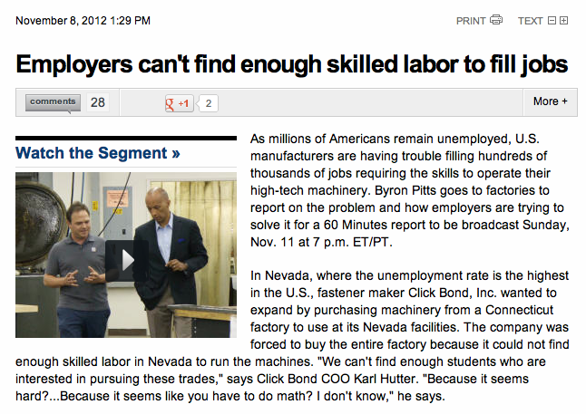
Where we stand….

Slide 5

What can I do?

Slide 6
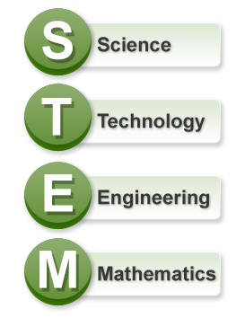



NASA Endeavor Fellowship

Slide 7

Did you know….
The Next Generation Science Standards were just released?
Did you know that there is now a K-12 engineering component?

Slide 8
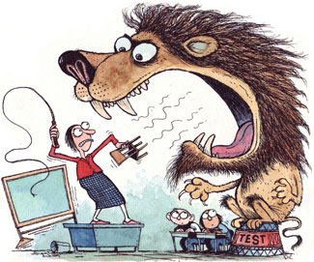
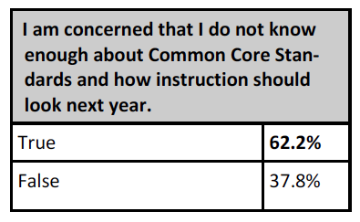
How Some Teachers Feel about Common Core
TVEA Educator Survey

Slide 9
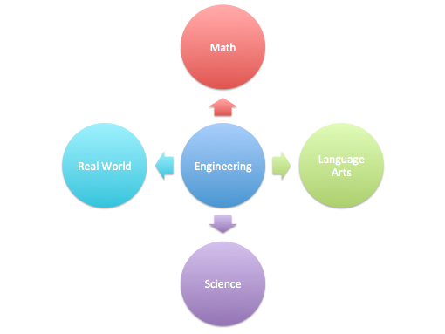
Engineering=Perfect vehicle for Common Core
4 C’s
Creativity
Collaboration
Critical Thinking
Communication

Slide 10
My
“STEM”
Experience!

Slide 11
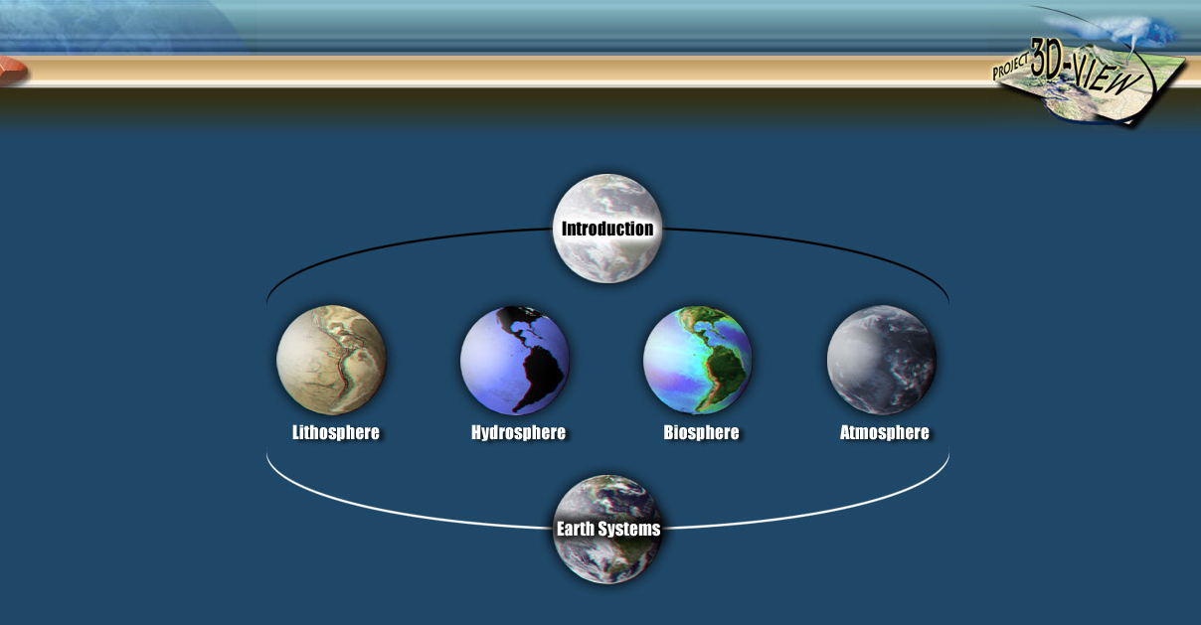
NASA Project 3d View: Uses 3D images to teach about Earth’s Spheres

Slide 12
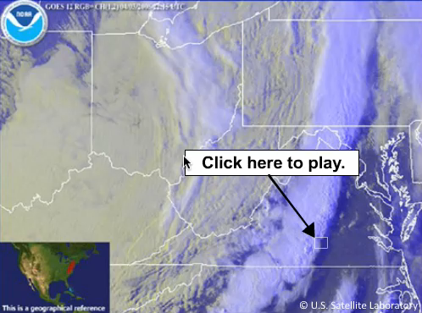
NASA Project 3DView: Uses 3D images to teach about Earth’s Spheres

Slide 13
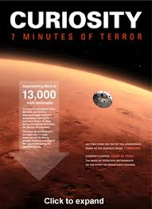
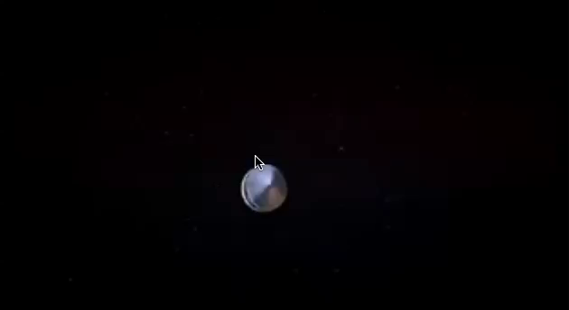
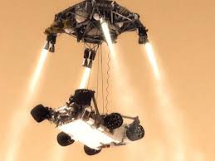
Atmosphere: Videoconference with NASA
Guest Speaker: Engineer from NASA Jet Propulsion Lab

Slide 14
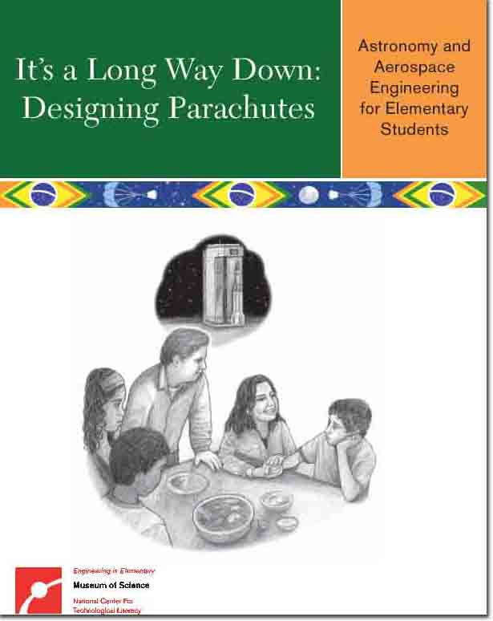
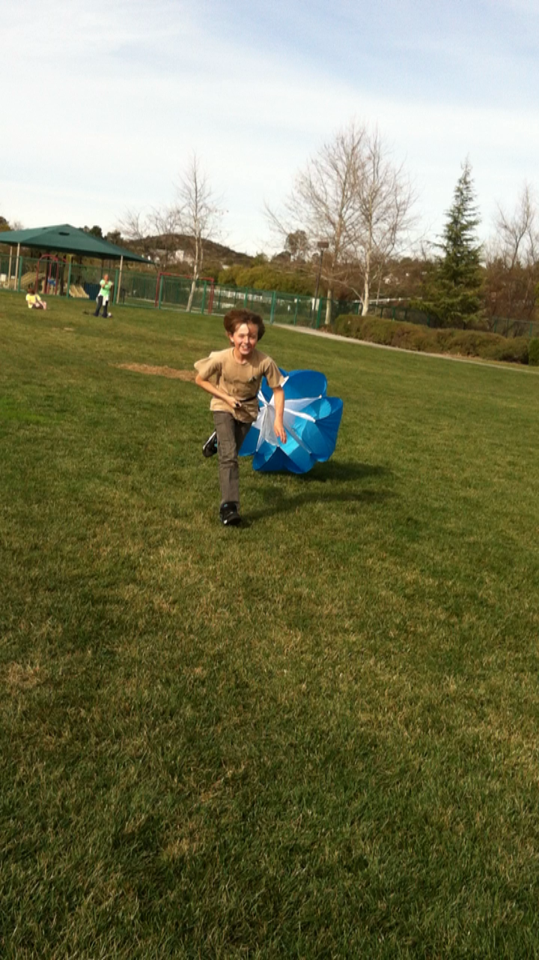
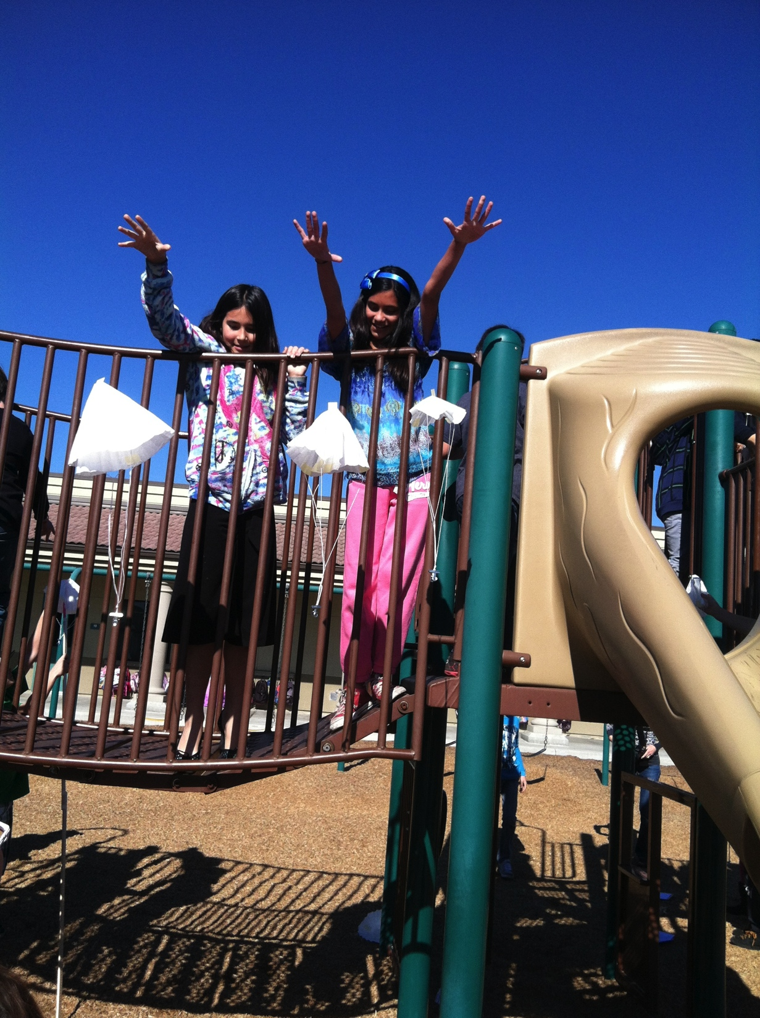
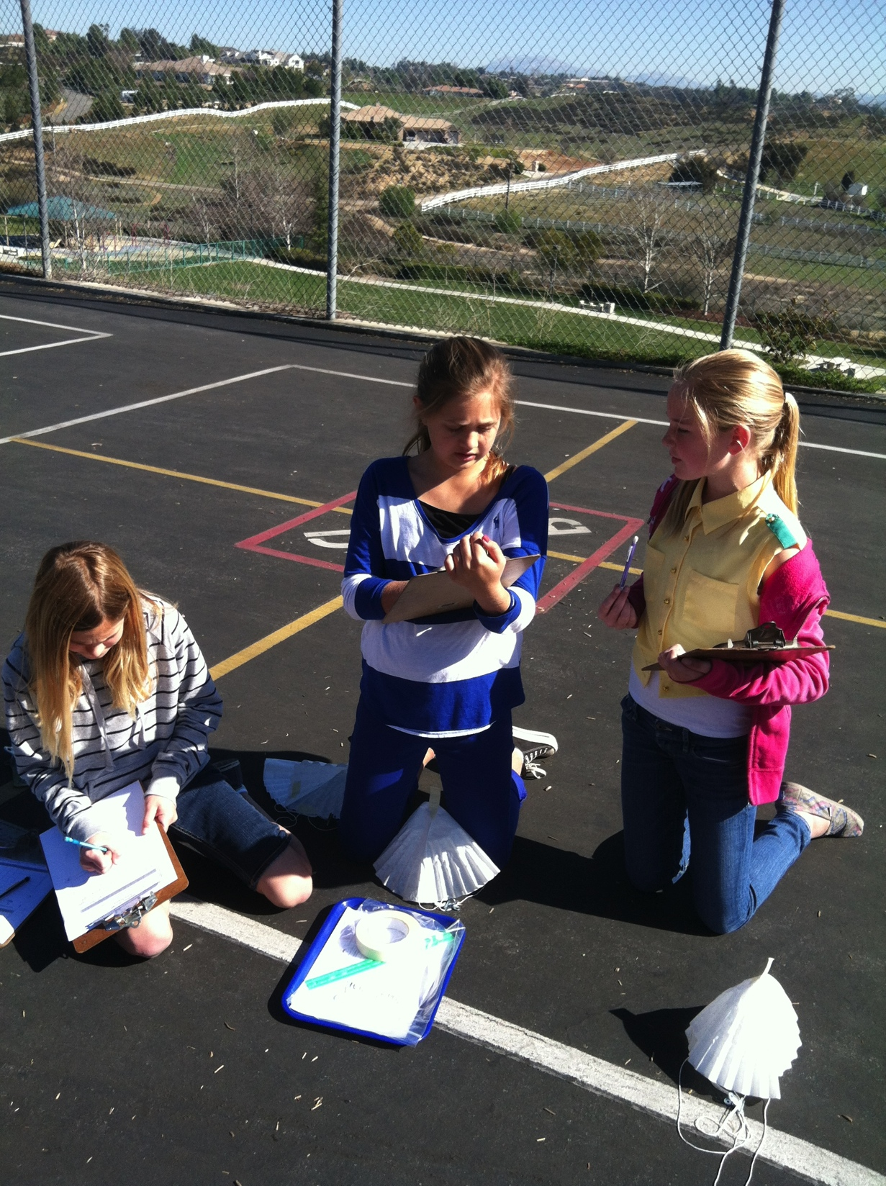
Atmosphere Unit: Designing Parachutes
Variables
Measurement
Collaboration
Research
Trial and Error
Series: Engineering is Elementary

Slide 15
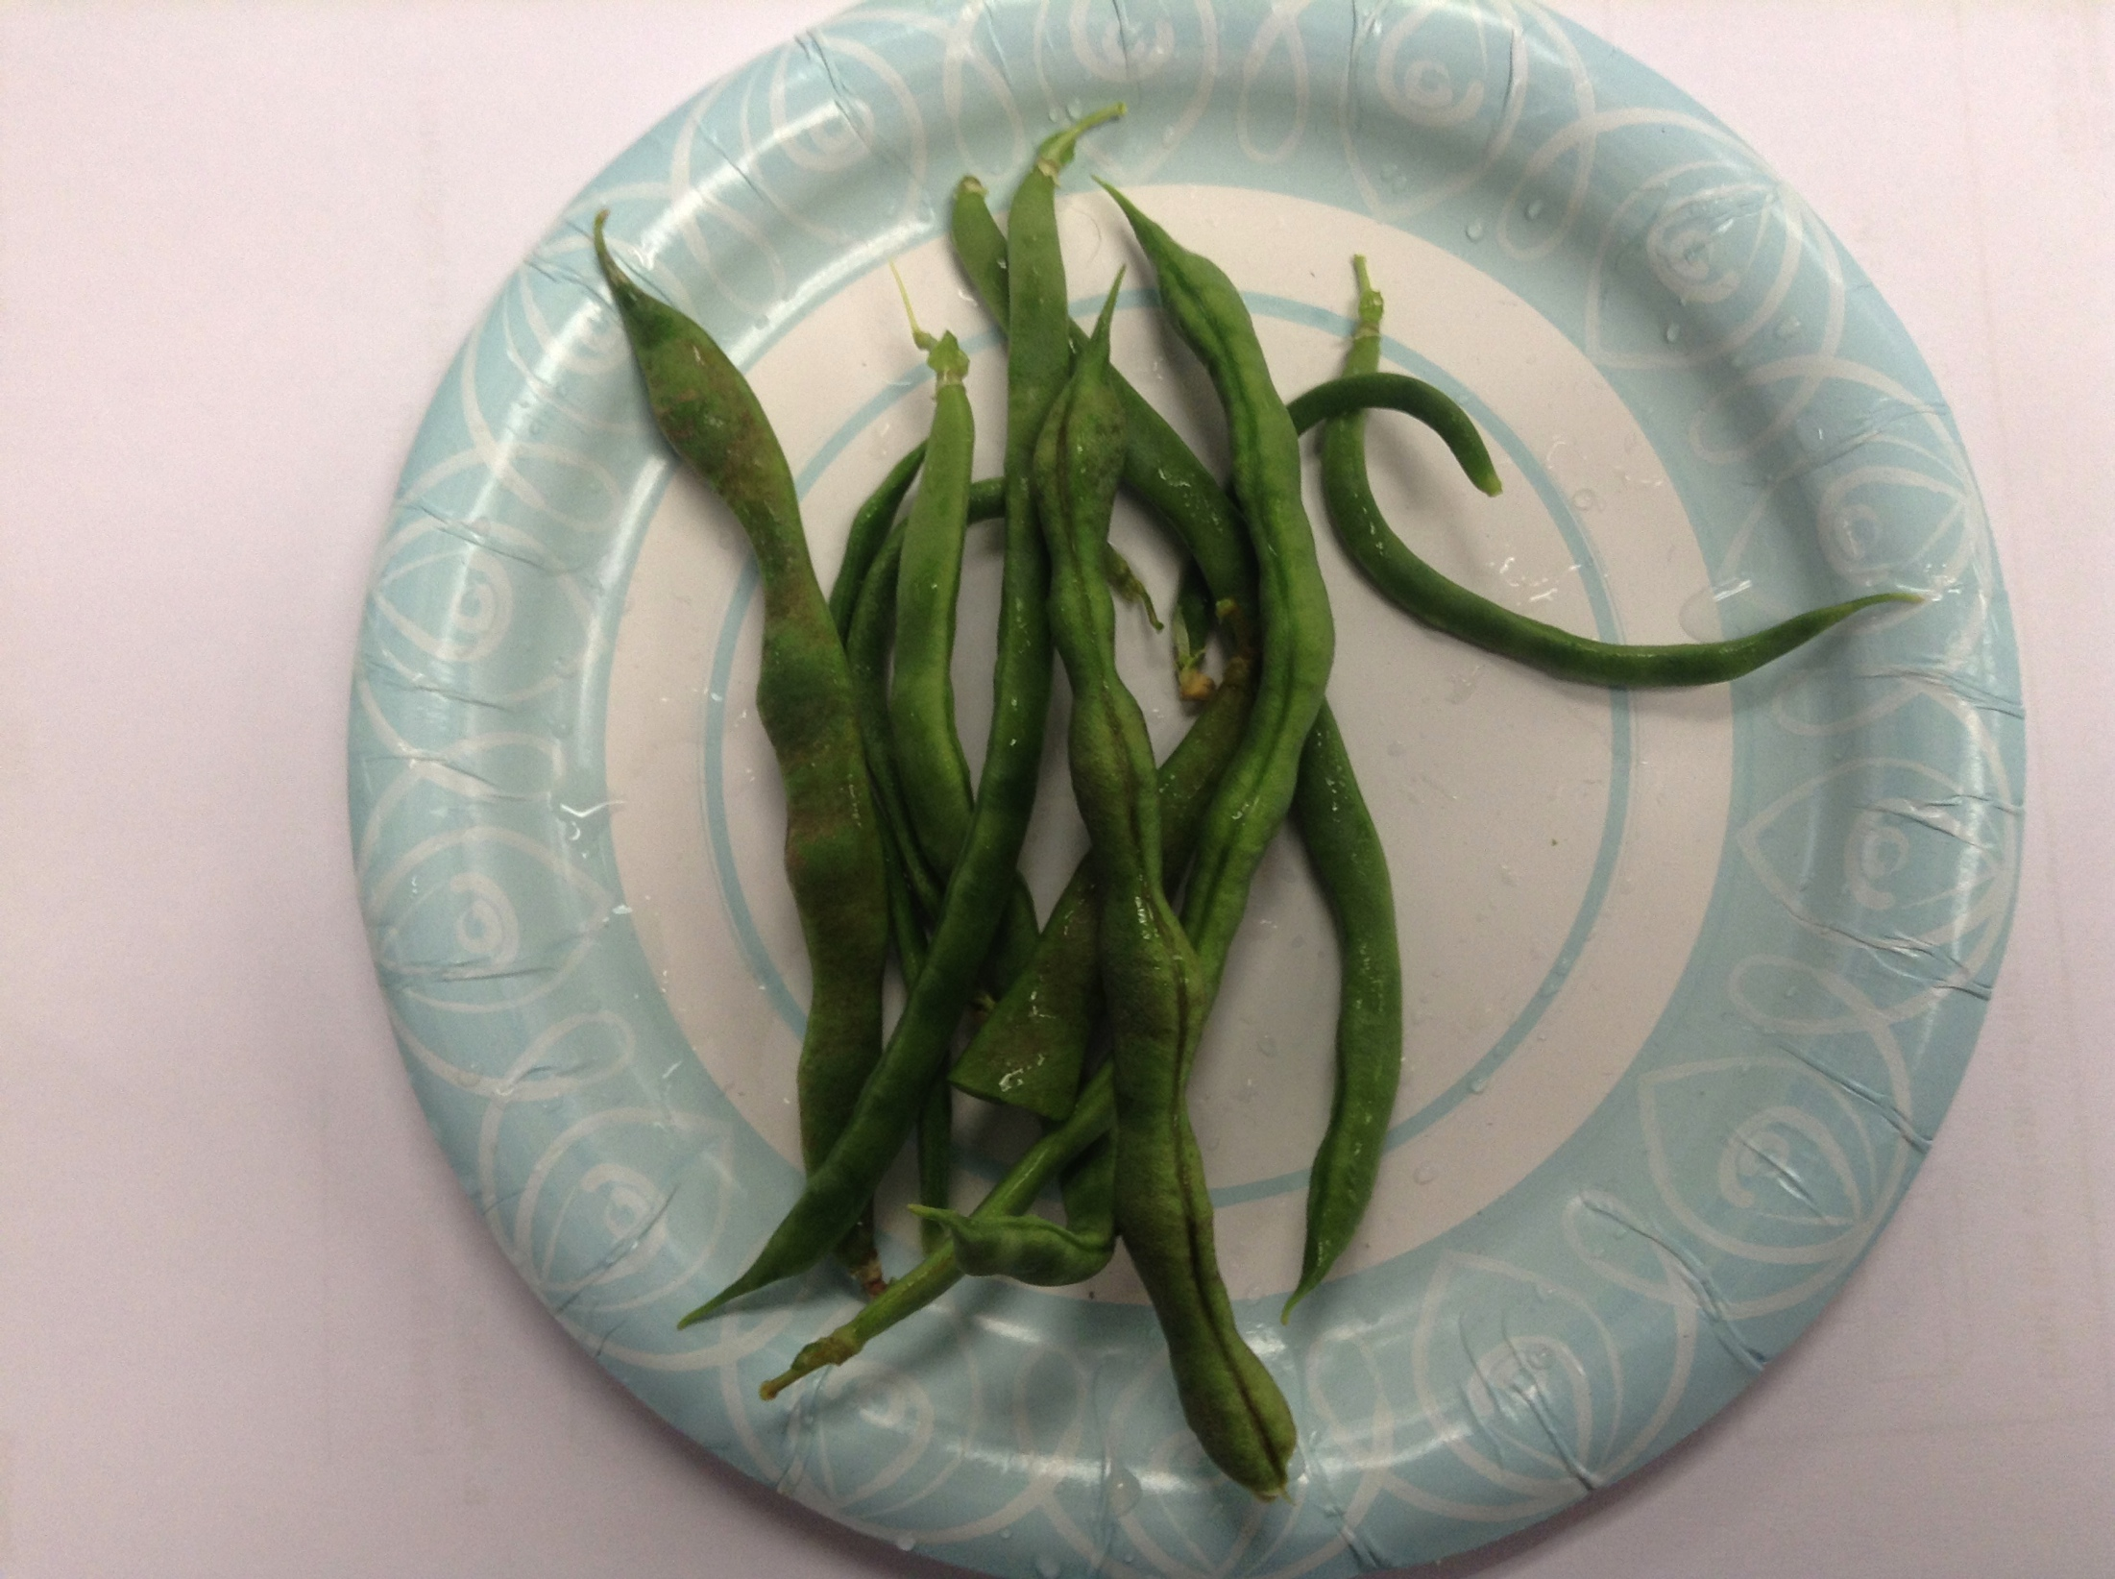
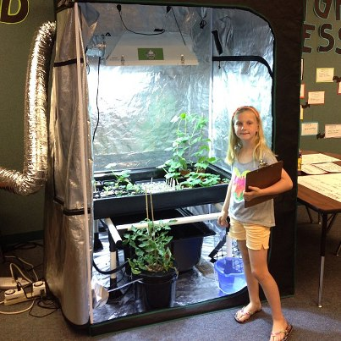
Hydrosphere/Biosphere: Hydroponics
Water Cycle
Plant Life
Conservation
Recycling
NASA connection for space travel
Field Trip: Temecula Valley Hydroponic Strawberry Farm

Slide 16
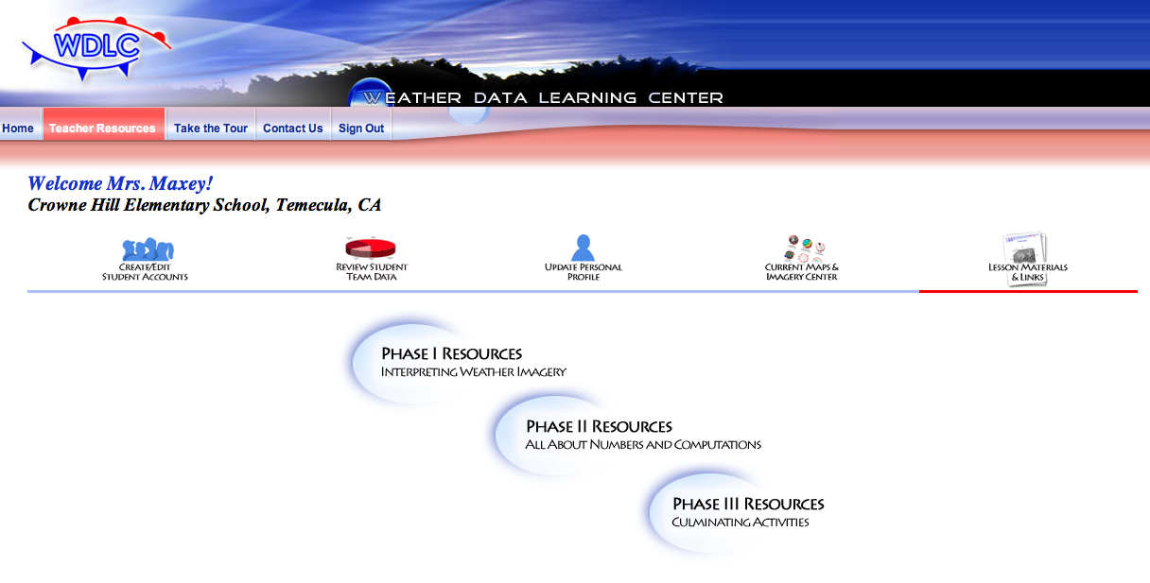
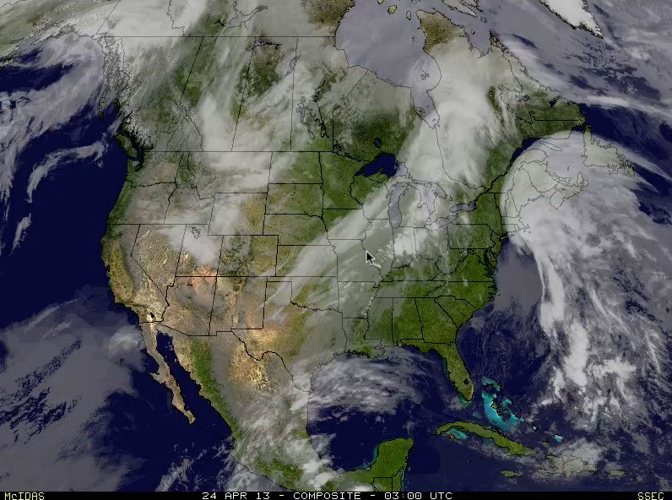
Weather Data learning Center: Uses Weather Maps to teach math Uses NASA Satellite images

Slide 17
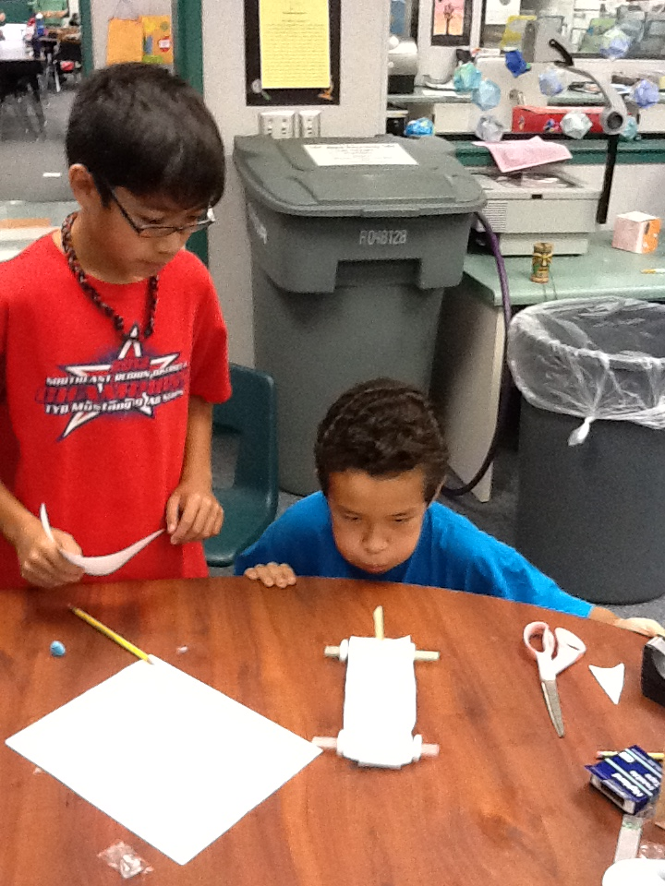
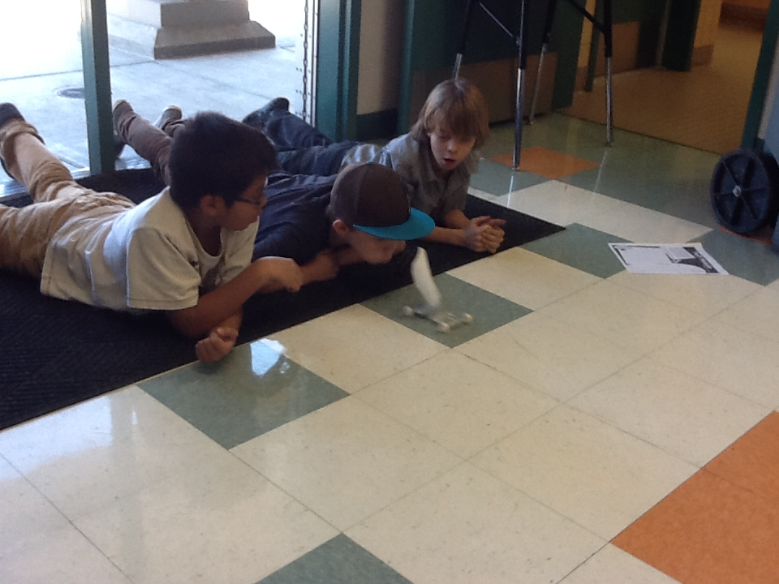
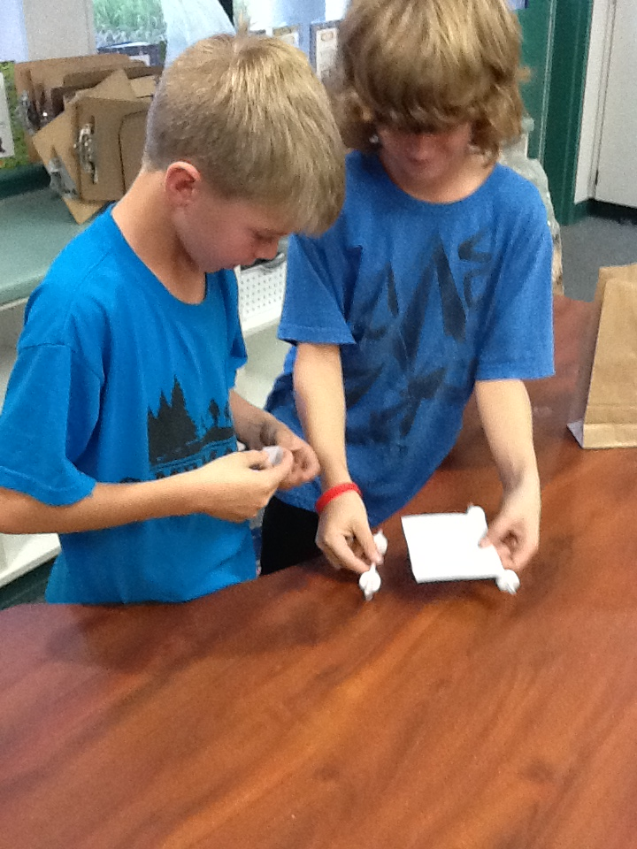
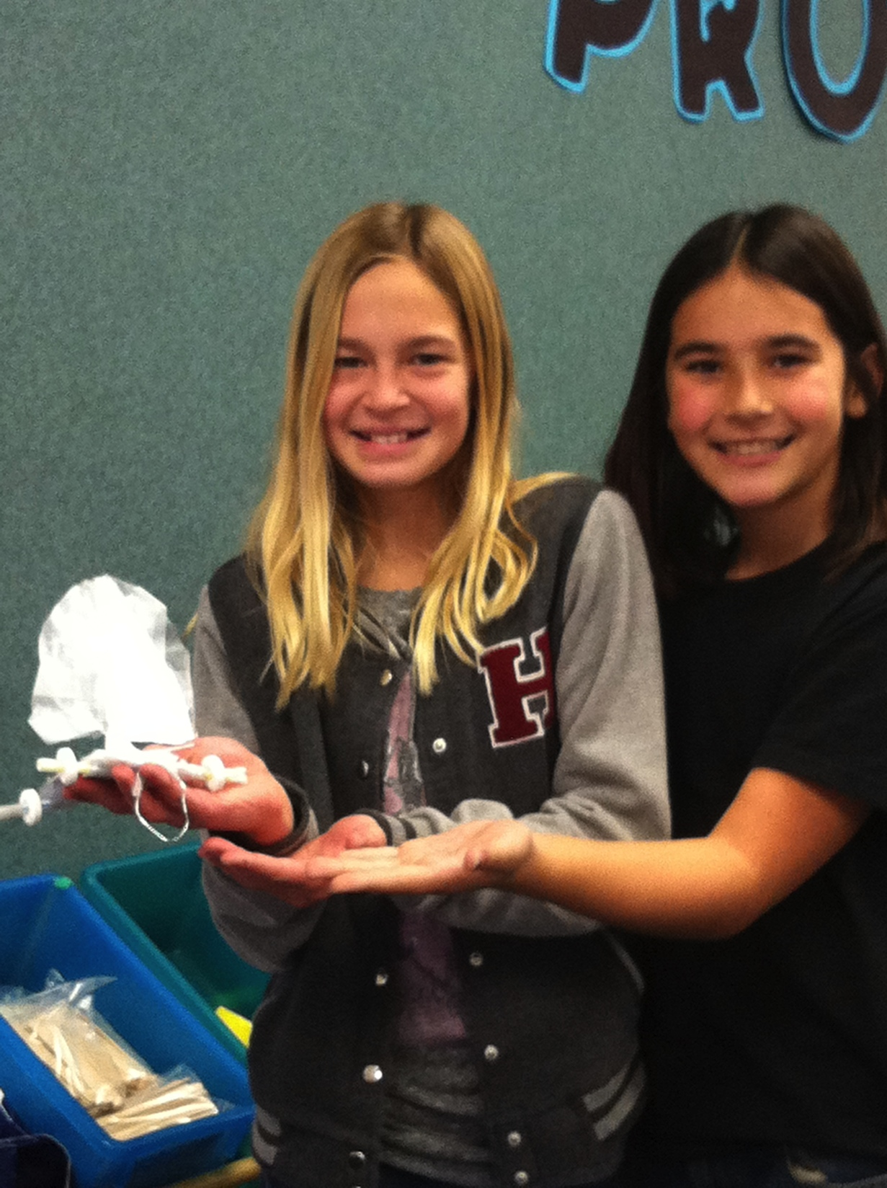
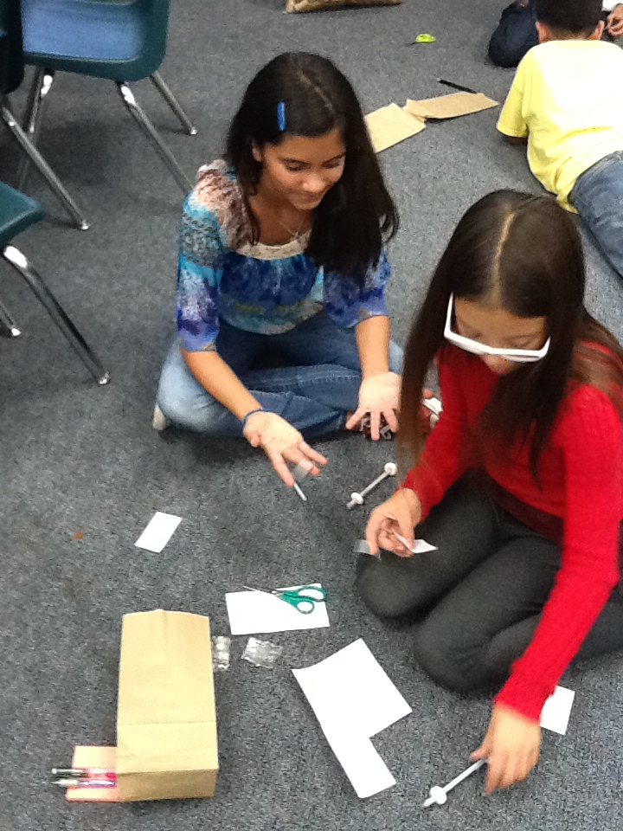

Alternative Energy: Weather and Wind
Puff Mobiles

Slide 18
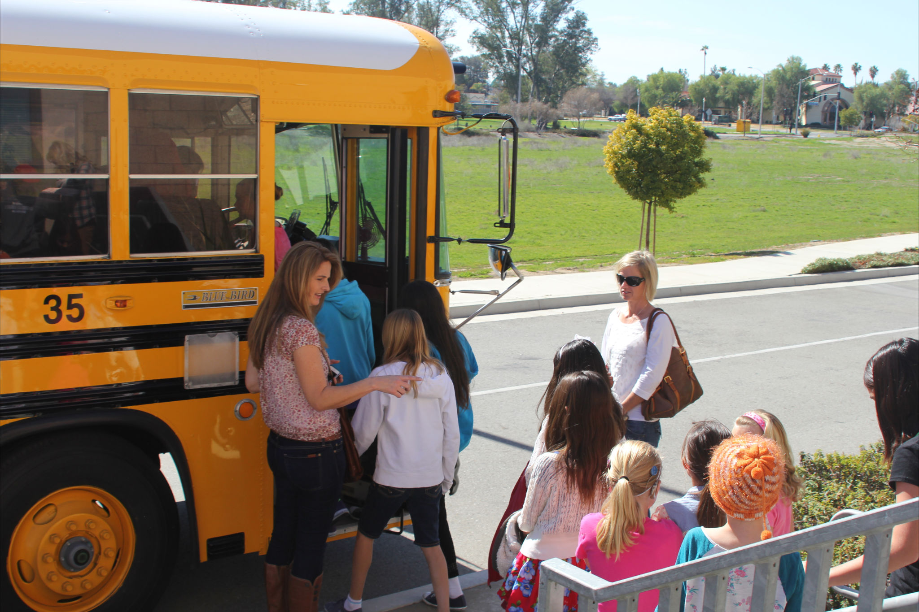
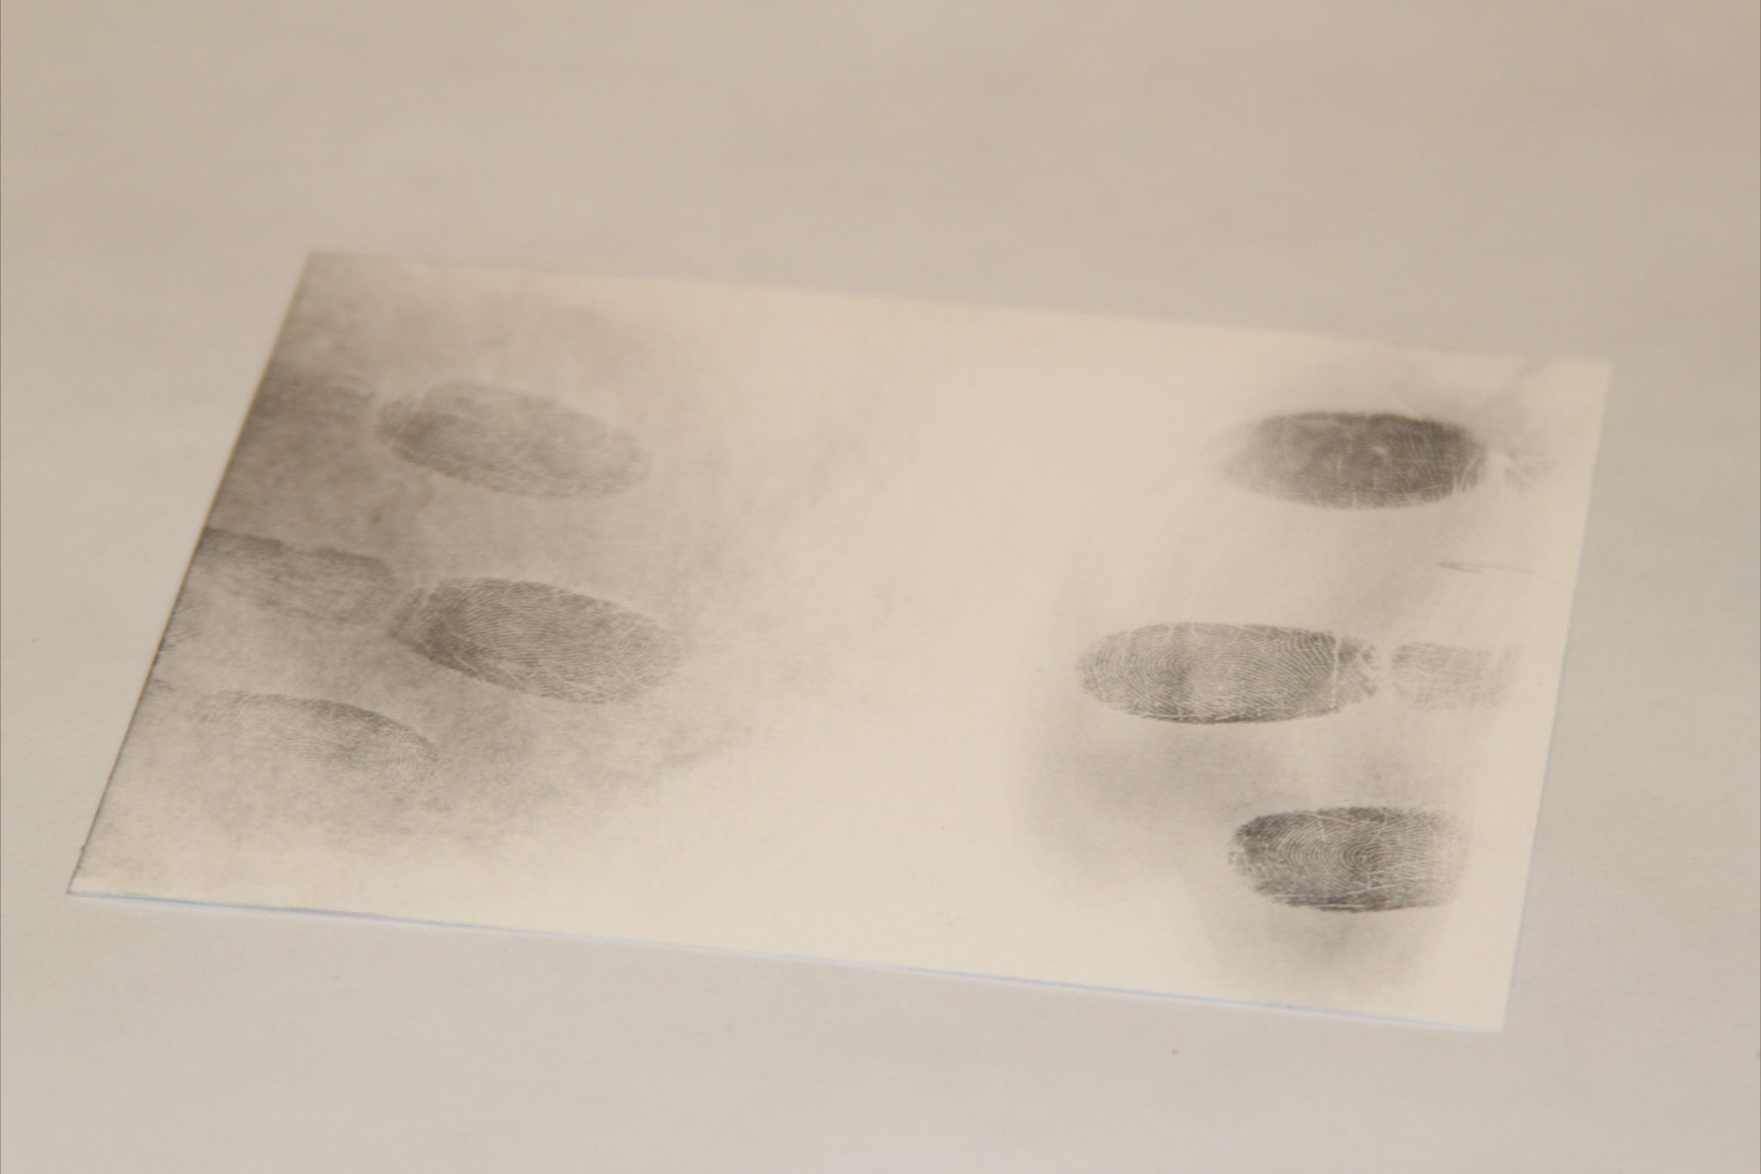
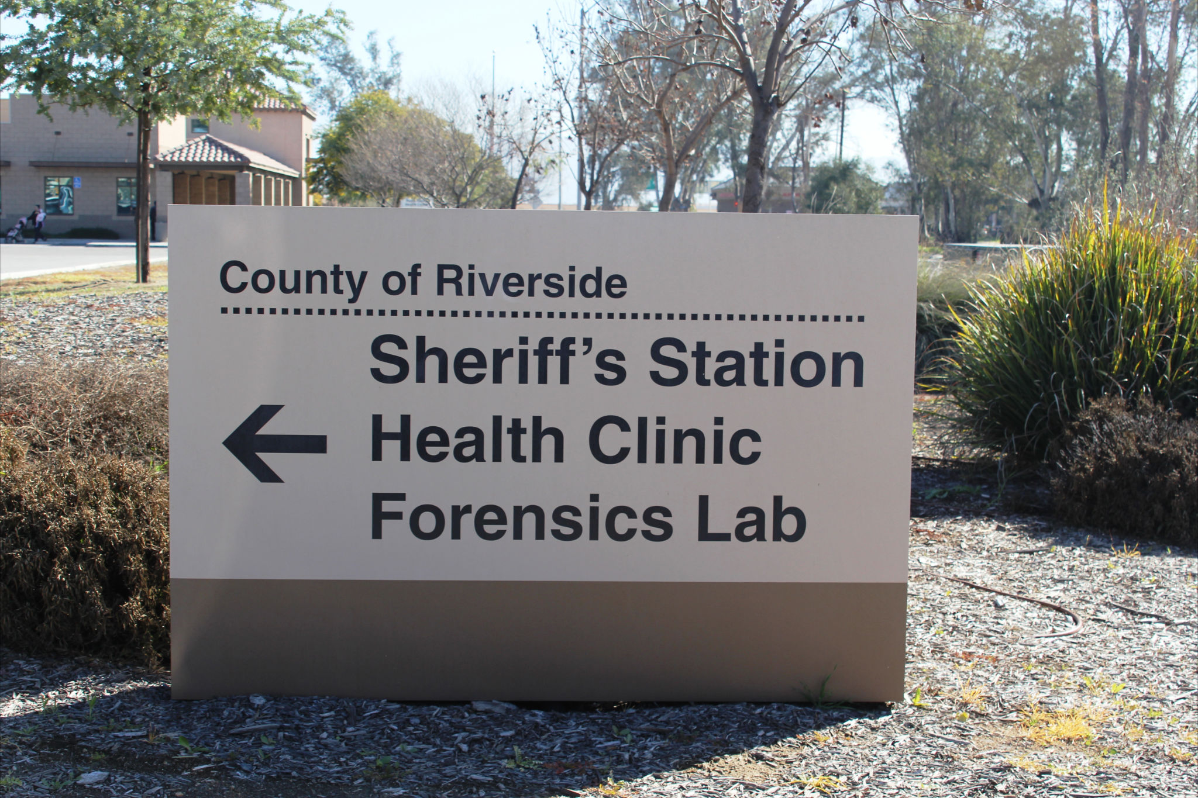
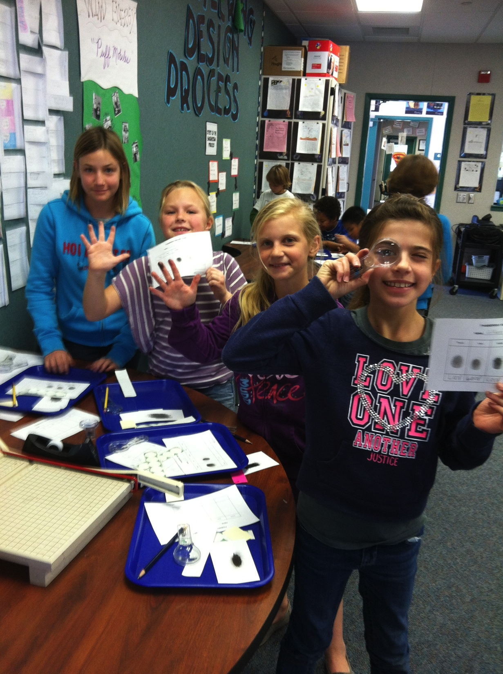
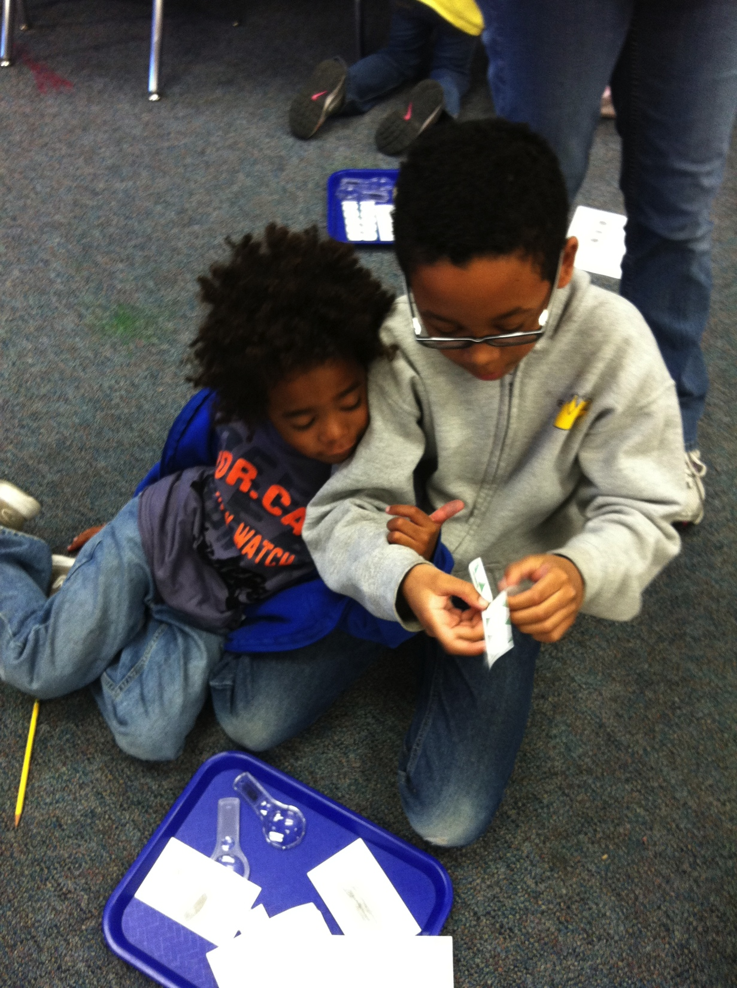
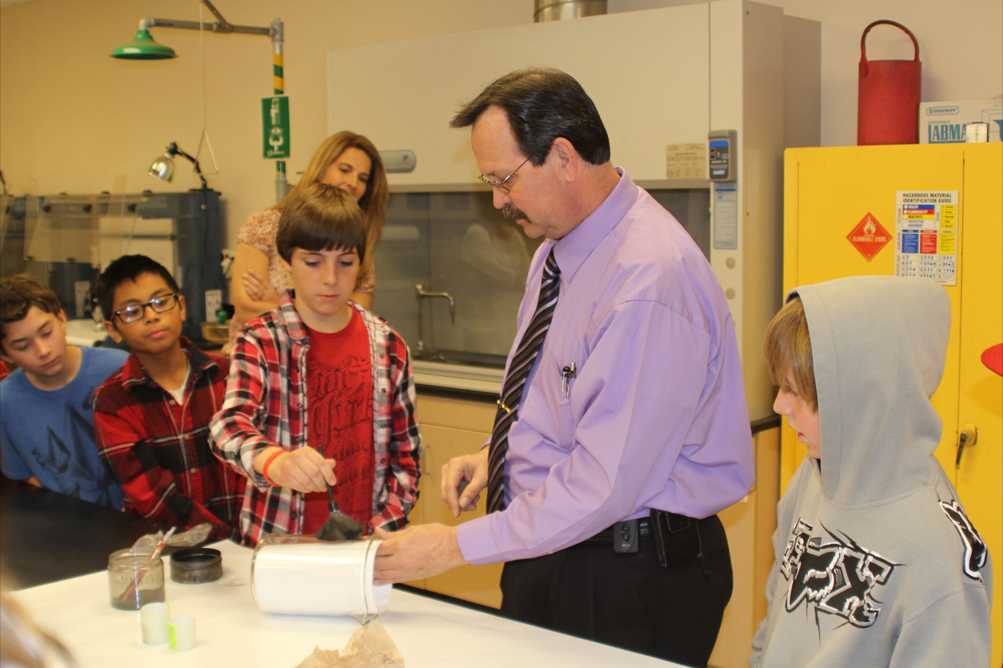
Problem Solving with FORENSICS! (Science, Math, and REAL LIFE!)

Slide 19
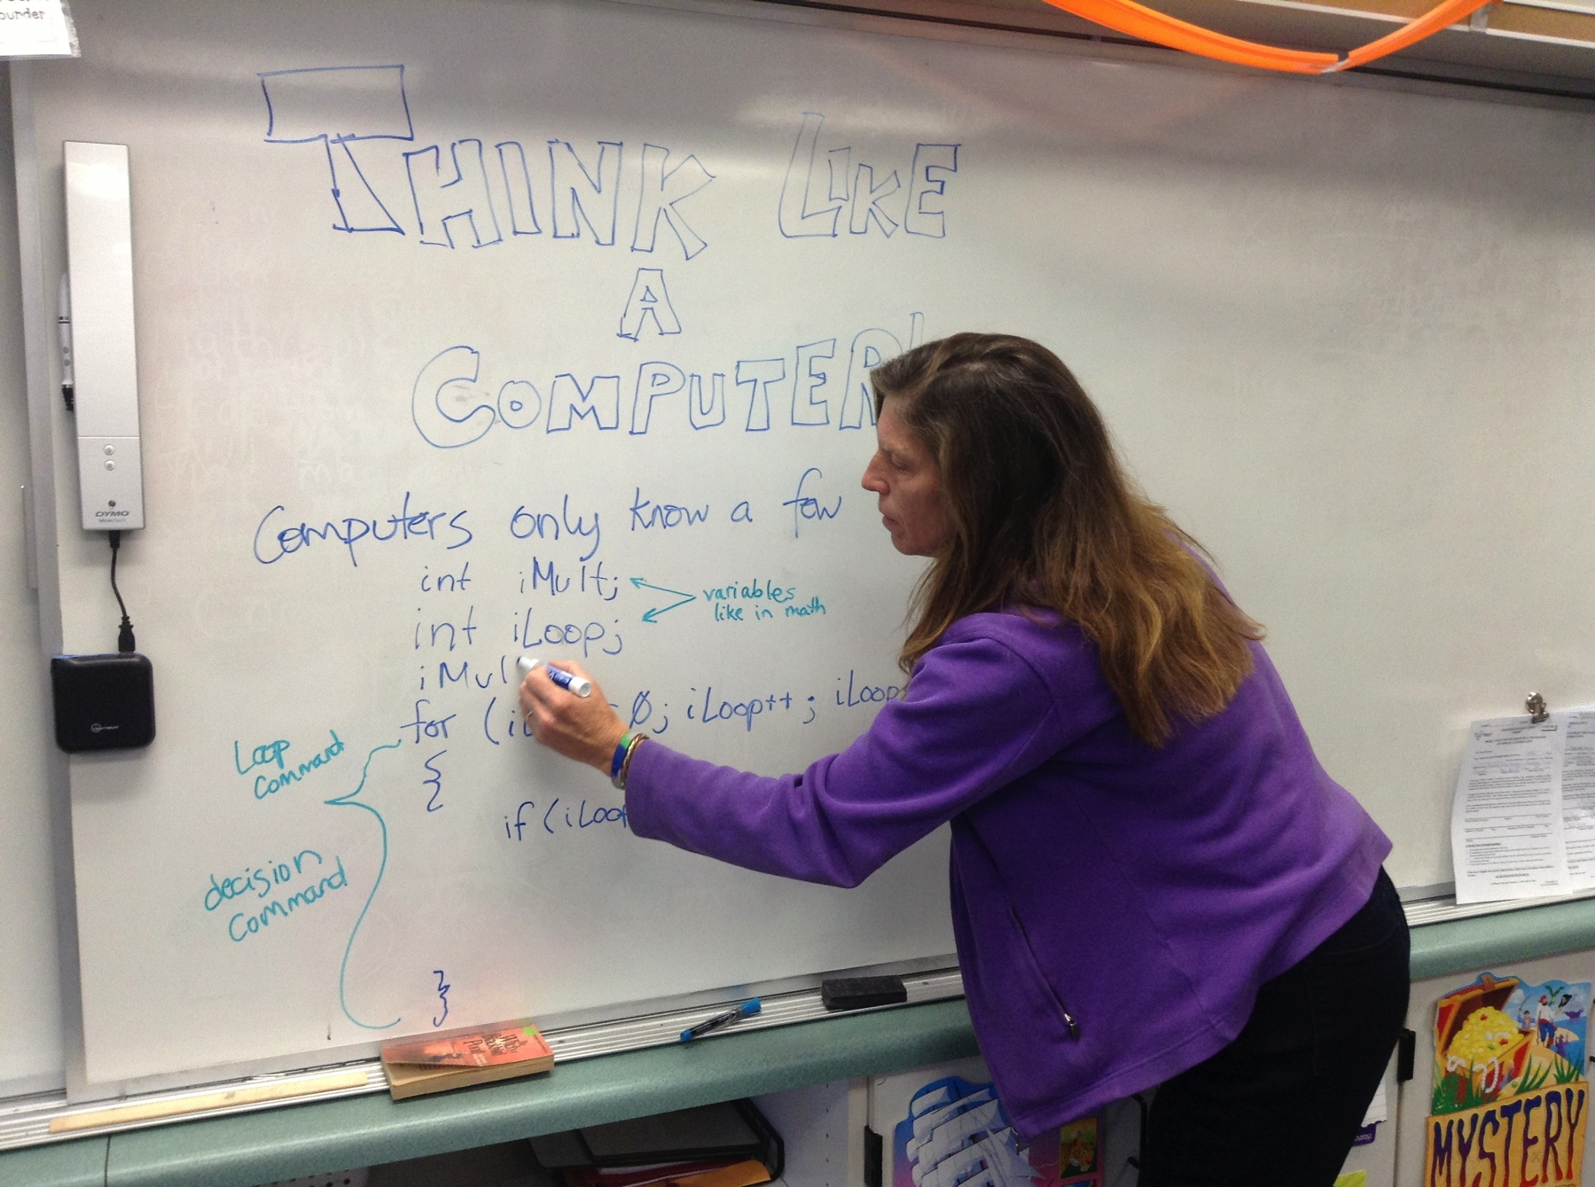
Bring in the Experts! REAL LIFE!!!
Computer / Software Engineer
Works for Microsoft
Computers in the Digital Age
Writing Code as a 2nd Language

Slide 20
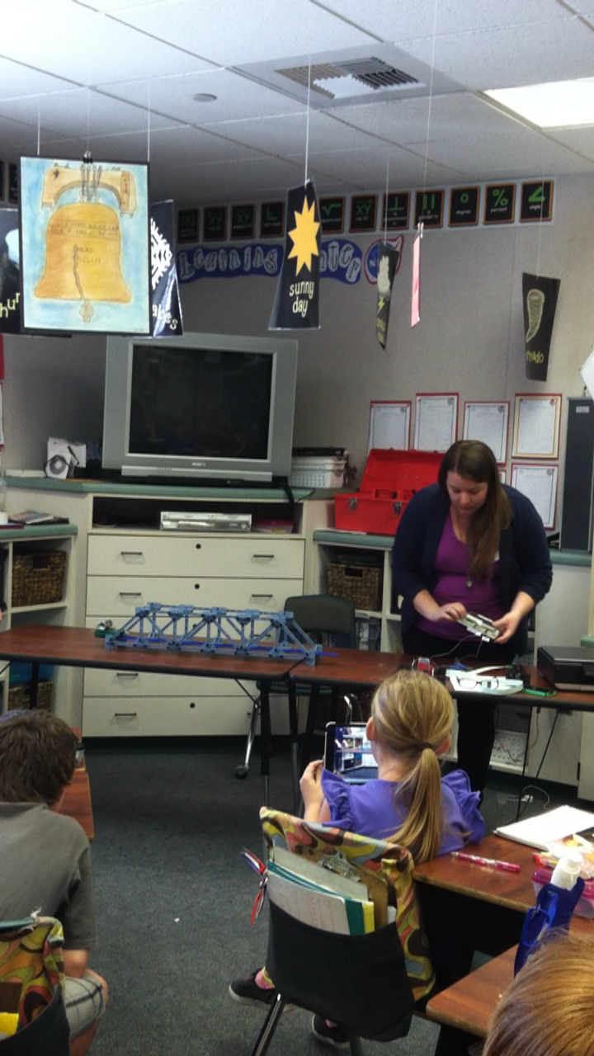
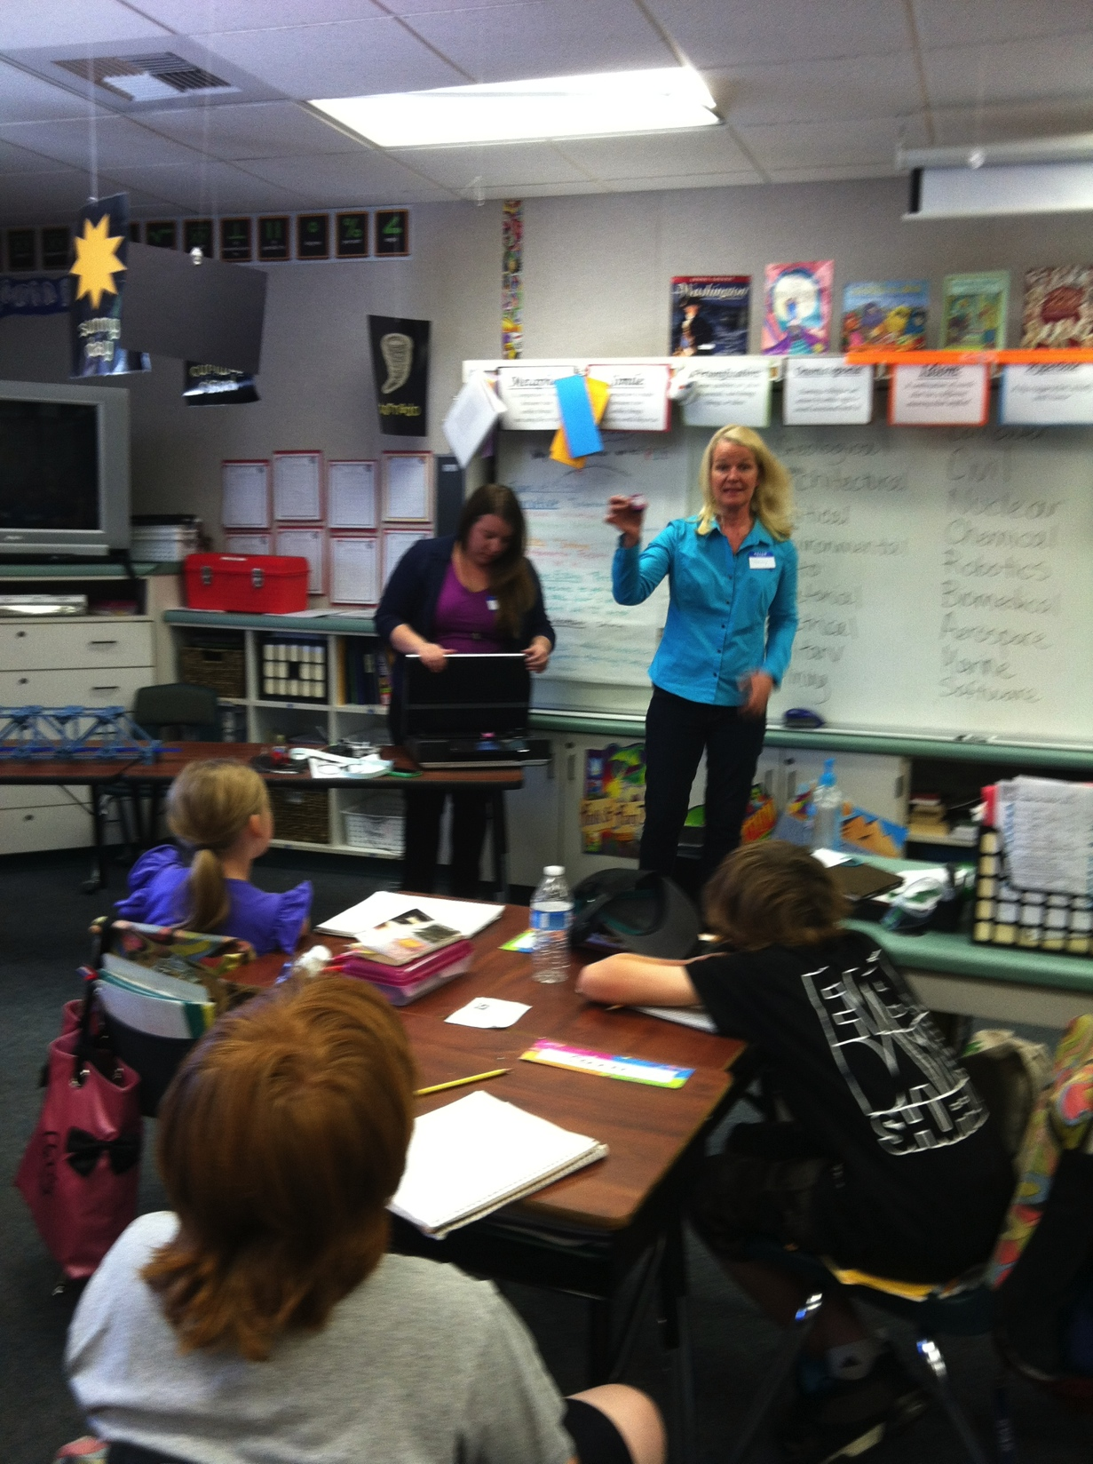
Guest Speakers: Structural Engineer and Mechanical Engineer!

Slide 21
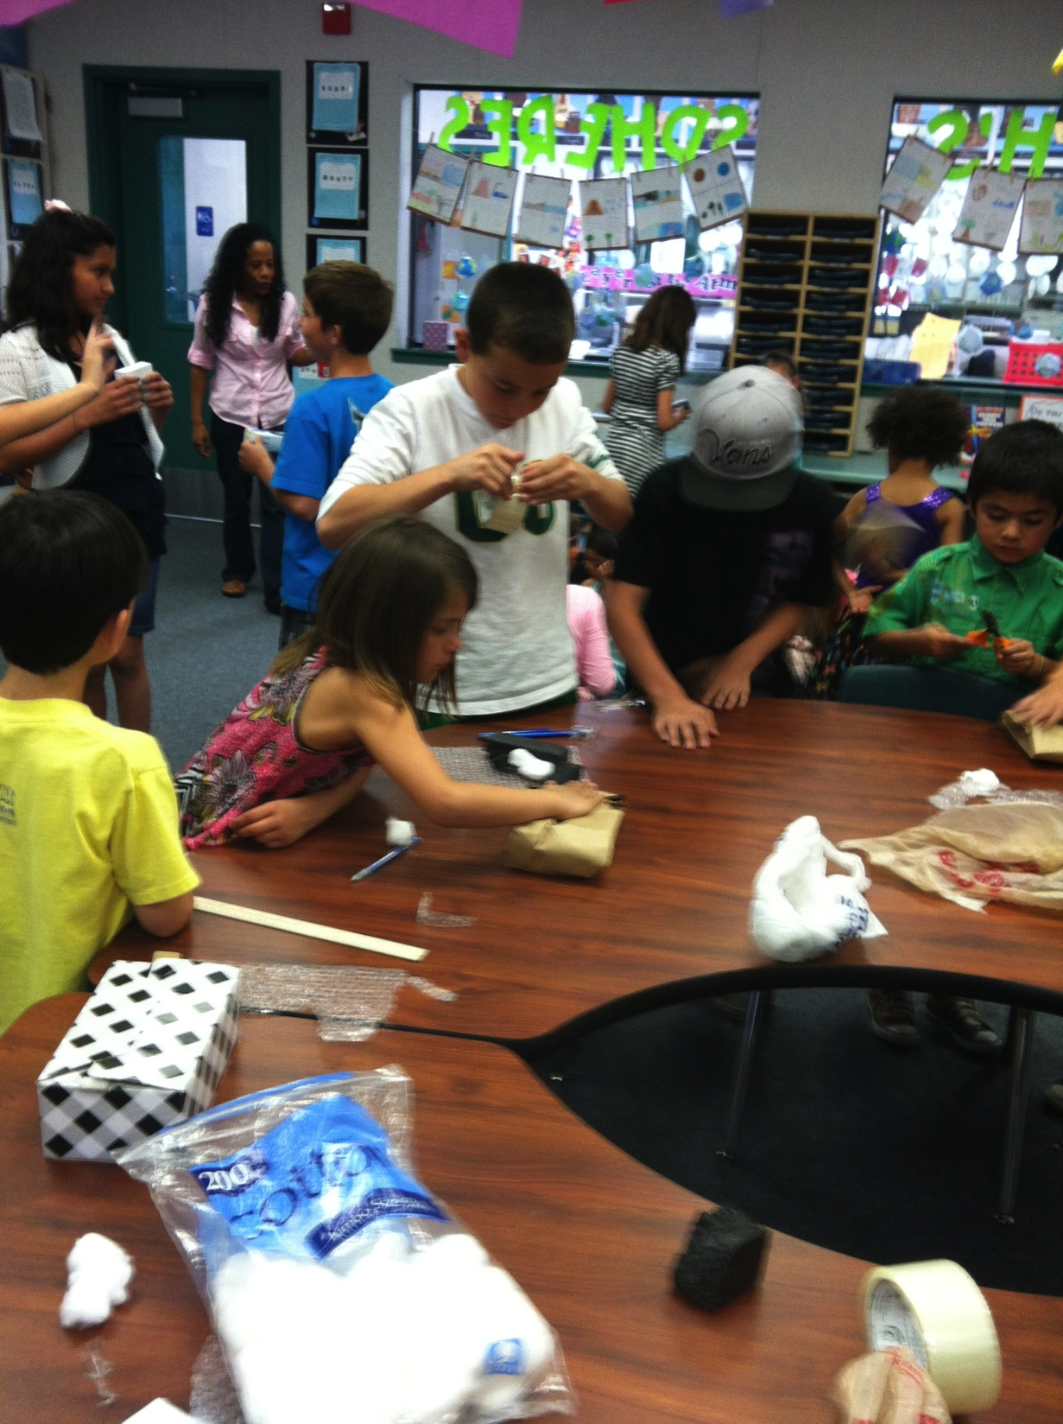
Packaging Engineers
Mission:
Design a method for packaging one Pringle potato chip to be sent across the United States and arrive INTACT!
Math: Surface area, volume, weight, division, decimals

Slide 22
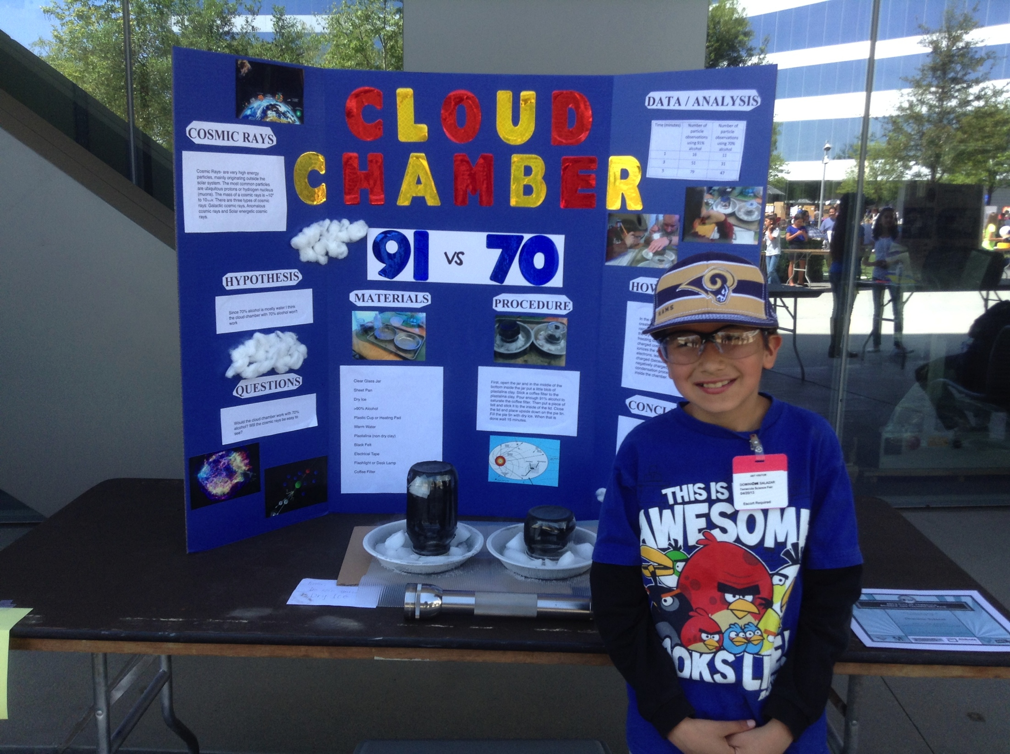
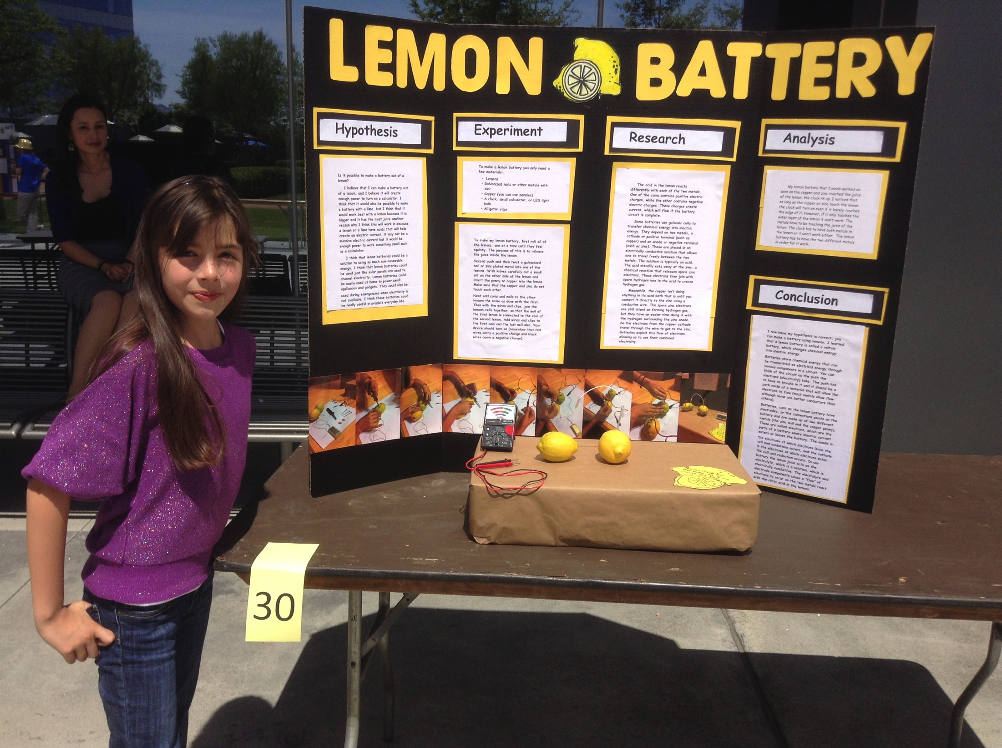
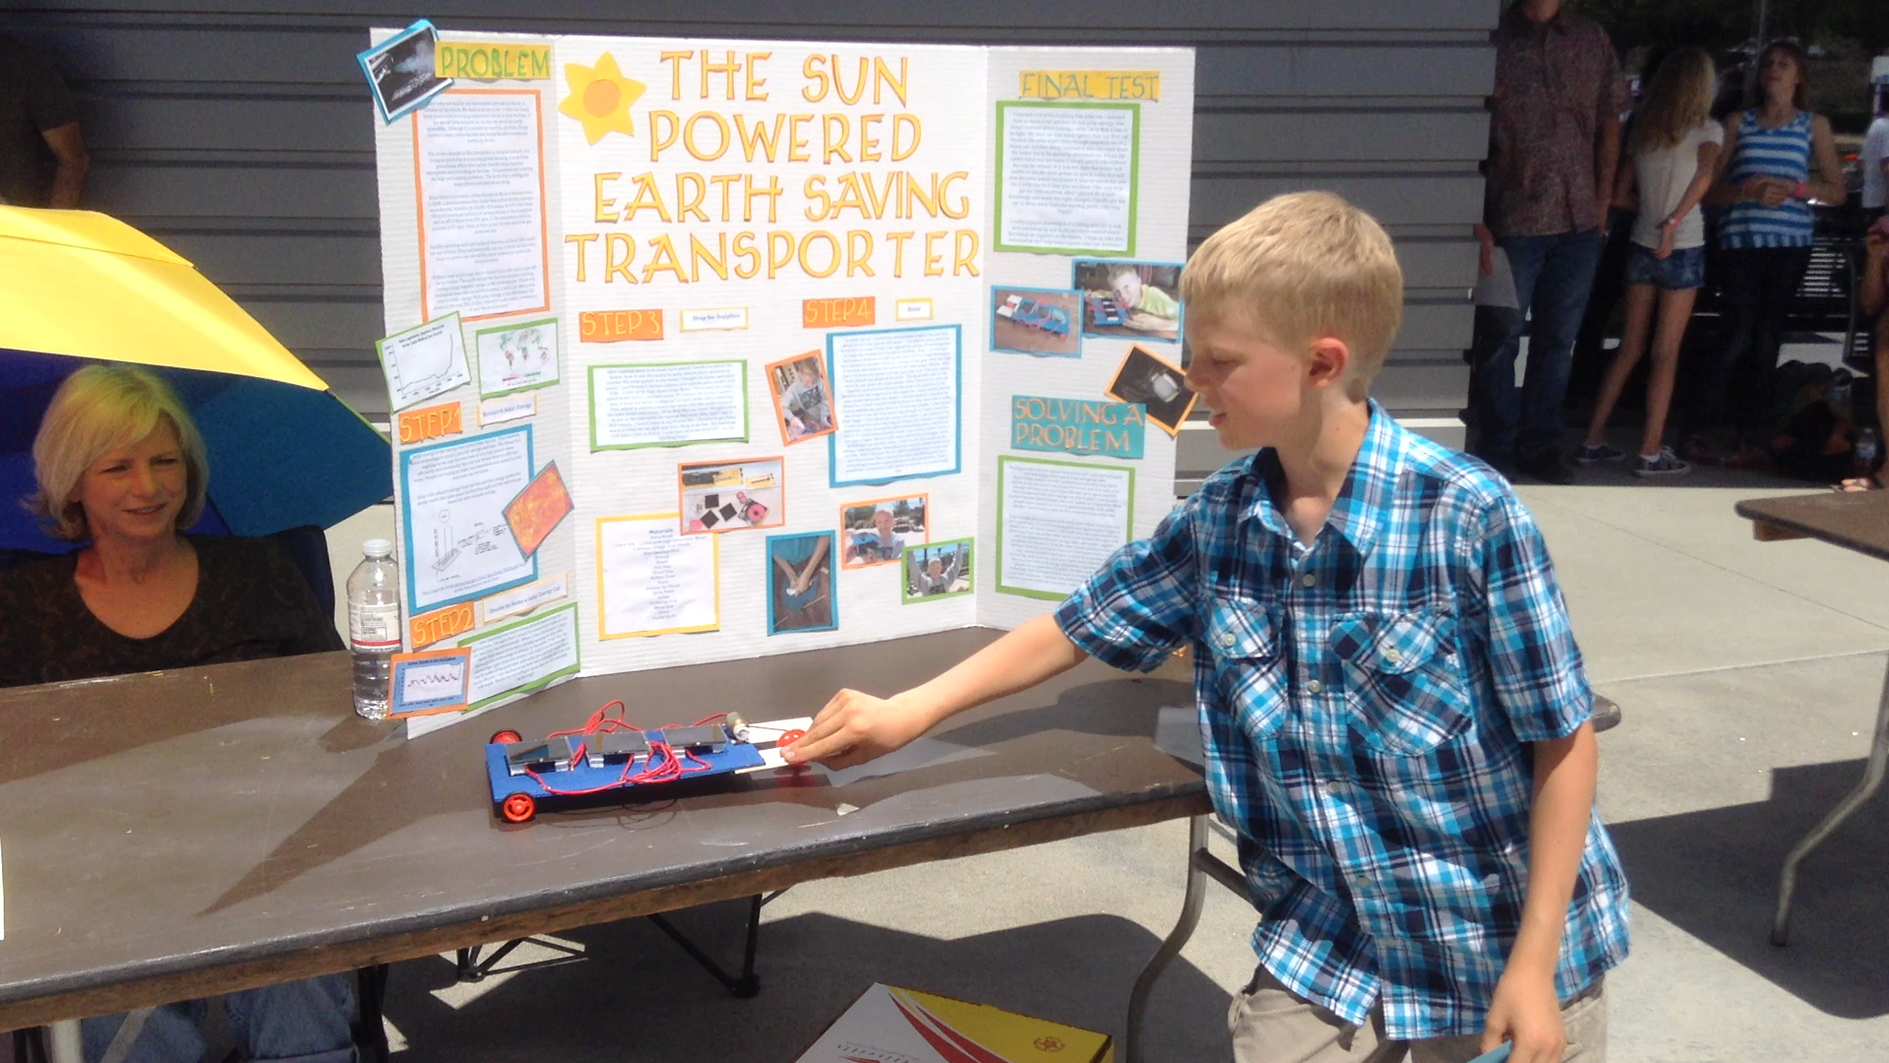
Connection to Community
Temecula becoming a STEM city

Slide 23




Resources: Engineering is Elementary

Slide 24
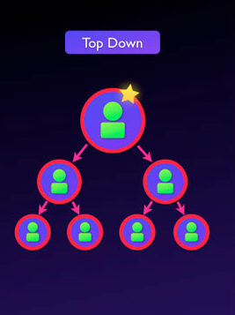

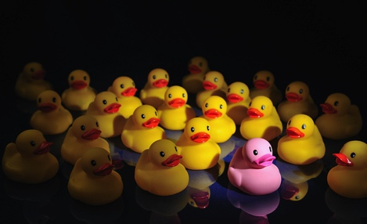
Where do we go from here?

Slide 25

and YOU!!

