Slide 1
S.T.E.M. Field Trip from the Local Watershed to the Ocean
Tuesday, November 16th, 2010
“The Prattsburgh Project”
Submitted by Mr. Mark Barone

Slide 2
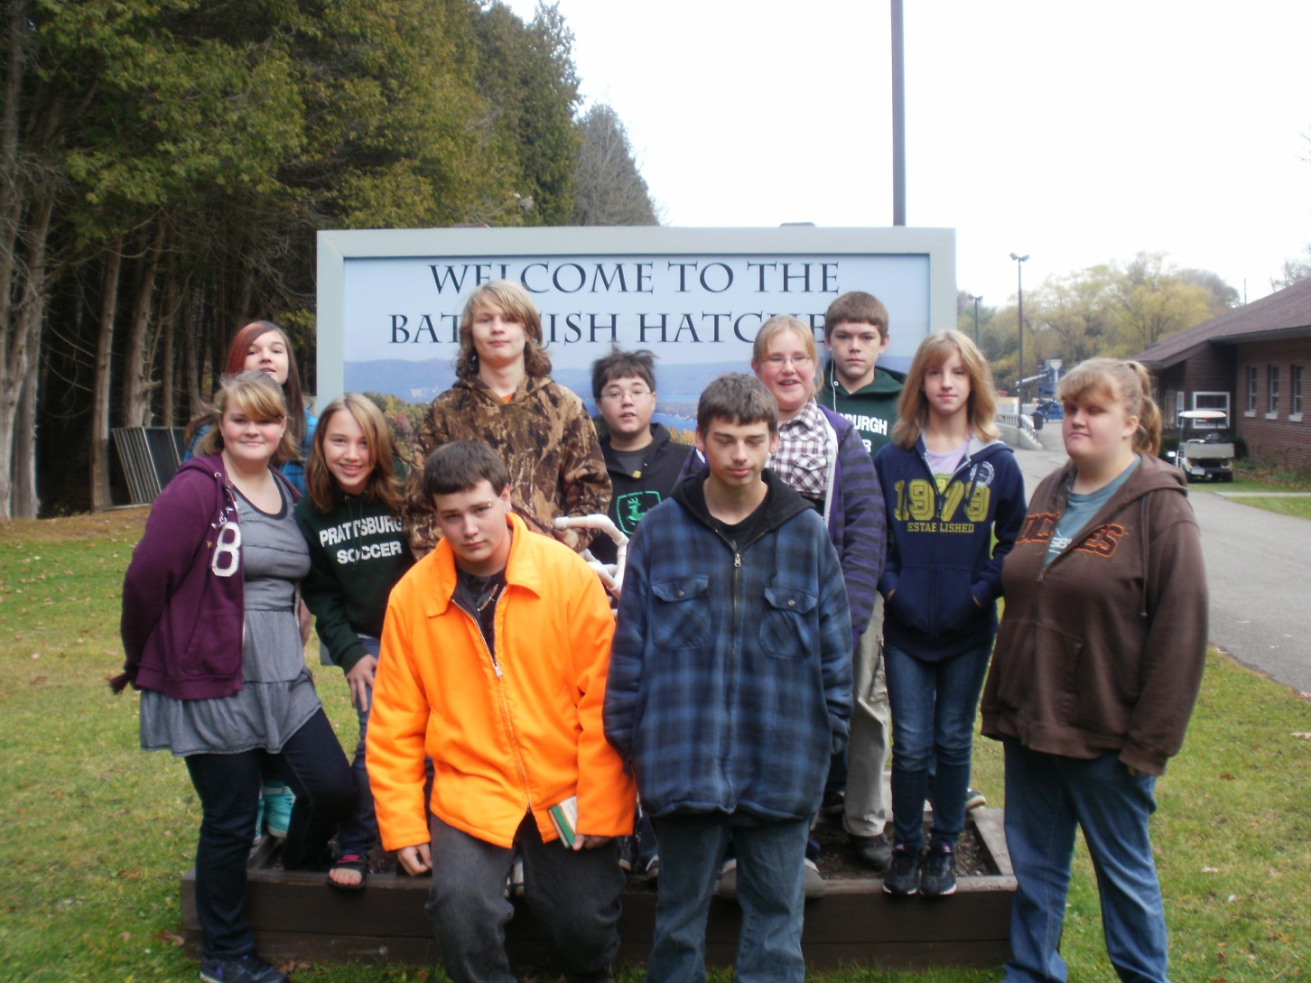
Arrival at the Bath Fish Hatchery to see the life cycle of fish.

Slide 3
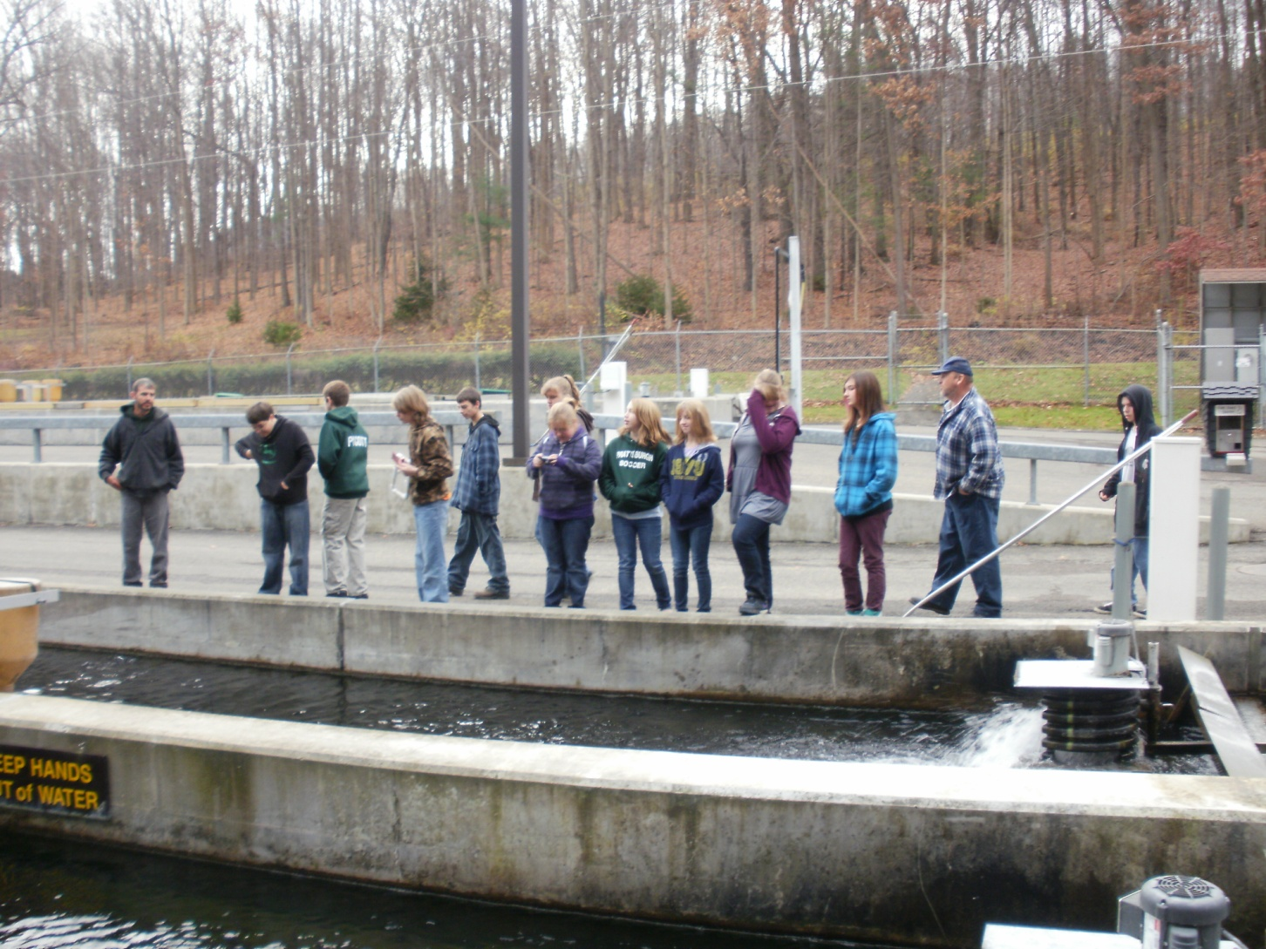
Think about where the water comes from and where the water will go.

Slide 4
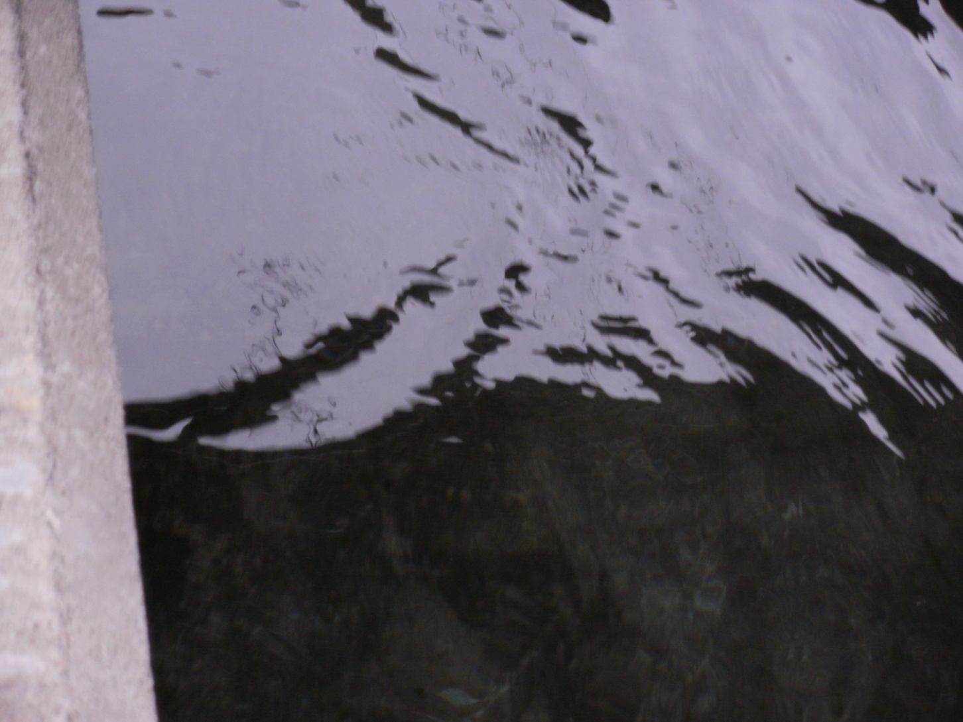
Species of lake fish start their life cycle at Bath Fish Hatchery in Bath, New York . Stages of lake fish include each of the following: egg, alevin, fry, and adult.

Slide 5
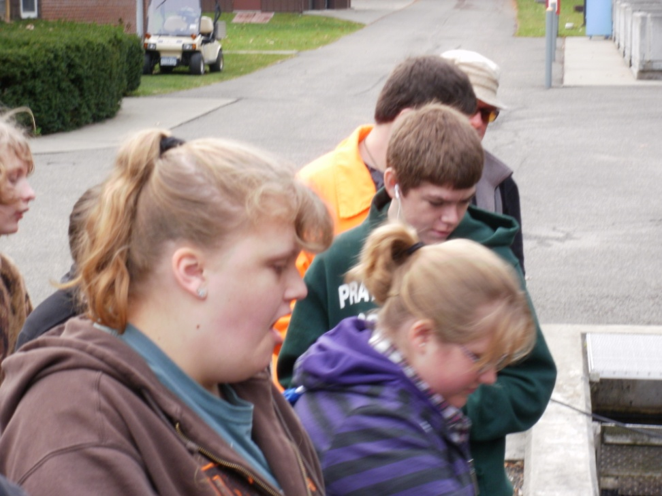
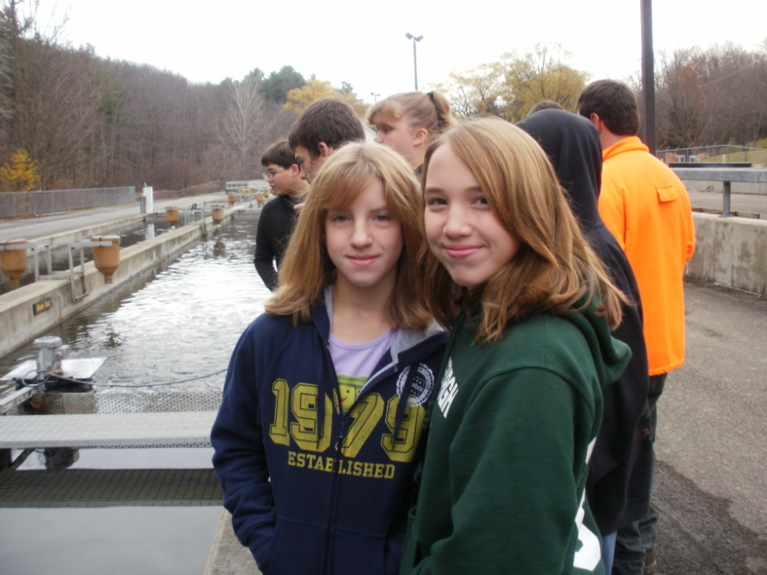
Students discuss their observations in order to understand fish growth, development, and movement through waterways.

Slide 6
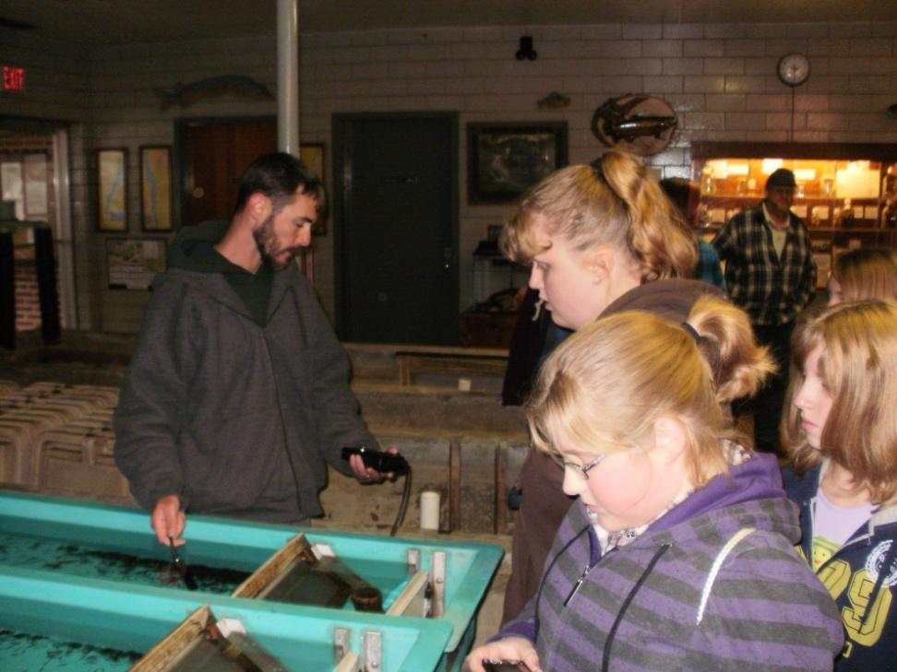
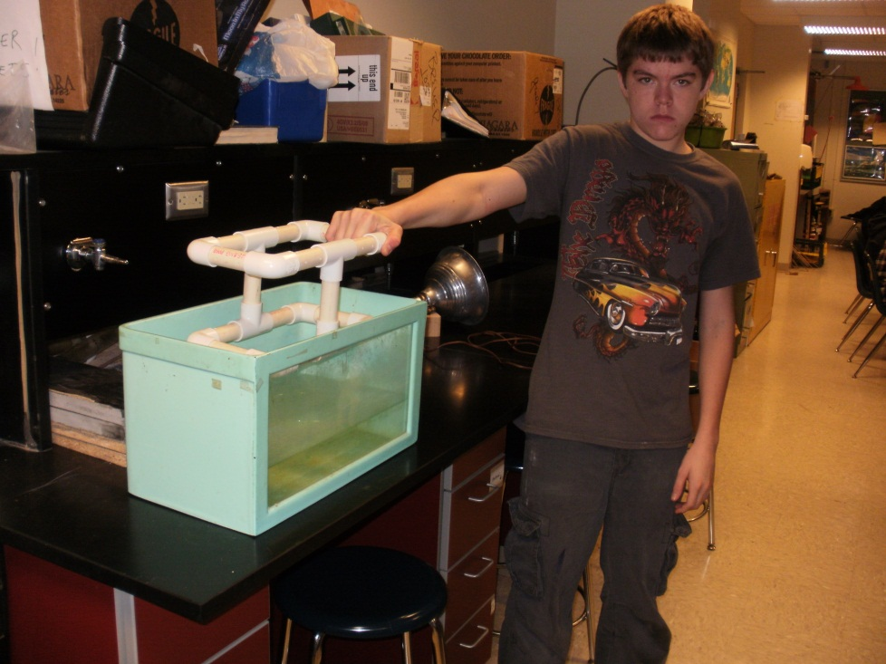
The concentration of oxygen in the water is a major factor in keeping various fish species alive. Monitoring the amount of oxygen in the water is a proactive step in keeping the fish alive. Building a submersible is the first step in understanding the science, design, and fabrication of underwater robotics. Submersibles are used to monitor and study underwater conditions.

Slide 7
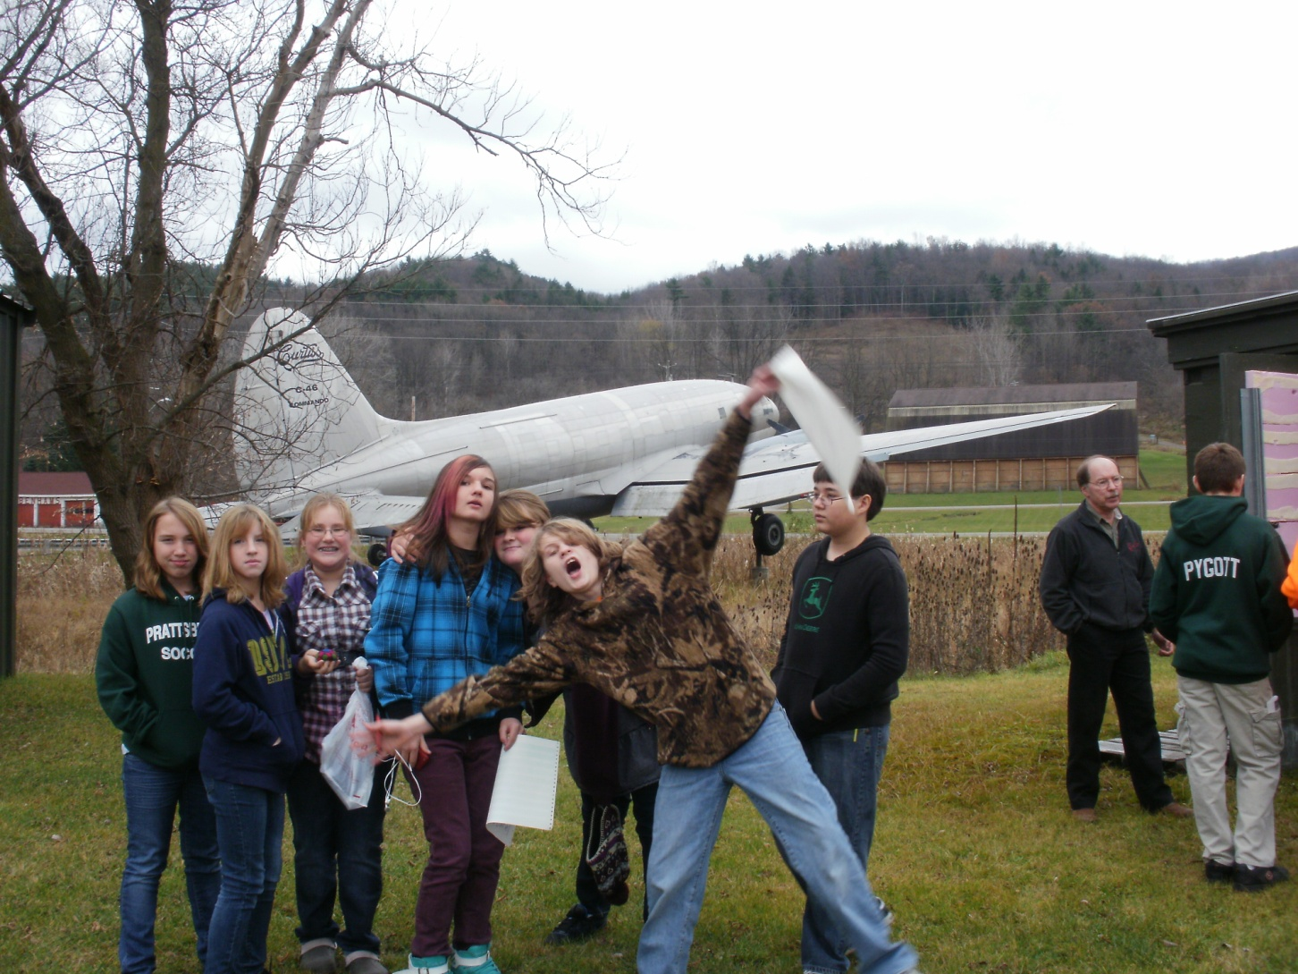
Try to get a bird’s eye view of the waterways. Let’s take a tour of the Glenn H. Curtiss Museum in Hammondsport. Glenn Curtiss pioneered the development of naval aviation. The impact of his efforts allowed humans to visualize the flow of water throughout Earth’s hydrosphere.

Slide 8
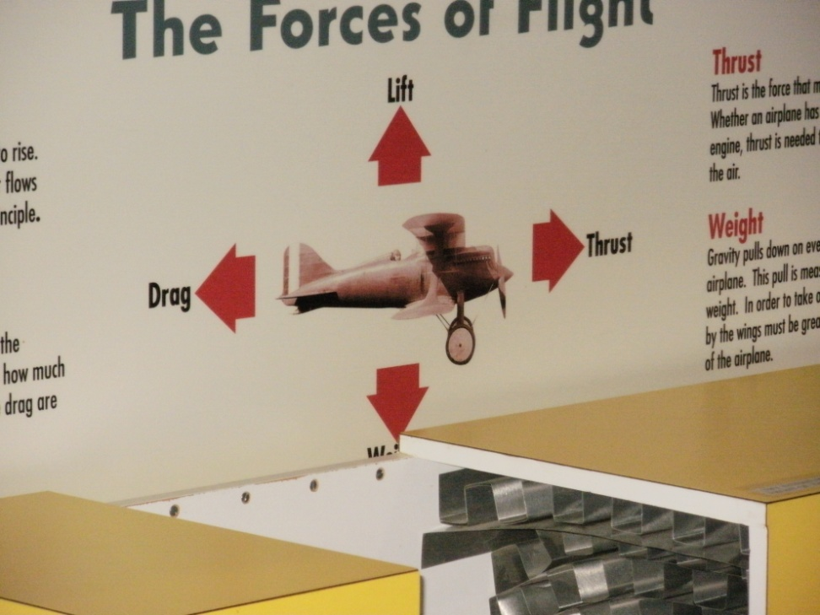
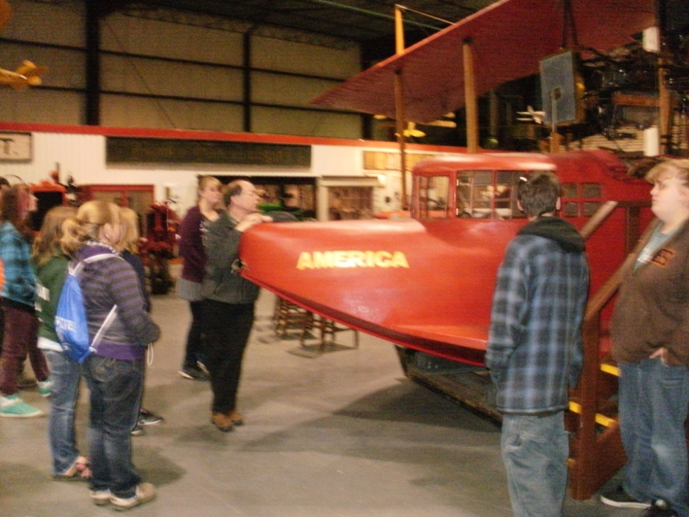
The four forces at work in flight helped humans to observe planet Earth from a distance.

Slide 9
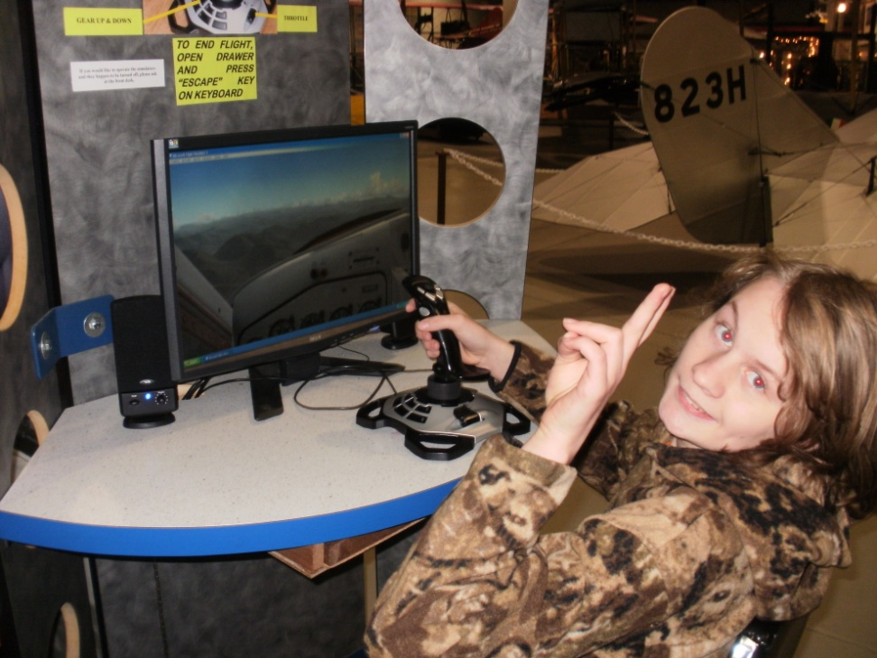
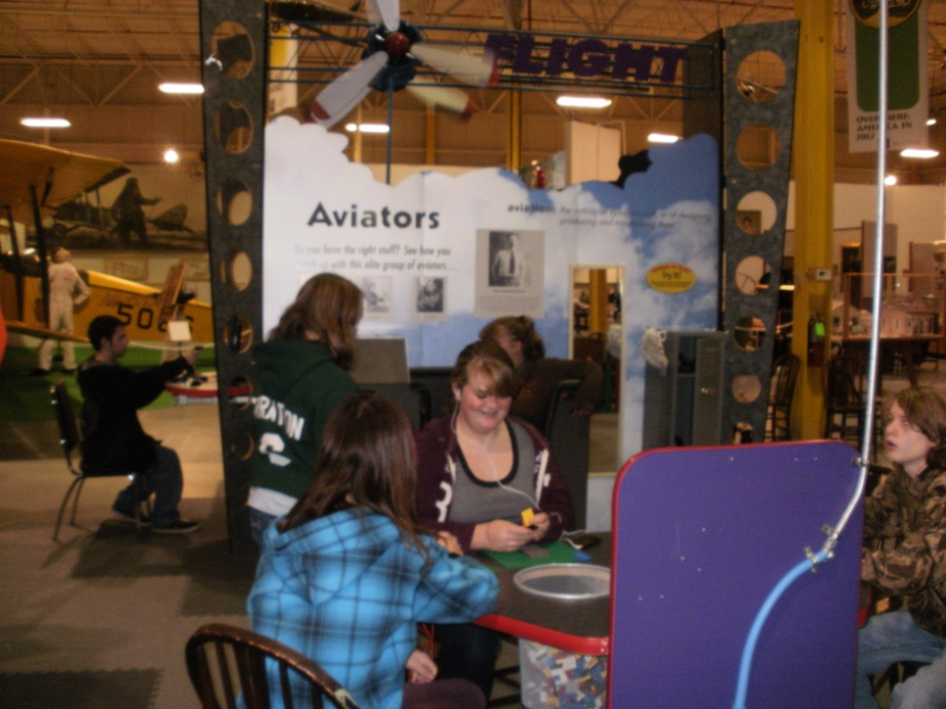
Prattsburgh students learned to move through the atmosphere by using modern technology in applications of flight simulation. They learned how their coordinated efforts influenced movements over land and water.

Slide 10
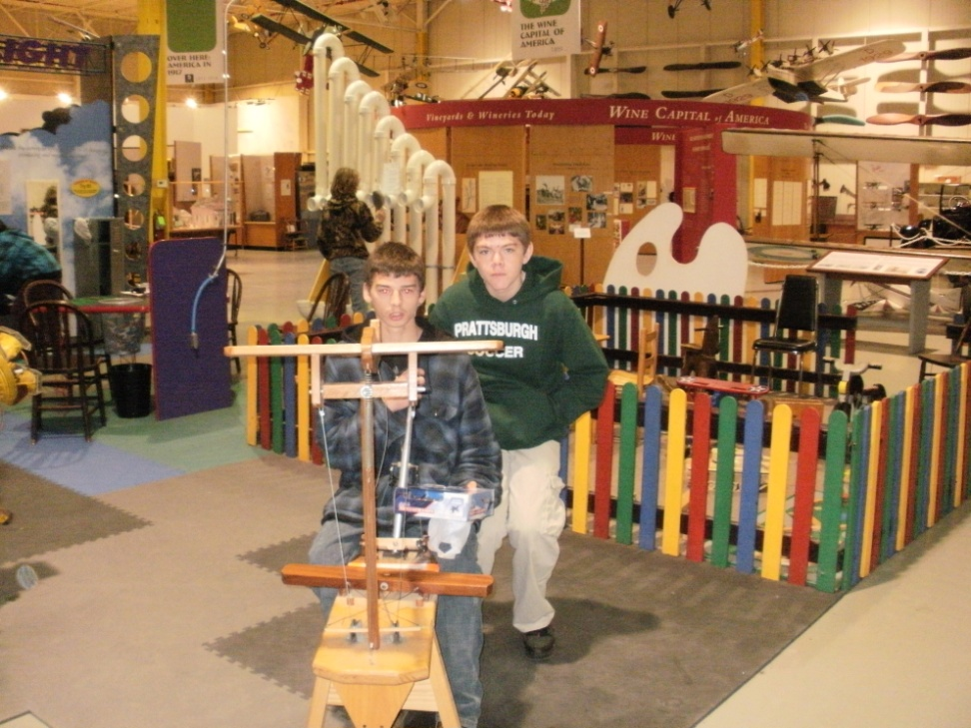
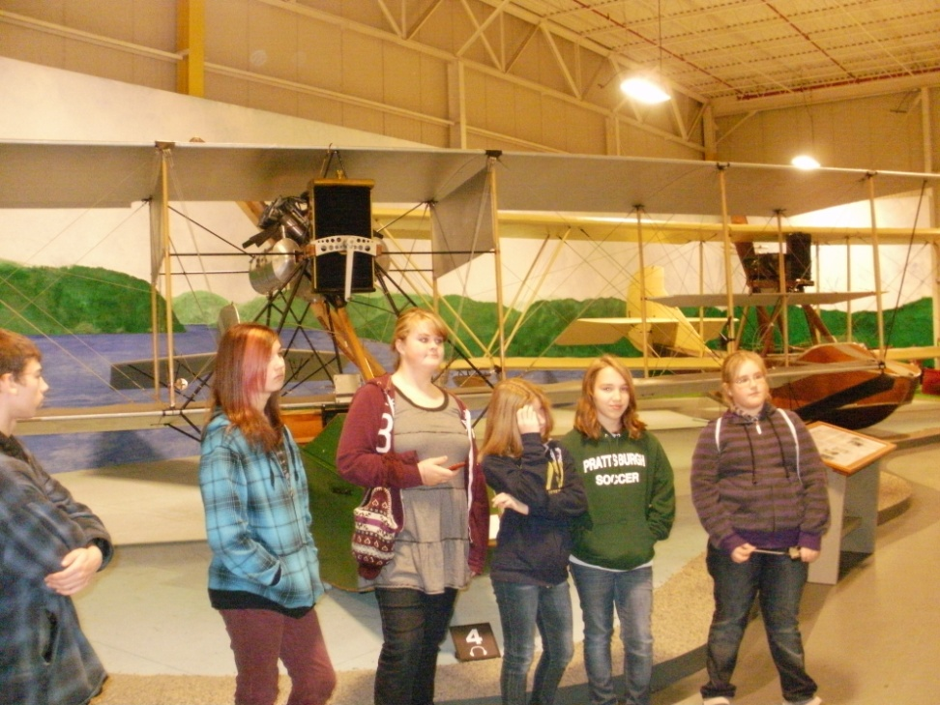
Most importantly, the students of Prattsburgh Central School learned how to apply their S.T.E.M. skills to learning techniques of improving environmental conditions of both land and water.

