Slide 1

On The Moon Design Challenge
The “E” in STEM:
Meaningful Content for Engineering
Dr. Josh Brown
December 12, 2010
Corey J. Peloquin
NASA Endeavor Fellow – Cohort II

Slide 2
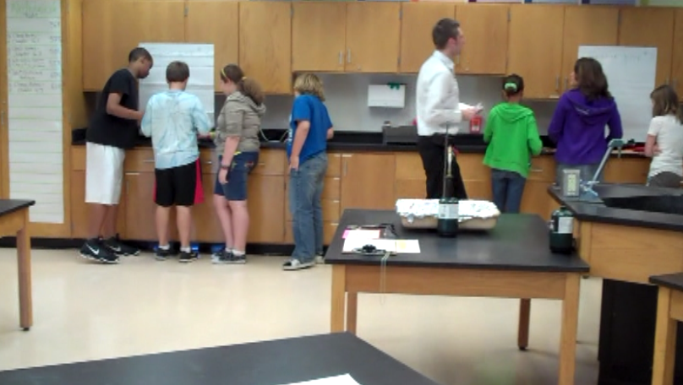
Design Challenge – Thermal Protection System
Our protocol
Identify the problem
Brainstorming
Design
Build
Test and Evaluate
Redesign
Share the solution

Slide 3
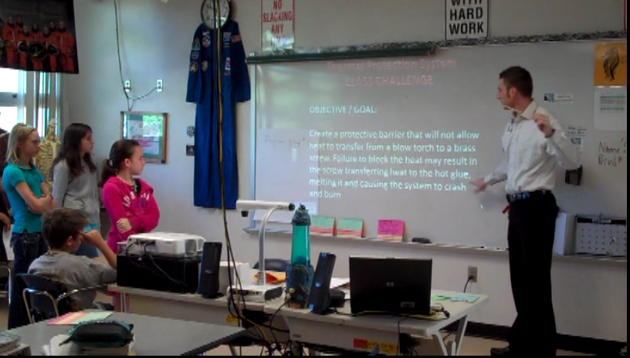
Design Challenge – Thermal Protection System
STEP # 1 – IDENTIFY THE PROBLEM

Slide 4
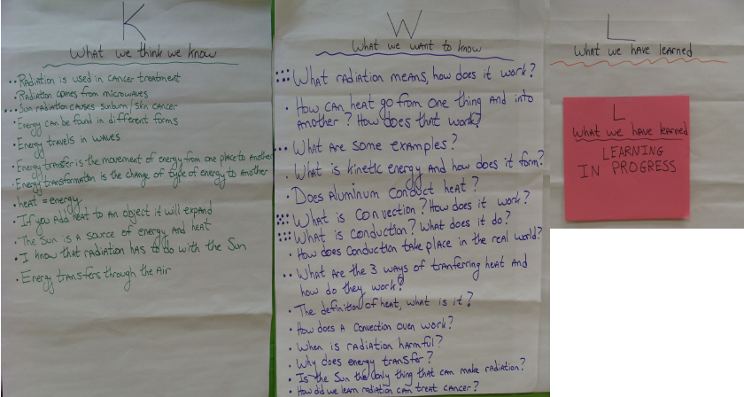
Design Challenge – Thermal Protection System
STEP # 2 - BRAINSTORMING

Slide 5
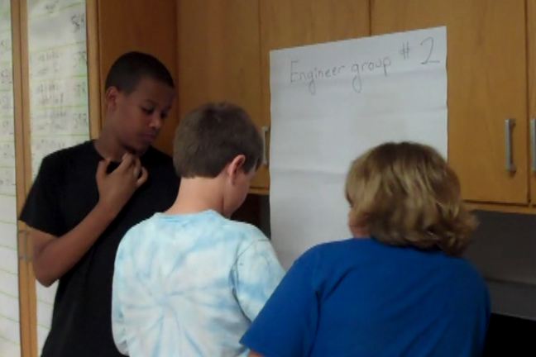
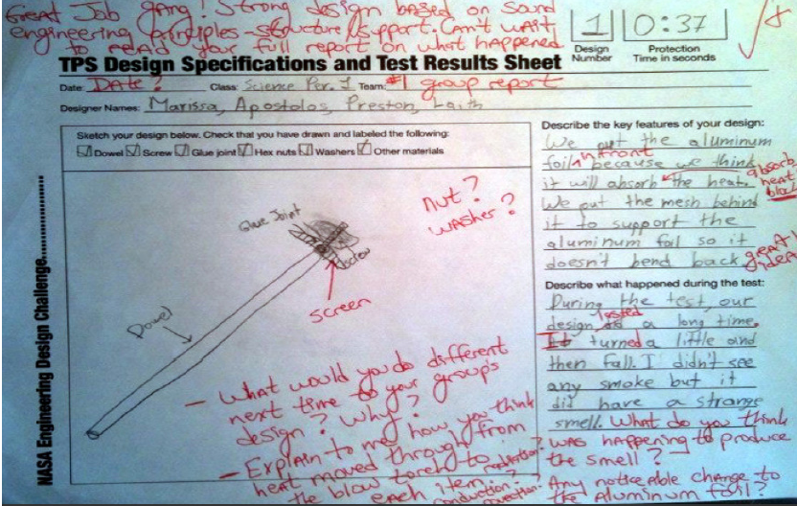
Design Challenge – Thermal Protection System
STEP # 2 - BRAINSTORMING

Slide 6
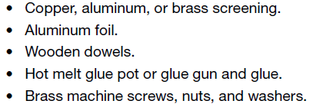
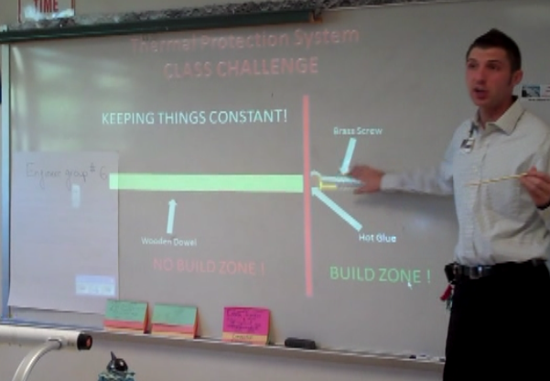
Design Challenge – Thermal Protection System
STEP # 3 - DESIGN

Slide 7
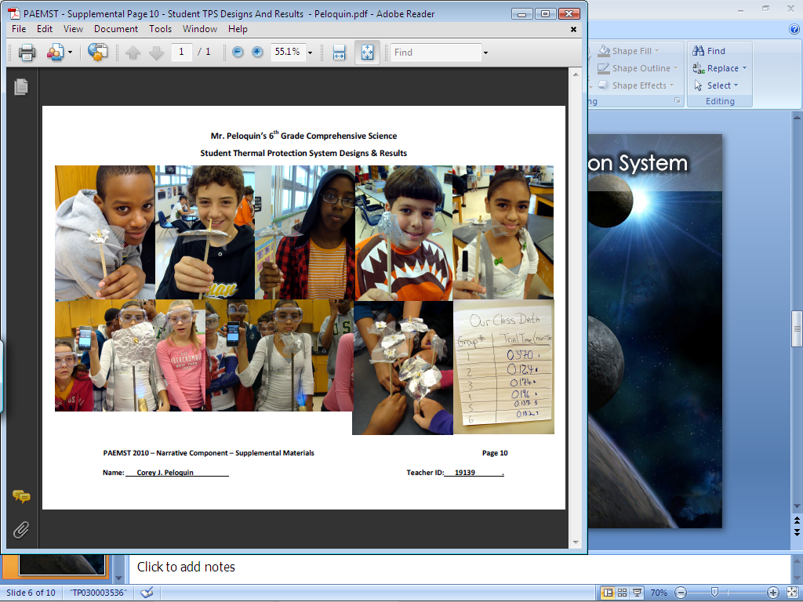
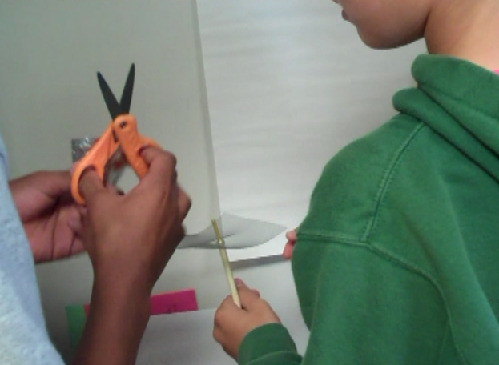
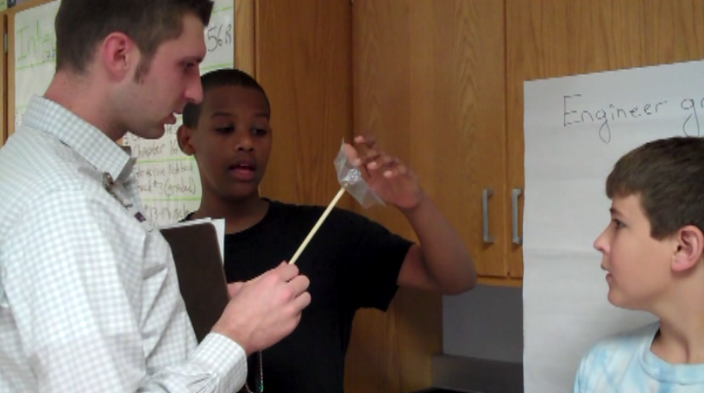
Design Challenge – Thermal Protection System
STEP # 4 - BUILD

Slide 8
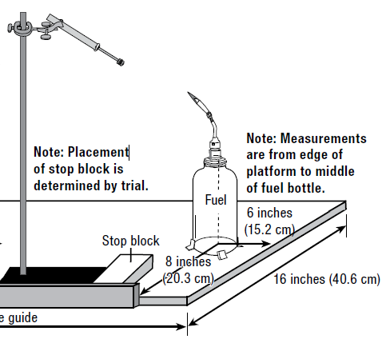
Design Challenge – Thermal Protection System
Trial # 1
Trial # 2
STEP # 5 – TEST …

Slide 9
Design Challenge – Thermal Protection System
STEP # 5 - … and Evaluate

Slide 10
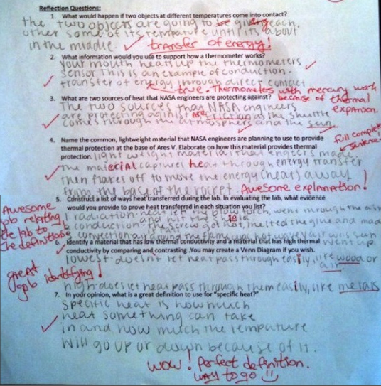
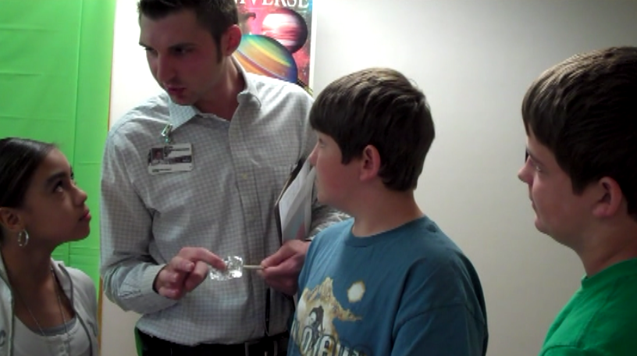
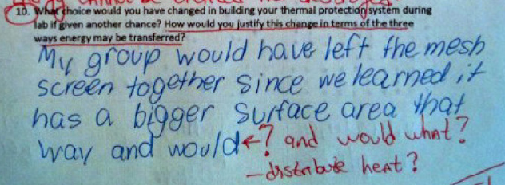
Design Challenge – Thermal Protection System
STEP # 5 - … and Evaluate

Slide 11
Design Challenge – Thermal Protection System
STEP # 6 REDESIGN
TRIAL # 2

Slide 12
Design Challenge – Thermal Protection System
STEP # 7 SHARE THE SOLUTION
Glog page using Glogster.com/edu
Podcast
Poster including visual and written synopsis
Traditional Science Fair Poster Board
In class “Gallery Walk” scheduled

