Slide 1

Option 1: Unit Development
Your Age on Different Planets
Notes:
For my project, I chose Option 1. Our project started off as: How much would you weigh on another planet? however, due to the group of students which just came in, (Emotionally Disabled/Special ED) I tiered the lesson to meet the new students needs. Average functioning level is at 3rd grade, and 2/3 of the kids have been truant for almost a year. Our new topic became, “ Your age on different planets”. It was a three week unit.

Slide 2


Overview
How old would you be if you lived on another planet?
How we measure time on Earth is dependent upon our orbital motion around the Sun and how fast the Earth spins on it’s axis. Would you be the same age if you lived on Mars? What if you lived on Saturn?
How long is a year on Jupiter? Closer planets revolve faster, more distant planets revolve slower. Why?
Notes:
I began the unit by asking my students the open ended question: how old would you be if you lived on another planet? Once the students had a an answer they were asked to explain their reasoning. I asked what variables may play into their answer, the size of the planet? The orbit of a planet ? How long is a year on Neptune? Is it the same length as an Earth year? WHY?

Slide 3
Integration of Mathematics, Science and Writing
Students started this unit by doing two weeks of background reading on the Solar System and review of multiplication and division.
Measurement skills, number lines and geometric shapes(circles, eclipses) were integrated into the science text book readings and hands on activities.
In addition…
Students were required to write a descriptive essay, working with the Language Arts Teacher, on their planet, and to complete a drawing of their planet.
Notes:
Basic skills are lacking. The first two weeks in math class were spent learning and reviewing multiplication, division and graphing skills through worksheets, a computer video game and by integration of mathematic skills as we worked through the space chapter activities in our science text book. Geometric shapes were also reviewed as we discussed the size, shapes and orbits of planets.

Slide 4
Math and Science Standards
All curriculum in my district must be aligned to the Arizona Department of Education Standards. We teach to the standards.
(partial listing)
Math
S1C1P01, S1C2PO1, S1C2PO2, S1C3PO1
Science
S1C1PO1-PO3, S1C2PO1-PO5, S1C4PO1-PO5, S1C3PO1, S1C3PO6
Writing
S2C1PO1-4, S2C2PO1-6, S2C4PO1-4,S2C4PO1-4, S2C5PO1-4
Notes:
My district is relatively new. The Bureau of Indian Affairs provided all education for the community up until 2004. In 2004 the tribe built their own charter schools and new jail (thank you casinos), all curriculum had to be aligned to state standards.

Slide 5

Model It
Students modeled the Earth’s rotation on its axis, and rotation around the sun. Each student took turns being the Sun, the Earth, and the planet of their choice. We made distance estimates to position each student/planet from the Sun. We also attempted to model the orbit of the planet in order to give the students an idea how long a year was on their planet.
Notes:
We modeled day and night, using a flashlight as the sun. Students were planets and spun on their axis. We added the Earth’s orbit into the modeling as well. Unfortunately, the jail does not allow cameras. It was very amusing watching this group of young men spin and wobble. The activity was helpful. It demonstrated day/night, the difference in a Earth year compared to a Mars year, and seasons. Their were many ideas/questions from students about other planets, seasons, and space travel - opportunities for enrichment.

Slide 6
Pick a Planet
Once we had completed our background reading, had our multiplication and division down, students picked a planet of their choice.
2 chose Neptune
5 chose Mars
2 chose Jupiter
One student was allowed to chose Pluto as she knew it had been reclassified as a “Dwarf Planet”.
Notes:
Once we had finished the four chapters in science and everyone had their basic multiplication and division facts down(week 2) each student picked a planet. I provided addition information from EDHELPER on their planet and we watched National Geographic DVD’s on the universe – all of my students are visual learners. There were several short quizzes, cloze activities and writing prompts.

Slide 7
Student Work
Students multiplied the orbital period of their planet, relative to Earth, by the length of a year in Earth days, then divided their Earth age by the orbital period of their planet.
Example: Mars
1.881(orbital period of Mars) x 365 days(Earth year) = 686.57(length of a year in Earth days on Mars).
17(Earth age)/1.881 = 9.02 years old on Mars
A 17 year old would be 9.02 years old on Mars
Notes:
Students multiplied the orbital period of their planet, relative to Earth, by the length of a year in Earth days, then divided their Earth age by the length of a year on their planet. This was then multiplied by the length of an Earth year, in days, to determine their age.

Slide 8
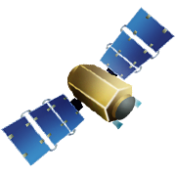
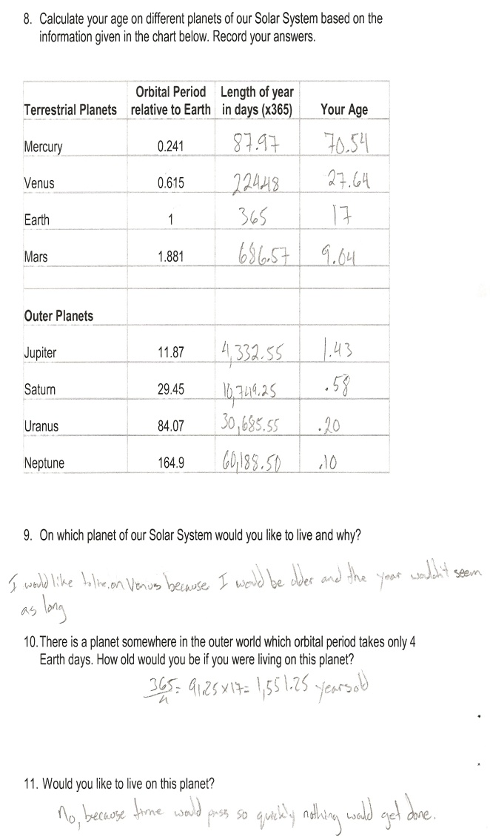
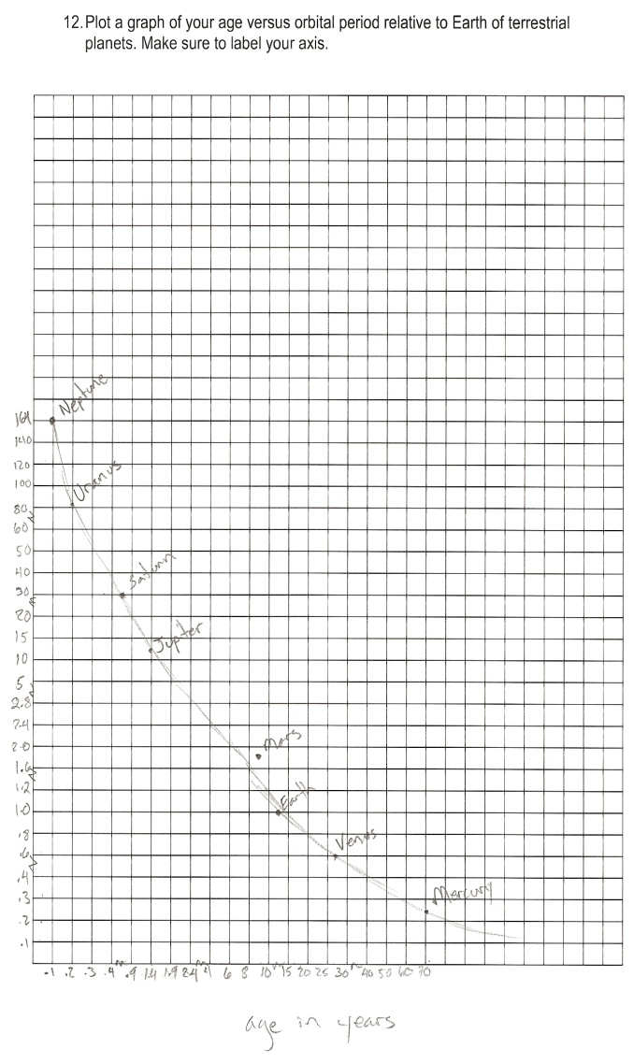
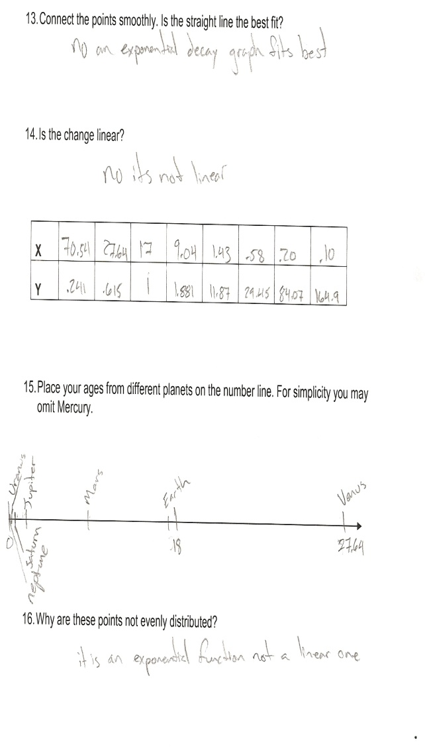
Your Age on Different Planets Worksheet
Notes:
Students completed the worksheet, doing the math, then graphing the results. New vocabulary was introduced throughout the Unit.

Slide 9
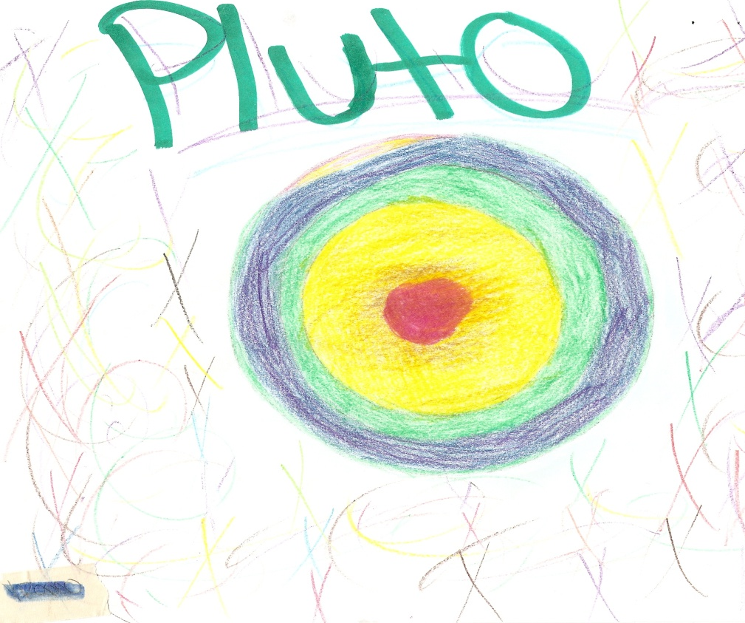
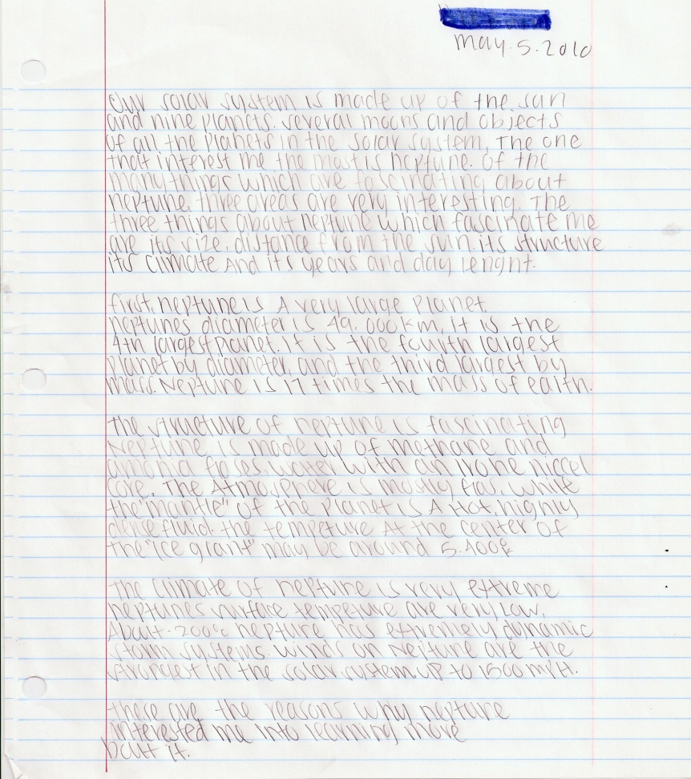
Essays and Drawings
Students completed their essays and drawings, using our text books, handouts, and pictures on our Promethean Board
Notes:
Our Language Arts teacher modified his lesson plans to incorporate our topic for his class. Although I have had students which have won national awards for their art work, this group seemed to enjoy the simpler approach to art; coloring.

Slide 10
Remediation
Review and mastery of basic math and problem solving skills.
Additional adapted and modified reading and writing assignments.
Adapted and modified homework (jail work) over the weekend.
Notes:
One of the challenging aspects of this unit was the fact two of my kids only knew their multiplication facts 0-5(one was 17 years old). It is challenging having a 17 year old functioning at a 2nd grade level. However, it was awesome watching his peers step up to work with him. They displayed enthusiasm, encouragement and continual praise for this young man as he managed to memorize facts 1-11 in two weeks.

Slide 11
Enrichment Activities
Students thought it would be fun to calculate their jail sentences in days, according to the length of a day on their planet.
For higher functioning ESS and regular students: use the formula: F= (Mm)/r² to determine your weight on other planets.
All of the students were fascinated with the idea of colonizing other planets. They all liked the idea of designing their own city on their planets.
Additional writing and reading assignments on Kepler, Brahe, and Galileo.
Notes:
My kids had dozens of questions each day about the lesson and Space. They are fascinated with the idea of going to other planets and how they would survive. I did introduce the formula and big picture on how to determine your weight on another planet. All students were enthusiastic about taking on the next math challenge.

Slide 12

Conclusion
The Unit lesson went smooth and the students had fun with the hands on activities.
Students were able to apply and integrate math skills and concepts(multiplication, estimation, and geometric shapes) to problem-solve science question.
I will challenge this group of students to determine their weight on other planets the next time they are incarcerated .
Notes:
Overall I think the Unit went smooth and I think was very successful. I would have liked to have introduced more challenging mathematics. I have let all of my guys know that is what awaits them the next time they are arrested and return to school. I think one of the highlights of the Unit was that it clearly demonstrated how math skills are needed outside of the math class. It also stimulated an interest in astronomy, from how we went to the moon to how we will colonize Mars.

