Slide 1
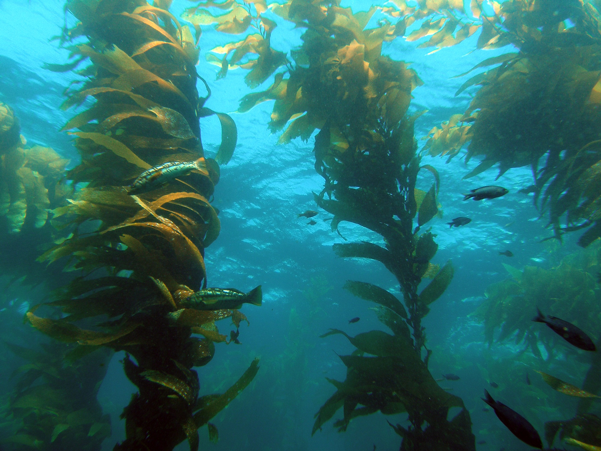
Ocean Studies—Spring 2012
April King
High School Biology and Chemistry Classes

Slide 2
What Have I Been Doing?
Ocean Literacy Paper
Lesson Plans for implementing ocean studies into biology.
National Water Study Challenge
Scientists Webinar

Slide 3
Outcomes
Lessons have increased relevancy when applied to NC oceans and waterways.
Students were very excited about meeting with scientists during webinar.
More engaging context within lessons
Fresh ideas for future activities

Slide 4
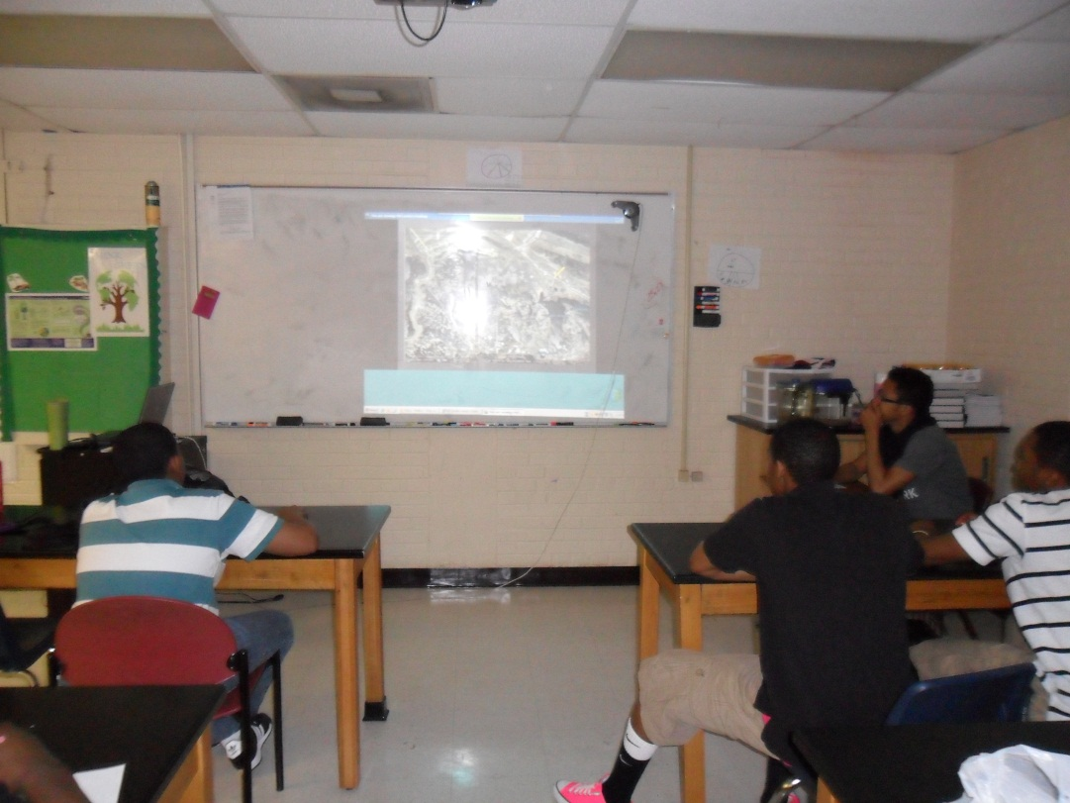
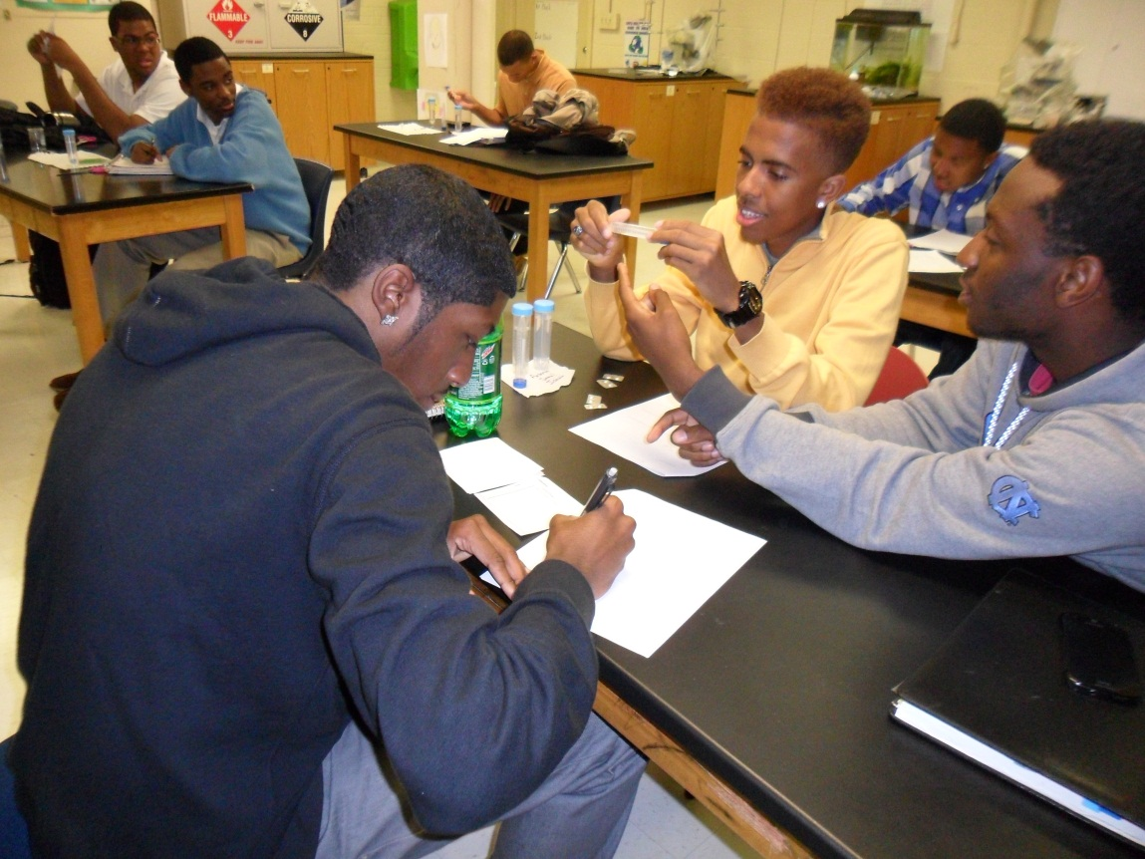
Scientist Webinar
National Water Study Challenge

