Slide 1
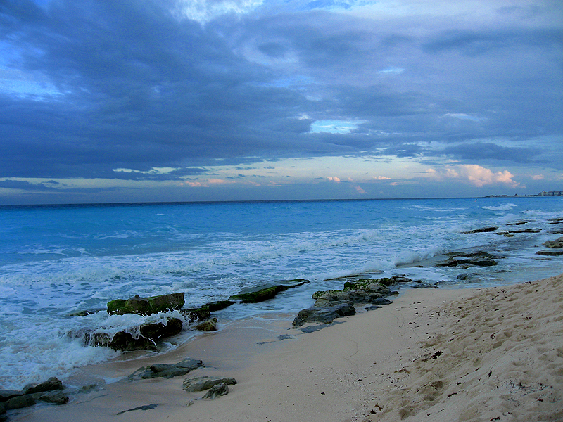
Michele Bubley Wiehagen
Life and Marine Science: Tracking Live Marine Animals
Final Power Point Presentation

Slide 2
What are we working on…
Webcasts
Lesson Plans
Field Trips
Water Challenge
Tracking Animals
Student Gallery for the school

Slide 3
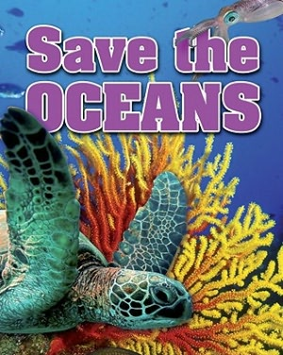
Ocean Unit adapted for Elementary Level
Notes:
Started with a literature connection. The students in the schools I am responsible for many have not been to the ocean. So I try and bring as much of the ocean to them. We started with a KWL of the ocean.

Slide 4
Student responses about what they “think they” know about the ocean
“We can’t swim in there because the sharks will eat us.”- Jeremy
“The salt water will kill the fish.”- Kenya
“The water is soooo dirty- the fish pee and poop in there.”- Willy
“I am NEVER going in there!”- Corey
Notes:
So after asking students about what they knew about the ocean- we took them to the gulf which feeds into the ocean. Here they were able to experience the ecosystems, the water, the marine life, etc.

Slide 5
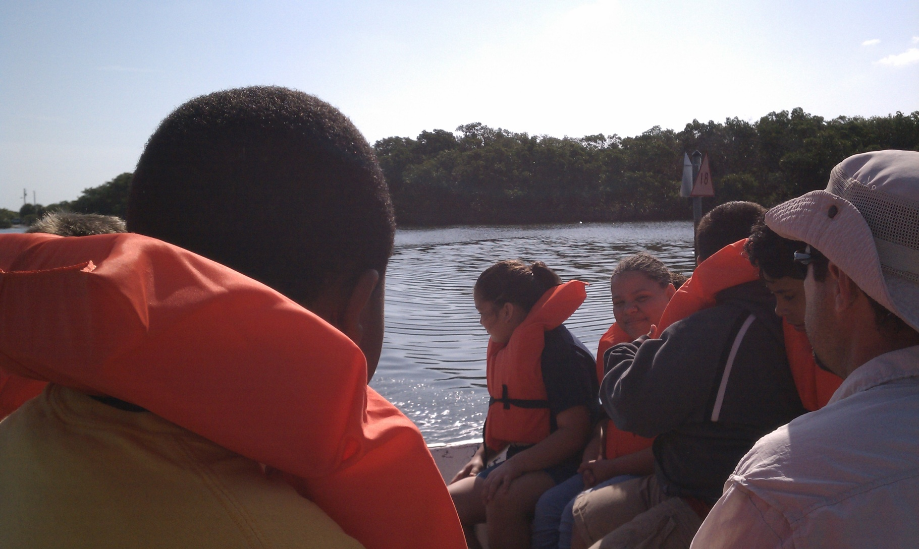
Field trip to the Gulf
Notes:
The students in our inner city have never been to the water, though it is twenty minutes from them, for most of these fifth graders this was the first experience they have had by the water, or on a boat. We took the entire fifth grade to the Gulf- the field trip included a boat ride, dipping for marine life, creating food chains, studying mangroves, and learning about the water that surrounds Tampa.

Slide 6
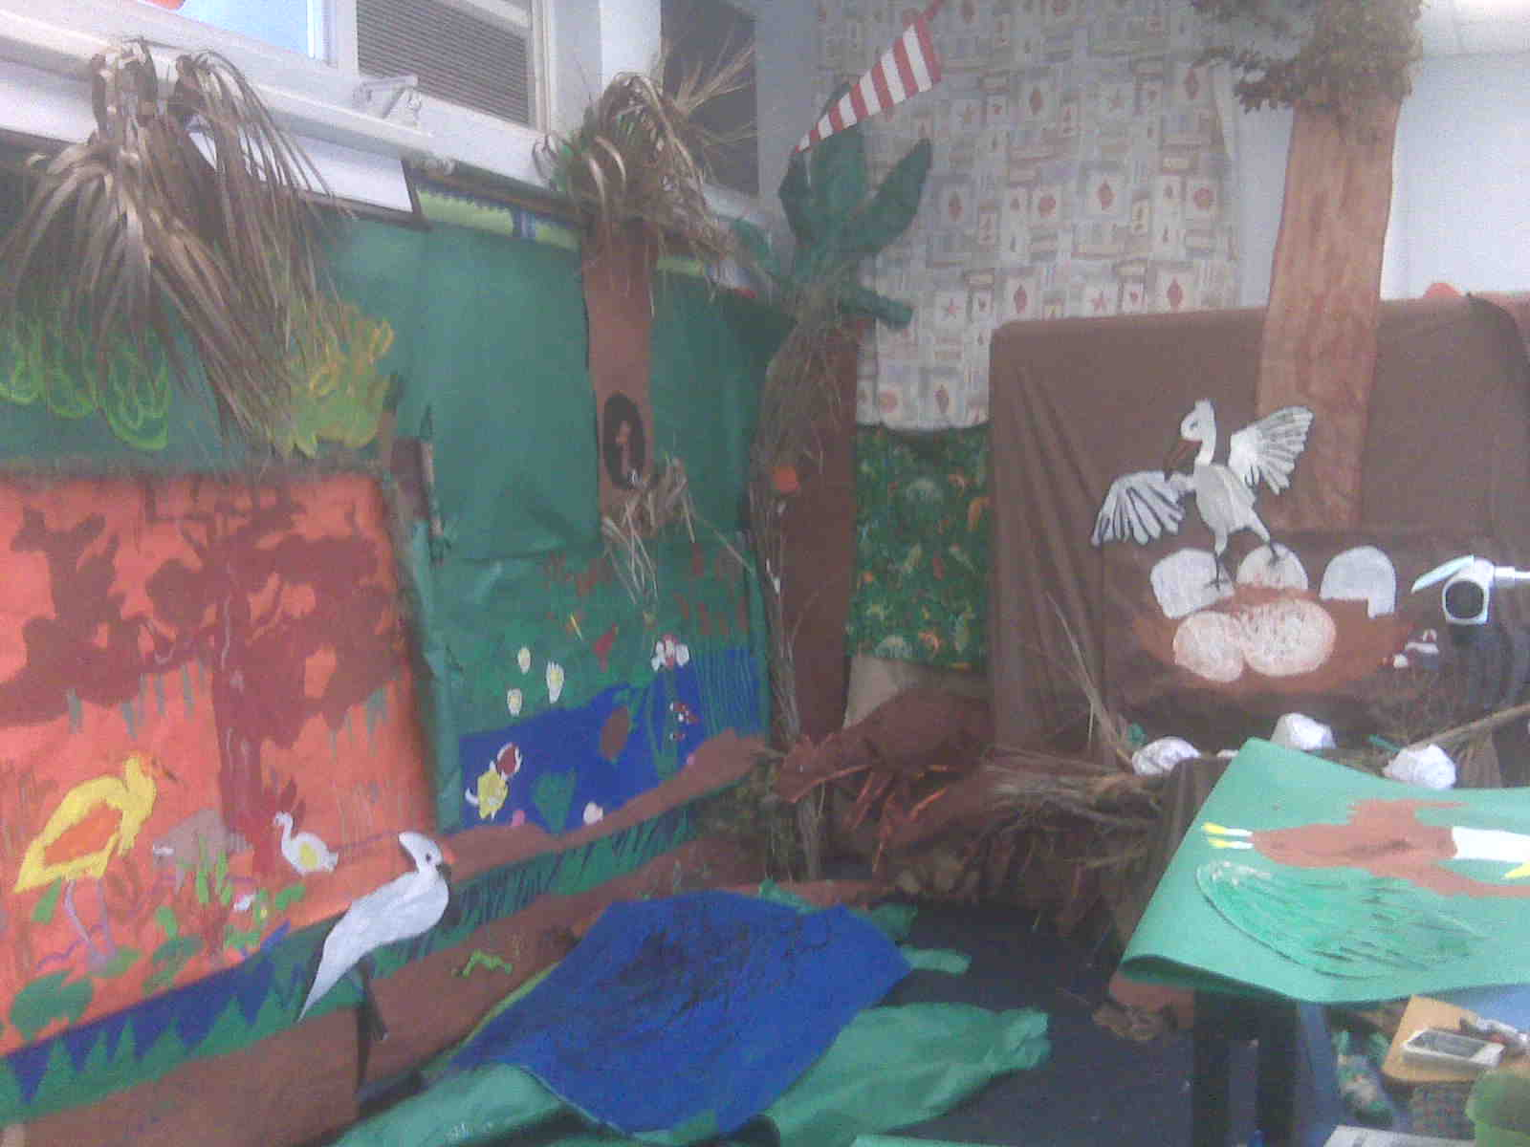
Classroom Lessons
Notes:
Each group researched their animal and became the student experts in their fields. They then were able to share their expertise with the whole school in a gallery. The ACES lessons were used but adapted to fit the needs of the intermediate science curriculum.

Slide 7
WEBCAST
Our school chose to use webcasts from the Jason Project. They were very elementary school friendly and we used pre recorded ones. We still had the students submit questions on the blog.
http://link.brightcove.com/services/player/bcpid1370867862?bctid=1817750814
Notes:
Depending on the grade level and the Next Generation Sunshine State Standards the videos were used for different purposes. If you google the Jason Project and go to the videos there is a variety of snippets and full length videos to choose from depending on the course of study. For fourth grade we used the webcasts from the explosions under the water, where as in fifth grade we used the adaptations of the beluga whale.

Slide 8
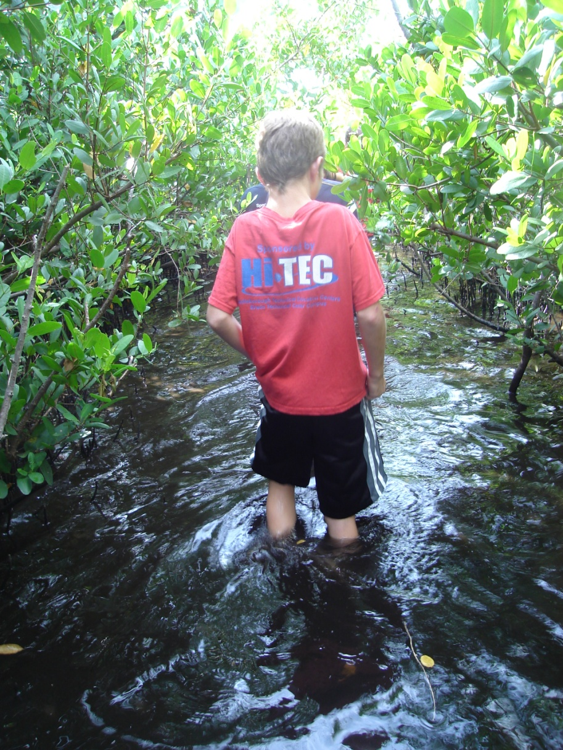
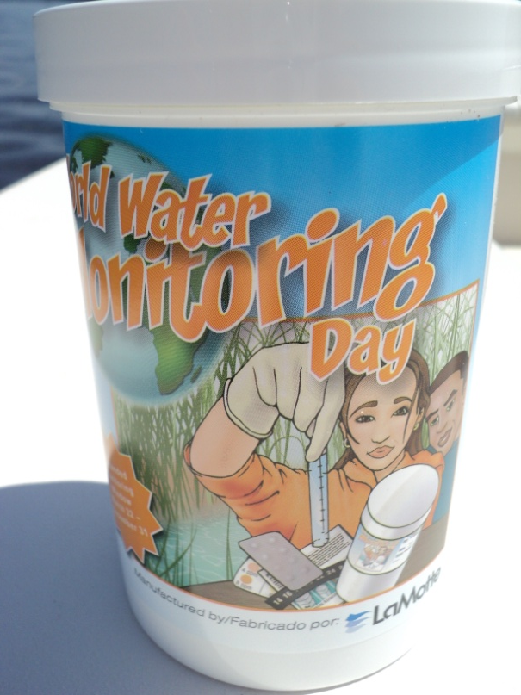
Water Challenge
Students collected water from the field trip in order to test the quality. Once the testing is done they will submit it to the water challenge.

Slide 9
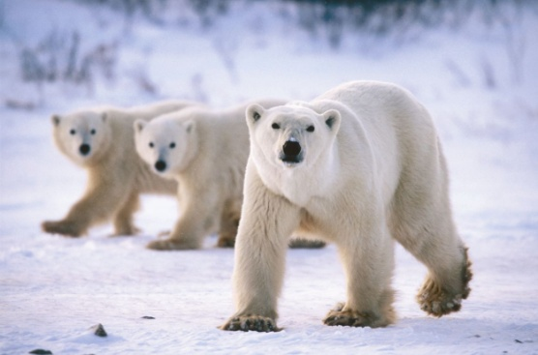
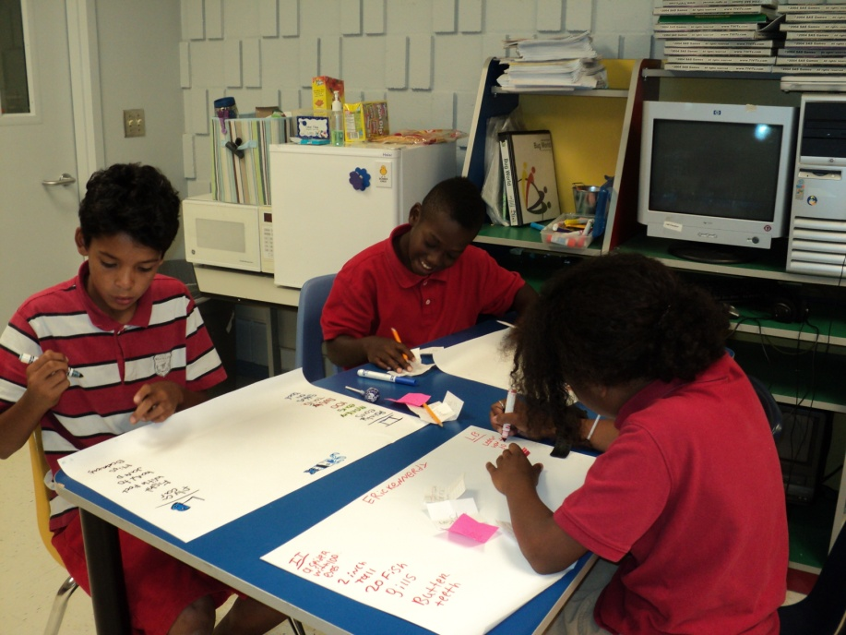
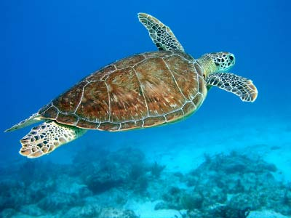
Animal Tracking
Students were extremely interested in tracking the turtles since they do find them here in Florida. We are currently working in our research teams.
Notes:
Due to state testing, teaching the students the pre information of maps and geography and computer lab access we are just getting to the tracking of animals. Our fourth graders are tracking the turtle and the fifth graders are tracking polar bears, since they did tie into the curriculum at their grade levels. We have students every morning announce different facts or where their animal has been on the morning show so the school gets excited. We are using this as our school wide long term investigation.

