Slide 1

Is it good or bad?!
NUCLEAR ENERGY
UNLOCKED
By Maria Singh
01

Slide 2

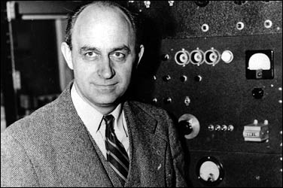

THE HISTORY
James Chadwick in 1932 was credited with deiscovering the neutron, which led up to nuclear experiments. Then, Enrico Fermi came and created the first artificial nulcear reactor: Chicago Pile-1 (CP-1). Eventually, atomic energy caught along and nuclear fission was being used in battles, such as World War 2. After this war atomic energy was put to use for good. Soon enough the USSR’s Onninsk Nuclear Power Plant on June 27th, 1954 became the world’s first nuclear power plant, which generated eletricity.It developed about 5 megawatts of power! Once this happened the United States headed right down the road of developing nuclear power plants.
Enrico Fermi
DEFAULT STYLES
02

Slide 3
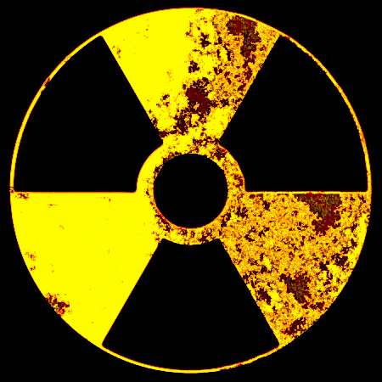
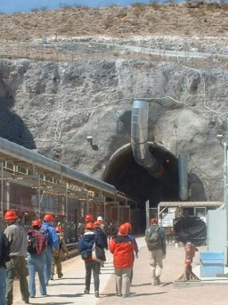
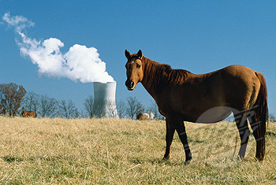
DISADVANTAGES
One of the biggest problems that evolves because of nuclear energy is radiation exposure. Both humans and animals are endanger of disfigurement, cancer, and death. Workers take the biggest chance by laboring around the radioactivity too. Nuclear power is stabilized at a nuclear plant, but if conditions are changed or the environment its placed in is unbalanced, then a nuclear bomb will form. Right now at the Yucca Mountain Repository, nuclear fuel wastes are stored. However, Nevada for example has a lot of seismic activity every year, and placing that much radioactivity in a mountainous area seems very risky! A lot of people had opposed to the notion of storing such highly lethal wastes in there homeland area.
Meltdowns always are a possibility at every power plant, like the Chernobyl disaster on April 26th 1986, where approximately 4,057 people perished and 300,000 were evacuated. That day all of Europe suffered because of the massive amounts of radioactivity that had escaped. Just imagine if it was a much, much larger nuclear power plant! It would be a catastrophe and probably would cause colossal damage to planet Earth that could be irreversible! Also, it costs millions, and sometimes billions of dollars to repair depending upon the wreckage to the nuclear centers.
Uranium mining is very important to nuclear power plants. Since uranium ore releases radon gas, there is a very high chance of water and air contamination. In 1990 it was finally decided by Congress to issue the Radiation Compensation Exposure Act, for so many workers blamed their current health problems because of the radioactivity.
DEFAULT STYLES
03

Slide 4
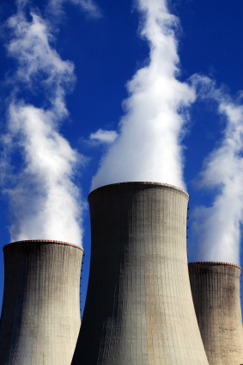
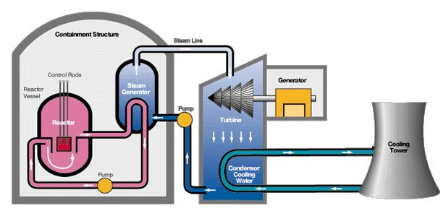
ADVANTAGES
All nuclear reactions produce more energy than hydropower and wind energy. When using nuclear energy green house gases are not released. These greenhouse gases include: carbon dioxide ,methane, ozone, and chlorofluorocarbons. The fission reaction with a little amount of uranium generates tons of energy. The Earth holds high reserves of uranium and it can last for more than 100 years! One nuclear power plant releases a lot of energy. Nuclear fuel is cheaper to transport around from place to place too.
04

Slide 5

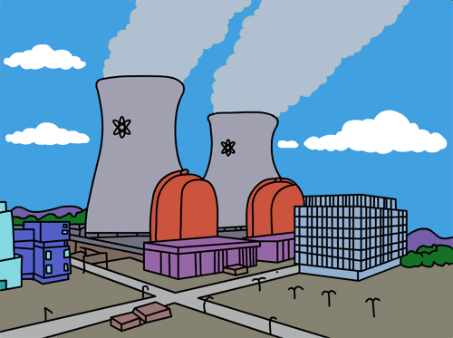

MY OPINON
Overall, I believe that Nuclear energy does provide some benefits, but when you consider all of the dangers it’s not safe for humans in the long run. This is because if the U.S. continues to build nuclear power plants, then their will be too much nuclear waste to store. Plus, as of today there is no way to really safely store the waste and mine ore for nuclear energy. The whole process of building a nuclear plant costs the U.S. billions of dollars. Rivers and streams have a very high chance of being contaminated, over the course of several years their have been several claims about radioactive wastes in water. The process of transporting, refinement, and storage is very dangerous for everyone who lives the area of a nuclear plant. Communities do have an increased risk of cancer too. Nuclear disasters can happen anytime and anywhere. So, I think we should cut back from using nuclear energy and start using the other renewable energy resources out there, which are ten times safer. With improved technology and using alternative sources for energy today there is a higher chance that we will no longer need to construct nuclear power plants. America and other parts of the world should definitely use “green” energy technology!
05

Slide 6
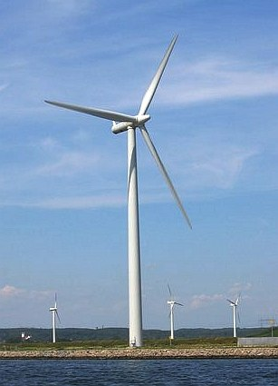
OUTLINE OF GOALS FOR THE FUTURE
To promote: Green Technology
Cut back on coal, petroleum, and nuclear power by replacing it with solar or wind energy.
Find a way to eliminate nuclear wastes safely.
Have the government set up a plan that makes sure that resources are not going to nuclear energy technology and use money to set up research development centers for greener energy.
All of this can be accomplished in the future if everyone works together for a cleaner world and future presidents continue to stress new forms of renewable energy.
06

Slide 7
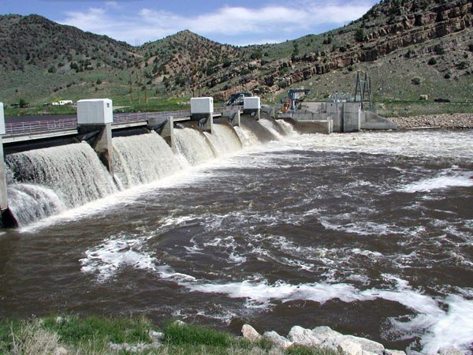
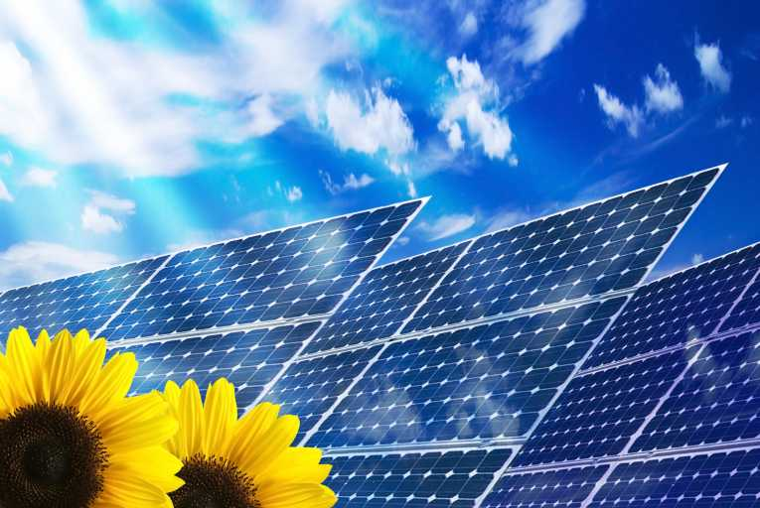
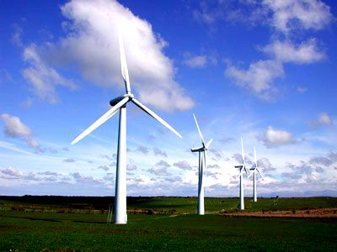
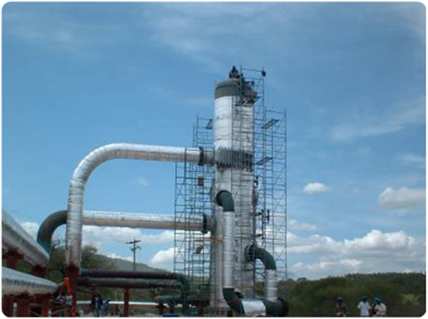
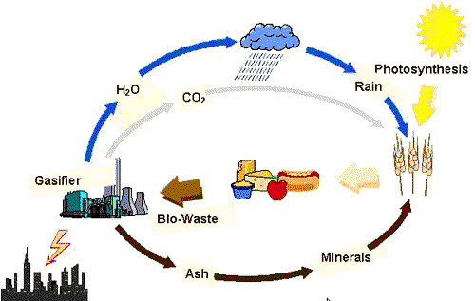
TYPES OF GREEN ENERGY
Hydropower
Solar Power
Solar Power
Geothermal Power
Biomass
DEFAULT STYLES
07

Slide 8

CONSUMERS + PRODUCERS
the United States
France
Russia
Japan
Germany
South Korea
Ukraine
Canada
the United Kingdom
China
Taiwan
Spain
Belgium
India
Czech Republic
Switzerland
Bulgaria
Finland
Slovakia
Brazil
South Africa
Lithuania
Hungary
Romania
Mexico
Argentina
Slovenia
Holland
Pakistan
Armenia
Iran
~31 COUNTRIES
08

Slide 9
CHART
COUNTRY | MW(power)
United States | 101,119
France | 63, 236
Japan | 47, 104
Russia | 21, 743
Germany | 20, 339
S. Korea | 17,716
Ukraine | 13, 168
Canada | 12, 652
UK | 11, 035
Sweden | 9,399
Today the U.S. has the greatest amount of nuclear reactor shutdowns and generates the most power. However, for France roughly 76% of their national power comes from nuclear reactors!!!
09

Slide 10
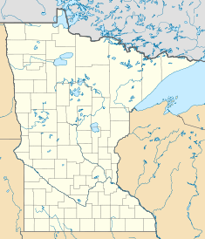
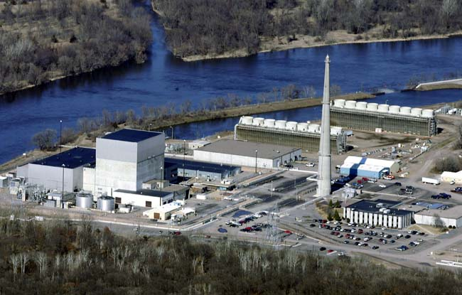
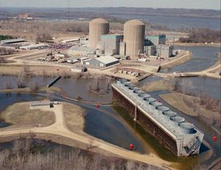
MINNESOTA!
Annual generation of power: 4,192 GW-h
Annual generation of power: 8,914 GW-h
The Monticello Nuclear Generating Plant
Prairie Island Nuclear Generating Plant
Located in: Monticello, Minnesota
Located in: Red Wing, Minnesota
12

Slide 11
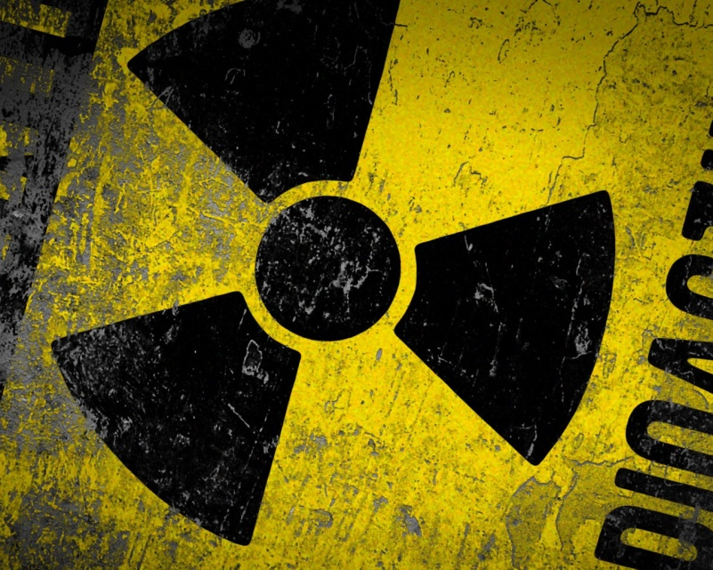
ADRESS PROBLEMS
Cost
Time of construction/delays
Safety
Waste
Area
The cost of building is something that needs to be taken in consideration. High cost of construction depends on the location and type of energy/power. All building delays cost more time and money, so they must be avoided. The building/plan should be thought over well and concise. Safety is the of the most importance because it could cause a disaster in the end. So, perhaps stricter policies should be put in place by the government too. Waste can add up, especially for nuclear energy, and this needs to be solved by developing new technologies in the future. The area a power plant is built in should not cause any animals to move out, or to be harmed in anyway. There should be some sort of boundary so that people/animals are not exposed to the chance of getting cancer too. All of these solutions must also be pointed out by the president of the United States.
10

Slide 12


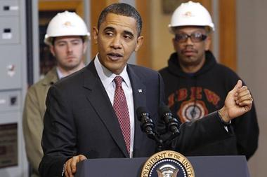
MARKET ECONOMY
Nuclear power plants can be extremely costly and takes billions of dollars or more to construct. However, once created the nuclear plants generate hundreds of jobs for people in the United States. There is no doubt that would stimulate money in the economy, but considering the fact that if meltdowns occur or problems can occur at power plants, then investments would be lost. Nuclear energy is very efficient and easily provides a substantial amount of energy, which boosts the United States local economies overall.
NUCLEAR POWER PLANTS: create approximately 4,000 jobs or more for people!
Today nuclear energy provides for 20% of the United States electricity
11

Slide 13

SOURCES
http://www.businessweek.com
http://www.eia.doe.gov
http://www.darvill.clara.net
http://green.blorge.com/2010/01/the-top-10-nuclear-power-countries/
http://www.greenenergychoice.com/green-guide/renewable-energy-types.html
http://www.buzzle.com/
13

Slide 14

13

