Slide 1
Needs for Life
A comparison of
Earth and Mars

Slide 2

Atmosphere
Earth’s gravitational field is strong enough to hold the atmosphere.
Earth’s surface gravity (m/s²) is 9.80, while Mars is 3.71, which is inadequate to hold an atmosphere able to support abundant life.
Data Source: http://nssdc.gsfc.nasa.gov/planetary/factsheet/marsfact.html

Slide 3

Atmosphere
Our atmosphere is composed of an appropriate mixture of gases for a wide variety of life. Mars’ atmosphere 95.32% Carbon Dioxide.
Earth’s atmosphere also protects us from harmful radiation from the sun.

Slide 4
Temperature
With an average temperature of 16° C, our planet supports a wide variety of life.
The following slide shows temperature data on Mars, collected on Viking missions.

Slide 5
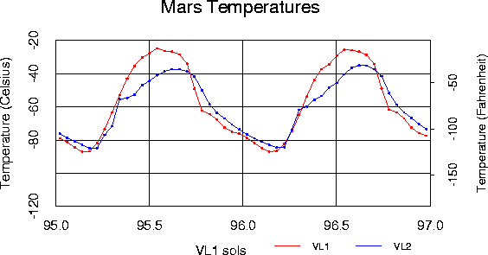
Temperature
With a temperature range of -89 to – 31 C (Viking 1 Lander Site), water cannot exist in a liquid state…at least, not for long. No liquid water, no life likely.
http://www-k12.atmos.washington.edu/k12/resources/mars_data-information/temperature_overview.html

Slide 6
Evidence of life on Mars
So, is it possible life exists on Mars now, or did during the distant past?

Slide 7
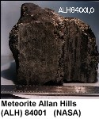
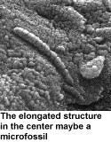
Meteorites
Meteorite Allan Hills, found in Antarctica, 1984:
Evidence of PAH’s (methane), which could have been formed by dead organisms.
Chemical changes present, which are similar to those present on Earth, caused by primitive bacteria
Possible presence of micro-fossils.
Source: http://nssdc.gsfc.nasa.gov/planetary/marslife.html

Slide 8
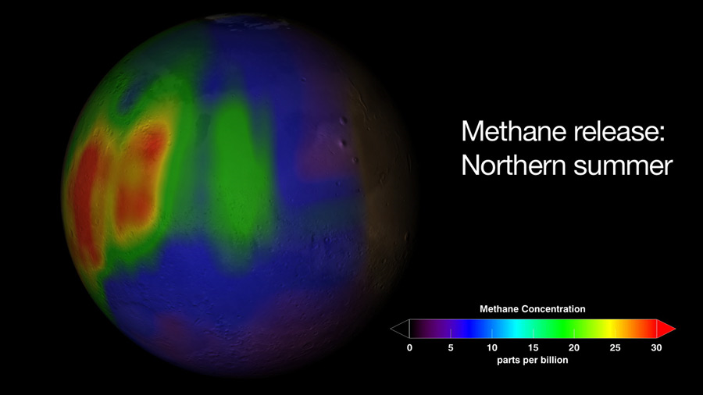
Methane
*Bacteria?
*Volcanoes?
*Hot springs?
*Or just a stray comet splattering the stuff?
http://www.nasa.gov/vision/universe/solarsystem/mars_20050207.html
Source: http://apod.nasa.gov/apod/ap090119.html

Slide 9
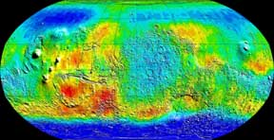
Subsurface water
Source: http://www.lanl.gov/orgs/pa/News/MarsOdyssey.html
Evidence of high hydrogen content in surface soils may indicate water bound below the surface.
http://www.lanl.gov/orgs/pa/News/MarsOdyssey.html

Slide 10
Dianne Saltzman
Exploring Mars: A New Twist on Earth Science
March 15, 2011
All sources are cited within the slideshow.

