Slide 1
NASA “On the Moon” Notebook
By:
Trisha Bray
With the help from Burns SciTech Extended Day Design Squad

Slide 2
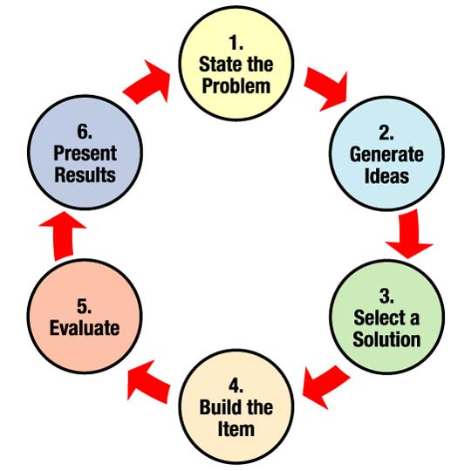
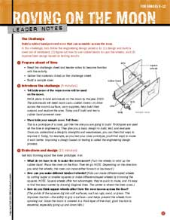
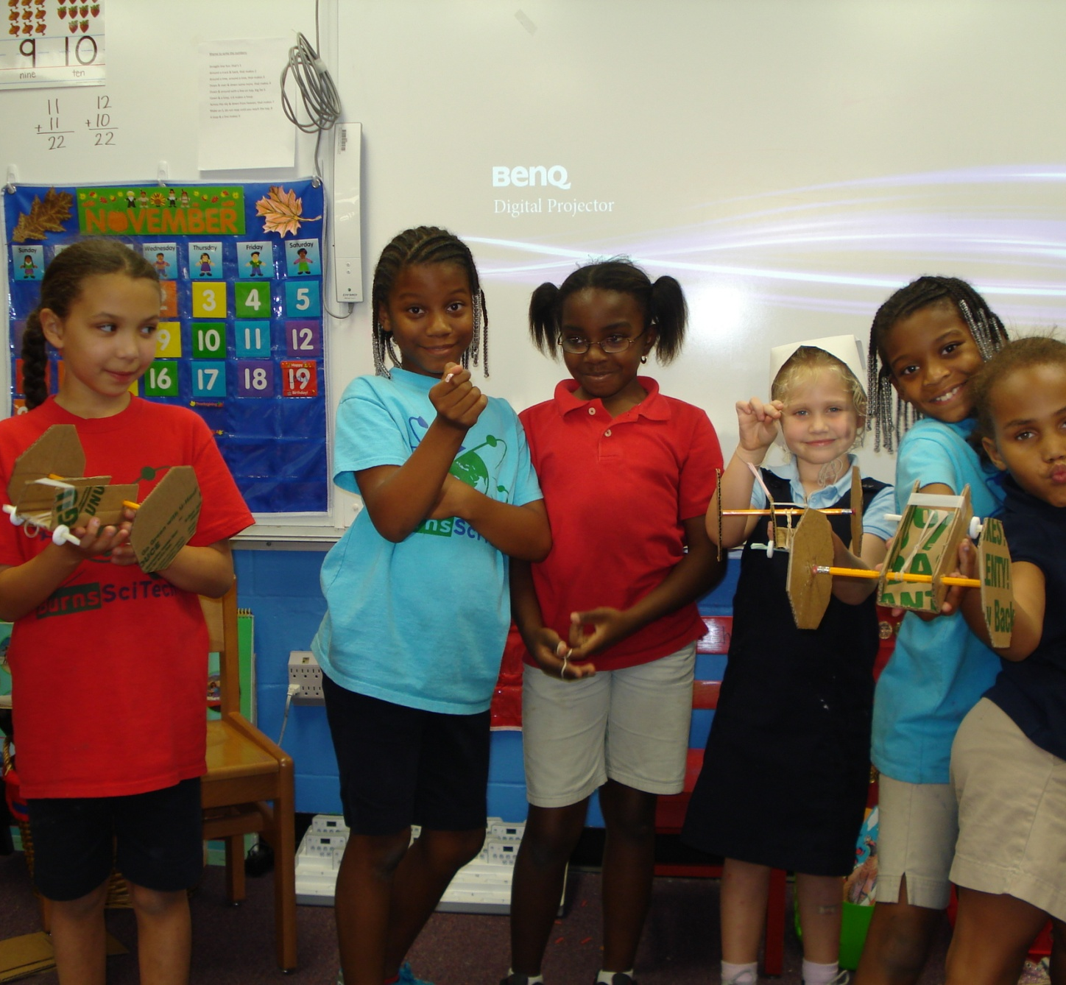
What I used:
NASA’s Elementary School
Engineering Design Process Model
NASA’s Roving On The Moon
Leader Notes for Grades 6-12
Burns SciTech Design Squad

Slide 3
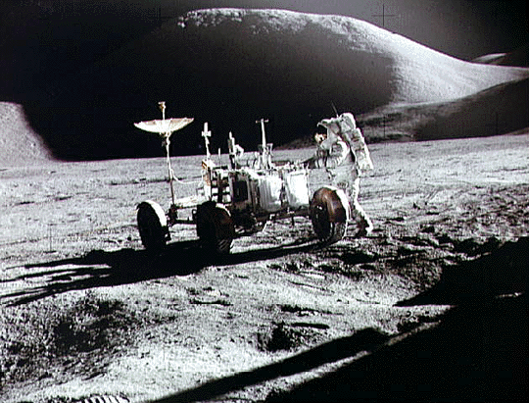
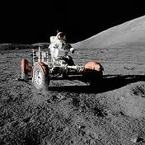
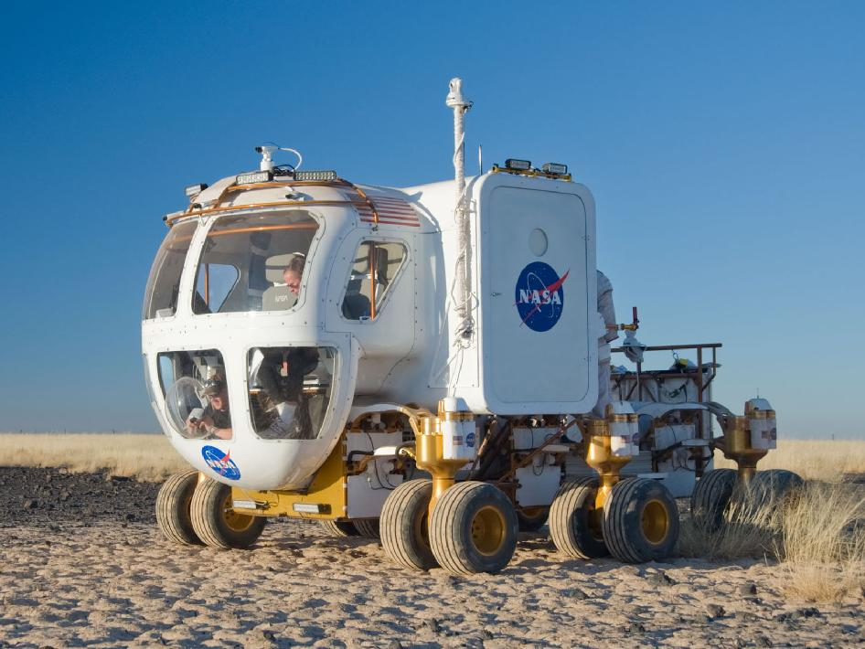
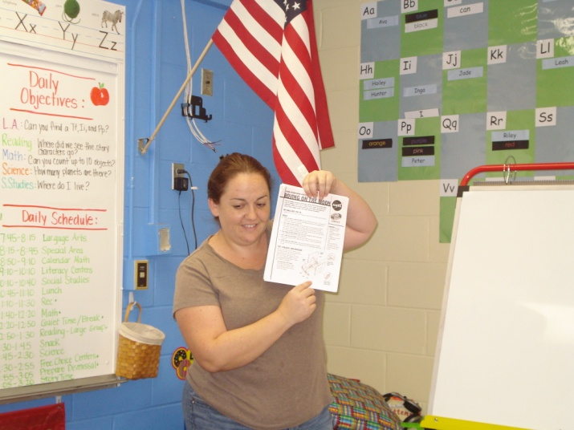
STATE THE PROBLEM
I began the process by showing my kids a video about moon rovers. It was the Apollo 15 Lunar Rover. I found it on the NASA website as a Quick Time file. The kids really enjoyed it, and it worked great as an introduction to the project. I also showed some pictures on the interactive board that I also found on the NASA website.
I then presented the Design Challenge to the students. I told them that the challenge was to produce a rubber band powered moon rover that would actually move across the floor.

Slide 4
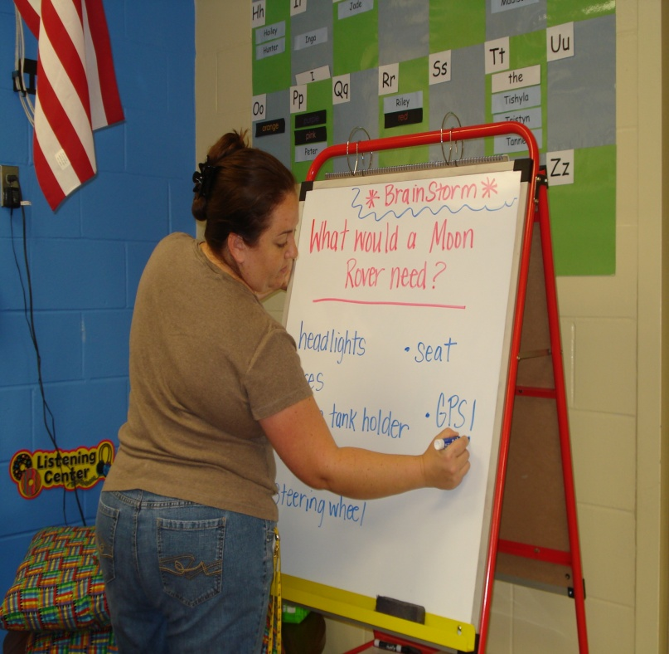
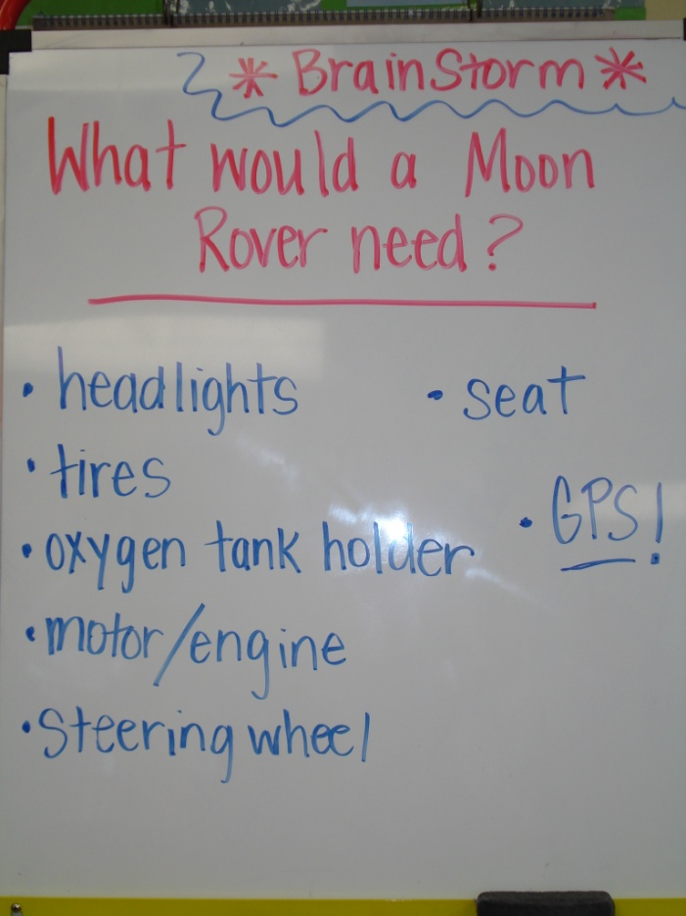
GENERATE IDEAS
After reading the challenge to the students, and showing them the pictures and video, I asked them to give me some ideas of what a moon rover needed to have. The brainstorming activity generated ideas such as: tires, headlights, oxygen tank holder, motor, steering wheel, a seat for the astronaut, and a GPS!

Slide 5
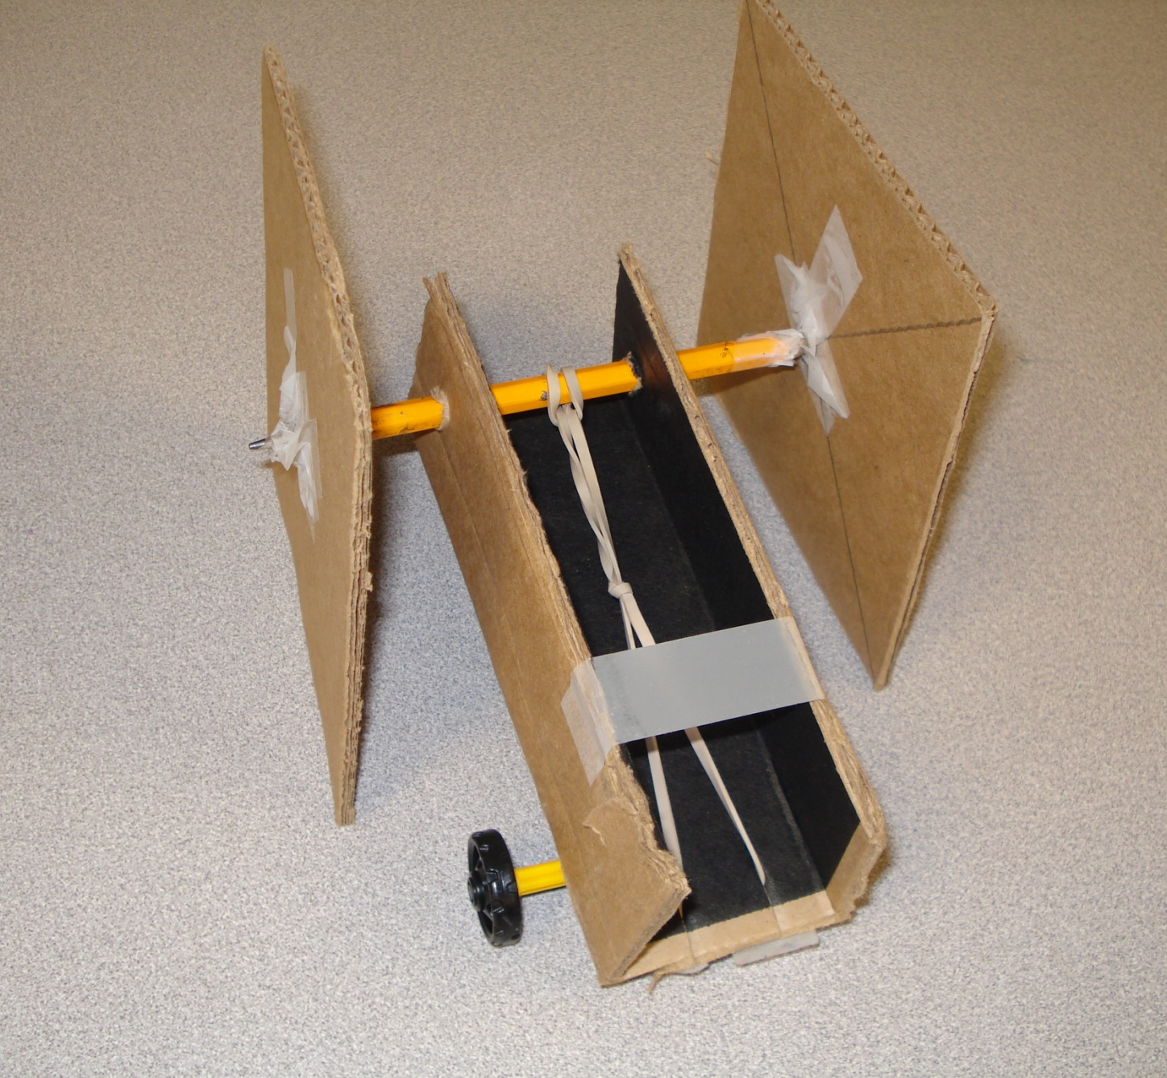
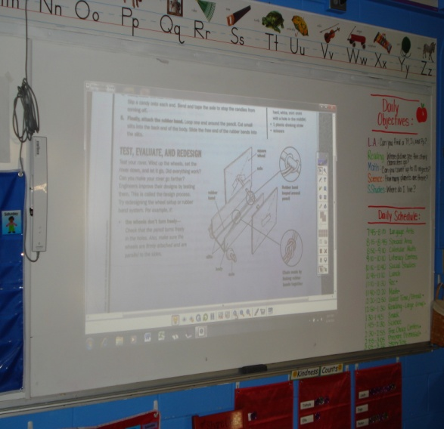
SELECT A SOLUTION
After our brainstorming session, I showed them the Design Squad prototype that I made from the instructions. I explained to them that we were going to make the same one in pairs of two and the real challenge was going to be to get it to move across the floor. I told them to keep in mind that we might have to make revisions, and redesign our rovers in order for them to work in our environment. I encouraged them to write their notes on the board so they wouldn’t forget their ideas.

Slide 6
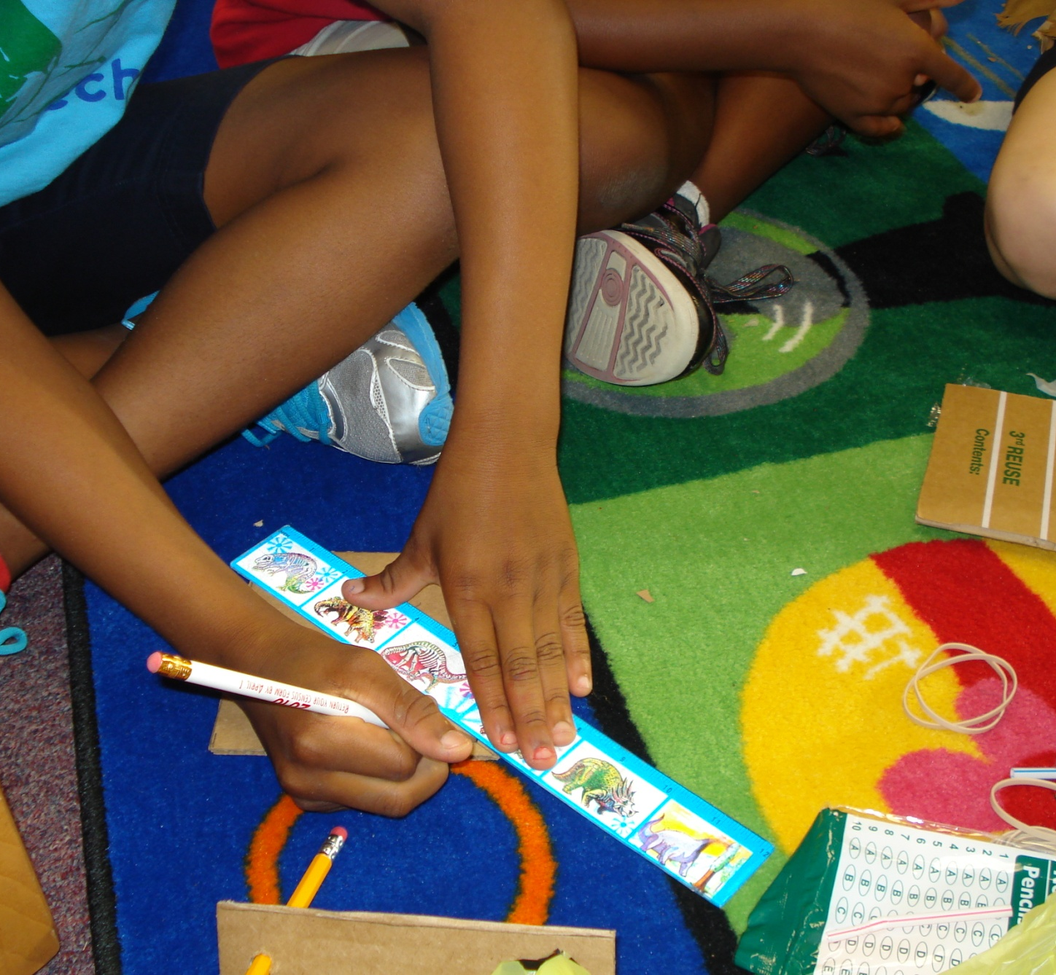
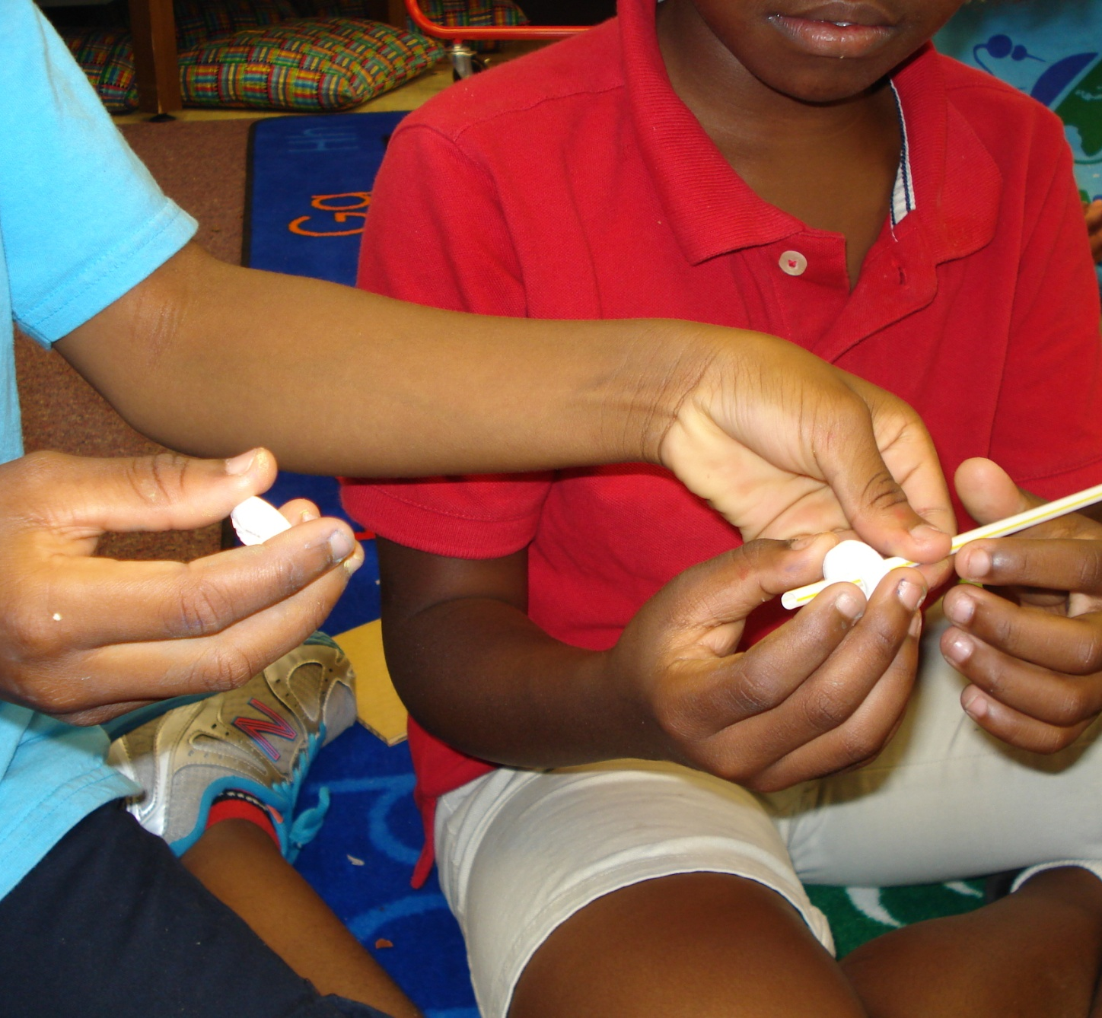
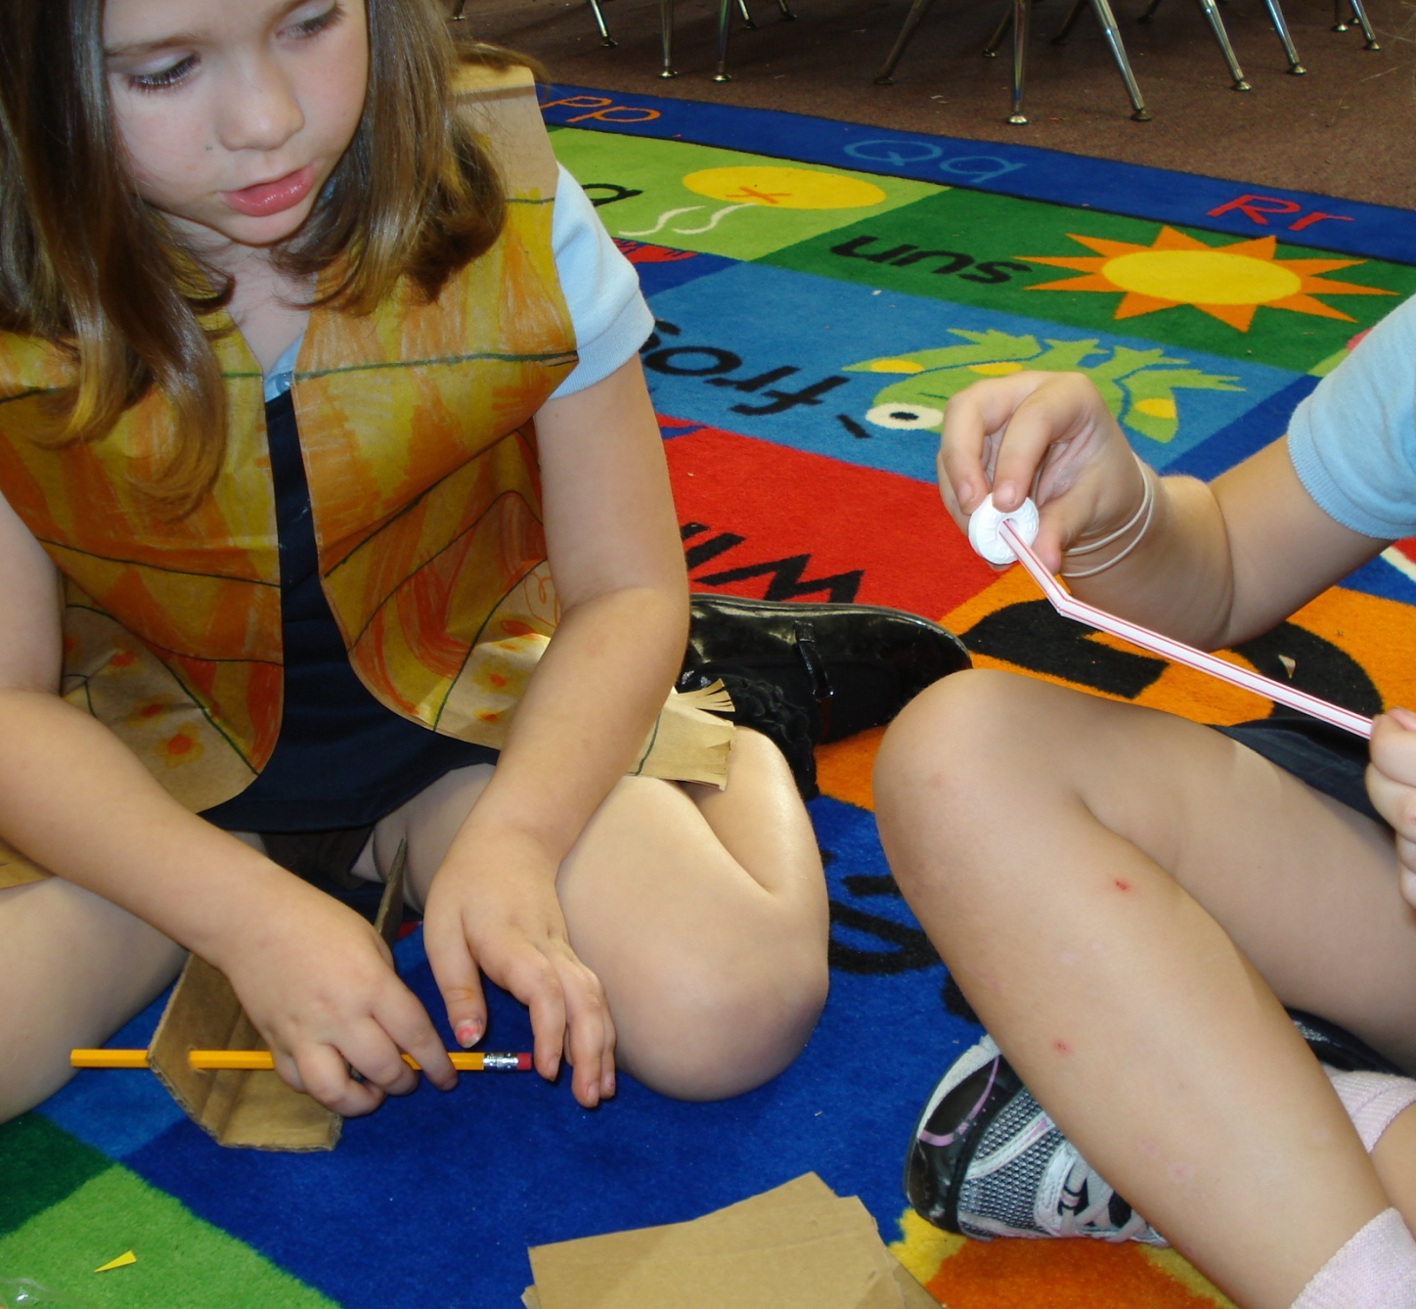
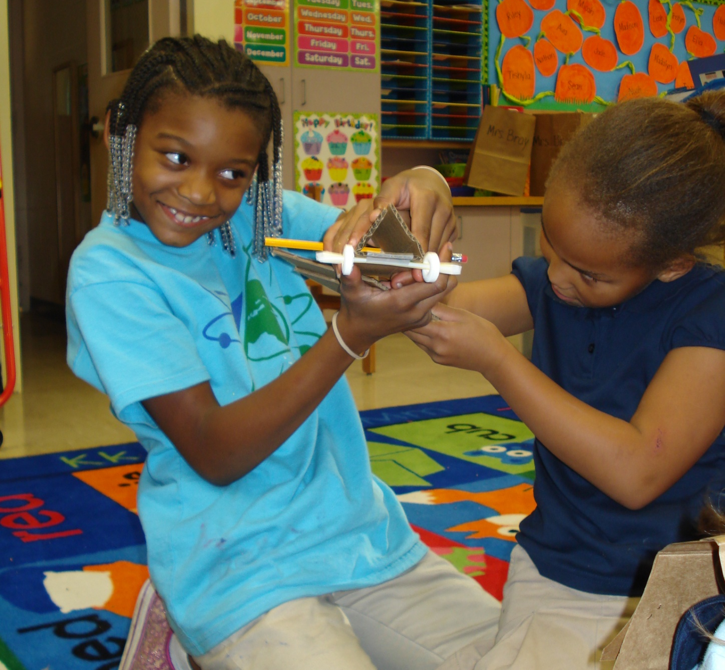
BUILD THE ITEM
I gave the students the materials needed to complete their moon rovers. Because my students are only K-3, I cut the cardboard squares out for them, and I let them work in pairs. I had 9 students total. The hardest part was to attach the pencils to the cardboard with only tape.

Slide 7
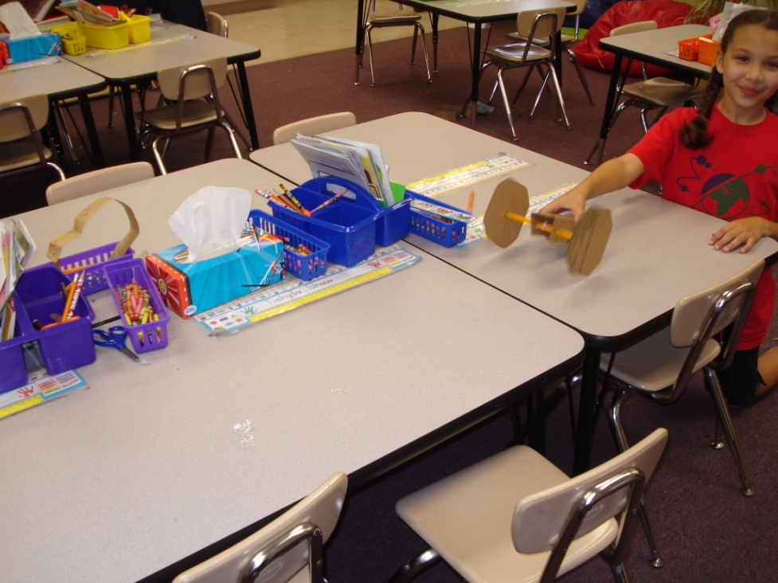
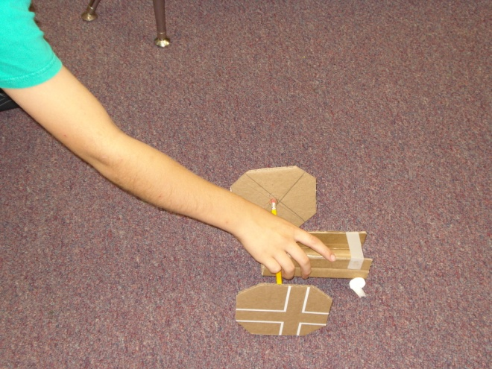
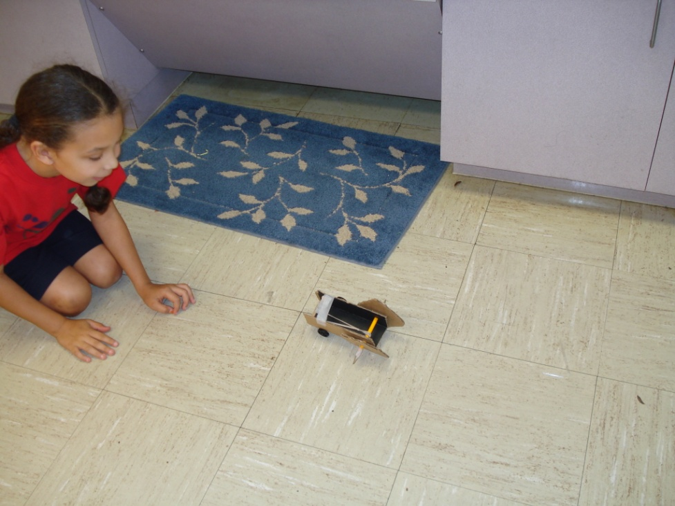
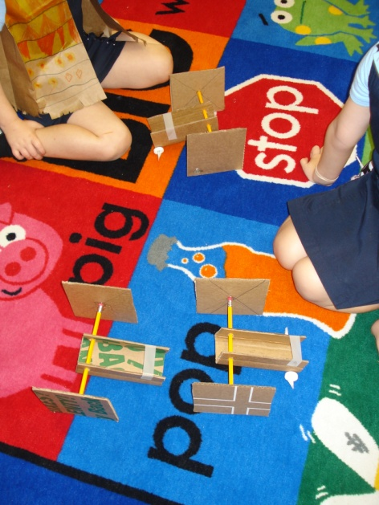
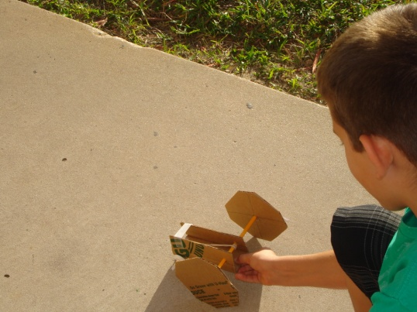
EVALUATE
In my classroom, we had different elements to test our moon rovers on; rugs, commercial carpet, slick table tops, and linoleum tile floors. The commercial carpet worked best. They took them outside and also tried it on the concrete sidewalks, but eventually came back to the commercial carpet. I would periodically remind them of what the moon surface was like compared to our indoor environment that we were using. They all agreed that the square wheels would have worked best for the moon surface, but was not ideal for what we were using our moon rovers on.

Slide 8
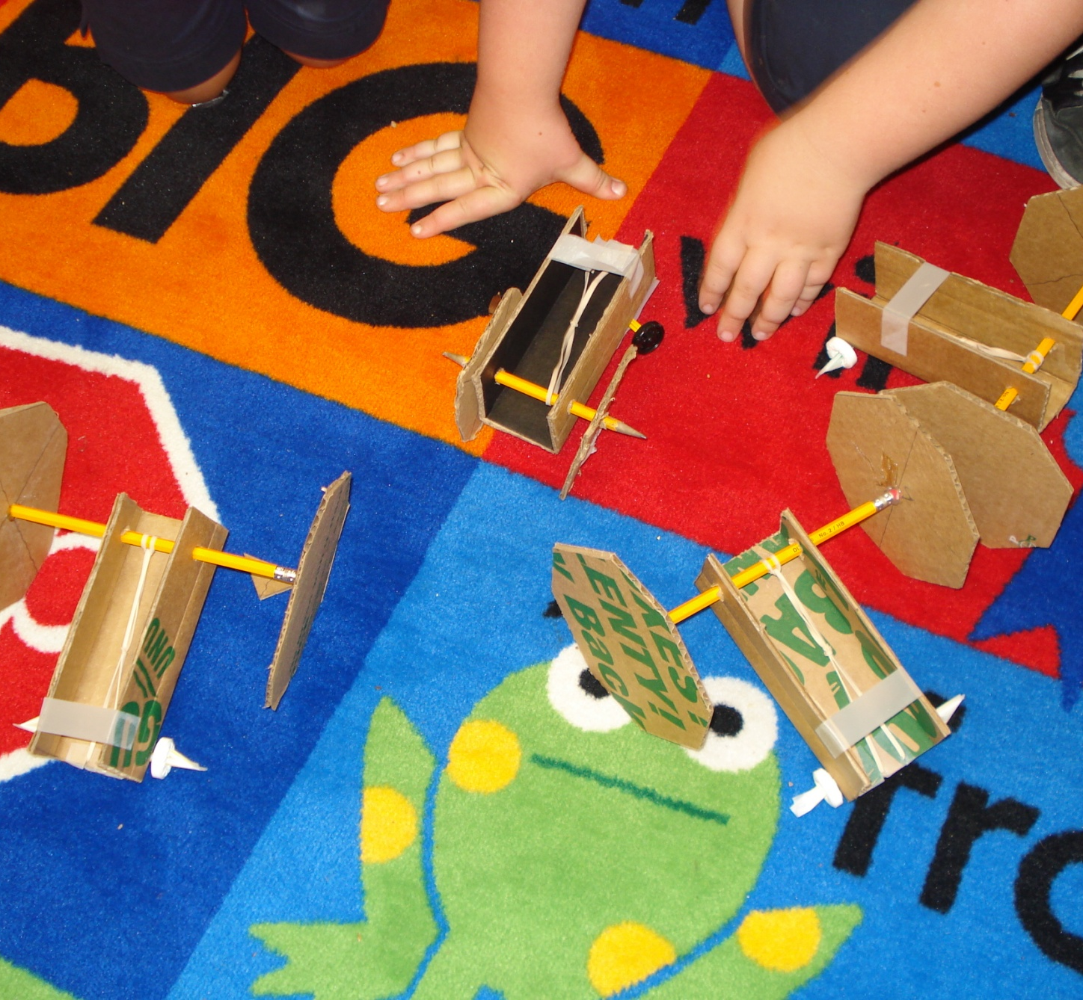
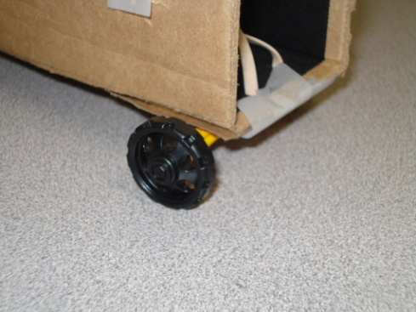
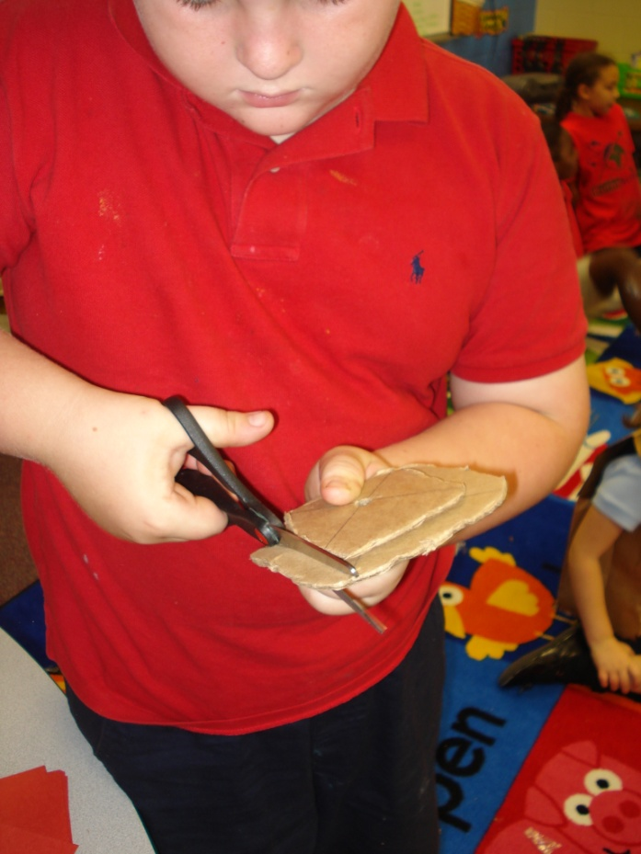
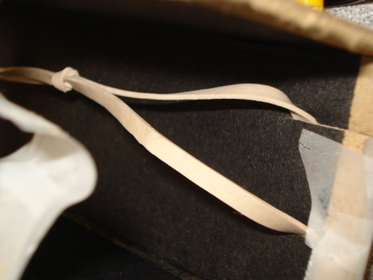
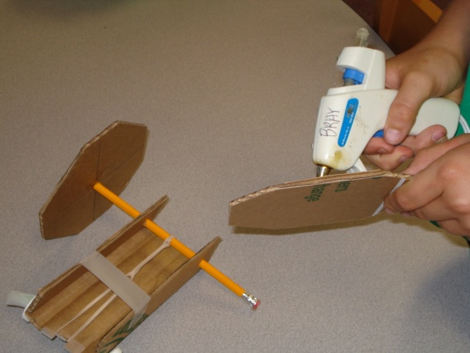
REDESIGN
The first thing that was noted to make revisions on was using something other than tape to attach the wheels to the cardboard. One of the Kindergarteners came up with the idea of using a hot glue gun. What a genius! It worked. Then one of the boys was the first one who said that we should trim the squares into octagons to help lesson the grip on the rug. That also worked. He ended up continuing to cut his into more of rounded squares by the end of our time together. His went the farthest. This is the picture of him to the left. The wheels also became smaller in the process. One of my third graders came up with not turning the rubber band so tight; instead only putting a small amount of tension on the rubber band. This also worked. Another third grader suggested using thicker rubber bands, which she then went and found and this also worked. I was so impressed by the ideas that these kids had. It was truly amazing that even the youngest ones could problem solve at so many levels.

Slide 9
PRESENT RESULTS
The kids got to each take turns in pairs and present their “modified” moon rovers to each other. I then allowed them to take their moon rovers back to the extended day program and present their projects to the whole group. I reminded them to explain the design process. We even rolled down my dry erase board so they could see our journey. The kids did a great job, and were really proud of their accomplishments. (I forgot my camera, so I don’t have any pictures!) I am now scheduled to teach this Design Squad project to the entire extended day program on December 6th. :) About 55 students will be present! Yay!

