Slide 1
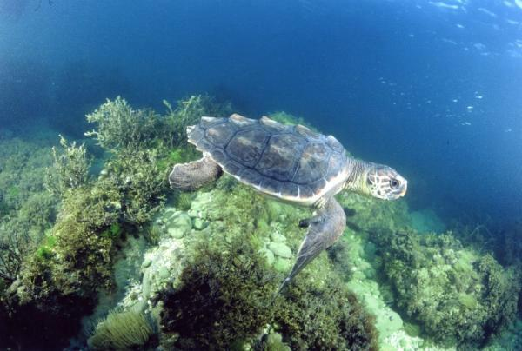
Loggerhead Sea Turtles
Linda** tracked 6/2011-2/2012 FL to TX in Gulf of Mexico http://www.signalsofspring.net/ACES/students/index.cfm?journalopen=yes&user=student
Loggerhead species = Caretta caretta
Endangered & Threatened

Slide 2


Loggerhead Sea Turtles
Linda eats, lives on continental shelf
Travels = 1100 km for entire journey
Mostly in high Chlorophyll areas
Phytoplankton map (wk 2/9/12), show large red colored ~5.0 mg/m3 concentrations of Chlorophyll
Foods for Linda rely on Phytoplankton
Omnivore = eats a variety of ocean animals & plants, loves crustaceans, jellyfish, and sponges

Slide 3
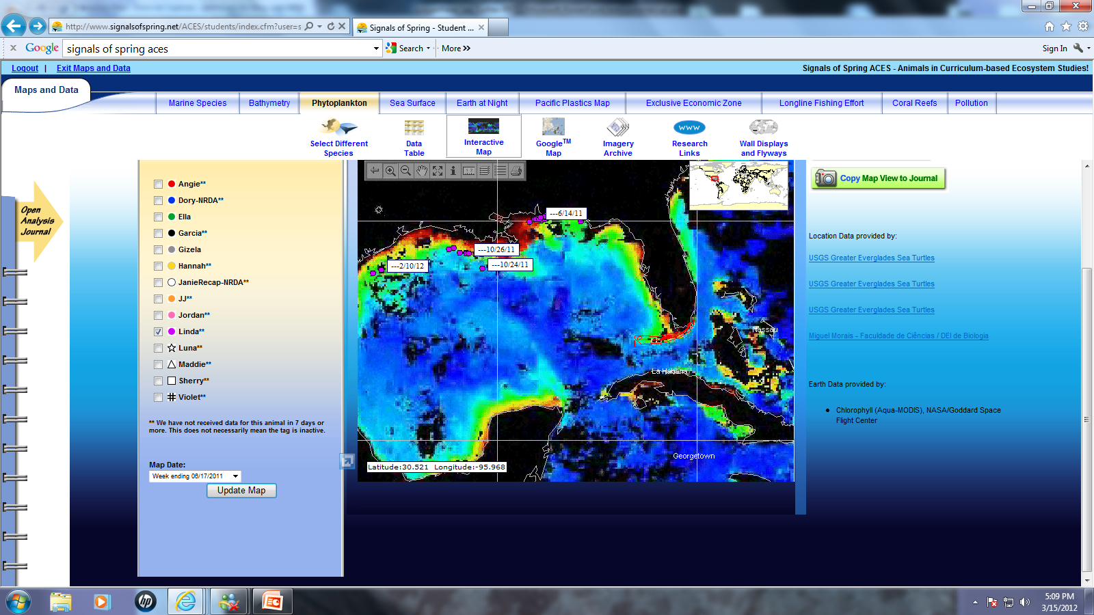

Slide 4
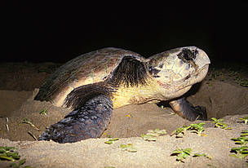
Loggerhead Sea Turtles - population worldwide ??
Humans crowd beaches: Habitat & nesting lost to development & Climate Change-SST maps
& warm H2O (Earth Night maps)
In very busy highly polluted areas 2012 Pollution maps-detail Ocean-based & Nutrient & Plastics
Migrated in areas of Economic importance to fishing, oil, and recreation industries.
Lucky Linda did not (?) migrate where Longline Fishing nets = Bycatch & drowning (old maps)

Slide 5
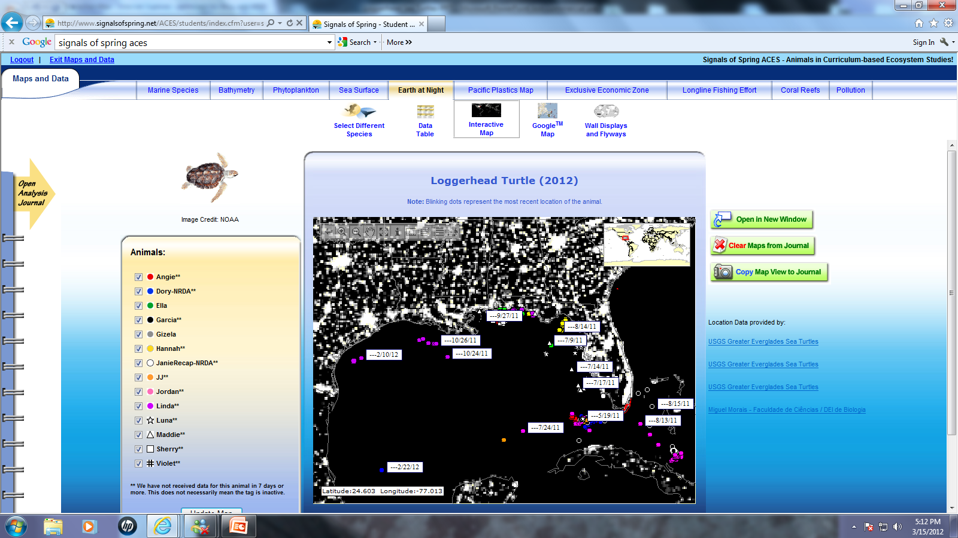

Slide 6
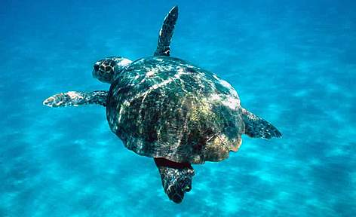
SST summer maps - Linda consistently in 26-30 ° Celsius H2O.
Linda in the 12-20 ° Celsius H2O in winter
Reptile Species depend on external heat sources
Commercial uses of shells *Eggs/meat eaten

Slide 7
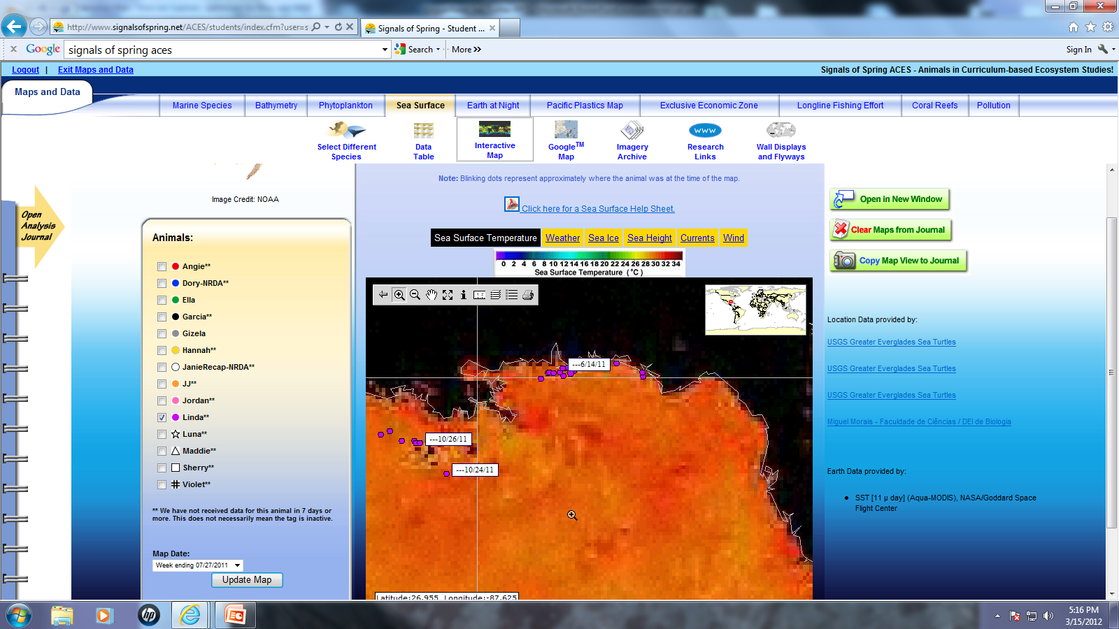

Slide 8
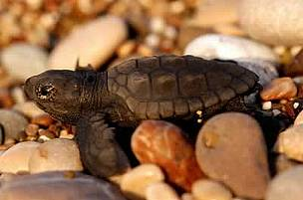
Loggerhead Sea Turtles
Very Low survival, SLOW growth & reproductive rates!
Breeding : 32-37 years/Lifespan 50 yrs??
Omnivore: shellfish, sea grass, sponges
Red-brown carapace (top), plastron (bottom) shell
Large head, strong beak-no teeth, paddle flippers, heart-shaped body
Sleep underwater

Slide 9
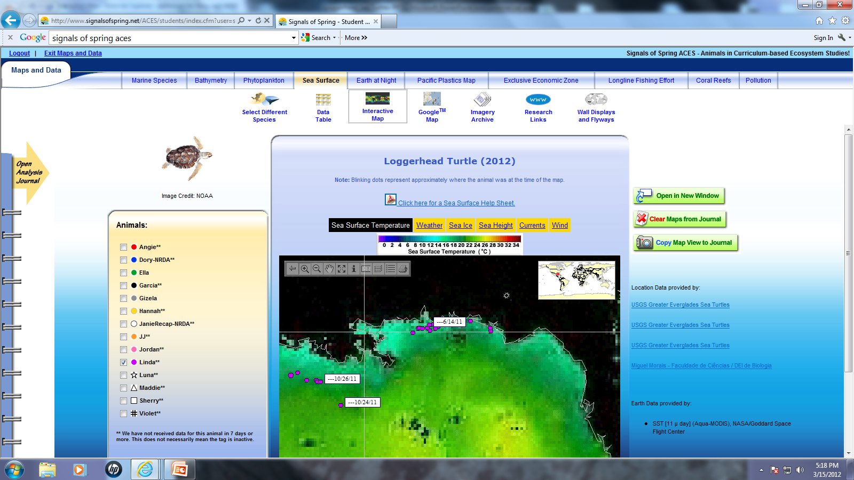

Slide 10

Loggerhead Sea Turtles by NASA ENDEAVOR FELLOW Raya-Jean Zaczyk
Air breathers=must surface before dives
Share their food sources (Bathymetry & Phytoplankton maps)
Protect Marine Sanctuaries & Oceans Worldwide
How You Can Save Them!!
Protect Beaches/Estuaries
Slow Boats *Reduce STRESS
Decrease POLLUTION
Boycott Products of Shells
Decrease YOUR Carbon
Photos & all Resources : Signals of Spring/Aces

