Slide 1
Methods Presentation
Ayana Lucas

Slide 2
I Like to Move It, It
Newton’s Third Law of motion states, for every action, there is an opposite or equal reaction. Through this law, students can watch it in motion as they observe the balloon operated vehicle travel an unpredictable distance. Therefore, students will be able to create a mobile device and discover the different factors that can affect their car’s movement.

Slide 3
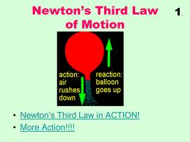
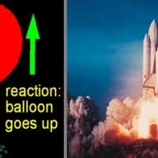
Newton’s Third Law
For every action, there is an opposite and equal reaction.

Slide 4
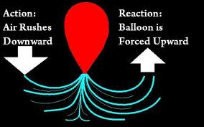
Newton’s Third Law

Slide 5
Challenge
You have just received a call from your principal. He states, “Viking, I need you to complete a task for me. The school has to move the ant farm from Room 234 to Room 240 and I need your help. We can’t carry the ant farm to the location with our hands. We can only use a mobile device and we have to move in the least amount of time as possible. Please construct a plan and prototype of a mobile device that can carry the ant farm from one location to the other in the least amount of time. I know you can get this done. I’m counting on you. Thank you for your help.”

Slide 6
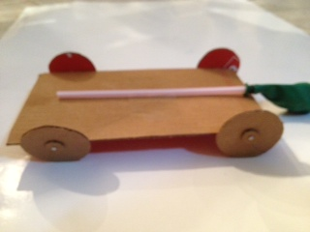
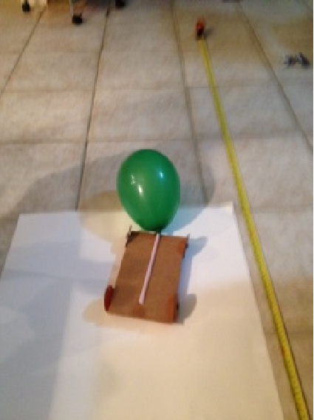
Mobile Device
Place students in Groups.
Explain challenge to students.
Provide students with list of
available Materials.
Procedures
Worksheets
Assessments

Slide 7
Caffeine or Non-Caffeine
Question: Does coffee affect the growth of plants?
Purpose: The purpose of this experiment is to determine if caffeine has an effect on plant growth.
Why this topic: Recently, I participated in writing a lesson on vertical farming. While creating the lesson, it involved research on plants and different components that affect plant growth. Therefore, I thought it would be interesting to conduct an experiment on either, the different sources of light and how it affects plant growth or the affect of caffeine on plant growth. Since caffeine is a drug that can energize individuals by acting as a central nervous system stimulant, I thought it would be interesting to see if it affects plant growth in which can also be added to the vertical farming lesson and increase production in a vertical farm.
Hypothesis: I predict that the plants watered with caffeine will grow at a faster rate than the non-caffeine watered plants.

Slide 8
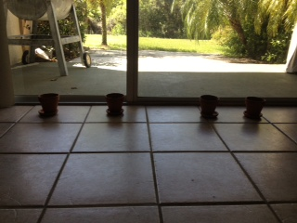
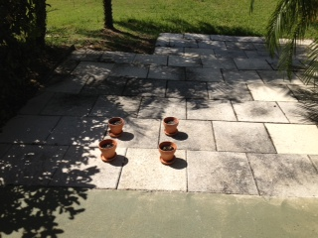
Plan
Procedures
Plant seeds in four different planting pots using the same amount of potting soil for each soil.
Water the plants with cup of water every other day. Two plants will be watered with plan tap water. The other two with a caffeine mixture of 200 mg of caffeine and water.
Record observations daily
As the plants begin to sprout and grow, I will record the height of the plants.
This data will allow me to answer my initial question of whether caffeine has an effect on plant growth.
Materials
plant seeds (Green
beans)
Potting soil
Four planting pots
Caffeine tablets
Water

Slide 9
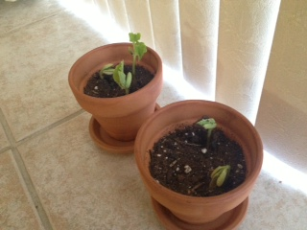
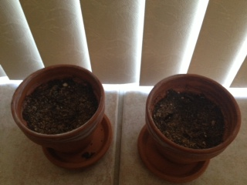
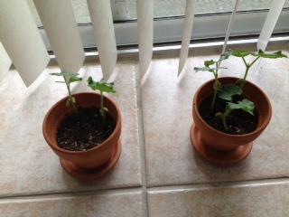
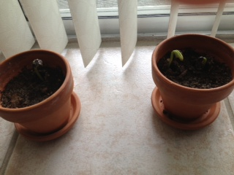
Inferences based on Observations
Day 9
Day 14

Slide 10
Plant Growth
Height in Cm
Days

Slide 11
Wrap Up
Conclusion
As supported by the observations and evidence of the data gathered, Caffeine appeared to slow down the plant growth as compared to the plants that were not watered with the caffeine mixture.
Relevance
Based on the rapid increase in population in some areas, the lack of available land for agriculture has become a concern. Therefore, vertical farming has become an alternative to provide a solution to the problem. Therefore, researching elements that can affect the rate of plant growth can help with the production level and availability of resources. Questions that can be asked, “Can different forms of caffeine affect plant growth?” Can caffeine affect plant growth in a positive way if the seeds were grown in a different type of soil?

