Slide 1
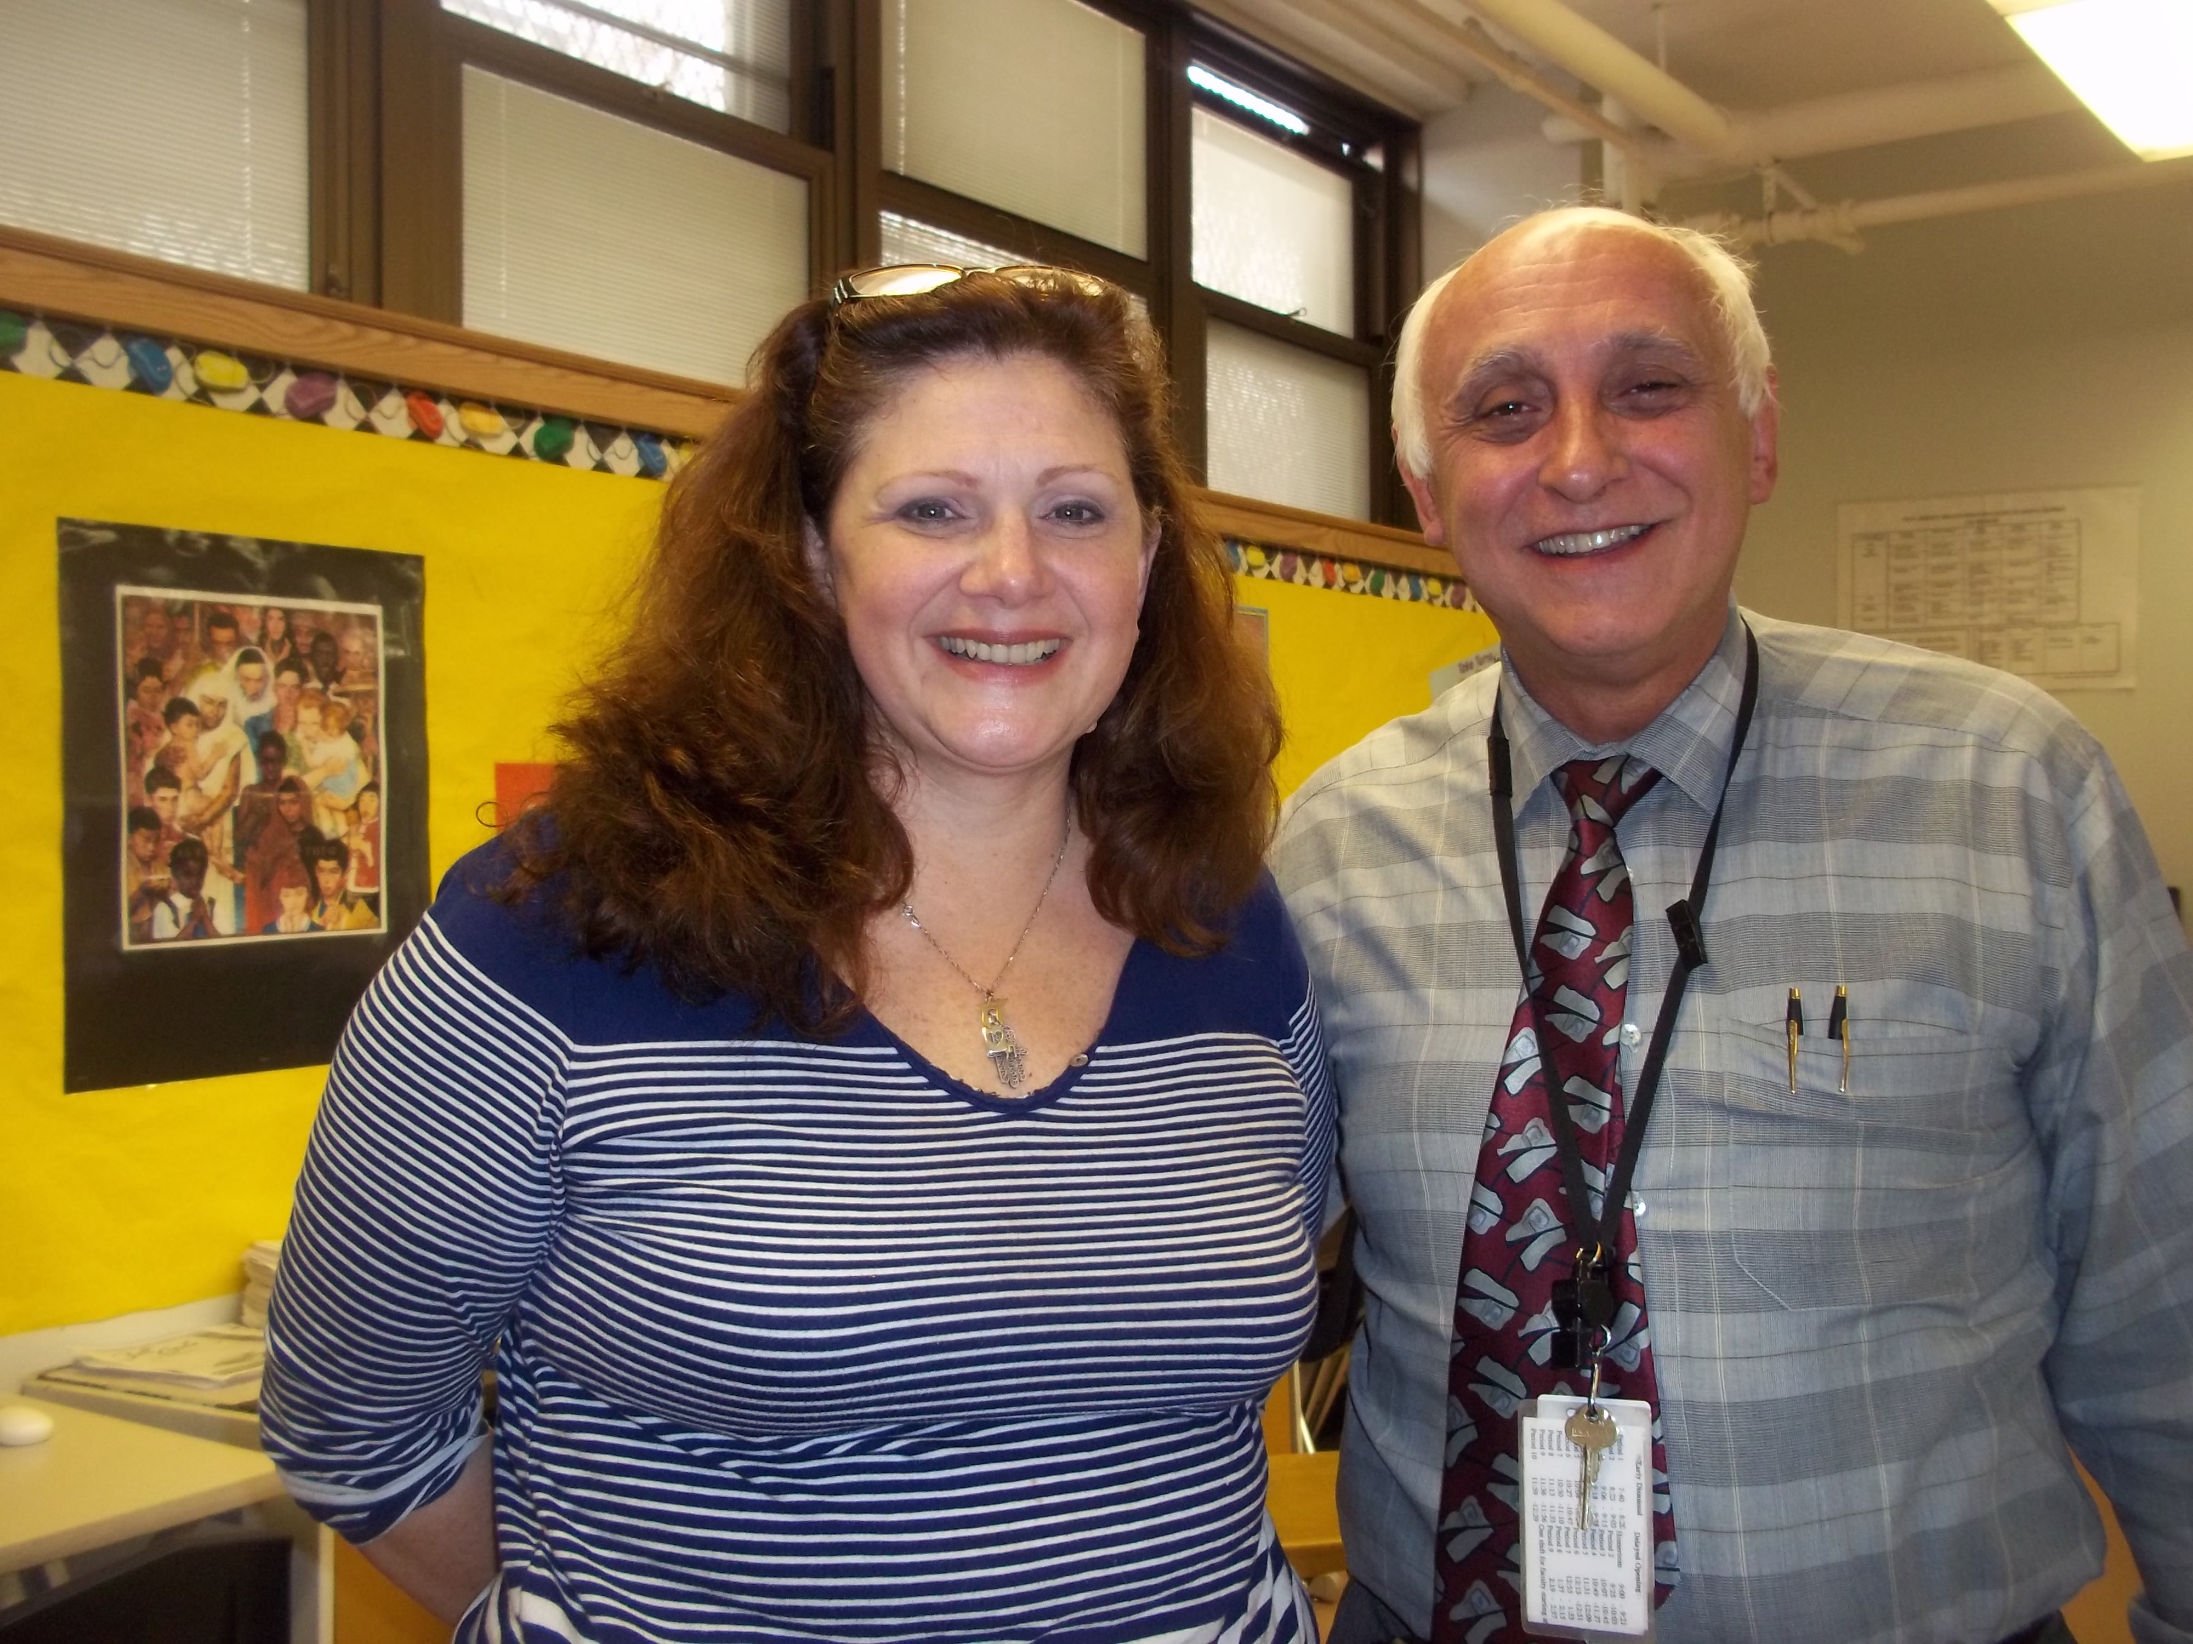
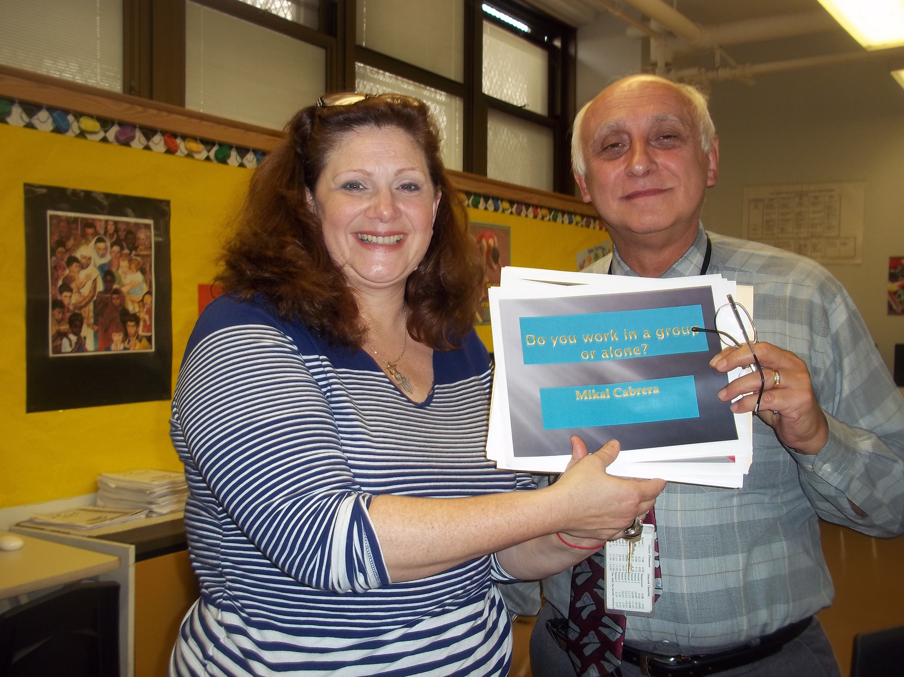
Mr. Orlando and I Meeting and Looking at Questions from 4th Grade Class. He is meeting with the class this Wednesday.

