Slide 1
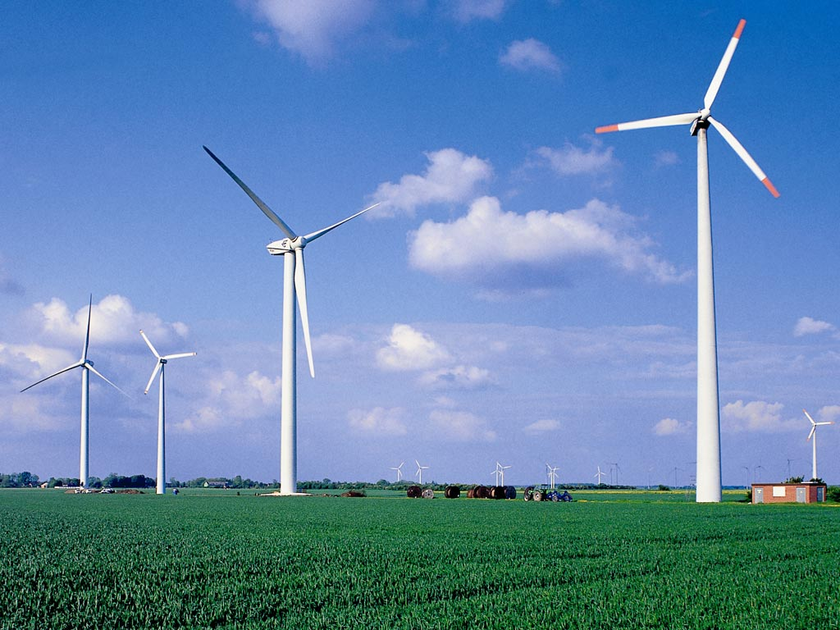
Darcie Fregoe
Methods of STEM Education
Science Research Project
Wind Power in Massena, NY

Slide 2
Is the average daily wind speed in Massena, NY within the acceptable range for wind turbines to generate electricity?

Slide 3
.
Wind speeds recorded at 10 a.m. ranged from to 38 mph with an average wind speed of
10 mph
Wind speeds recorded at 2 p.m. ranged from calm to 31 mph with an average wind speed of 11 mph.
Source:
http://www.wunderground.com/history/airport/KMSS/2010/4/4/DailyHistory.html?req_city=Massena&req_state=NY&req_statename=New+York

Slide 4
Wind speed needs to be approximately 10 - 33 miles per hour (4-5 meters per second to 15 meters per second) consistently for wind turbines to work.
Sources:
http://www1.eere.energy.gov/windandhydro/pdfs/41869.pdf 20% Wind Energy by 2030: Increasing Wind Energy’s Contribution to the U.S. Electricity Supply. US Department of Energy . 2008.
http://www.bwea.com/ref/faq.html#blow renewableUK: The voice of wind & marine energy. 2010.

Slide 5
The average daily wind speed in Massena, NY is at the bottom of the acceptable range for wind turbines to generate electricity from 10 a.m. – 2 p.m., but does not blow ≥ 10 mph consistently enough to be a reliable source of energy.

