Slide 1
March Weather
Stephanie Cobb

Slide 2
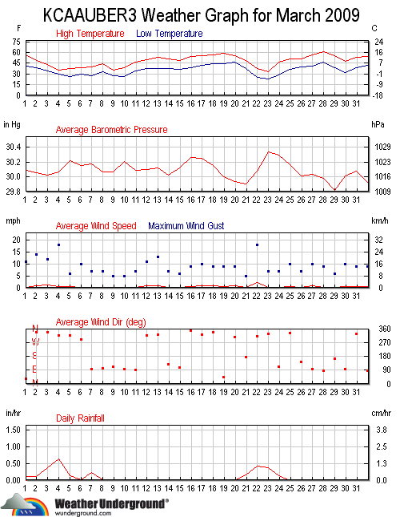

Slide 3
Source: Weather Underground
2009 | Temp. (°F) |  |  | Dew Point (°F) |  |  | Humidity (%) |  |  | Sea Level Pressure (in) |  |  | Visibility (mi) |  |  | Wind (mph) |  | Gust Speed (mph) | Precip (in)
March | high | avg | low | high | avg | low | high | avg | low | high | avg | low | high | avg | low | high | avg | high | sum
1 | 56 | 51 | 41 | 39 | 30 | 21 | 89 | 47 | 30 | 30.16 | - | 30.02 | - | - | - | 1 | 0 | 11 | 0.10
2 | 48 | 45 | 39 | 43 | 41 | 38 | 95 | 86 | 71 | 30.12 | - | 29.99 | - | - | - | 3 | 1 | 14 | 0.10
3 | 43 | 38 | 34 | 38 | 36 | 33 | 96 | 92 | 81 | 30.09 | - | 29.96 | - | - | - | 2 | 1 | 12 | 0.38
4 | 36 | 32 | 29 | 35 | 31 | 27 | 97 | 95 | 88 | 30.19 | - | 29.94 | - | - | - | 3 | 1 | 18 | 0.63
5 | 38 | 32 | 26 | 32 | 26 | 16 | 95 | 79 | 48 | 30.26 | - | 30.17 | - | - | - | 2 | 0 | 6 | 0.13
6 | 38 | 32 | 29 | 32 | 28 | 26 | 94 | 87 | 76 | 30.19 | - | 30.12 | - | - | - | 2 | 0 | 10 | 0.02
7 | 40 | 34 | 28 | 34 | 28 | 20 | 87 | 77 | 56 | 30.22 | - | 30.12 | - | - | - | 2 | 0 | 7 | 0.23
8 | 45 | 38 | 34 | 37 | 31 | 22 | 93 | 74 | 51 | 30.16 | - | 29.98 | - | - | - | 1 | 0 | 7 | 0.01
9 | 36 | 32 | 28 | 33 | 30 | 24 | 95 | 90 | 82 | 30.17 | - | 29.96 | - | - | - | 1 | 0 | 5 | 0.00
10 | 39 | 30 | 26 | 29 | 23 | 16 | 92 | 77 | 60 | 30.24 | - | 30.17 | - | - | - | 1 | 0 | 5 | 0.00
11 | 46 | 41 | 34 | 34 | 25 | 18 | 67 | 53 | 40 | 30.14 | - | 30.04 | - | - | - | 1 | 0 | 7 | 0.00
12 | 50 | 43 | 38 | 37 | 29 | 18 | 89 | 60 | 41 | 30.15 | - | 30.04 | - | - | - | 3 | 1 | 11 | 0.00
13 | 54 | 44 | 38 | 40 | 31 | 14 | 87 | 64 | 26 | 30.18 | - | 30.07 | - | - | - | 4 | 1 | 13 | 0.00
14 | 51 | 43 | 38 | 38 | 34 | 22 | 89 | 70 | 48 | 30.07 | - | 29.97 | - | - | - | 2 | 0 | 7 | 0.00
15 | 48 | 41 | 37 | 40 | 32 | 21 | 91 | 72 | 48 | 30.24 | - | 30.01 | - | - | - | 2 | 0 | 6 | 0.00
16 | 55 | 46 | 38 | 46 | 40 | 34 | 96 | 81 | 62 | 30.30 | - | 30.23 | - | - | - | 2 | 0 | 9 | 0.00
17 | 56 | 48 | 42 | 47 | 41 | 30 | 96 | 78 | 52 | 30.31 | - | 30.20 | - | - | - | 3 | 1 | 10 | 0.00
18 | 57 | 50 | 44 | 50 | 43 | 32 | 100 | 80 | 49 | 30.23 | - | 30.07 | - | - | - | 2 | 1 | 9 | 0.00
19 | 59 | 52 | 44 | 51 | 44 | 30 | 96 | 77 | 44 | 30.07 | - | 29.94 | - | - | - | 2 | 0 | 9 | 0.00
20 | 56 | 49 | 47 | 46 | 34 | 25 | 92 | 59 | 38 | 29.96 | - | 29.91 | - | - | - | 2 | 1 | 9 | 0.00
21 | 49 | 46 | 37 | 46 | 42 | 36 | 96 | 87 | 61 | 29.95 | - | 29.85 | - | - | - | 1 | 0 | 5 | 0.15
22 | 37 | 30 | 26 | 36 | 28 | 24 | 96 | 94 | 90 | 30.28 | - | 29.88 | - | - | - | 6 | 2 | 18 | 0.43
23 | 34 | 29 | 23 | 30 | 26 | 19 | 95 | 89 | 63 | 30.39 | - | 30.29 | - | - | - | 2 | 0 | 7 | 0.38
24 | 46 | 38 | 29 | 39 | 32 | 23 | 93 | 81 | 52 | 30.36 | - | 30.24 | - | - | - | 1 | 0 | 7 | 0.14
25 | 51 | 43 | 36 | 41 | 35 | 23 | 91 | 73 | 47 | 30.25 | - | 30.07 | - | - | - | 2 | 0 | 10 | 0.00
26 | 51 | 45 | 40 | 44 | 40 | 36 | 91 | 84 | 70 | 30.06 | - | 29.96 | - | - | - | 1 | 0 | 7 | 0.00
27 | 57 | 49 | 41 | 42 | 39 | 36 | 94 | 71 | 51 | 30.07 | - | 30.00 | - | - | - | 2 | 1 | 10 | 0.00
28 | 61 | 52 | 46 | 44 | 38 | 36 | 71 | 59 | 43 | 30.06 | - | 29.89 | - | - | - | 2 | 0 | 9 | 0.00
29 | 55 | 48 | 39 | 46 | 36 | 29 | 73 | 63 | 55 | 29.88 | - | 29.76 | - | - | - | 1 | 0 | 6 | 0.00
30 | 48 | 40 | 32 | 31 | 26 | 22 | 73 | 56 | 38 | 30.16 | - | 29.86 | - | - | - | 2 | 0 | 10 | 0.00
31 | 53 | 46 | 39 | 36 | 27 | 19 | 59 | 48 | 38 | 30.18 | - | 29.98 | - | - | - | 3 | 1 | 9 | 0.00

