Slide 1
Magnetosphere

Slide 2
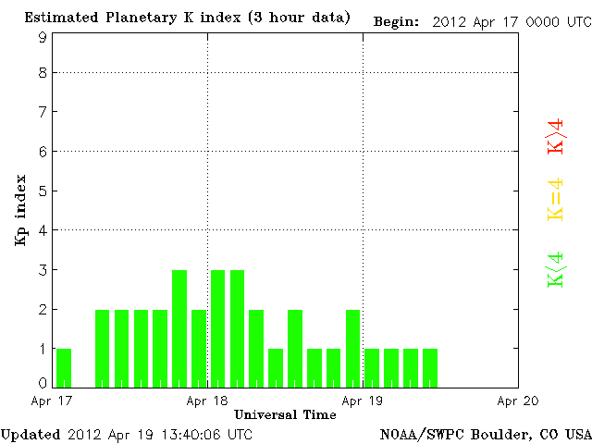
Kp Index
The higher the Kp index the greater the chances of seeing Auroras closer toward the equator.
Green indicates less than 4.
Yellow equals 4
Red is greater than 4 and indicates a solar storm warning.

Slide 3
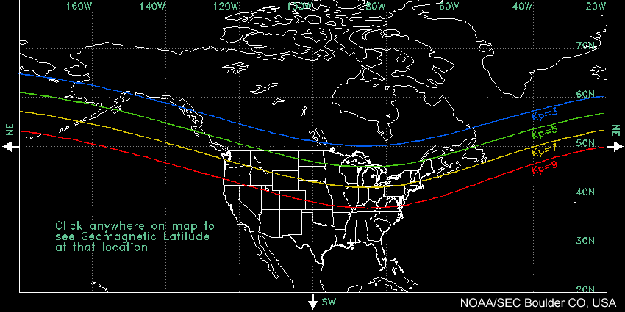
The colors correspond to the colors of the Kp Index

Slide 4
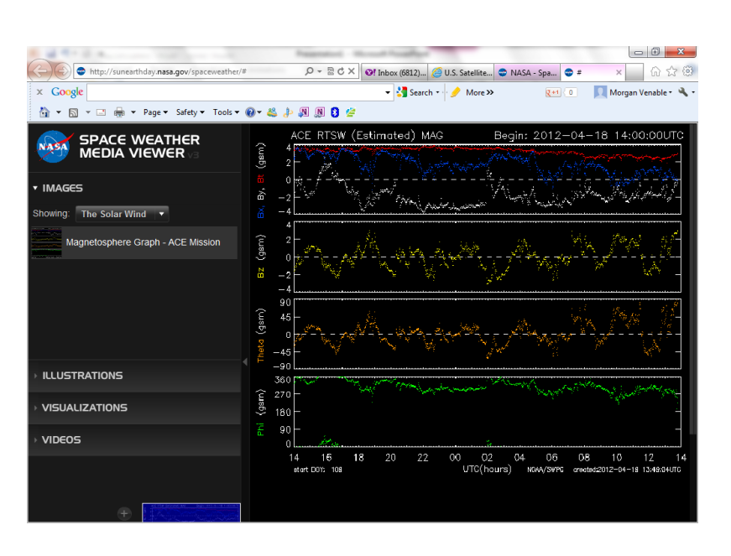
The second graph, Bz, indicates solar wind’s affect on Earth
Whenever the line drops below the 0 line, the earth’s magnetosphere has been affected by solar winds.
Data is collected from ACE satellite that is positioned 1 million miles from the Earth. This satellite is always between the earth and the sun.
ACE satellite gives researchers one hour notice of solar storms.

