Slide 1
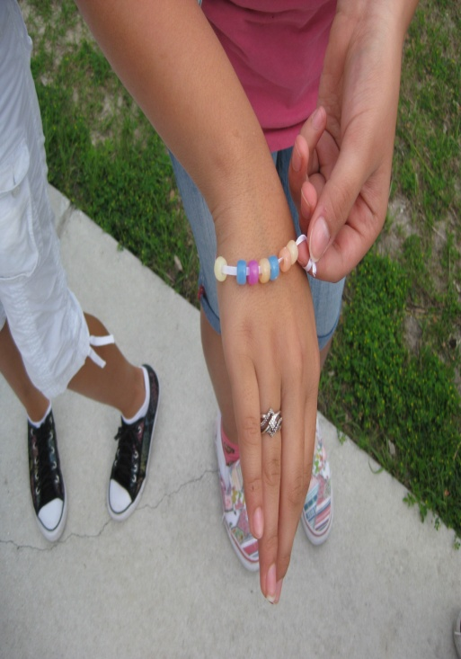

How does the UV index vary with temperature, humidity, and cloud cover? Data collection: weather.gov, epa.gov, UV detecting beads, pictures of clouds

Slide 2
Results

Slide 3
Results

Slide 4
Results

Slide 5
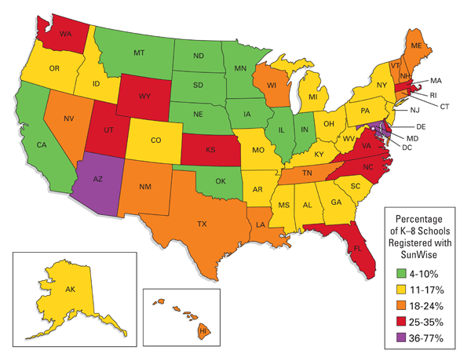
Future Research
If students and teachers are regularly educated using the EPA SUNWISE Program, will the incidence of skin cancer decrease?

