Slide 1
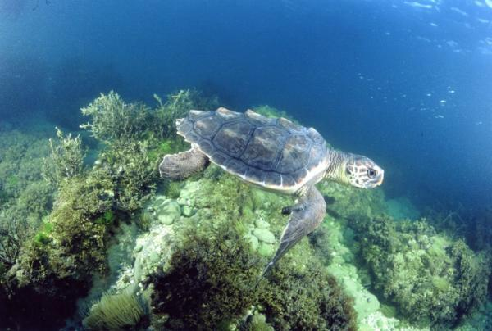
Loggerhead Sea Turtles
Linda** tracked 6/2011-2/2012
FL to TX in Gulf of Mexico
Loggerhead species = Caretta caretta

Slide 2
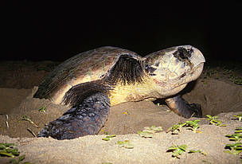
Loggerhead Sea Turtles - population worldwide ??
Endangered & Threatened:
harm no one & help control Jellyfish
Man crowds beaches & warm H2O (Earth Night maps)
Negative Impacts to Turtles
Bycatch: fishing & longlines = drowning (mapped)
Habitat & nesting lost to human development
Eggs/meat eaten
Commercial uses of shells
Pollution*Oil spills & Plastics (mapped)
Climate Change-SST maps

Slide 3

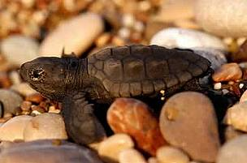
Loggerhead Sea Turtles
Very Low survival, SLOW growth & reproductive rates!
Breeding : 32-37 years/Lifespan 50 yrs??
Omnivore: shellfish, sea grass, sponges
Red-brown carapace (top), plastron (bottom) shell
Large head, strong beak-no teeth, paddle flippers, heart-shaped body
Sleep underwater

Slide 4
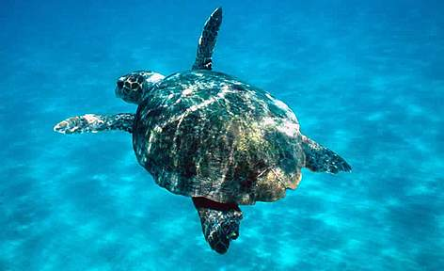

Loggerhead Sea Turtles by NASA ENDEAVOR FELLOW Raya-Jean Zaczyk
Air breathers=must surface before dives
Share their food sources (Bathymetry & Phytoplankton maps)
Protect Marine Sanctuaries & Oceans Worldwide
How You Can Save Them!!
Protect Beaches/Estuaries
Slow Boats *Reduce STRESS
Decrease POLLUTION
Boycott Products of Shells
Decrease YOUR Carbon
Photos & all Resources : Signals of Spring/Aces

