Slide 1
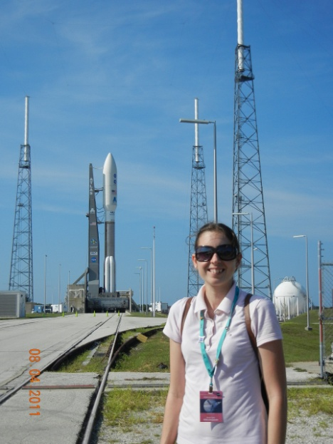
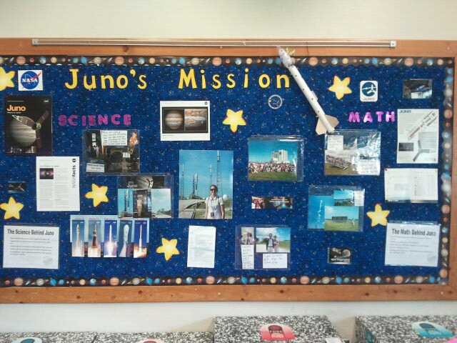
Juno Rocket Science and Math
Juno is a satellite that launched from Kennedy Space Center on Aug. 5th. I was lucky enough to have press access to learn all of the great math and science that goes into Juno’s launch and its mission in 5 years .
I am going to use the information I learned to create a two week 5th grade unit. This unit will seamlessly integrate math and science together by discussing how satellites are launched, Juno’s mission, and why Juno has to crash into Jupiter.
Resource to share: http://solarsystem.nasa.gov/eyes/
Math key points for this unit are:
Learning about shapes: Cones, Cylinders, Faces, Edges, Vertices.
Discussing weight conversion from grams to pounds
Graphing Data
Figuring out speed
Science Key Points
Gravities effect on planets
Background knowledge of Jupiter
Discuss forces and how they effect the satellite

