Slide 1

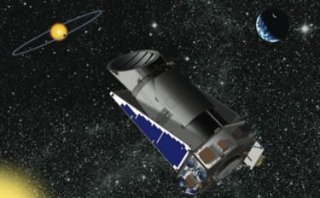
Another Earth-A Search for Habitable Planets NASA Kepler Mission
Middle School Astronomy Unit (~8 weeks)
Earth, Moon, Sun Interactions Solar System Stars Universe
Use math to guide science instruction (new perspective for me to frame instruction)
Imagine that Kepler finds several planets that are similar to Earth in many respects. Since space travel is so expensive, NASA will only have the funding to send one mission to one of these “other Earths.” Knowing several parameters about each of these planets, you will have to convince officials at NASA which planet will have the best chances for life. NASA also requests proposals for scale models of the new solar system chosen. This includes to scale drawings and an estimated budget for space travel.
(Kepler mission is an interest of mine and is also naturally engaging for students)
Math Common Core Curriculum for Grades 7 & 8
Work with radicals and integer exponents
Analyze proportional relationships and use them to solve real-world and mathematical problems.
Solve real-life mathematical problems using numerical and algebraic expressions and equations.
Draw, construct, and describe geometrical figures and describe the relationships between them.
Solve real world and mathematical problems involving angle measure, area, surface area, and volume.
NASA Components;
Kepler Home Page
NASA Planet Quest-data on real extrasolar planets
NASA.gov for information about general expenses for students to estimate the budget for
space travel

