Slide 1
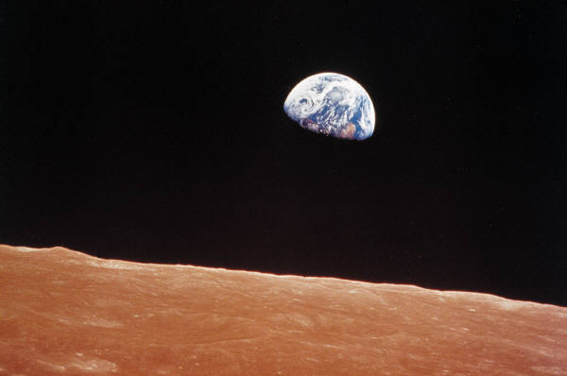
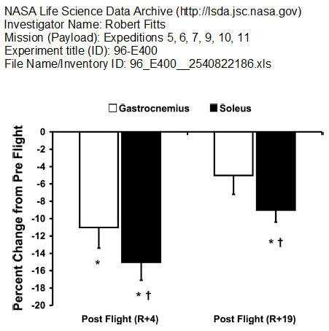

Effect of Prolonged Space Flight on Human Skeletal Muscle
Percent Changes in Muscle Volume
The aim of this study was to document the exercise program used by crewmembers aboard the ISS and examine its effectiveness for preserving skeletal muscle size and function. The focus of the study was on the calf muscles, since it has shown to atrophy more than other leg and upper body muscles with unloading. To obtain a comprehensive profile of skeletal muscle before and after flight, the investigators utilized magnetic resonance imaging (MRI) to assess muscle volume, static and dynamic muscle testing to assess muscle performance, and muscle biopsies from the gastrocnemius and soleus to assess fiber type, contractile function, and microanatomy.
This graph represents percent changes in gastrocnemius and soleus muscle volume from preflight to post flight recovery
days 4 (R+4) and 19 (R+19). *P < 0.05 versus preflight. †P < 0.05 versus gastrocnemius.
Chapter 11: The Horizontal Stuff What if you never got out of bed?
Students will investigate energy systems used during various sports/exercise, students will evaluate expected performance in microgravity environment.
Jamie Jenkins

