Slide 1
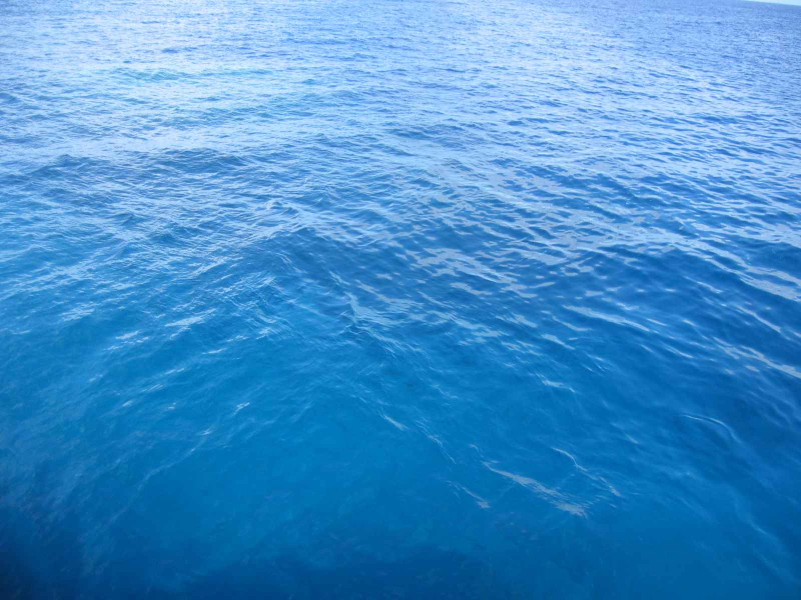

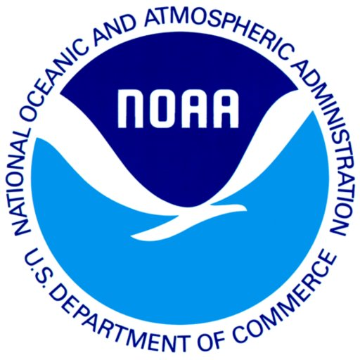
How does Sea Level Rise Affect YOU?
M.Y. S.P.A.C.E.
Team 2011

Slide 2
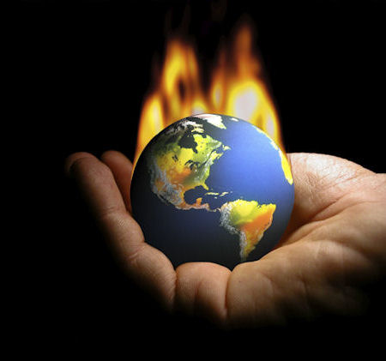
What is Climate Change?

Slide 3
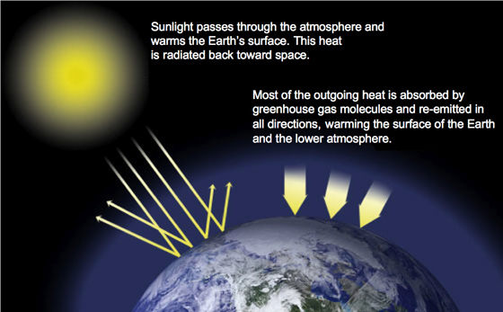
Greenhouse Effect

Slide 4
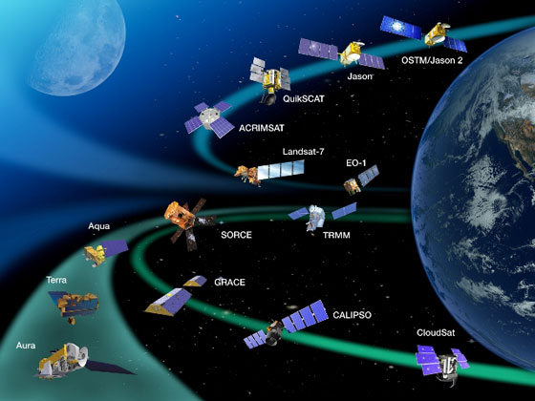
NASA’s Role

Slide 5
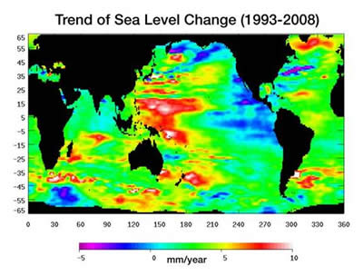
Sea Level Rise
Since 1900 1 to 2.5 mm per year
Over the past decade 3.1 mm per year
Predicted 110-770 mm from 1990-2100

Slide 6
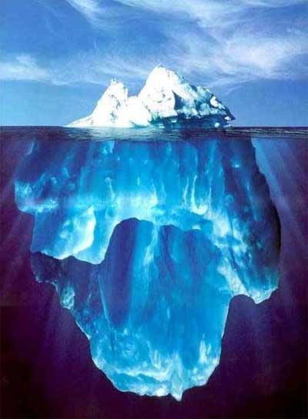
Glaciers
What are Glaciers?
How are Glaciers formed?
Due to its massive weight it is in constant motion and can move from a few millimeters to whole meters in one day

Slide 7
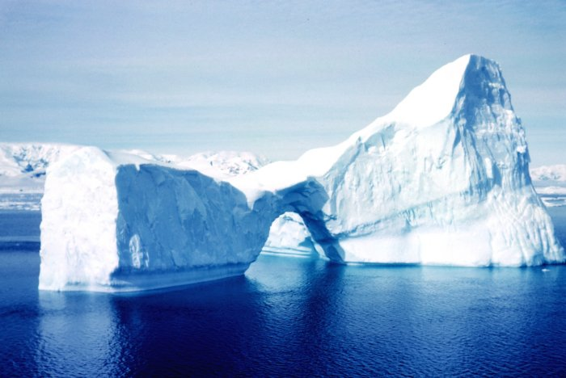
Melting of Ice
When an ice cube melts in a cup of water it
does not cause the glass to overflow due to
Archimedes principle.
Fresh water is less dense then salt water
Because glaciers are made of fresh water, when they melt the salt water gets displaced but the fresh water takes up more volume.
Result? Small increase in sea level rise.

Slide 8
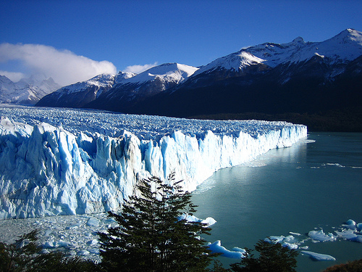
Ice Melting is Normal…
Glaciers melting is natural, but it used to be a balanced process.
Two factors that control glacier size are temperature and precipitation.
But now there is a problem.
If temperatures go above a certain point and last for an extended amount of time there is not enough recovery time and slowly the glacier loses mass.
Because of climate change there are longer melting periods and shorter recovery periods.
NASA missions that help moniter sea and land ice are Grace, Terra, and IceSAT.

Slide 9
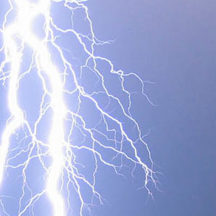
Hydroelectric
Many people depend on the flow of the melting of glaciers as a form of electricity.
If all the glaciers are gone then can no longer rely on this source for power.
Because no nation can live without electricity, places will have to adapt to new methods that could potentially pollute and increase Global Warming.
Glacial runoff is used to power hydroelectric plants, sustain fish runs and irrigate crops as well as to supply the needs of large metropolitan areas.

Slide 10
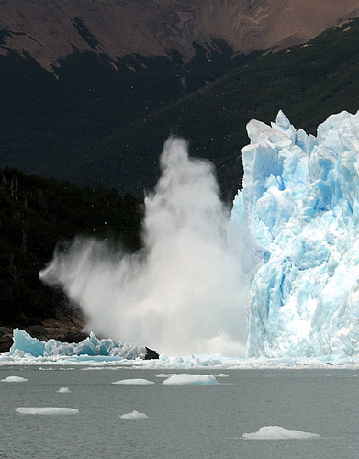
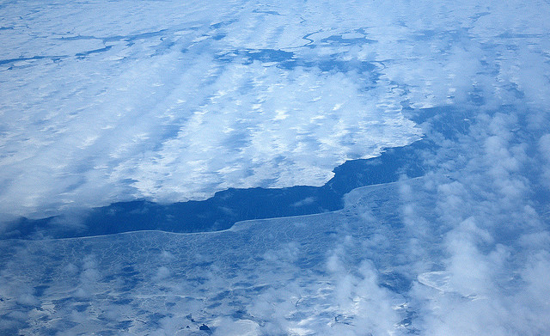
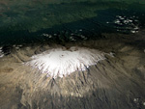
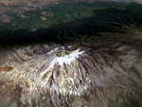
Causes of Reduction in Ice
collapses & thinning of Antarctic ice shelves
withdraw of Arctic sea ice
Giddy Heights, Africa
February 17, 1993
February 21, 2000

Slide 11
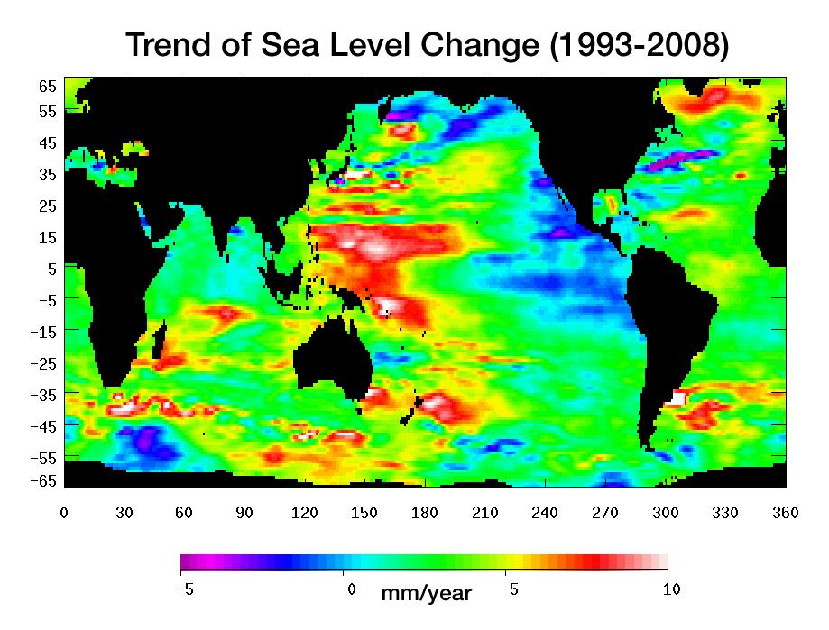
Sea Level Rise and Its Effect on Ocean Currents
Jason – 1 (TOPEX/Poseidon)

Slide 12
Ocean Currents
What are ocean currents and what do they mean to us?
In basic terms they are like a global oceanic river system. The good part of ocean currents is that they stir up nutrients from the bottom of the ocean and brings them to the top, and besides transporting nutrients it also transfers heat and salt on a planetary scale. This means to us as inhabitants is that our ocean is doing its job and is providing us a well-balanced global ecosystem.
What do they influence?
Climate, ecosystems, and us.

Slide 13
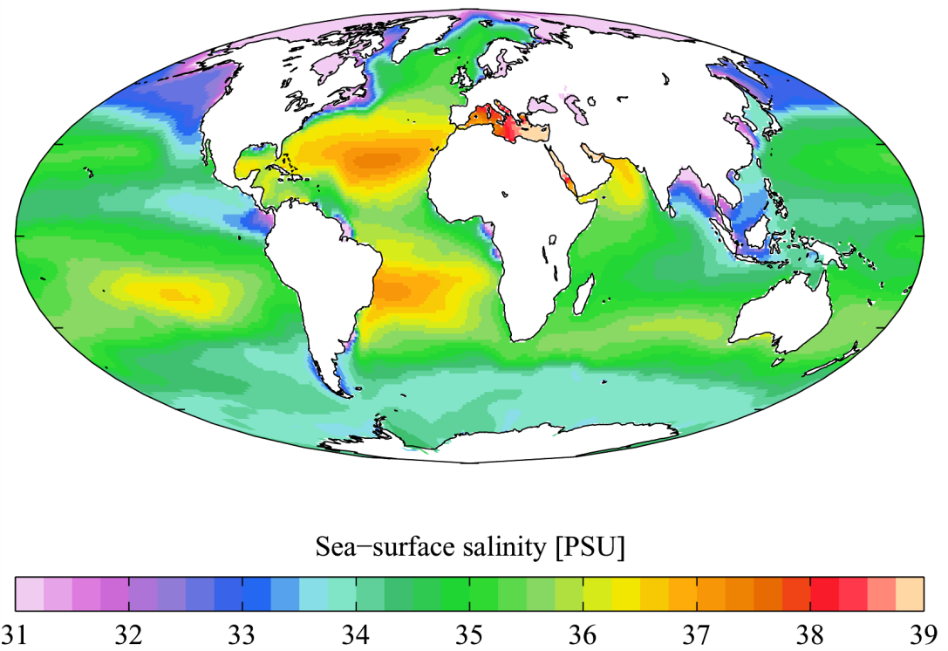
Salinity and Currents
As the sea level rises, salinity decreases
Salinity affects water density
The ocean would become less dense with rising sea levels

Slide 14
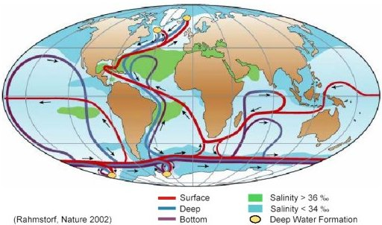
Thermohaline Circulation
Oceanic convection
Caused by density differences and surface cooling
The cold, denser surface water sinks to bottom
Cold water absorbs CO2 and follows the current until it is released back at the surface
“Overturning” of the world’s ocean

Slide 15
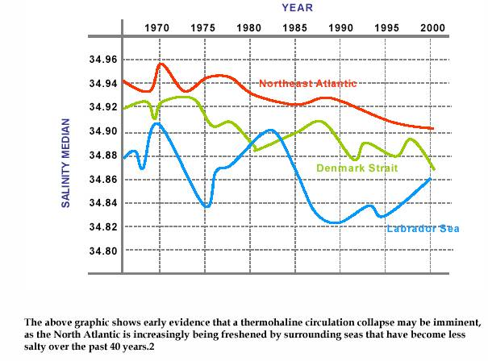
Thermohaline Circulation (TC) Shutdown
Glaciers melt → the sea level rises with an influx of freshwater
The salinity level and density of the water would decrease
This would throw off the thermohaline circulation
The surface water would not be able to sink as easily because of the decrease in density
It would result in the cooling of the tropics
The oceanic circulation of CO2 would be reduced
According to the American Geophysical Union (San Francisco, Dec. 13-17), Greenland cooled by 7 C⁰ during the end of the last ice age
Notes:
because of the melting of glaciers, less density, collapse of the thermohaline circulation

Slide 16
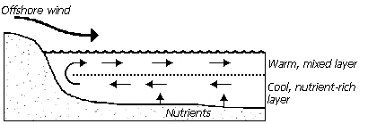
Upwellings
Deep sea currents drive nutrition cycling
Upwellings: “the process in which cold, often nutrient-rich waters from the ocean depths rise to the surface”
TC collapse → nutrients from the bottom of the ocean would not reach the upper zones
Many species of oceanic life would die off
Notes:
Nitrogen, phosphorus, and silicon

Slide 17
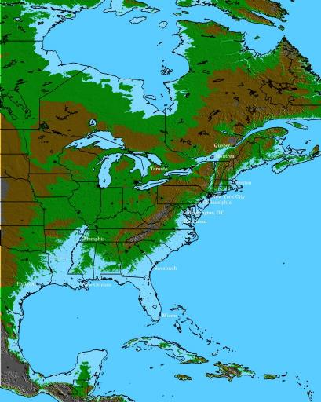
Coastlines
Currents are largely affected by the shape of the coastline
Sea level rise → parts of the coastline would be submerged
Erosion would take place
Different coastlines → shift in the shape of ocean currents

Slide 18
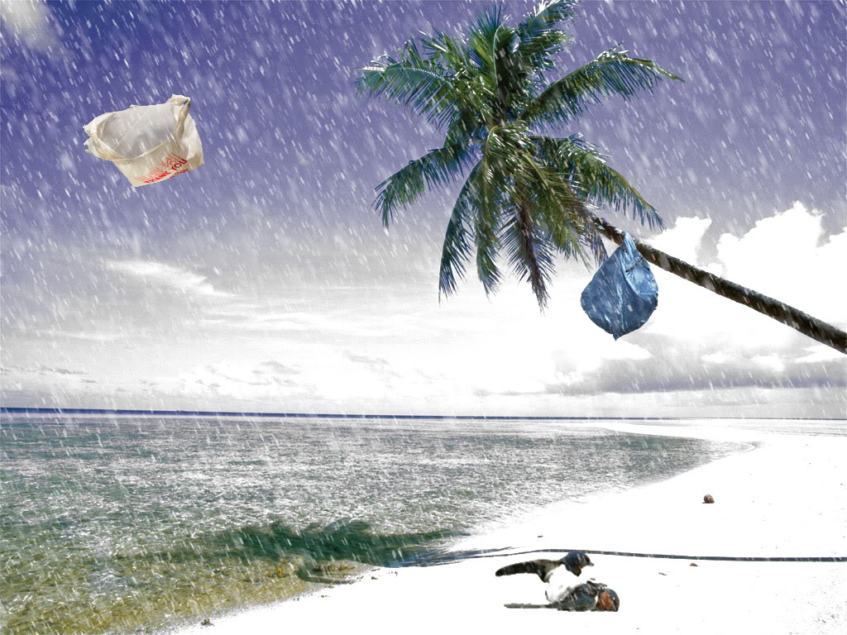
Effects of Current Change
If ocean currents were to change, it could cause a massive migration or even annihilate species
If the California coastline were to switch from a cold current to a warm current, then species of plants and animals may migrate to colder waters or just die out
Because currents influence climate, they could change the climate of Florida to seem like the climate of Siberian Russia

Slide 19
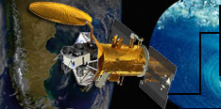
Aquarius
“The mission of Aquarius is to map the salinity of the ocean surface. This mission is important to understanding two major parts of Earth's climate system which are the water cycle and ocean circulation. By measuring ocean salinity from space, Aquarius will provide new insights into how the massive natural exchange of freshwater between the ocean, atmosphere and sea ice influences ocean circulation, weather and climate.”- NASA Missions website
Salinity varies from place to place and by using Aquarius’ data we are able to notice trends and learn about salinity’s role in shaping the currents and its affect on the water cycle.
Also Aquarius shows how freshwater moves between the ocean and atmosphere and around the globe.
Knowing ocean surface salinity can also help scientists track ocean currents and better understand ocean circulation. Salinity, together with temperature, determines how dense and buoyant seawater is. This, in turn, drives how ocean waters are layered and mixed and the formation of water masses. Salinity also has a major effect on ocean circulation, including the flow of currents that move heat from the tropics to the poles.

Slide 20
Jason 1
Provide a 5-year view of global ocean surface topography
Increase understanding of ocean circulation and seasonal changes
Improve forecasting of climate events like El Niño Measure global sea-level change
Improve open ocean tide models
Provide estimates of significant wave height and wind speeds over the ocean

Slide 21
Jason 2
Extend the time series of ocean surface topography measurements beyond TOPEX/Poseidon (T/P) and Jason to accomplish two decades of observations Provide a minimum of 3 years measurement of global ocean surface topography
Determine the variability of ocean circulation at decadal time scales from combined data record with T/P and Jason
Improve the measure of the time-averaged ocean circulation
Improve the measure of global sea-level change Improve open ocean tide models

Slide 22
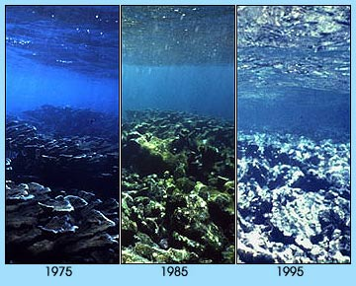
Coral Reef Impacts

Slide 23
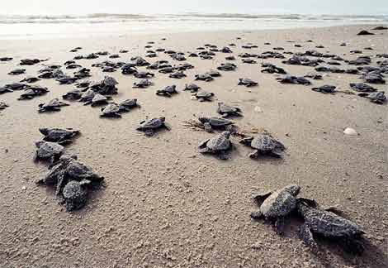
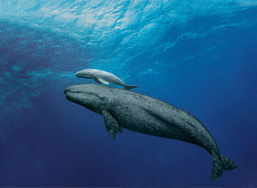
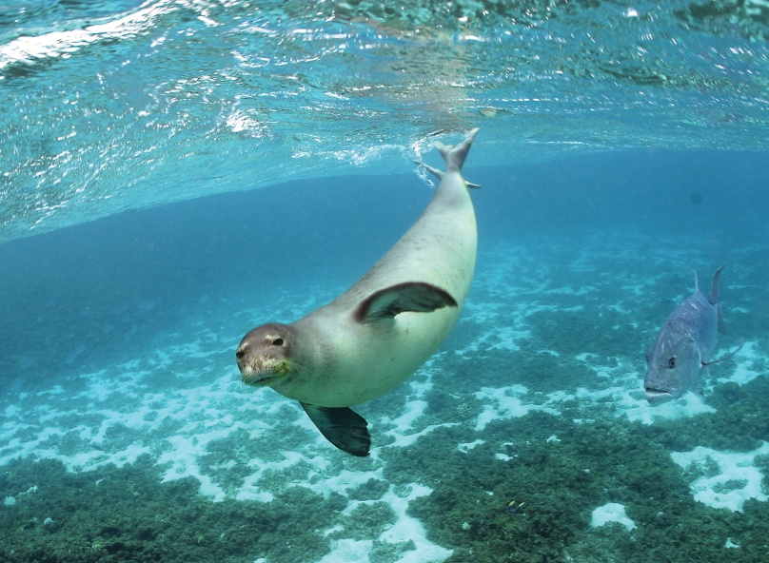
Raising Offspring
Sea Turtles
Mediterranean Monk Seals
Whales and dolphins

Slide 24
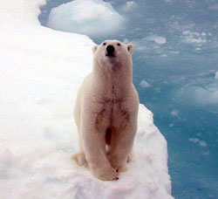
Polar Bears
NOAA

Slide 25
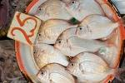
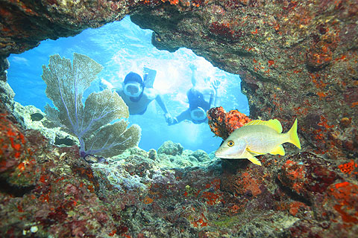
Humans
Tourism
Food
Jobs (Fish Industry)
Recreational opportunities
Coastal protection

Slide 26
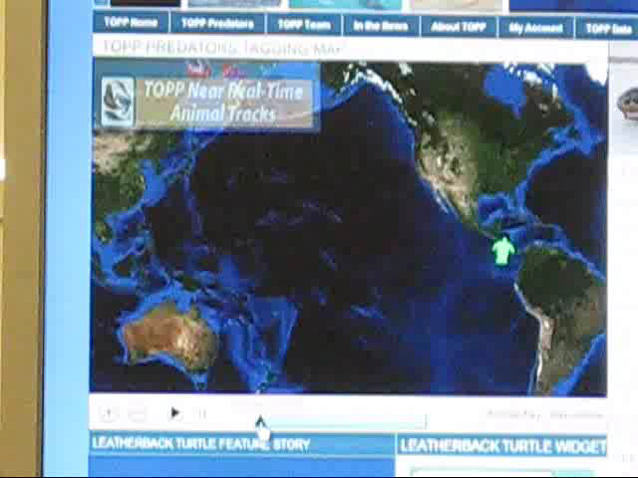

Slide 27
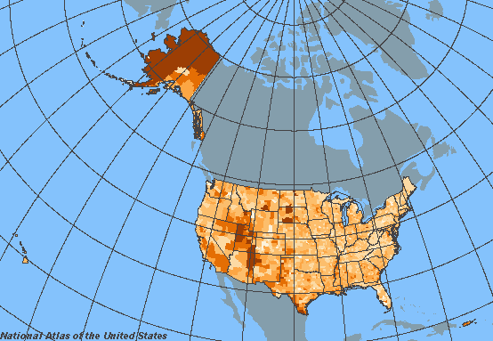
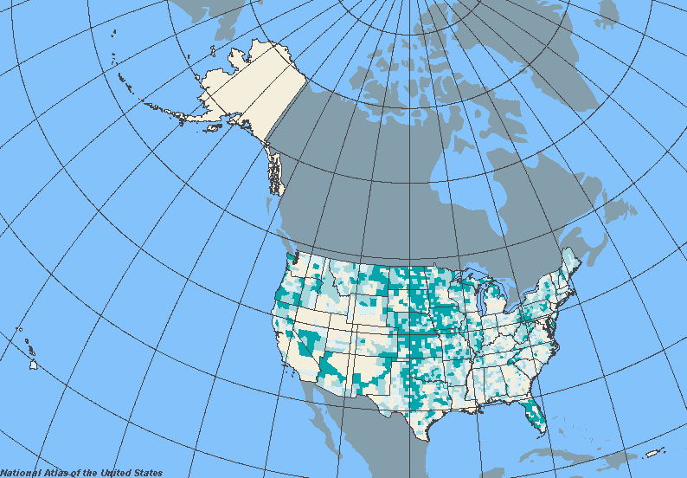
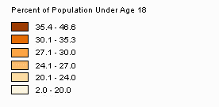
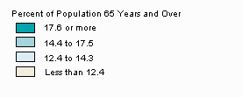
Population

Slide 28
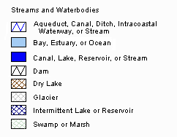
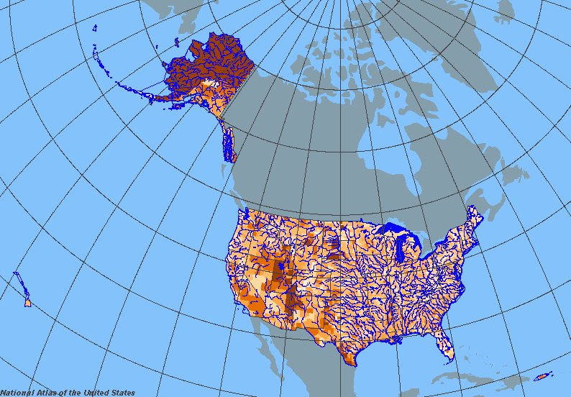
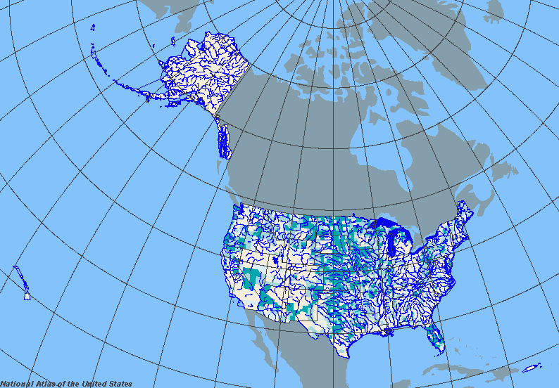
Population

Slide 29
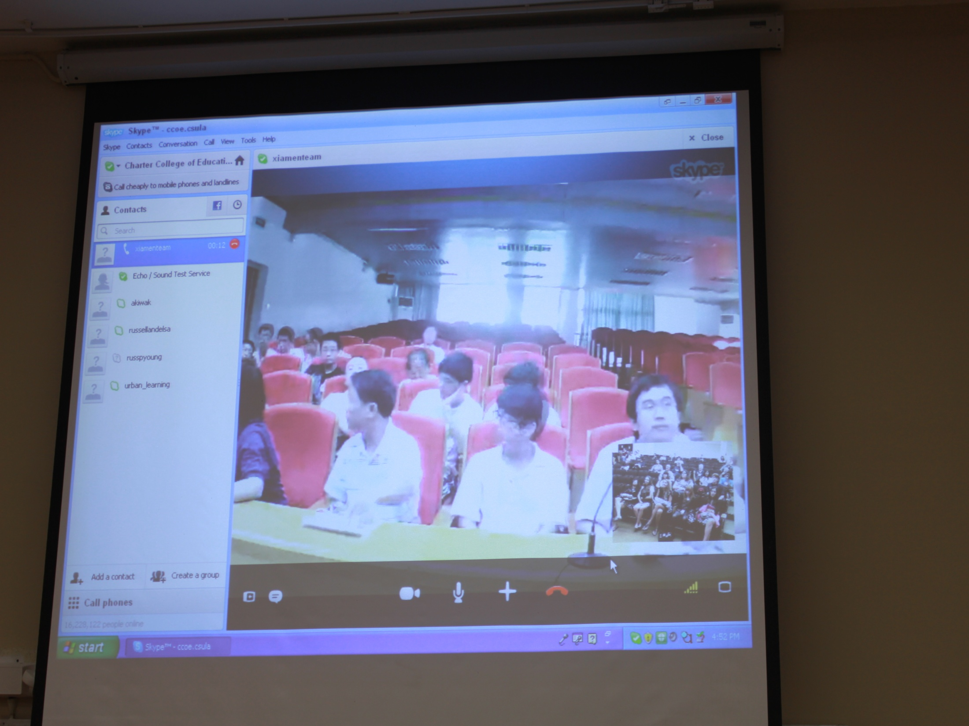

Slide 30
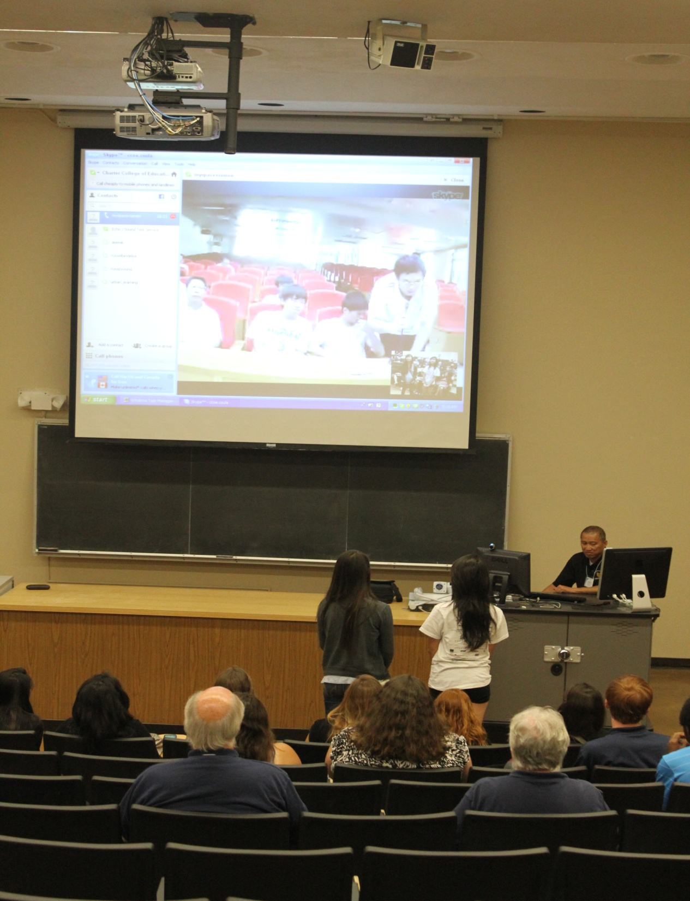

Slide 31
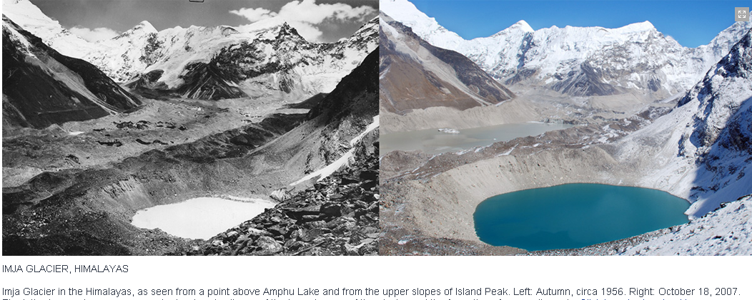

Slide 32
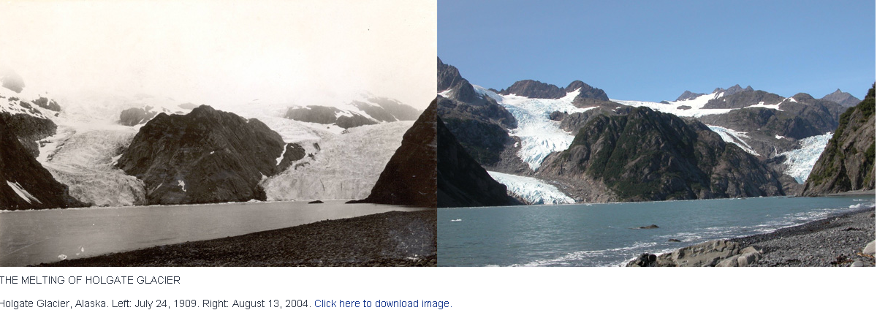

Slide 33
Sources
http://www.sciencedaily.com/releases/2004/12/041219153611.htm
http://www.windows2universe.org/earth/Water/circulation1.html
http://www.stateoftheocean.org/flash/system.html
http://www.kean.edu/~csmart/Observing/15.%20Oceans%20and%20coastal%20processes.pdf
http://www.ehow.com/about_5517246_salinity-impact-oceans-currents.html
http://climate.nasa.gov/causes/
http://www.bbc.co.uk/climate/evidence/
http://oceanservice.noaa.gov/facts/sealevelclimate.html
http://climate.nasa.gov/NasaRole/
http://earthguide.ucsd.edu/earthguide/diagrams/greenhouse/
http://ecofuture.net/environment/files/2010/09/Climate-Change.jpg
http://climate.nasa.gov/images/normPage-3.jpg
http://seabass.gsfc.nasa.gov/seabass/images/NASA_Logo.gif
http:
//www.nosb.org/wp-content/uploads/2011/05/noaa-logo-klein.jpg
http://climate.nasa.gov/images/normPage-10.jpg
http://www.climate.org/topics/sea-level/images/clip_image002.jpg
http://www.kidsgeo.com/images/ocean-temperature.jpg
http://www.earthwatch2.org/LFF/Livingston/uploaded_images/diving_ocean-792387.jpg
http://www.travelvivi.com/wp-content/uploads/2009/07/Perito-Moreno-Glacier-1.jpg
http://www.climate.org/topics/sea-level/index.html
http://topp.org
http://nationalgeographic.org
http://www.sciencedaily.com/releases/2004/12/041219153611.htm
http://www.windows2universe.org/earth/Water/circulation1.html
http://www.stateoftheocean.org/flash/system.html
http://www.kean.edu/~csmart/Observing/15.%20Oceans%20and%20coastal%20processes.pdf
http://www.ehow.com/about_5517246_salinity-impact-oceans-currents.html
http://peakoilmedicine.wordyblog.com/wp-content/uploads/figure-3.jpg
http://photojournal.jpl.nasa.gov/feature/africa?start=0

