Slide 1
Homemade Toys
Engineering Design Brief

Slide 2
Why Homemade Toys?
Rationale:
Since my fourth graders have had little to no experience with using the engineering design process, I wanted to give them an opportunity to participate in an introductory problem-based activity that they would have the necessary background knowledge to complete.
After all, what kid doesn’t like toys?

Slide 3
The Problem
Every day people throw away items that can easily be reused. If the items that were commonly thrown away were used for a different purpose, there would be less waste. Less waste improves both the environment and our communities.
We must find a way that we can reduce waste by reusing the trashed items.
How can we help? Children all over the world have some things in common. They all need food, shelter, and clothing. And they all play.

Slide 4
Your Engineering Task
Use the engineering design process to design and build a homemade toy that at least two children from anywhere in the world can play with together. You must use as many found materials as possible. No store bought toys will be accepted. All creations must be original.

Slide 5
Criteria
The toy you design should:
-be a toy that children around the world would like to play with.
-be designed for at least 2 children to be able to play with together.
-be constructed of mostly found materials.
-be safe to play with.
-be easy to carry.

Slide 6
Materials-What Can You Use?
Materials Provided By Ms. Moses:
Items You May Bring From Home:
• straws
• craft sticks
• pipe cleaners
• thread
• glue
• tape
• string
• paper clips
Clean, reusable materials including:
empty food boxes
cardboard
paper tubes (paper towel, toilet paper, etc)
egg cartons
milk cartons
drink bottles
fabric scraps
yarn
string
buttons
ribbon
washers
wire
rubber bands

Slide 7
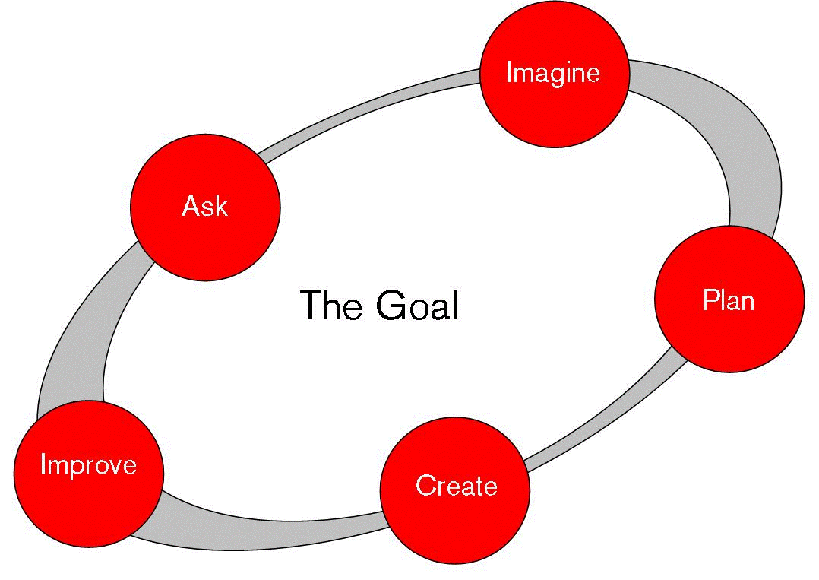
Elementary Engineers In Action
First, we discussed the engineering design process.
Then, we set expectations for what each step in the process required.

Slide 8
Elementary Engineers In Action
The students then chose partners and got to work.
They completed this engineering task using a modified engineering notebook called a guided portfolio. The following slides show the students in action as well as their prototypes.

Slide 9
Guided Portfolios
The modified version of the engineering notebook

Slide 10
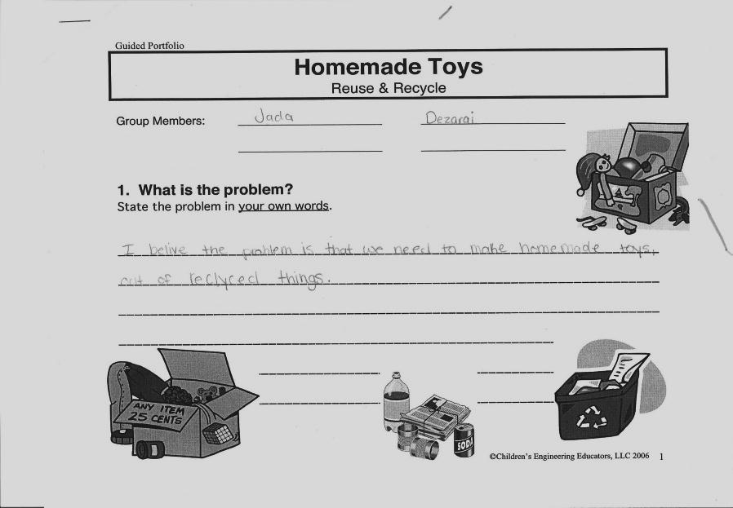
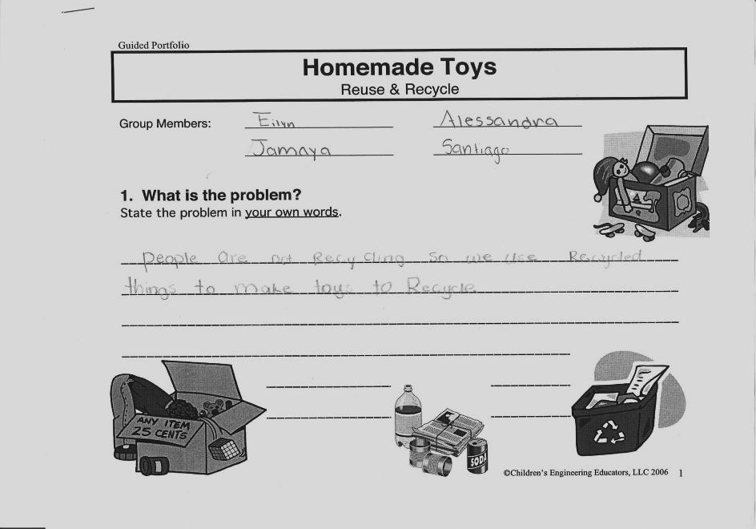
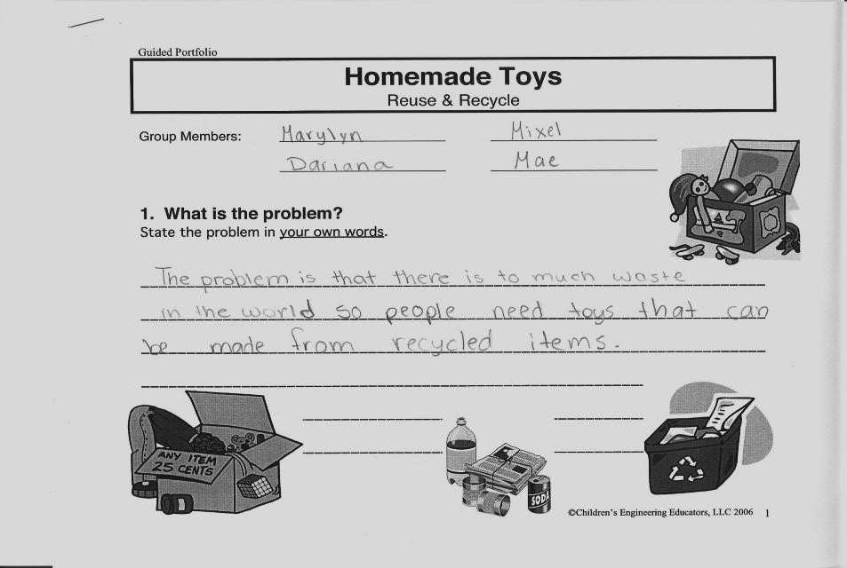
What is the Problem?
As you can see, students had different thoughts about what the problem was.

Slide 11
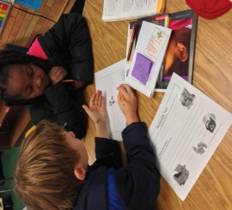
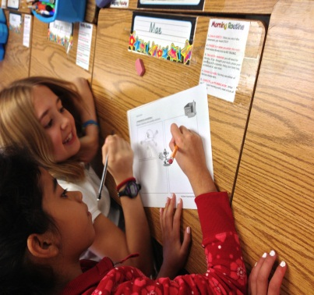
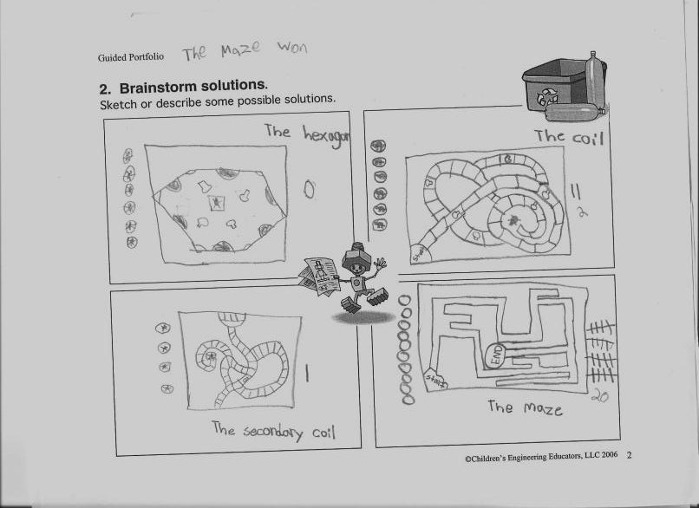
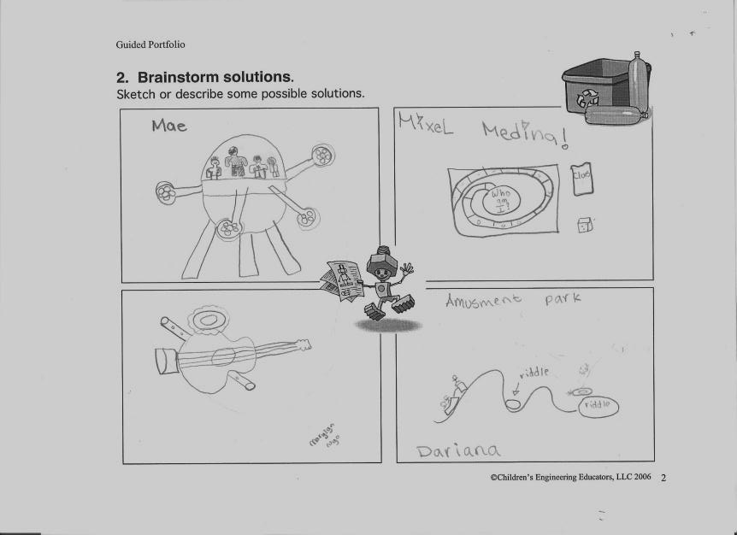
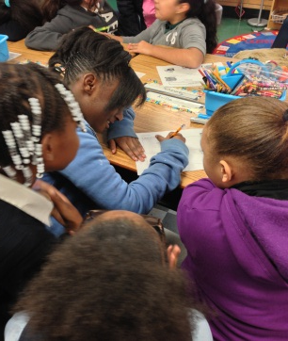
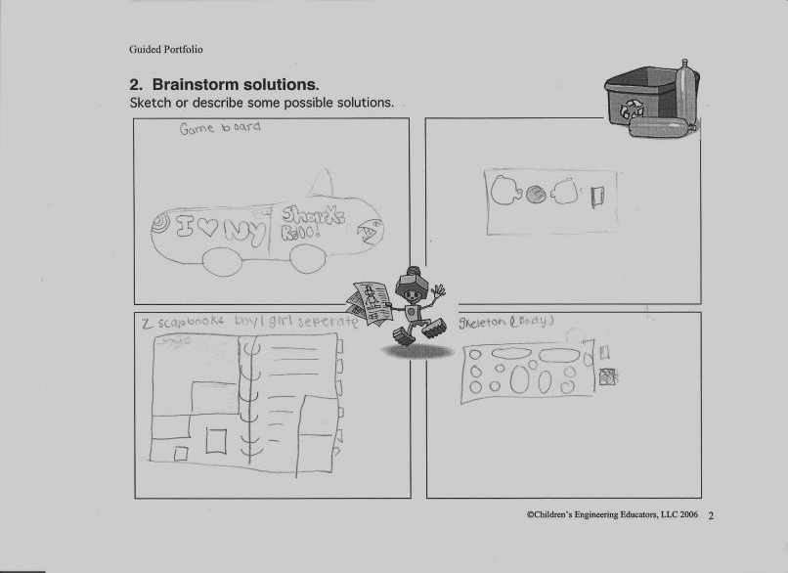
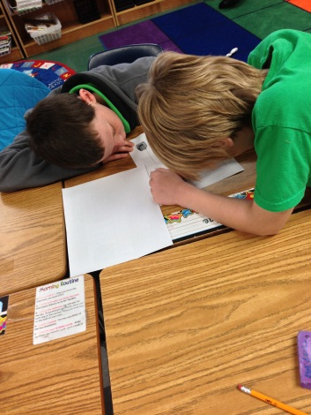
Brainstorming
Students worked in teams to brainstorm solutions to the problem, then they came up with designs for their toys.

Slide 12
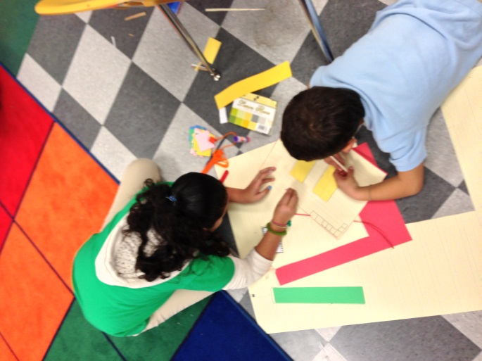
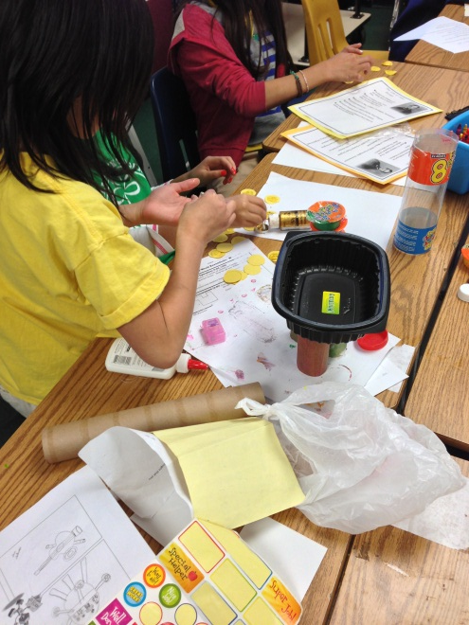
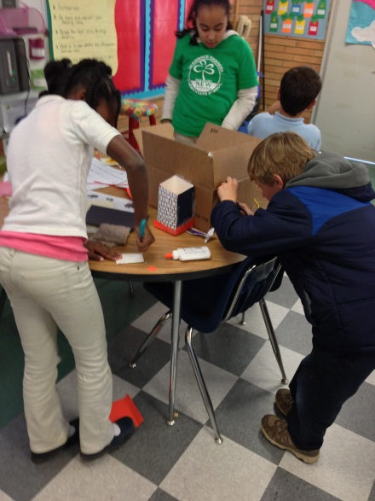
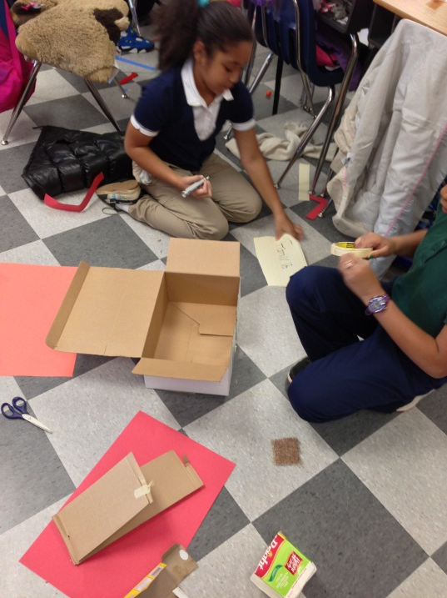
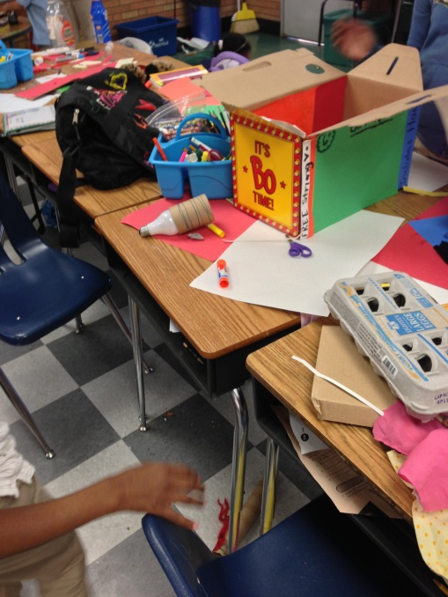
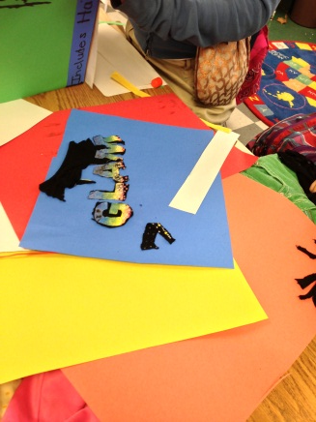
Build

Slide 13
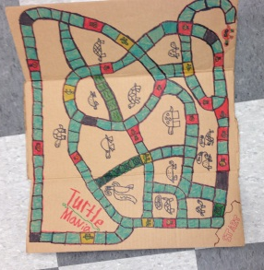
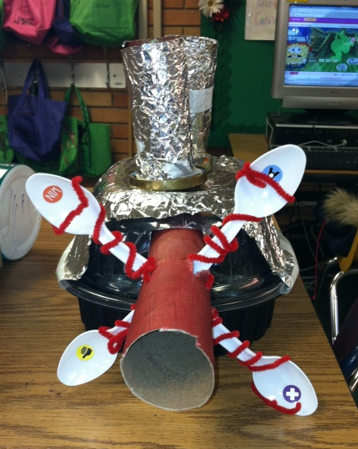
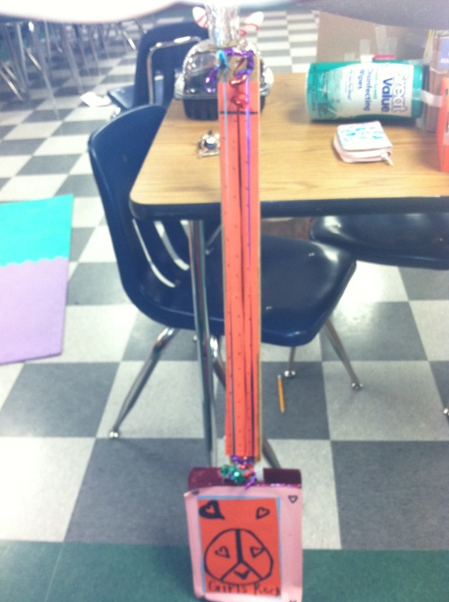
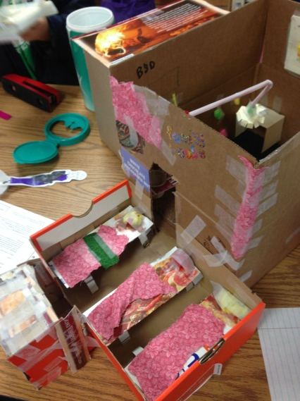
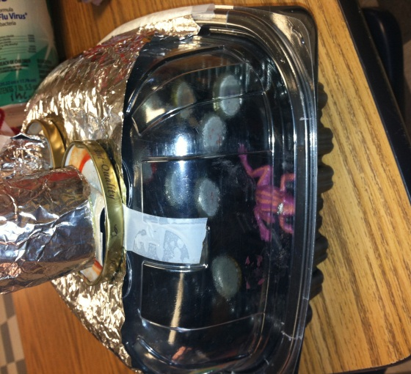
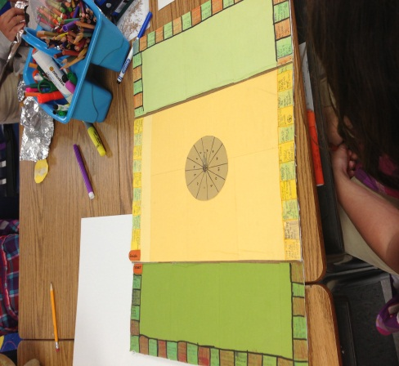
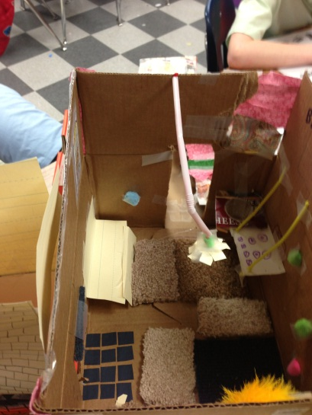
Test & Evaluate
Students went to other classes and tested their designs to see if their games were enjoyable. Modifications were made based on the data they received.

Slide 14
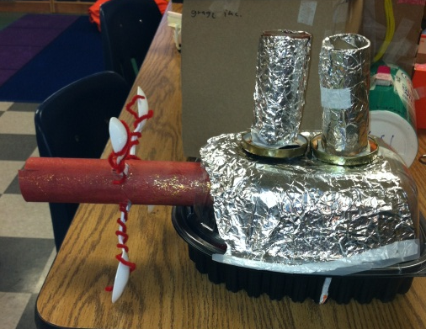
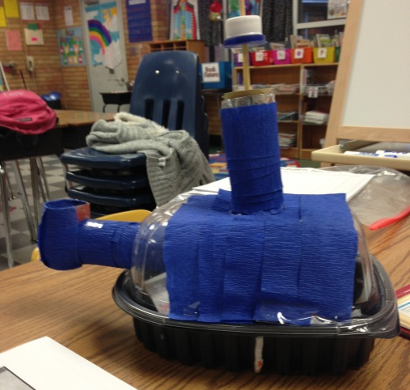
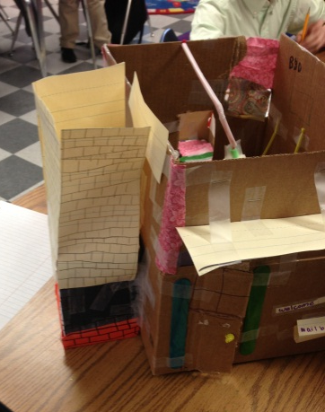
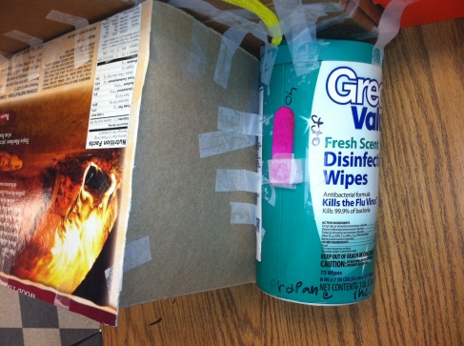
Redesign
Several students were able to improve their original designs. Afterwards, they wrote about their experience including what improvements they made after testing their toys/games.
Before
After
This group’s first game was made of tagboard. They imporved their gameboard by using cardboard which is more durable.
The students in this team added a propane tank to their house.

Slide 15
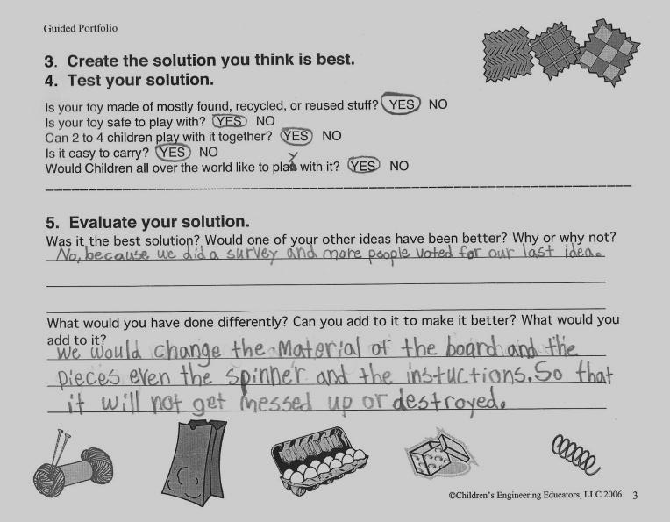
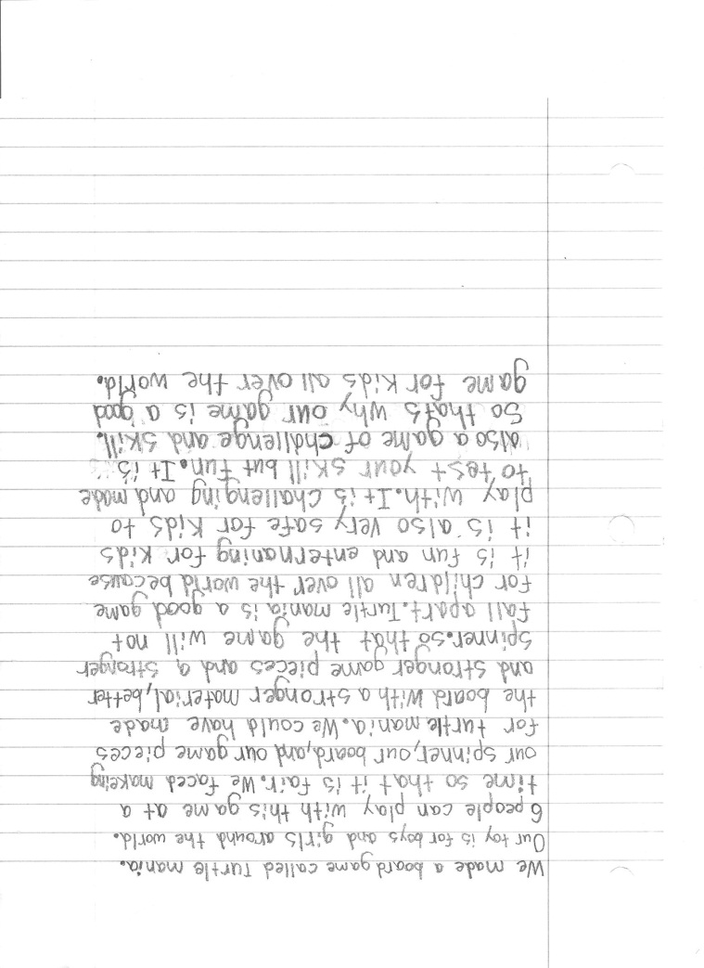

Sharing the Solution
Because each team is in a different stage of the process, not all of them have finished improving/redesigning their prototypes. One group was confident that their toy was complete. Their description is below.

Slide 16
Concluding Thoughts
All of the groups have completed prototypes and are in the process of testing and redesigning their toys. Due to time constraints, and the fact that I have a class full of perfectionists, the remaining groups will be finished by the end of the week.
The final step of the process is for the students to complete a written summary of their experience while completing this task. Each summary must answer the following questions:
What kind of toy did you make?
Is your toy for boys, girls, or both?
How many people can play with your toy at a time?
What challenges did you face while creating our toy?
What could you have done differently?
Why is your toy a good toy for children around the world to play with?

