Slide 1
Solar Flares
By: Kathryn “Annie” Arnone

Slide 2
Electromagnetic Radiation Emitted from Sun
Speed = ~300,000 km/s

Slide 3
Solar Wind
Speed = ~470 km/s

Slide 5
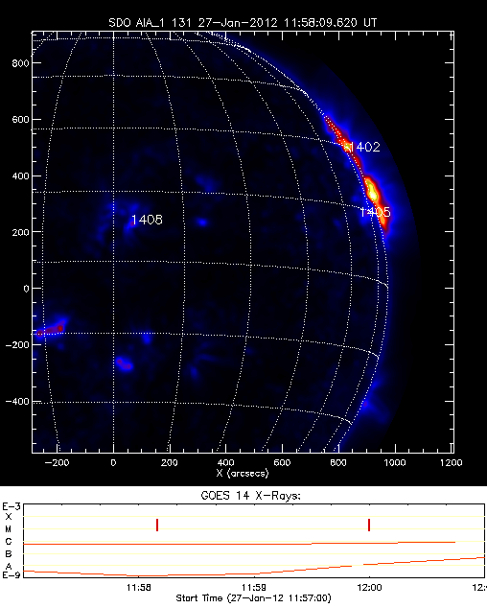
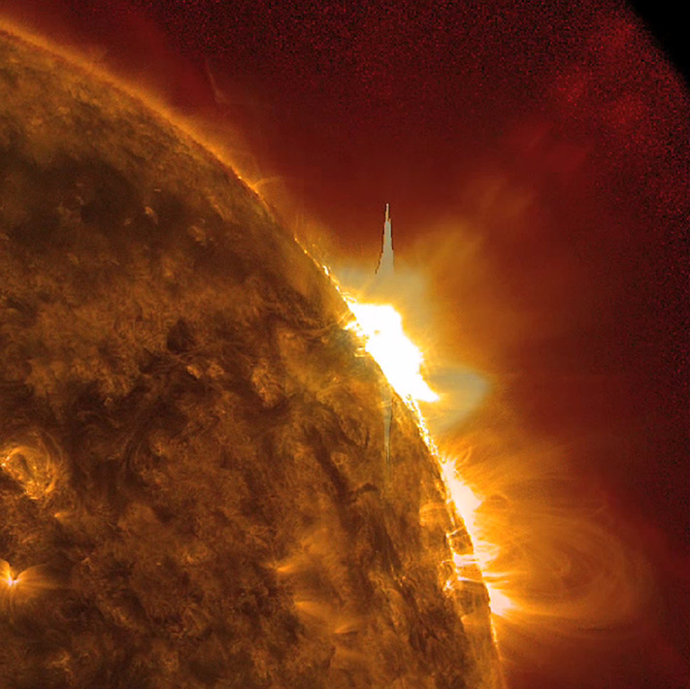
Solar Flare: January 27, 2012
Coronal Mass Ejection

Slide 6
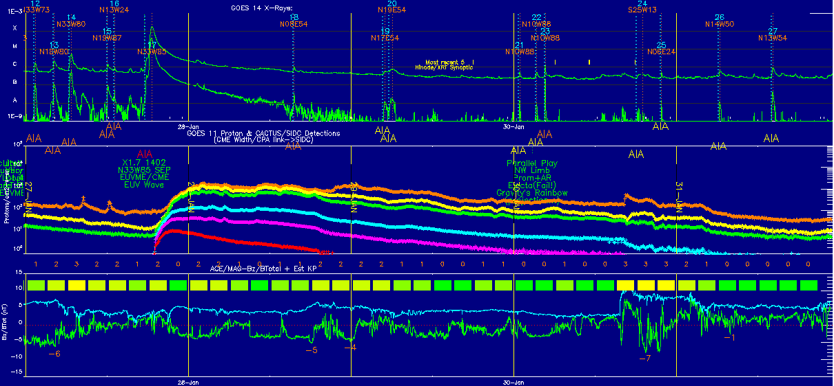
Solar Flare: January 27, 2012
X-Ray Flux Spike Detected
3 Day Time Difference
Magnetospheric Storm Detected

Slide 7
Resources
Space and Weather Action Center
http://sunearthday.nasa.gov/swac/data.php

