Slide 1
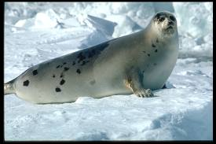
Meet Nona, the Harp Seal
By Trisha Bray
Why Sea Surface Temperature would affect the movement of an animal.

Slide 2
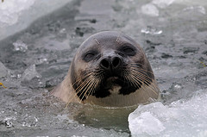
NONA
Nona is a Harp Seal who resides in the northern most part of the United States, and all the way up to Greenland.
I found that Nona goes as far south as Wood Island Harbor, Biddeford, Maine, and as far north as 70.037N, 50.32W. Since there were no labels of nearby cities or towns, I put the coordinates in on Google Maps, and found that she goes as far north as a small harbor off of the Davis Strait in Greenland. There was a nearby island named Qeqertaq.

Slide 3
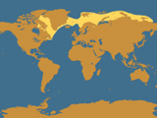
Ice Matters
I learned that Nona traveled on the edge of the ice drifts. When the ice was solid in the north near Greenland, Nona would be more south near Newfoundland and Maine. But, when the ice melted in the north around August and September, Nona would be near Greenland.
This picture to the right shows Harp Seal Territory.

Slide 4
March 3-April 3, 2010.
I chose the time frame of March 3-April 3, 2010. I chose this because she was in this are the longest of all of her tracking locations.
During this time, the area of Port Saunders Harbour, Newfoundland, ice is present, but there is still areas for the Nona to swim, hunt for food, and take breaks on floating ice.
All areas north of Nona are completely frozen over at this time and this is why Nona is here for so long.
It is possible that Nona, and females like Nona, would have had pups of their own, and therefore, sea surface temperature would have been very important to their survival based on open water to feed and ice to rest on.

Slide 5
Conclusion
April 27, 2010 was her last tracking date available. At this time, she was still only 30 miles northeast of her last location near Newfoundland.
I found this lesson to be very interactive and educational. I think sea surface temperature is something students would not think about when it came to animal migration. By using this type of lesson and the resources, it could teach students that animals must move and relocate in order to survive. Food, maneuverability, water temperature and resting/nesting places are all things that all animals need.

Slide 6
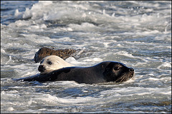
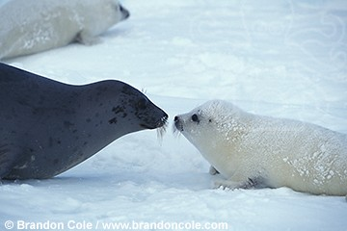
Video Clip
As I was searching on the internet for maps of Newfoundland, I found this really cool YouTube video of Harp Seals in early March of 2010 in Port Saunders Harbour in Newfoundland. I would like to think that Nona could be one of these seals in the video! She was there at this time.
http://www.youtube.com/watch?v=YCV05hse6cQ

