Slide 1

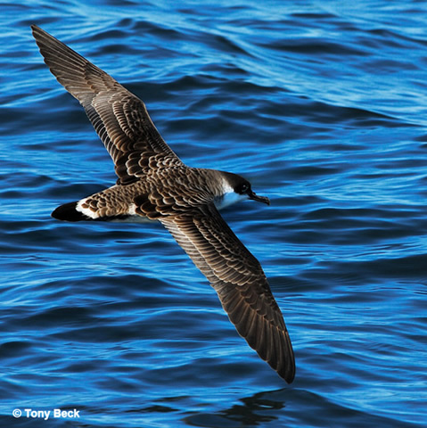
Introducing Chase
A Greater Shearwater
from

Slide 2
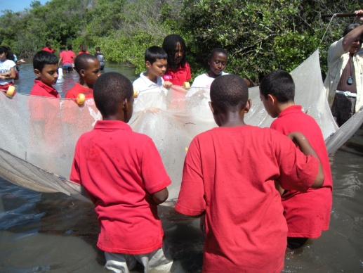

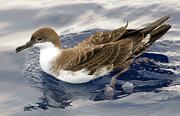
Student Research Teams for the Greater Shearwater
Developed research Teams
Did field studies
Logged on to the ACES Signals of Spring as a class
Tracked Chase and created a hypothesis

Slide 3
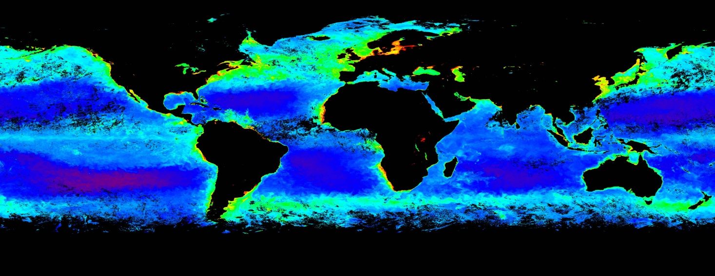
We tracked the phytoplankton in 2009 and Chase. Here is one of the maps we looked at from April 2009
The chlorophyll therefore the phytoplankton is at the greatest concentration where it is red on the coast line it is green and that is a higher concentration than the blue in the middle of the ocean
Notes:
The Chlorophyll is at the greatest concentration where it is red on the coast line it is green and that is a higher concentation than the blue in the middle of the ocean

Slide 4
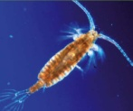

Our Observations based on the maps:
-The phytoplankton are more abundant in the northern hemisphere during the Spring months.
-We see that Chase, the Greater Shearwater does spend a good majority of his time along the coastline where the phytoplankton is in higher concentrations in 2009
We then see what looks like Chase flying in a normal migration pattern in 2008 but not in 2009.
The phytoplankton is present in Chase’s flight to the Southern Hemisphere and then present in greater concentrations again at the coast where he seems to land.

Slide 5


Justifications/ Hypothesis, Research, Further Questions???:
Phytoplankton is more abundant in the Spring months because there is more sunlight to start the photosynthesis process.
There is a lot of phytoplankton growth where the two ocean currents meat in the Southern Hemisphere since this creates a disturbance of the water and keeps the water nutrient rich.
It does not look like the reason Chase flew South in 2008 is to follow the phytoplankton. Based on our research we have learned that Chase is following the pattern of most Greater Shearwaters and is going to the islands to breed. Why does the data show that Chase only followed this pattern in 2008?

Slide 6
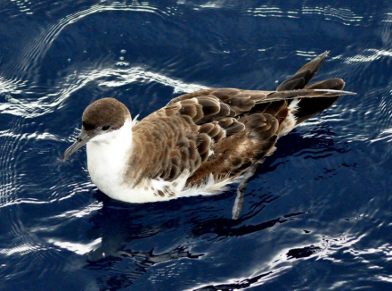
Justifications/ Hypothesis, Research, Further Questions???:
One reason that Chase may have stayed in the Northern Hemisphere in 2009 is that it was a recorded high in temperatures set that year. Does Chase respond to the cold weather in order to indicate it is time to fly South?
We do also know that when Chase was flying South in 2008 he was flying through the middle of the Ocean, not along the coast line. We wonder if there is a weather pattern that would align to this flight pattern? We do also know that Chase's food source consists of smaller fish, squid and crustaceans. Does the food source follow an ocean current pattern or migration pattern?
Our other thought is that maybe Chase is not mature enough to breed therefore he did not fly to the "breeding" ground of the islands.

