Slide 1
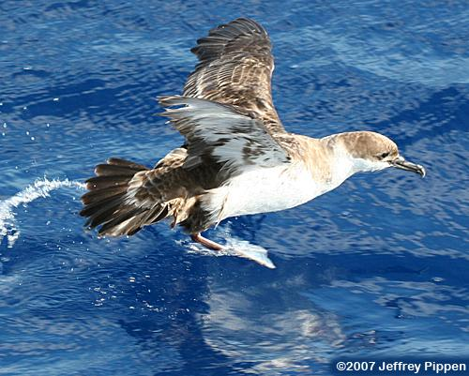
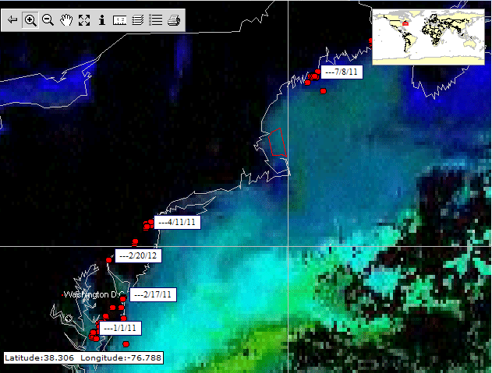
Greater Shearwater Sea Surface Temperature Analysis

Slide 2
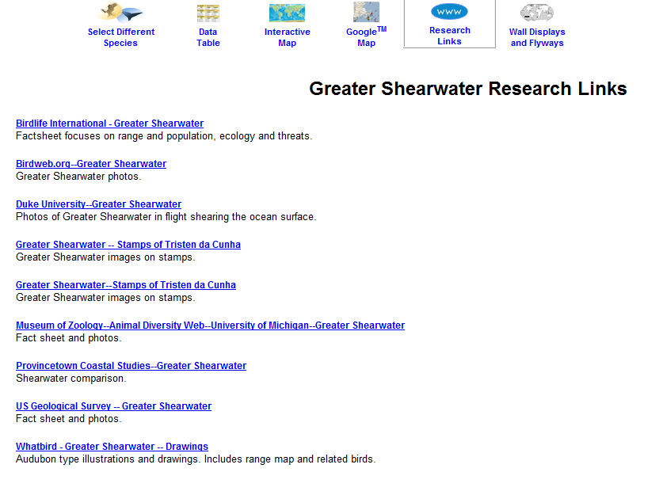
Quick Background Research
Notes:
Geographic range~ breeds mainly in South Atlantic ( the Falkland Islands and Gough Island) then migrates north to north-eastern Canada
Breeding season ~ October- December
Behavior~ most of life spent flying
“Shearwater” comes from the flying behavior just above the surface of the ocean shearing the water surface with the pointed tips of the its wings
Food habits~ feed in groups on mostly fish and squid by plunge diving from heights of 6-10 m, surface seizing or pursuit diving.

Slide 3
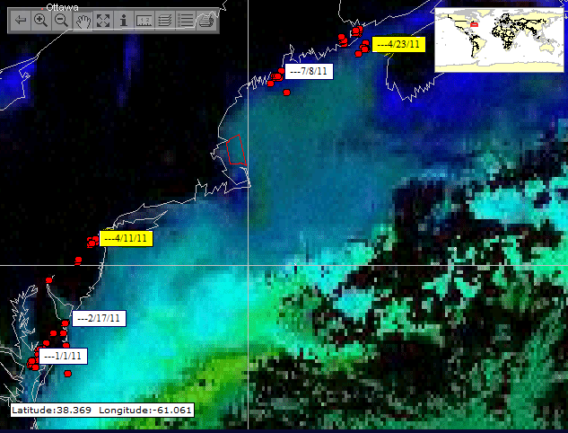
Intensify focus on movement between 4/11/11 and 4/23/11

Slide 4
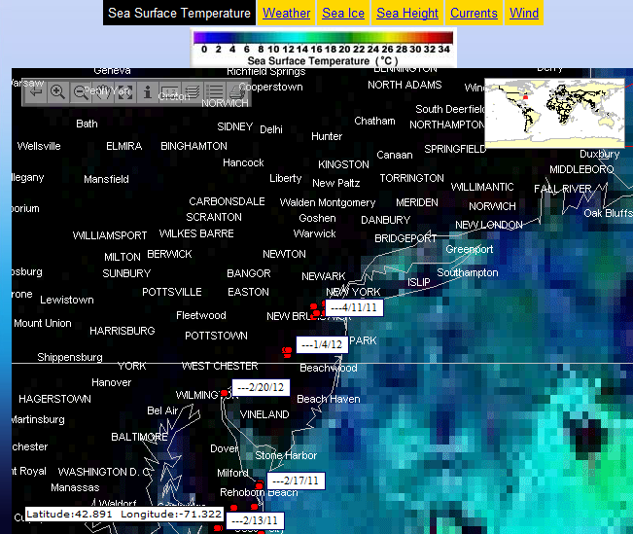
Map Week Ending 4/14/11
Notes:
Surface temp~ 6-8 °C (red arrow)
Note~ surface temp in the January/February (yellow arrow) in the 10-12 °C range

Slide 5
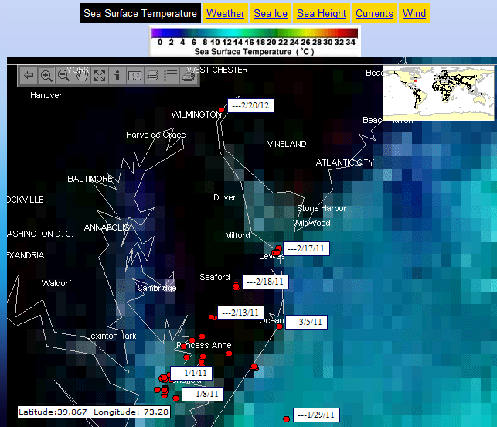
Intensified Jan/Feb 2011 Surface Temps
Notes:
Much more teal coloration than the blue we saw previous slide/April

Slide 6
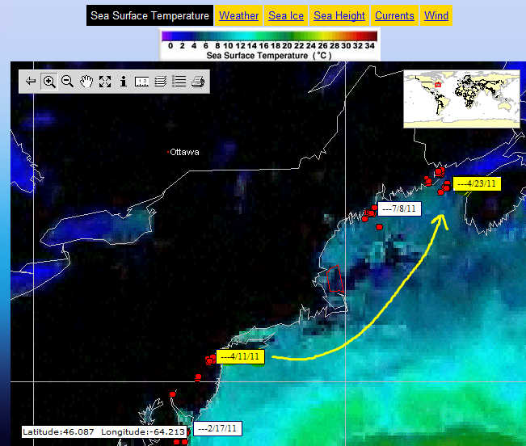
Map Week Ending 4/30/11

Slide 7
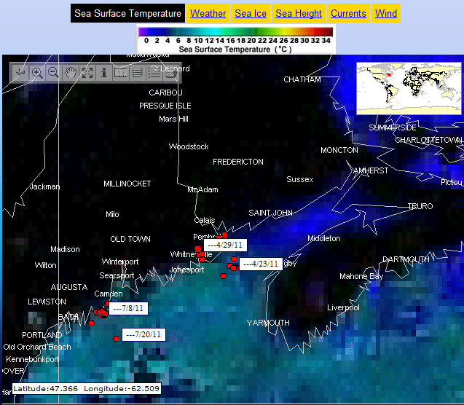
Intensified 4/23/11 Surface Temps
Notes:
Clearly GS 084368 is on the move over the 11 day span to much more blue area consistent with temps in the 6-8 °C range.
Note~ GS 084368 never encroaches the deep blue 2°C area most notable in this map.

Slide 8
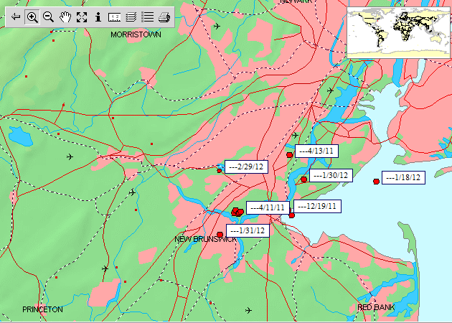
Most recent location of GS 084368 as of 2/29/12

Slide 9
