Slide 1
Glaciers
Stephanie
Cobb
Notes:
Copyright © 2004 Glenna R. Shaw and FTC Publishing
All Rights Reserved

Slide 2
Mars Reconnaissance Orbiter
Vast underground glaciers
Protected by rocky debris
Middle latitudes
Extend for miles from the edges of cliffs and mountains
Similar to massive glaciers detected under rocky coverings in Antarctica

Slide 3
Underground Glaciers on Mars

Slide 4
3-D Courtesy of MOLA

Slide 5
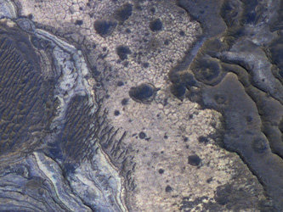
Mars Glacier

Slide 6
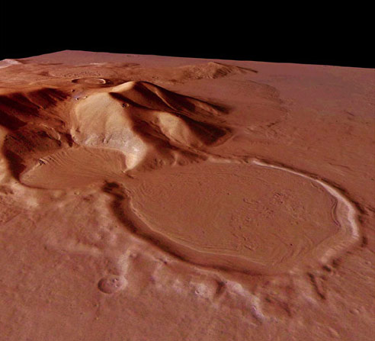
Martian Glacier

Slide 7
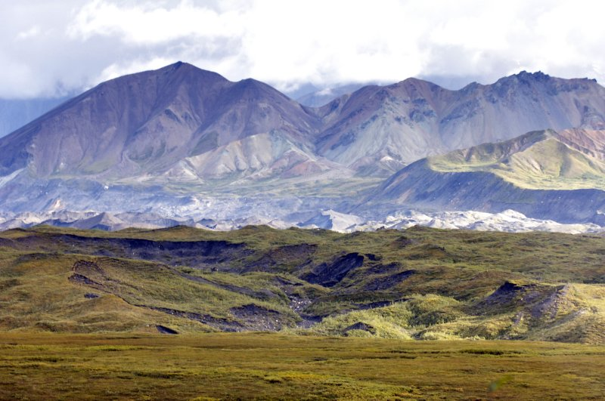
Underground glacier, Denali NP

Slide 8
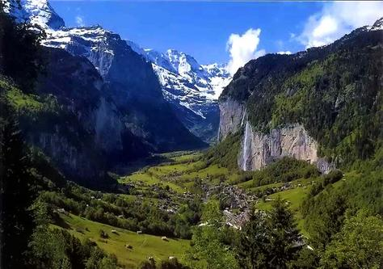
Glacial Valley

Slide 9
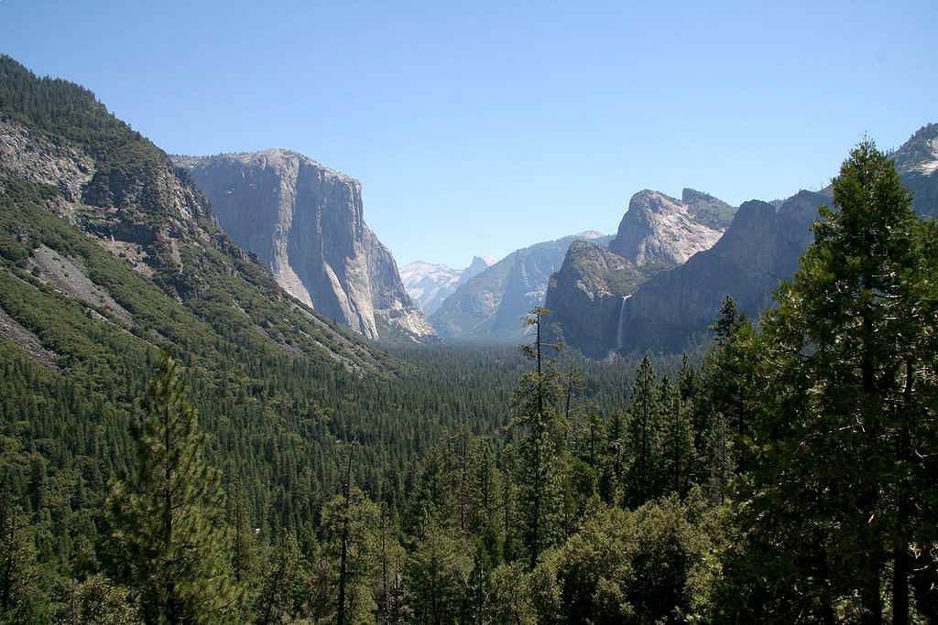
Yosemite National Park

Slide 10
The End

