Slide 1
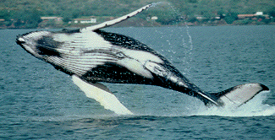
Sea Surface Study
Bumpy/#87631 the Humpback Whale
By
Florentia Spires

Slide 2
Humpback Whale Facts
Scientific Name: Megaptera novaeangliae Category: Cetaceans
No teeth/baleen
4.6 m meters/30-50 tons; 3-4.5 m/2 tons
Birth frequency and Gestational period
Life span
Predators
Mating and feeding

Slide 3
Preferences
Shallow water in coastal areas
Diet of krill, plankton, herring and mackerel
Prefer cooler waters
Eat enormous amounts of food in the summer
Breed in winter and give birth
Blubber and the tropics

Slide 4
Bumpy’s Travels in 2009
Bumpy was not detected in the year 2009
Bahamas locale (21.168 N, 70.12 W)/Washington, DC
349 km
23 – 25 degrees Celsius
.10 - .20 above average sea height
Other HBW
Weather and ocean current
No sea ice
Patterns from previous years

Slide 5
Travel Traits
Can travel over 9000 km in a straight course with minimal veering
Sun’s position, Earth’s magnetism, star maps
Whale watching

Slide 6
Why was Bumpy not detected?
Transmitter signals
Entanglement undetected and effects
Skin and blubber

Slide 7
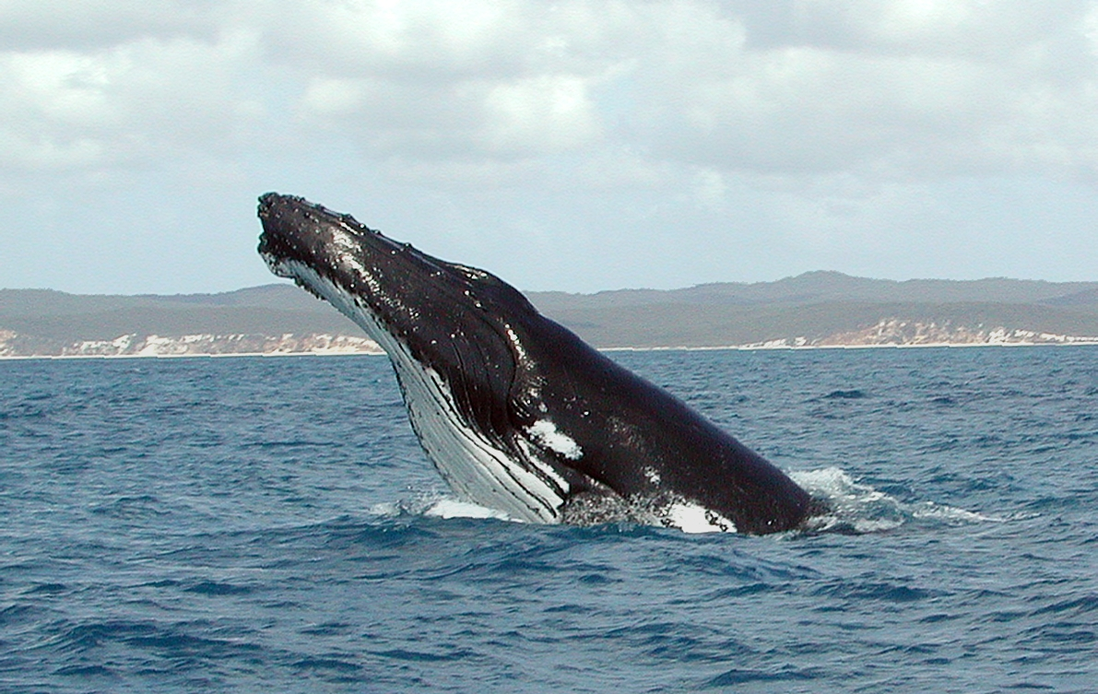
Analysis Statement
This activity was fun, informational and challenging.

Slide 8
Bibliography
"Do Humpback Whales Use the Stars to Navigate? Scientists Baffled by Stunning Accuracy of 10,000-mile Migrations." Mail Online. Web. 14 Mar. 2012. <http://www.dailymail.co.uk/sciencetech/article-1378791/Map-No-thanks-Humpback-whales-use-sun-moon-stars-navigate-ocean.html>.
"National Marine Mammal Laboratory." Alaska Fisheries Science Center Homepage. Web. 14 Mar. 2012. <http://www.afsc.noaa.gov/nmml/education/cetaceans/humpback.php>.
PBS. PBS. Web. 14 Mar. 2012. <http://www.pbs.org/wnet/nature/episodes/humpback-whales/introduction/2871/>.
Encyclopedia Britannica Online. Encyclopedia Britannica. Web. 14 Mar. 2012. <http://www.britannica.com/blogs/2011/08/wake-humpback-tracking-whale-migration-science-front/>.

